Slide 1
DATA ANALYTICS PROJECT
Bank Marketing Funnel Analysis
Understanding customer drop-off in a telemarketing campaign to increase term-deposit conversions
Narendra Kumar
Tools: Python (pandas) · Power BI · DAX

Slide 2
Problem Statement
The situation
Questions to answer
A Portuguese bank made 45,211 marketing calls to sell term deposits, but did not know why most calls failed to convert or where to focus effort.
Where do customers drop off in the funnel?
Which channel brings the highest-quality leads?
Which months and customer segments convert best?
Does repeated calling help or hurt conversion?

Slide 3
Methodology
1
Clean data in Python: convert y to 1/0, order months, keep "unknown" as its own category
2
Build a 3-stage funnel: Contacted → Engaged (>60s call) → Converted
3
Compare conversion rate across channel, month, job, marital status, housing loan, attempts, poutcome
4
Load cleaned data into Power BI and build DAX measures for KPIs
5
Build a 2-page interactive dashboard with slicers for month, job, contact, poutcome, attempts

Slide 4
Funnel: Where Customers Drop Off
Contacted: 45,211 (100%)
What this means
89% of calls are long enough to count as engaged, but only 12% convert.
Engaged (>60s): 40,445 (89.5%)
The biggest drop-off happens after the call connects, not during the greeting — the sales pitch itself needs improvement.
Converted: 5,289 (11.7%)

Slide 5
Best-Performing Channel and Timing
Channel
Month
Cellular — 14.9% conversion
Telephone — 13.4%
Unknown — 4.1% (29% of all calls)
March — 52.0%
September — 46.5%
December — 46.7%
October — 43.8%
May — only 6.7% (30% of all calls)

Slide 6
Customer Segments That Convert Best
Job
Marital status
Housing loan
Best: Student — 28.7%
Best: Retired — 22.8%
Worst: Blue-collar — 7.3%
Single — 14.9%
Divorced — 11.9%
Married — 10.1%
No loan — 16.7%
Has loan — 7.7%
More than double the gap

Slide 7
Effort vs. Result
Repeated attempts
Previous campaign outcome
1 attempt — 14.6%
2–3 attempts — ~11%
4–5 attempts — 8.6%
6–10 attempts — 6.5%
10+ attempts — 3.9%
Success — 64.7%
Other — 16.7%
Failure — 12.6%
Unknown — 9.2%

Slide 8
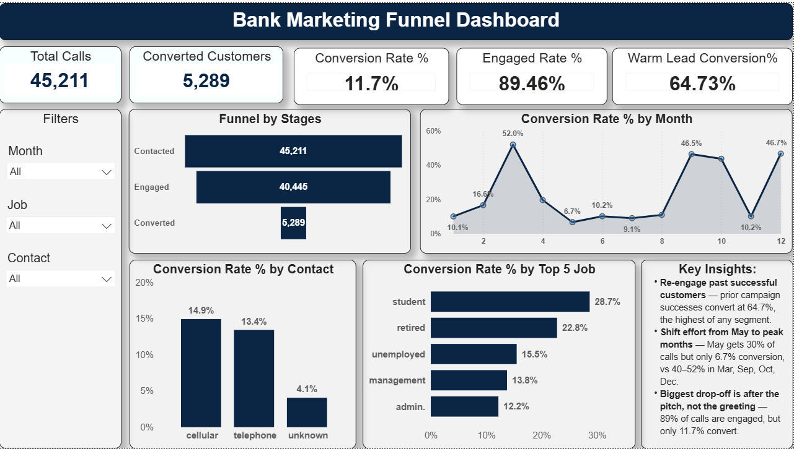
Power BI Dashboard: Overview, Channel & Time

Slide 9
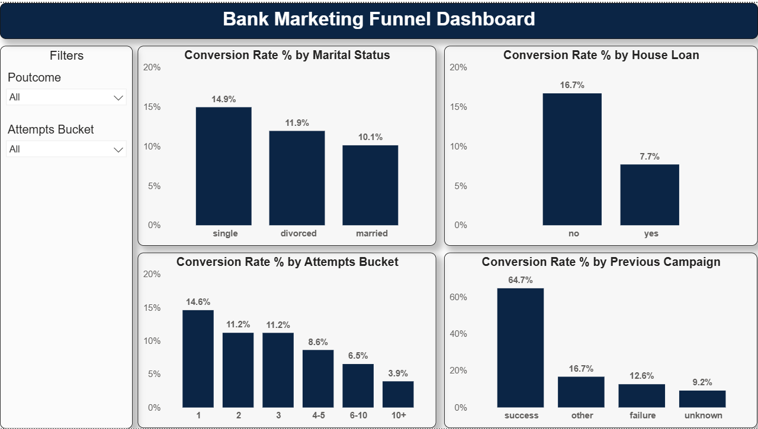
Power BI Dashboard: Segments & Effort

Slide 10
Recommendations
1
Re-contact customers with a successful previous outcome first (64.7% conversion)
2
Shift call volume from May to March / Sep / Oct / Dec
3
Prioritise the cellular channel; start recording channel for every call
4
Cap outreach at 3–5 attempts per customer
5
De-prioritise customers who already hold a housing loan
6
Strengthen the sales pitch used after the call connects

Slide 11
Conclusion
The 11.7% overall conversion rate hides large, addressable gaps by month, channel and customer history. Re-engaging past successful customers and reallocating effort away from May are the highest-impact, lowest-cost changes the bank can make.
Thank You

