Slide 1

Department of Cyber Security
2026-2027- Odd Semester
III Year /V Sem
CS23533-FOUNDATIONS OF ARTIFICIAL INTELLIGENCE
Review 1– 11.09.2026

Slide 2
Introduction
2
Background: Developed StudySync, an AI-powered study planning platform that converts student availability, exam schedules, and workload needs into optimized, conflict-free study timetables.
Domain & Application Area: Classical Artificial Intelligence (Constraint Satisfaction Problems) applied to Educational Technology (EdTech) and Automated Schedule Management.
Importance & Relevance: Eliminates manual planning stress, prevents academic burnout, and improves exam readiness through intelligent time allocation.
Key Highlights:
Automated CSP Engine: Uses Backtracking Search with Forward Checking to construct valid, non-overlapping hourly time blocks.
Dedicated Pre-Exam Days: Automatically reserves the day before an exam exclusively for that subject.
Visual Dashboard: Delivers interactive timetable grids, workload distribution analytics, and CSV exports.
[Department] | Project Review – 1 | [Academic Year]

Slide 3
Problem Statement
3
Students frequently struggle to manually construct effective study schedules when balancing multiple complex subjects, daily time constraints, and upcoming exam deadlines. Traditional calendar applications and manual planners lack intelligent constraint optimization, often leading to schedule conflicts, study fatigue caused by prolonged single-subject sessions, and inadequate dedicated revision time right before exams. Unstructured planning increases student stress, promotes burnout, and negatively impacts overall academic performance. To bridge this gap, there is a clear need for an automated, AI-driven solution like StudySync that utilizes Constraint Satisfaction Problem (CSP) algorithms to dynamically interleave study topics, enforce dedicated pre-exam focus days, and generate balanced, conflict-free study timetables.
[Department] | Project Review – 1 | [Academic Year]

Slide 4
Motivation
4
Why Was This Project Selected?
  Selected to address widespread student challenges in manual schedule planning, including burnout from single-subject marathons and poor pre-exam revision strategies.
Research / Industry Motivation
  Demonstrates the practical application of Classical AI principles—specifically Constraint Satisfaction Problems (CSP)—to solve complex scheduling challenges in Educational Technology (EdTech).
Expected Benefits
  Delivers automated, conflict-free time management, improves cognitive retention through subject interleaving, and reduces academic stress before major exams.
Practical Significance
  Provides students with a fully functional, web-based command center (StudySync) offering interactive timetable grids, real-time workload analytics, and exportable schedules for daily execution.
[Department] | Project Review – 1 | [Academic Year]

Slide 5
Objectives
5
To develop an automated CSP engine using Backtracking Search with Forward Checking to generate conflict-free, hourly study schedules based on student availability and exam dates.
To implement dedicated pre-exam focus rules that automatically reserve the entire day before an exam exclusively for that upcoming subject's preparation.
To integrate a subject interleaving mechanism that caps daily study time per topic on regular days to prevent student burnout and enhance cognitive retention.
To design an intuitive intake interface for students to easily configure course hours, subject priorities, difficulty levels, and daily time constraints.
To provide visual analytics and master timetable dashboards featuring interactive grid views, workload charts, and CSV export capabilities for seamless daily execution.
[Department] | Project Review – 1 | [Academic Year]

Slide 6
Literature Survey
6
S.No. | Author & Year | Method / Technique | Key Findings | Limitations
1 | J. Pablo Rosas Baldazo, Yasmin A. Rios-Solis, Romeo Nigenda, 2024 | Educational Planning Problem(EPP) | Stress-aware scheduling improves the personalization of study plans and efficiently generates feasible learning schedules. | Focuses mainly on stress and scheduling, with limited consideration of other changing student preferences and learning conditions.
2 | Sean A. Mochocki, Mark G. Reith, Gilbert L. Peterson , 2025 | Backtracking, Branch-and-Bound, Constraint Satisfaction | Shows that AI techniques such as Backtracking, Branch & Bound and Greedy Search can effectively generate personalized learning paths. | The approach was evaluated using a relatively small student dataset and requires further real-world validation of learning outcomes.
3 | Amir Hossein Nabizadeh, Jose Paulo Leal, Rajiv Ratn Shah , 2020 | Learning-path personalization; course generation; course sequencing | Identifies various methods for personalizing learning paths based on learner characteristics, goals, preferences and constraints. | Different studies use different parameters and evaluation methods, making comparison difficult; many approaches also lack dynamic adaptation and extensive real-world validation.
[Department] | Project Review – 1 | [Academic Year]

Slide 7
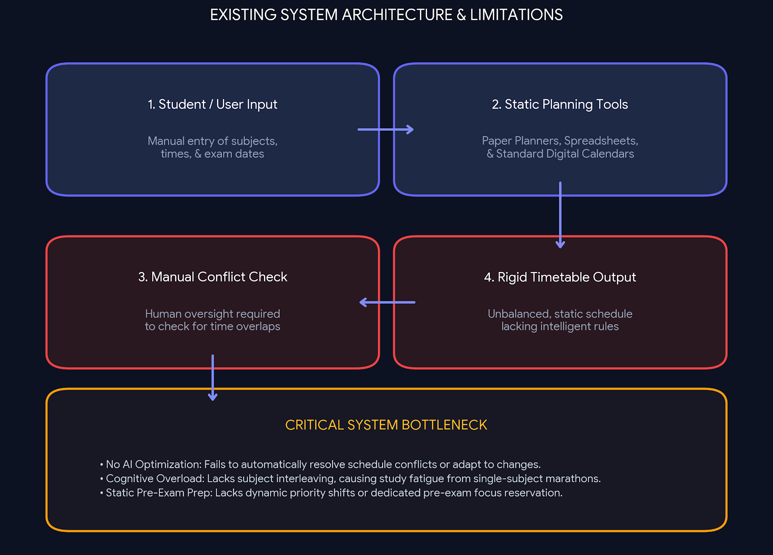
Existing System
7
Existing Approach:
Manual & Static Timetabling: Reliance on paper planners, digital calendar entries (e.g., Google Calendar), or basic Excel spreadsheets.
Advantages:
Simple & Familiar: Low barrier to entry and straightforward to use across basic personal devices.
Direct Manual Control: Allows users to manually set exact study times for fixed events.
Limitations:
No AI Constraint Satisfaction: Cannot automatically detect schedule overlaps or balance daily study workloads.
High Risk of Cognitive Fatigue: Fails to enforce subject interleaving, leading to long, continuous single-subject marathons.
High Overhead: Re-adjusting schedules due to unexpected delays or changed dates is tedious and error-prone.
[Department] | Project Review – 1 | [Academic Year]

Slide 8
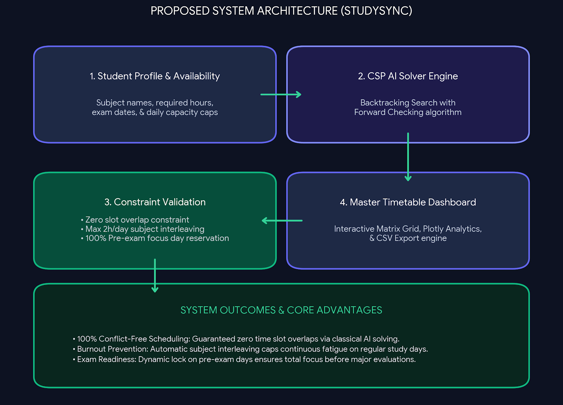
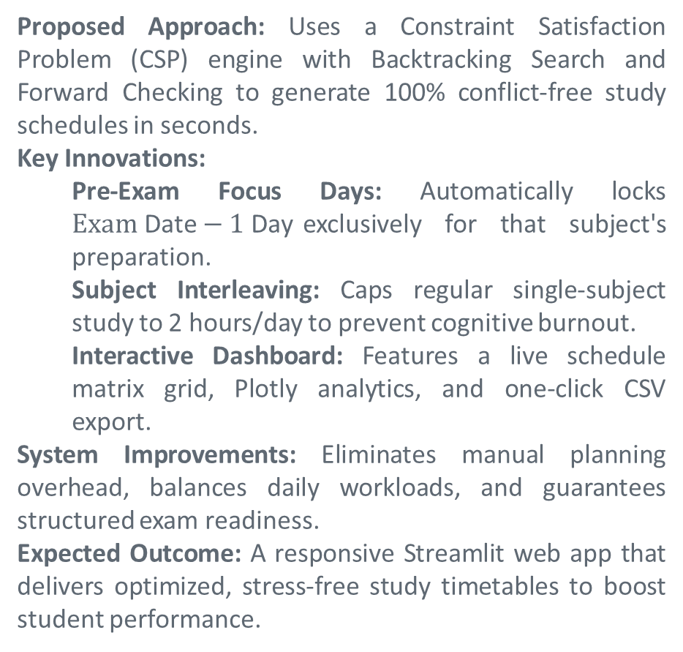
Proposed System
8
Proposed Approach: Uses a Constraint Satisfaction Problem (CSP) engine with Backtracking Search and Forward Checking to generate 100% conflict-free study schedules in seconds.
Key Innovations:
  Pre-Exam Focus Days: Automatically locks $Exam\text{ Date}−1\text{ Day}$exclusively for that subject's preparation.
  Subject Interleaving: Caps regular single-subject study to 2 hours/day to prevent cognitive burnout.
  Interactive Dashboard: Features a live schedule matrix grid, Plotly analytics, and one-click CSV export.
System Improvements: Eliminates manual planning overhead, balances daily workloads, and guarantees structured exam readiness.
Expected Outcome: A responsive Streamlit web app that delivers optimized, stress-free study timetables to boost student performance.
[Department] | Project Review – 1 | [Academic Year]

Slide 9
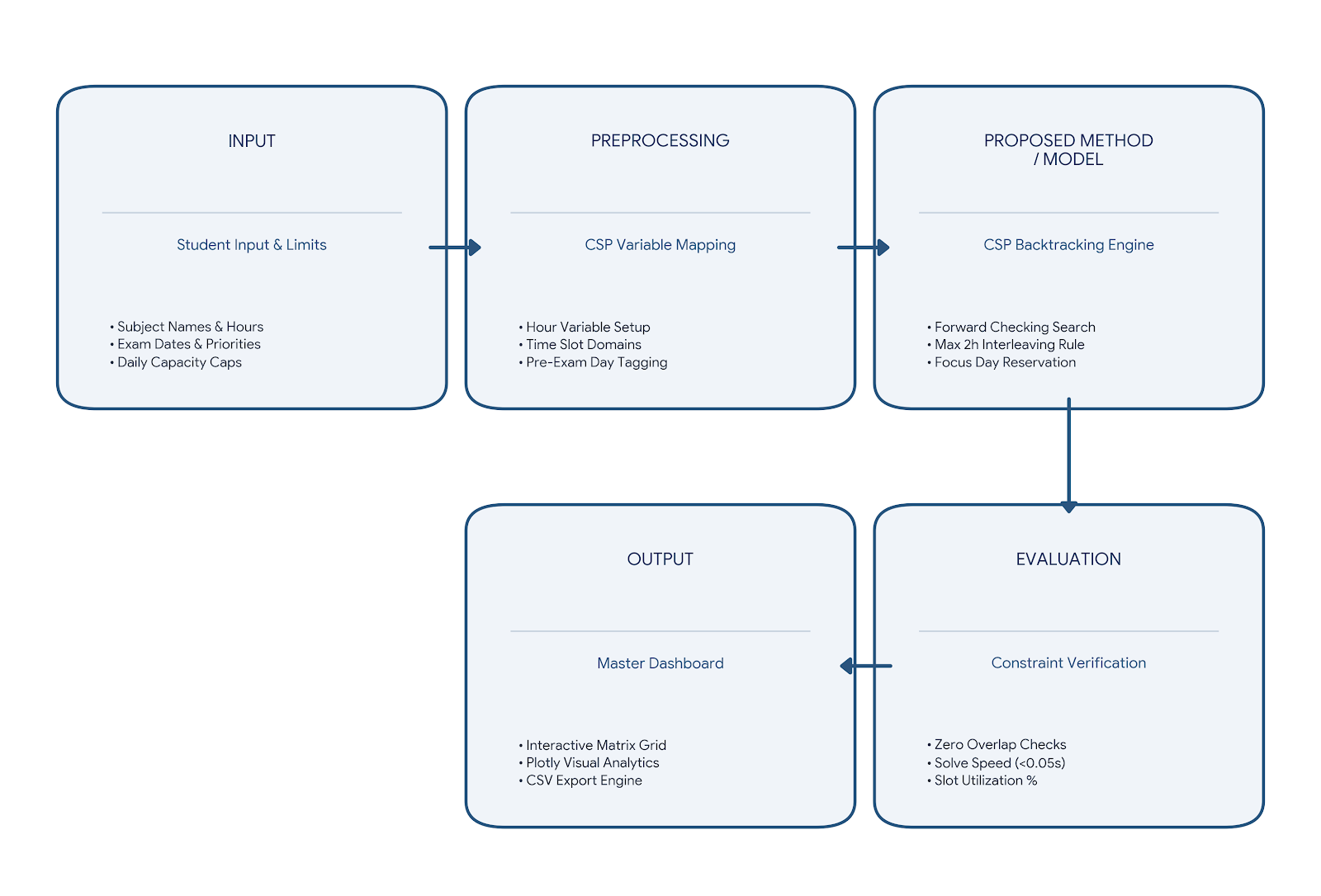
System Architecture / Block Diagram
9
PREPROCESSING
PROPOSED METHOD / MODEL
EVALUATION
[Department] | Project Review – 1 | [Academic Year]

Slide 10
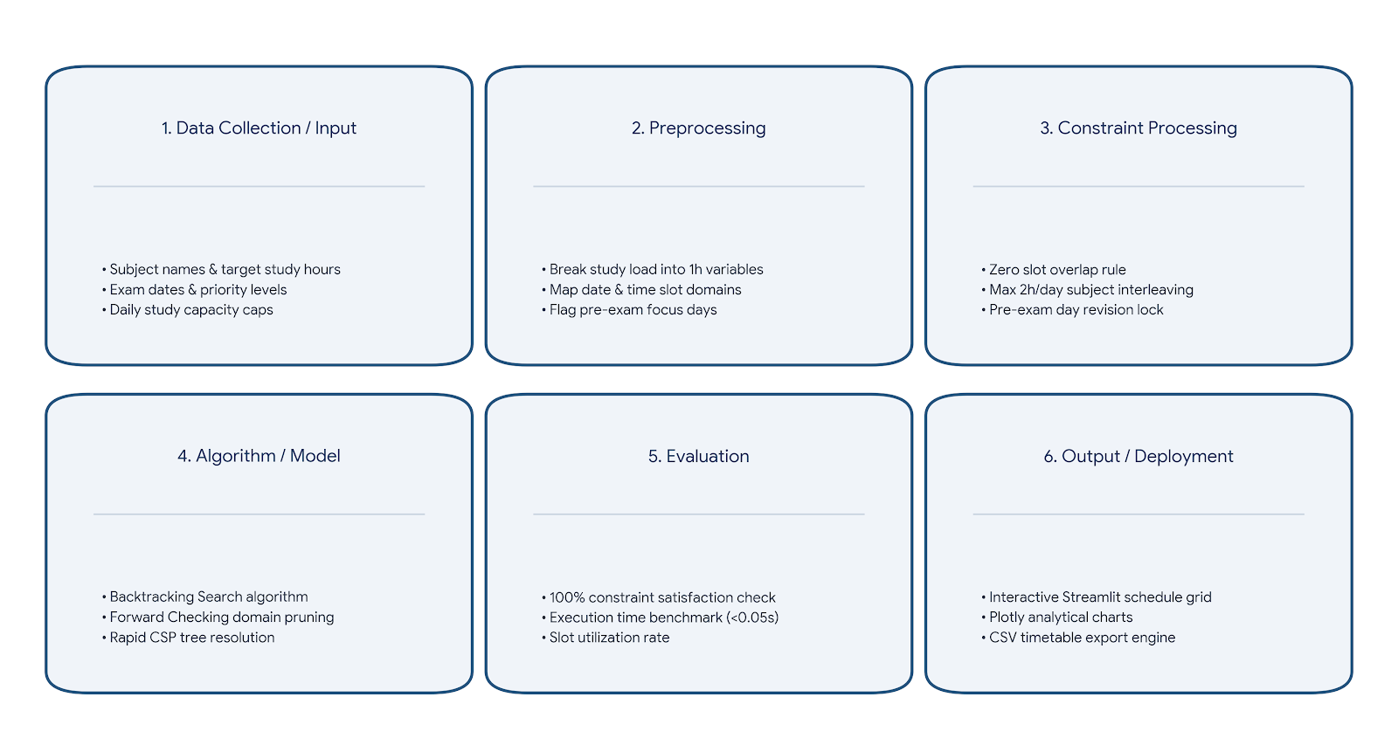
Methodology
10
1. [Data Collection / Input]
2. [Preprocessing]
3. [Feature Selection / Processing]
4. [Algorithm / Model]
5. [Evaluation]
6. [Output / Deployment]
[Department] | Project Review – 1 | [Academic Year]

Slide 11
Technologies Used
11
Programming Language: Python 3.10+ (Core AI constraint logic and data processing)
Framework / Library:
  Streamlit (Interactive web application interface)
  Pandas & NumPy (Data manipulation and matrix scheduling)
  Plotly Express (Dynamic analytics and visual study distribution charts)
Database: Streamlit Session-State & Flat-File CSV (In-memory schedule caching and downloadable local storage)
Tools / IDE: VS Code, Git & GitHub (Version control and code repository management)
Hardware: Standard Workstation / Laptop (8 GB RAM, Dual-Core CPU or higher)
[Department] | Project Review – 1 | [Academic Year]

Slide 12
Module Description
12
Module 1 – User Input and Profile Management
Module 2 – CSP Variable and Domain Modeling
Module 3 – AI Scheduling Engine
Module 4 – Schedule Validation and Performance Analytics
Module 5 – Interactive Dashboard and Expert Engine
[Department] | Project Review – 1 | [Academic Year]

Slide 13
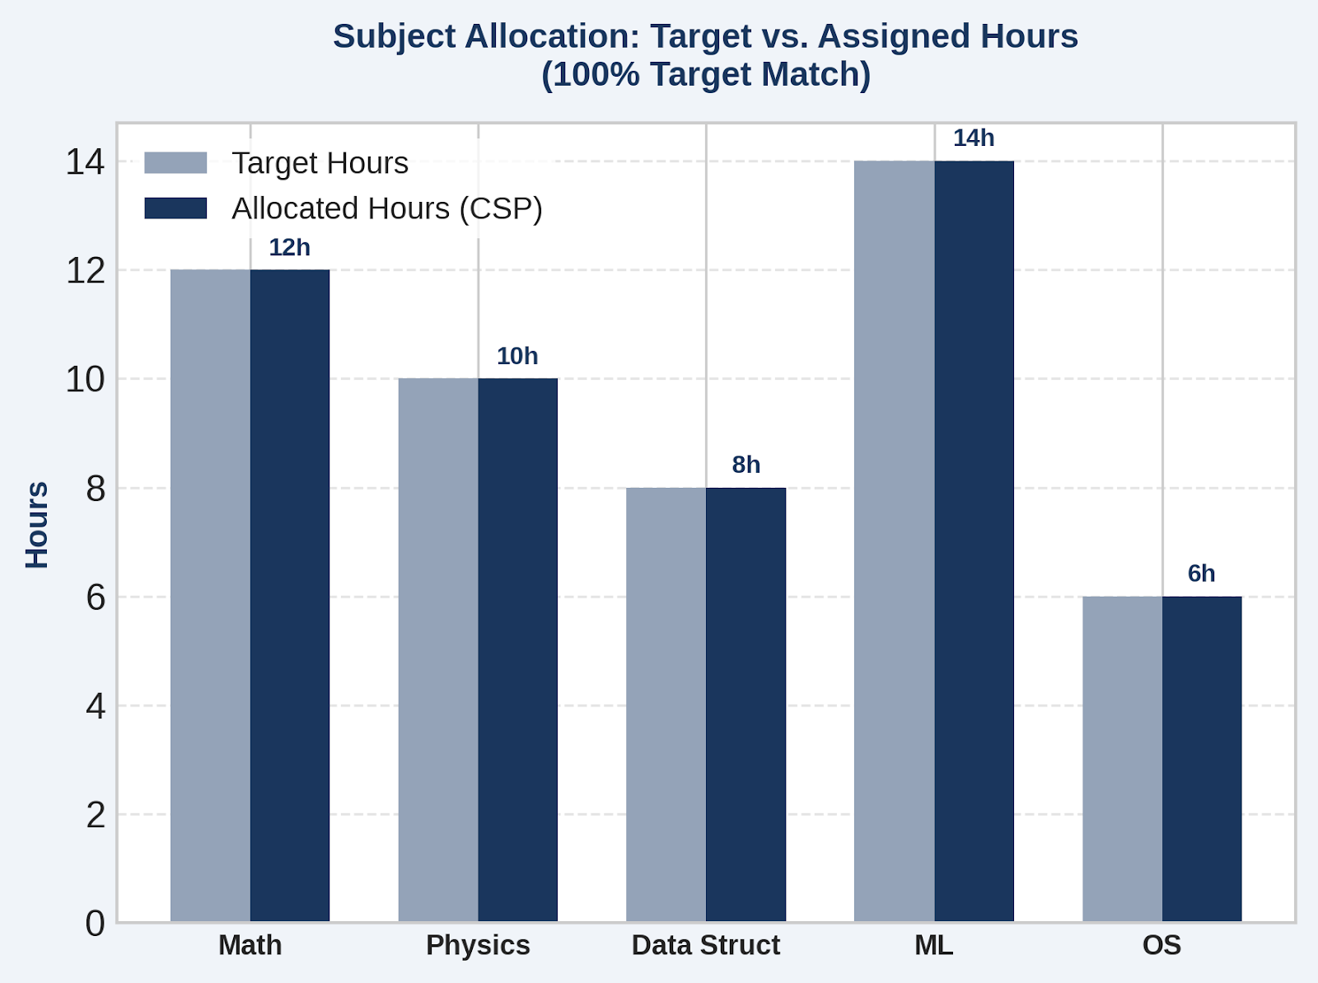
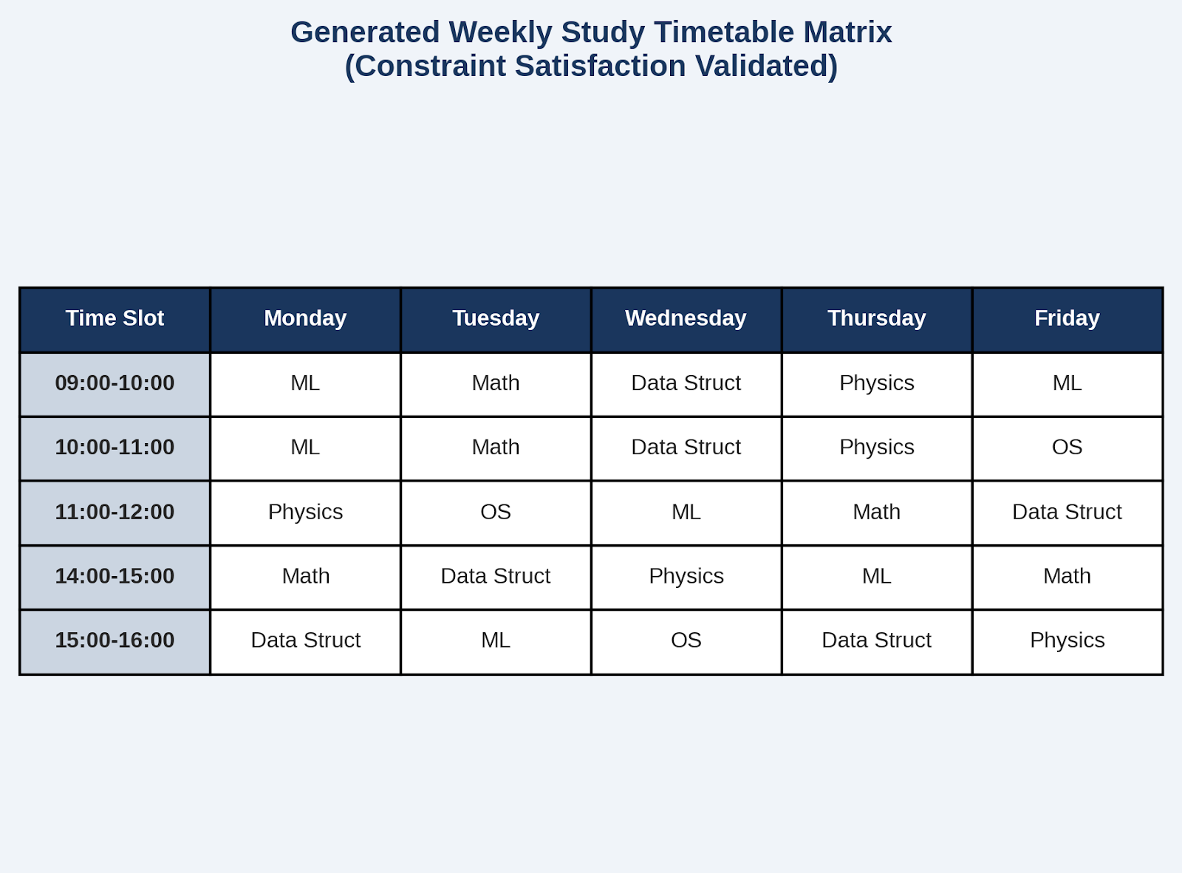
Preliminary / Expected Results
13
[Department] | Project Review – 1 | [Academic Year]

Slide 14
Project Schedule
14
Activity | Month 1 | Month 2 | Month 3 | Month 4
Literature Survey | ✓
Problem Identification | ✓
System Design |  | ✓
Implementation |  | ✓ | ✓
Testing & Evaluation |  |  | ✓
[Department] | Project Review – 1 | [Academic Year]

Slide 15
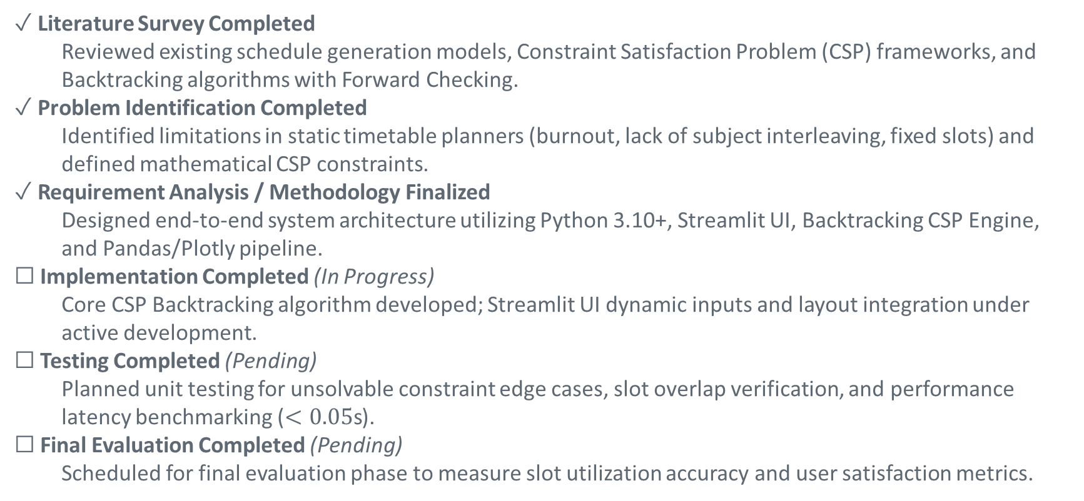
Current Progress
15
✓ Literature Survey Completed
  Reviewed existing schedule generation models, Constraint Satisfaction Problem (CSP) frameworks, and Backtracking algorithms with Forward Checking.
✓ Problem Identification Completed
  Identified limitations in static timetable planners (burnout, lack of subject interleaving, fixed slots) and defined mathematical CSP constraints.
✓ Requirement Analysis / Methodology Finalized
  Designed end-to-end system architecture utilizing Python 3.10+, Streamlit UI, Backtracking CSP Engine, and Pandas/Plotly pipeline.
☐ Implementation Completed (In Progress)
  Core CSP Backtracking algorithm developed; Streamlit UI dynamic inputs and layout integration under active development.
☐ Testing Completed (Pending)
  Planned unit testing for unsolvable constraint edge cases, slot overlap verification, and performance latency benchmarking ($<0.05\text{s}$).
☐ Final Evaluation Completed (Pending)
  Scheduled for final evaluation phase to measure slot utilization accuracy and user satisfaction metrics.
[Department] | Project Review – 1 | [Academic Year]

Slide 16
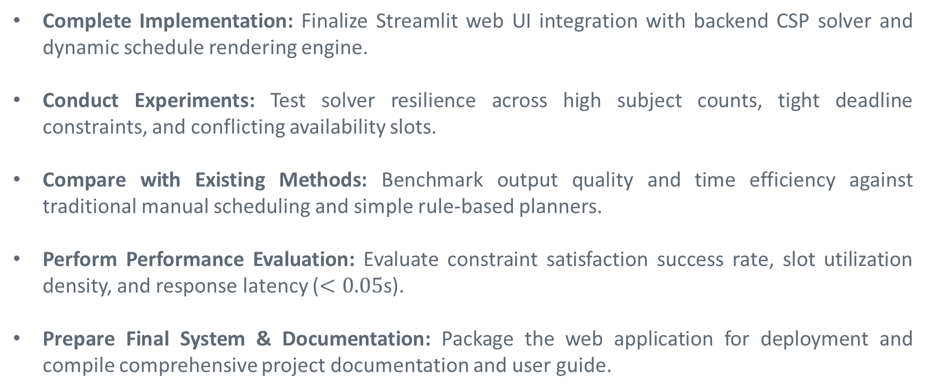
Future Work
16
Complete Implementation: Finalize Streamlit web UI integration with backend CSP solver and dynamic schedule rendering engine.
Conduct Experiments: Test solver resilience across high subject counts, tight deadline constraints, and conflicting availability slots.
Compare with Existing Methods: Benchmark output quality and time efficiency against traditional manual scheduling and simple rule-based planners.
Perform Performance Evaluation: Evaluate constraint satisfaction success rate, slot utilization density, and response latency ($<0.05\text{s}$).
Prepare Final System & Documentation: Package the web application for deployment and compile comprehensive project documentation and user guide.
[Department] | Project Review – 1 | [Academic Year]

Slide 17
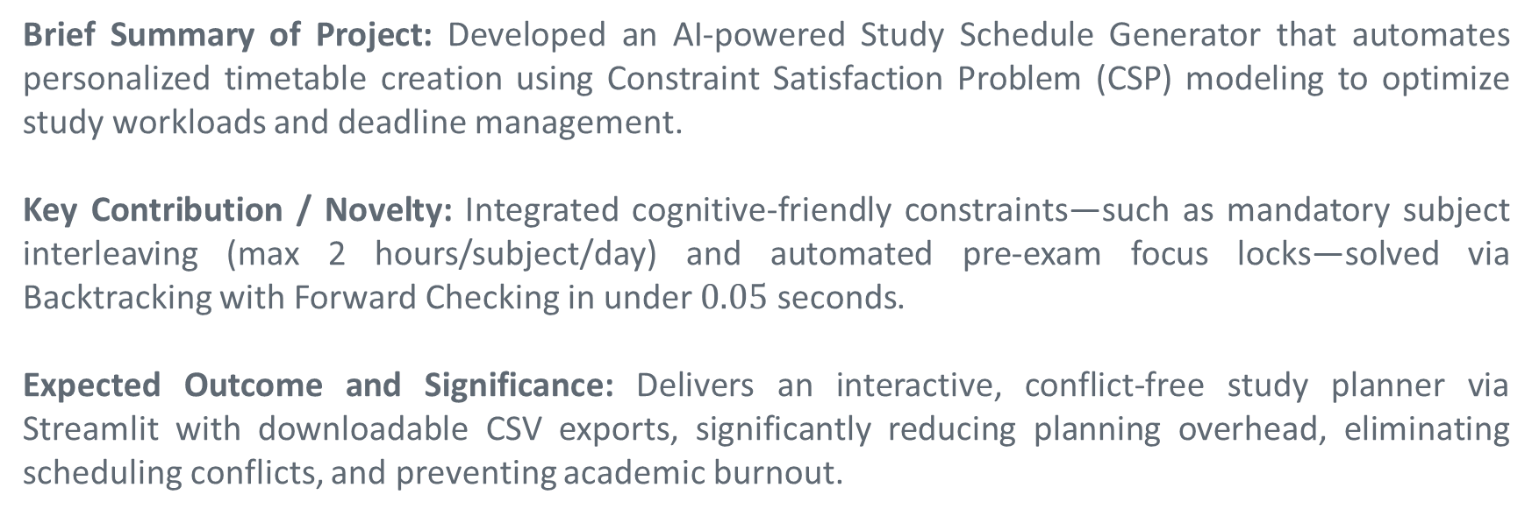
Conclusion
17
Brief Summary of Project: Developed an AI-powered Study Schedule Generator that automates personalized timetable creation using Constraint Satisfaction Problem (CSP) modeling to optimize study workloads and deadline management.
Key Contribution / Novelty: Integrated cognitive-friendly constraints—such as mandatory subject interleaving (max 2 hours/subject/day) and automated pre-exam focus locks—solved via Backtracking with Forward Checking in under $0.05\text{ seconds}$.
Expected Outcome and Significance: Delivers an interactive, conflict-free study planner via Streamlit with downloadable CSV exports, significantly reducing planning overhead, eliminating scheduling conflicts, and preventing academic burnout.
[Department] | Project Review – 1 | [Academic Year]

Slide 18
References
18
[1] J. P. Rosas Baldazo, Y. Á. Ríos-Solís, and R. Sánchez Nigenda, “Scheduling Personalized Study Plans Considering the Stress Factor,” Interactive Learning Environments, 2024.
[2] S. A. Mochocki, M. G. Reith, B. J. Borghetti, G. L. Peterson, J. D. Jasper, and L. D. Merkle, “Personalized Learning Path Problem Variations: Computational Complexity and AI Approaches,” IEEE Transactions on Artificial Intelligence, 2025.
[3] A. H. Nabizadeh, J. P. Leal, H. N. Rafsanjani, and R. R. Shah, “Learning Path Personalization and Recommendation Methods: A Survey of the State-of-the-Art,” Expert Systems with Applications, 2020.
[4] S. B. Deris, S. Omatu, H. Ohta, and P. A. B. D. Samat, “University Timetabling by Constraint-Based Reasoning: A Case Study,” Journal of the Operational Research Society, 1997.
[Department] | Project Review – 1 | [Academic Year]

