Slide 1

Department of Cyber Security
2026-2027- Odd Semester
III Year /V Sem
CS23533 - FOUNDATIONS OF ARTIFICIAL INTELLIGENCE
Zeroth Review – 05.08.2026

Slide 2
StudySync AI: An Intelligent Exam Preparation Planner using Constraint Satisfaction Problem (CSP)
Batch Members :
1. Naren Kartic 241901065
Supervisor:
Dr. S.Bhuvana
^{Assistant Professor[SG]}

Slide 3
OUTLINE
Abstract
Objective
Literature Survey
Summary of Literature
Proposed System & Novelty
Block Diagram
Hardware/Software requirements
References

Slide 4
ABSTRACT
StudySync AI is an Artificial Intelligence-based exam preparation planner that generates personalized study schedules using the Constraint Satisfaction Problem (CSP) approach. Students often find it difficult to organize their preparation when multiple subjects, examination dates, available study hours, subject priorities, revision requirements, and breaks must be considered simultaneously. The proposed system addresses this challenge by representing study sessions as variables, available time slots as domains, and academic requirements as constraints.
The system considers hard constraints such as examination deadlines, maximum daily study hours, required preparation time, non-overlapping sessions, and break requirements. It also considers preferences such as subject priority, difficulty level, preferred study periods, and revision needs to create a balanced study plan. Backtracking Search is used to explore possible assignments of study sessions, while Constraint Propagation through Forward Checking eliminates invalid choices early and reduces unnecessary search.

Slide 5
OBJECTIVE
To develop an AI-based system for generating personalized examination study schedules.
To formulate the study-planning problem as a Constraint Satisfaction Problem (CSP) using variables, domains, and constraints.
To allocate study sessions effectively by considering subjects, examination dates, priorities, available study hours, revision requirements, and breaks.
To implement Backtracking Search for systematically finding feasible assignments of study sessions to available time slots.
To apply Constraint Propagation using Forward Checking to eliminate invalid assignments and reduce unnecessary search.
To generate a balanced and conflict-free study schedule that satisfies the defined academic constraints.

Slide 6
Literature Survey
TITLE | YEAR | AUTHOR | TECHNIQUE
Scheduling Personalised Study plans considering the stress Factor | 2024 | J. Pablo Rosas Baldazo, Yasmin A. Rios-Solis, Romeo Nigenda | Educational Planning Problem(EPP)
Personalised learning path problem variations | 2025 | Sean A. Mochocki, Mark G. Reith, Gilbert L. Peterson | Backtracking, Branch-and-Bound, Constraint Satisfaction
Learning Path personalisation and recommendation methods: A survey of the State-of-the-Art | 2020 | Amir Hossein Nabizadeh, Jose Paulo Leal, Rajiv Ratn Shah | Learning-path personalization; course generation; course sequencing

Slide 7
EXISTING SYSTEM
Manual Study Planning: Students commonly create study timetables using notebooks, spreadsheets, or fixed weekly schedules. These require considerable manual effort and frequent modification when priorities or deadlines change.
Calendar and Reminder Applications: Digital calendars such as Google Calendar and similar scheduling tools mainly help users record deadlines, appointments, and reminders. Research has found that students use such tools for time management but also report limitations for study-specific planning.
Task-Based Study Planners: Existing academic planners allow students to enter subjects, tasks, deadlines, and estimated durations. However, many primarily organize user-entered tasks rather than reasoning over multiple interacting constraints.
AI-Based Study Planners: Recent systems have explored personalized scheduling using AI, adaptive rewards, learning analytics, and recommendation techniques. These may use student activity or performance data to adapt schedules, which goes beyond the scope of this FOAI project.

Slide 8
PROPOSED SYSTEM
CSP Formulation: Study sessions are represented as variables, available time slots as domains, and academic requirements as constraints.
Constraint Handling: The system applies hard constraints such as exam deadlines, maximum daily study hours, required preparation time, non-overlapping sessions, and breaks.
Preference Handling: Soft constraints are used to prioritize upcoming examinations, balance difficult subjects, consider preferred study periods, and include revision sessions.
Search & Reasoning: Backtracking Search systematically assigns study sessions to suitable time slots. Forward Checking removes invalid future assignments whenever a constraint conflict is detected.
Schedule Generation: Once all required constraints are satisfied, the system generates a personalized, balanced, and conflict-free study plan.

Slide 9
Novelty in Proposed System
CSP-Based Personalized Planning: Models the complete exam preparation process as a Constraint Satisfaction Problem, rather than treating study activities as simple tasks or reminders.
Multi-Constraint Scheduling: Simultaneously considers exam deadlines, subject priority, difficulty, available study hours, revision requirements, and break periods while generating the schedule.
Intelligent Conflict Resolution: Uses Backtracking Search to automatically revise previous assignments when scheduling conflicts occur instead of requiring manual rescheduling.
Constraint Propagation: Uses Forward Checking to eliminate invalid future time-slot assignments early, reducing unnecessary search.
Personalized Schedule Generation: Generates a schedule according to the individual student's academic requirements and preferences, rather than providing a fixed timetable.

Slide 10
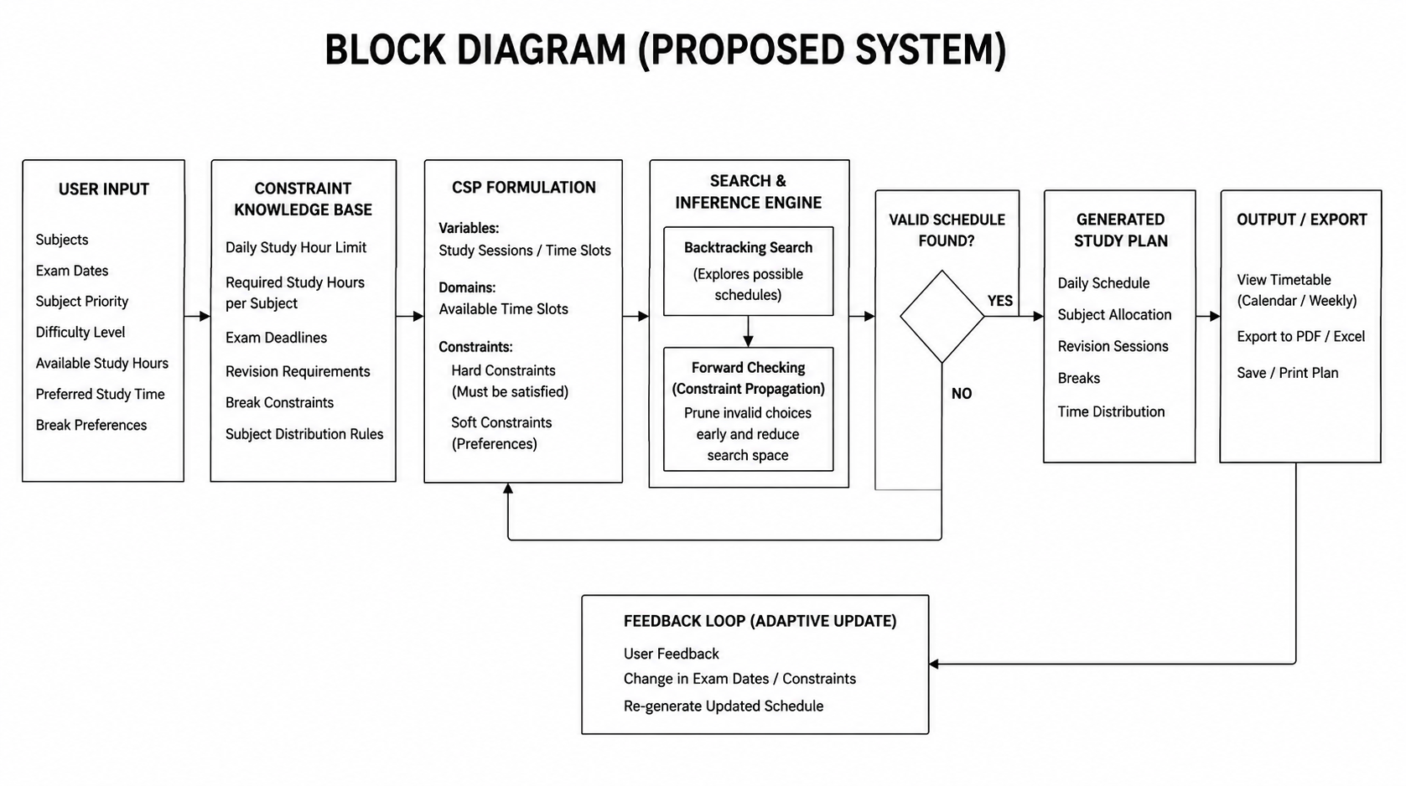
BLOCK DIAGRAM(PROPOSED SYSTEM)

Slide 11
Hardware/Software Requirements
HARDWARE REQUIREMENTS
Processor: Intel Core i3 / AMD Ryzen 3 or above
RAM: Minimum 4 GB
Storage: At least 500 MB free space
SOFTWARE REQUIREMENTS
Operating System: Windows / Linux
Programming Language: Python 3.x
GUI: Tkinter / CustomTkinter
Development Environment: VS Code / PyCharm
Data Storage: JSON / SQLite
Algorithms: CSP, Backtracking Search, Forward Checking

Slide 12
References
1. Rosas Baldazo, J. P., Ríos-Solís, Y. Á., & Sánchez Nigenda, R. (2024). Scheduling Personalized Study Plans Considering the Stress Factor. Interactive Learning Environments, 32(7), 3855–3874.
2. Mochocki, S. A., Reith, M. G., Borghetti, B. J., Peterson, G. L., Jasper, J. D., & Merkle, L. D. (2025). Personalized Learning Path Problem Variations: Computational Complexity and AI Approaches. IEEE Transactions on Artificial Intelligence, 6(3), 574–588.
3. Nabizadeh, A. H., Leal, J. P., Rafsanjani, H. N., & Shah, R. R. (2020). Learning Path Personalization and Recommendation Methods: A Survey of the State-of-the-Art. Expert Systems with Applications, 159, 113596.
4. Deris, S. B., Omatu, S., Ohta, H., & Samat, P. A. B. D. (1997). University Timetabling by Constraint-Based Reasoning: A Case Study. Journal of the Operational Research Society, 48(12), 1178–1190. The study tested its model using real data involving 536 lessons, 45 timeslots, and 21 rooms.

