Slide 1

Department of Computer Science and Engineering
(Cyber Security)
CS23533– Foundations of Artificial Intelligence
2026-2027
StudySync AI: An Intelligent Exam Preparation Planner using Constraint Satisfaction Problem (CSP)
MODEL REVIEW
Dr. BHUVANA PhD.,
Assistant Professor (SG)
NAREN KARTIC B
241901065

Slide 2
Problem Statement and Motivation
Problem Statement
Students often struggle to create effective study schedules due to multiple subjects, examination deadlines, limited study hours, and conflicting priorities. Poor planning can lead to stress, incomplete preparation, and inefficient time management.
StudySync AI addresses this problem by applying classical Artificial Intelligence techniques, particularly Constraint Satisfaction Problems (CSP) and search algorithms, to support systematic and efficient study planning.

Slide 3
Objectives
Project Objectives
Develop a user-friendly study-planning application using Python and Streamlit.
Model academic scheduling as a Constraint Satisfaction Problem (CSP).
Apply classical AI search techniques, such as Backtracking and Minimum Remaining Values (MRV), to find feasible study schedules.
Validate inputs and identify scheduling conflicts.
Generate organized study plans that improve time management and exam preparation.

Slide 4
Objectives
Measurable Objectives and Expected Outcomes
Provide a clear interface for entering academic details.
Check whether generated schedules satisfy all defined constraints.
Reduce scheduling conflicts and improve study-time organization.

Slide 5
Objectives
Objectives Completed So Far
Designed the StudySync AI landing page and user interface.
Created the four-stage workflow: Understand, Constrain, Search, and Validate.
Implement and test the complete CSP-based scheduling algorithm.
Integrate Backtracking and MRV into the working planner.
Validate generated schedules and display the final study plan

Slide 6
Abstract
ABSTRACT
StudySync AI is an intelligent study planning application developed using classical Artificial Intelligence techniques to help students manage their study schedules effectively. The system considers subject priorities, difficulty levels, examination dates, required study hours, and student availability to generate an organized study timetable. It uses a Constraint Satisfaction Problem (CSP)-based scheduling approach to assign study sessions to suitable time slots while considering scheduling constraints.

Slide 7
Abstract
Developed using Python and Streamlit, the application provides an interactive dashboard with timetable visualization, daily workload summaries, subject-wise study hours, and CSV export functionality. By combining constraint-based planning with a user-friendly interface, StudySync AI aims to reduce manual scheduling effort, improve time management, and support personalized and systematic examination preparation without relying on machine learning or deep learning techniques.

Slide 8
Literature Survey
S. No. | Author(s) & Year | Paper Title | Methodology / Algorithm | Limitations
1 | J. Pablo Rosas Baldazo, Yasmin A. Rios-Solis, Romeo Nigenda, 2024 | Scheduling personalized study plans considering the stress factor | Educational Planning Problem(EPP) | Focuses mainly on stress and scheduling, with limited consideration of other changing student preferences and learning conditions.
2 | Sean A. Mochocki, Mark G. Reith, Gilbert L. Peterson , 2025 | Personalized Learning Path Problem Variations: Computational Complexity and AI Approaches | Backtracking, Branch-and-Bound, Constraint Satisfaction | The approach was evaluated using a relatively small student dataset and requires further real-world validation of learning outcomes.
S. No. | Author(s) & Year | Paper Title | Methodology / Algorithm | Limitations
1 | Author A et al. (Year) | Enter the research paper title | Method / algorithm used | Limitation identified by the authors or your analysis
2 | Author B et al. (Year) | Enter the research paper title | Model / framework used | Unresolved issue or drawback
3 | Author C et al. (Year) | Enter the research paper title | Technique / dataset used | Scalability, accuracy, cost, or other limitation

Slide 9
Literature Survey
S. No. | Author(s) & Year | Paper Title | Methodology / Algorithm | Limitations
3 | Amir Hossein Nabizadeh, Jose Paulo Leal, Rajiv Ratn Shah , 2020 | Learning Path Personalization and Recommendation Methods: A Survey of the State-of-the-Art | Learning-path personalization; course generation; course sequencing | Different studies use different parameters and evaluation methods, making comparison difficult; many approaches also lack dynamic adaptation and extensive real-world validation.
5 | Marco Antonio Cruz-Chávez, Mireya Flores-Pichardo, Alina Martínez-Oropeza, Pedro Moreno-Bernal, and Martín H. Cruz-Rosales, 2016 | Solving a Real Constraint Satisfaction Model for the University Course Timetabling Problem: A Case Study | Constraint Satisfaction Problem (CSP) model and Constructive Approach Algorithm (CAA) | The study focuses on course scheduling at a specific university faculty, including classroom and teacher allocation. Its model may require adaptation for individual students' study hours, subject priorities, and personal learning preferences.

Slide 10
Research Gap/Existing System
What existing systems do?
Russell and Norvig [1] explain AI problem-solving and constraint satisfaction techniques.
Mackworth [2] studies consistency in constraint networks.
Haralick and Elliott [3] explore efficient search methods for CSPs.
Limitations observed:
Academic timetabling mainly focuses on institutional scheduling rather than individual study planning.
Personalized learning approaches may require extensive learner information and recommendation mechanisms.
Manual timetable preparation requires time and frequent adjustments
Research gap
A need exists for a simple, accessible study planning system that combines individual subject requirements, examination deadlines, study-hour limits, and availability using classical AI techniques without depending on machine learning or deep learning.
How our projects responds?
Develops a Python and Streamlit-based study planning application.
Collects subject priorities, difficulty levels, examination dates, required study hours, and availability.
Uses CSP-based scheduling to assign study sessions to suitable time slots.

Slide 11
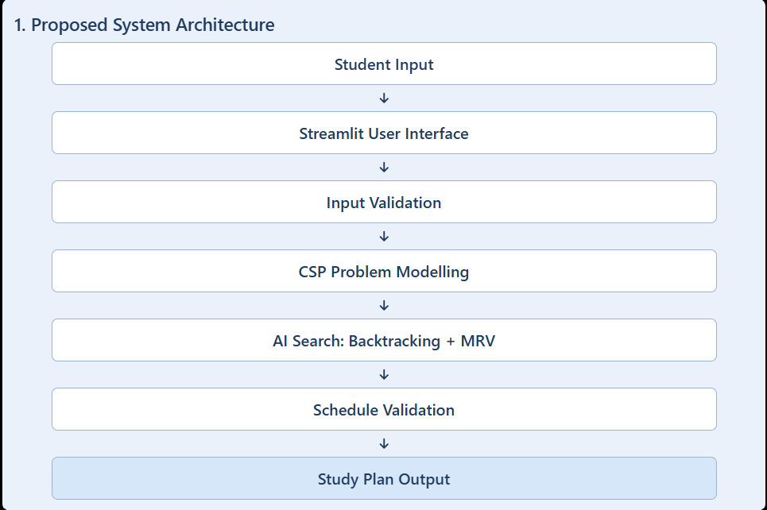
Proposed System

Slide 12
Proposed System
Personalized Inputs: Collects subjects, priorities, difficulty levels, examination dates, required study hours, and availability.
Constraint-Based Scheduling: Assigns study sessions to suitable time slots while considering scheduling constraints.
Conflict Management: Organizes sessions to avoid overlapping assignments and accommodate examination-related requirements.
Interactive Dashboard: Displays timetables, subject-wise study hours, and daily workload summaries.
Export Facility: Allows students to download their generated timetable as a CSV file.
Technology Stack: Python, Streamlit, Pandas, and classical AI scheduling techniques.

Slide 13
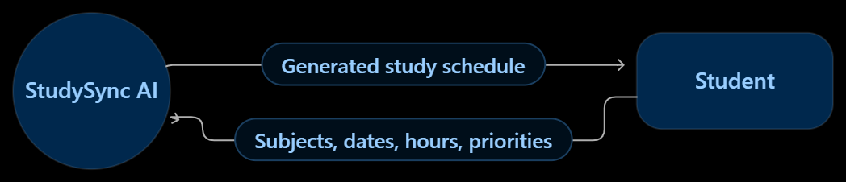
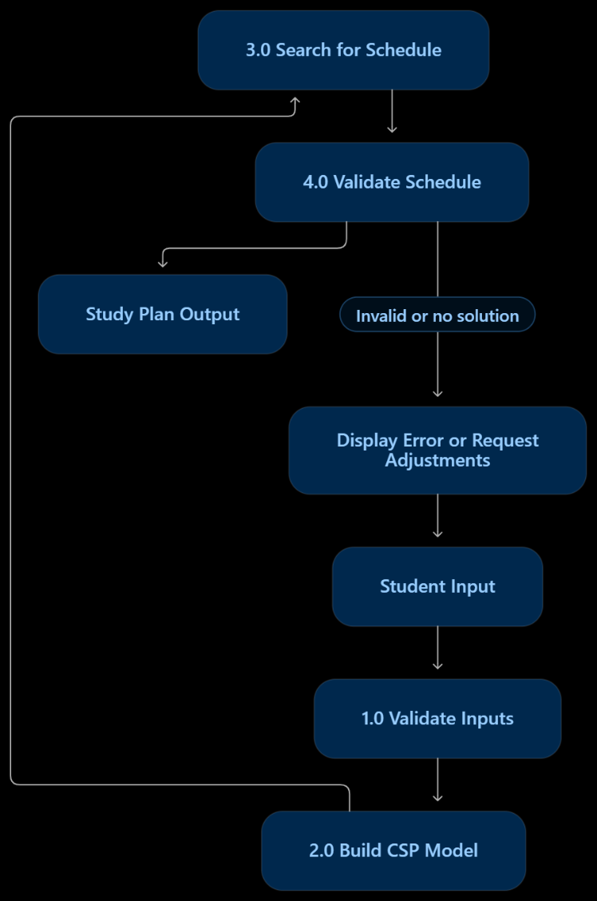
DFD Diagram
Data Flow Diagram (DFD – Level 0)
The student provides academic details to StudySync AI. The system processes these details, generates a schedule, validates it, and returns the study plan.
Data Flow Diagram (DFD – Level 1)
This diagram expands the system into its main processing stages.

Slide 14
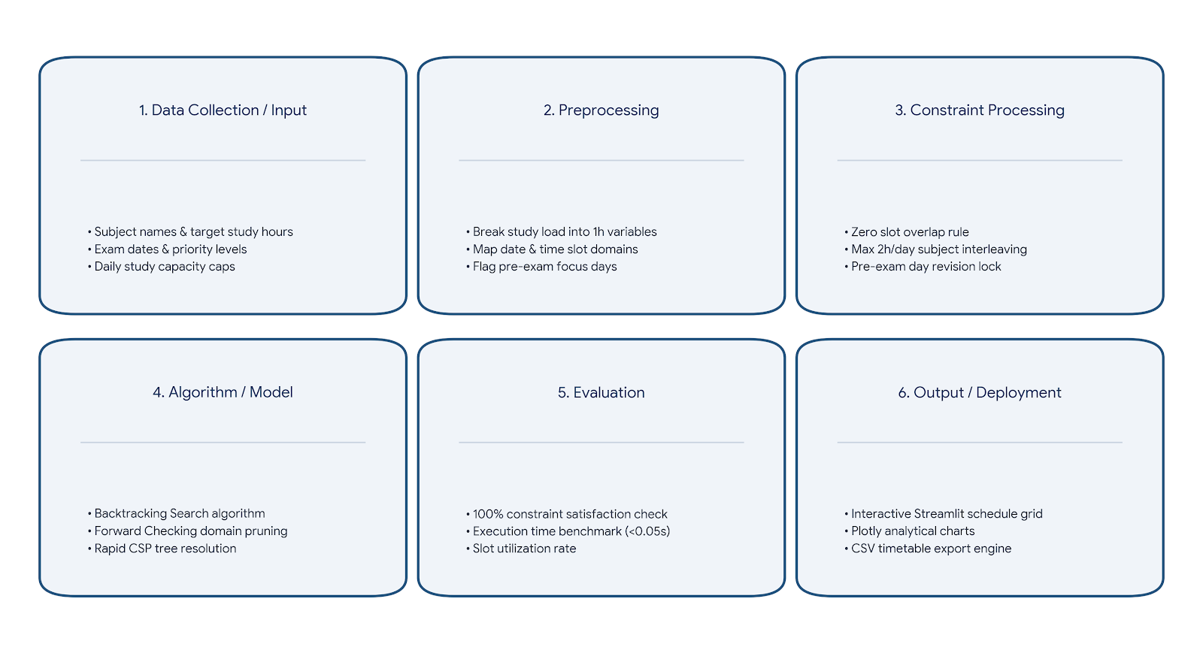
Methodology/Work Flow Diagram

Slide 15
Tools and Technologies
Programming Language: Python 3.10+ (Core AI constraint logic and data processing)
Framework / Library:
  Streamlit (Interactive web application interface)
  Pandas & NumPy (Data manipulation and matrix scheduling)
  Plotly Express (Dynamic analytics and visual study distribution charts)

Slide 16
Tools and Technologies
Database: Streamlit Session-State & Flat-File CSV (In-memory schedule caching and downloadable local storage)
Tools / IDE: VS Code, Git & GitHub (Version control and code repository management)
Hardware: Standard Workstation / Laptop (8 GB RAM, Dual-Core CPU or higher)

Slide 17
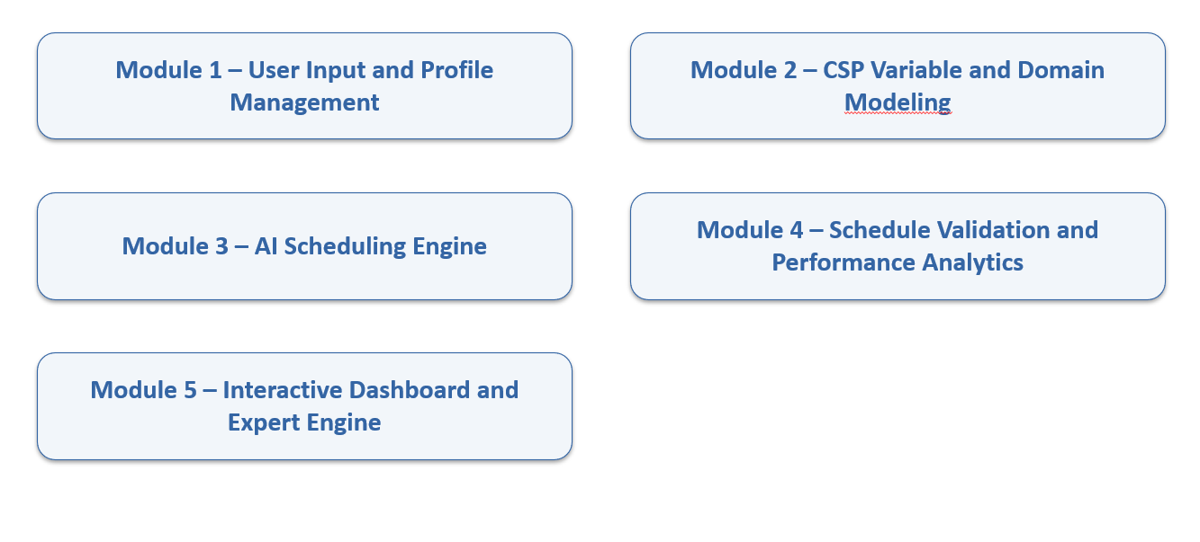
List of Modules

Slide 18
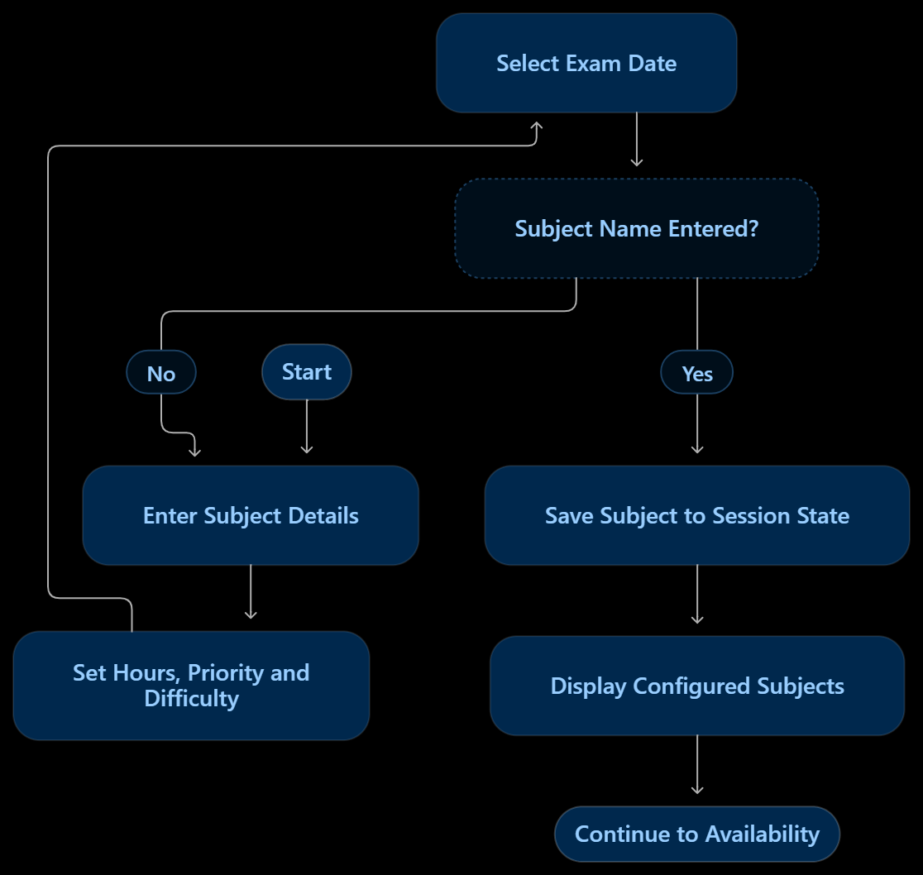
Module Description
MODULE - 1
MODULE – 01 STUDENT PROFILE
Purpose
The Understand module collects academic information from the student and prepares it for the planning process. It acts as the input layer of StudySync AI.
Functions
Collect subject names and examination dates.
Record available study hours.
Identify subject priorities and preparation requirements.
Collect preferred study periods and other preferences, where supported.
Check whether required fields have been provided.

Slide 19
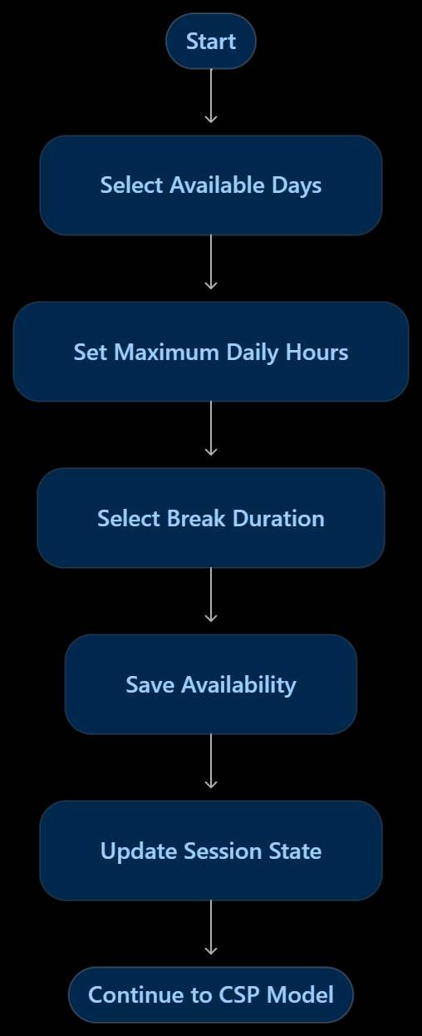
Module Description
MODULE – 2
MODULE – 02 AVAILABILITY
Purpose
Defines when the student is available to study and the maximum number of study hours per day.
Implemented features
Select active study days from Monday to Sunday.
Set maximum daily study hours, from 2 to 12.
Select a break duration.
Save availability settings in session state.

Slide 20
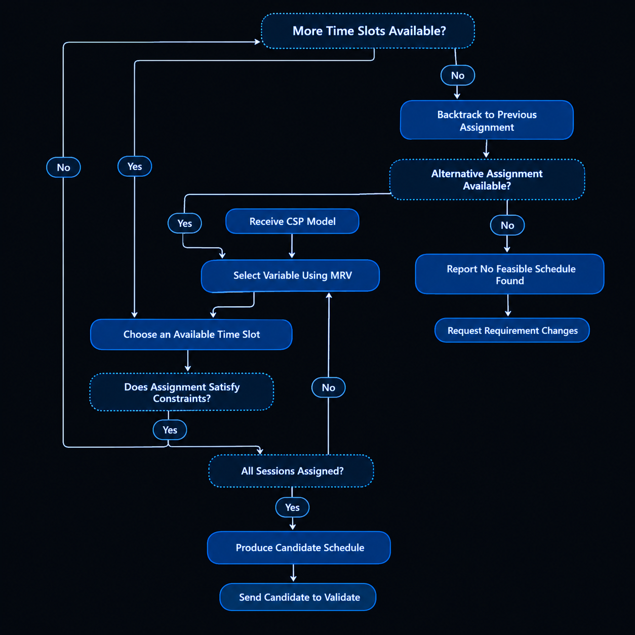
Module Description
MODULE – 3
MODULE – 03 CSP MODEL
Purpose
The Search module attempts to assign study sessions to time slots while satisfying the CSP constraints. It is the main problem-solving stage of StudySync AI.
Algorithms
A. Backtracking Search
Backtracking assigns a value to a variable, checks whether the partial schedule remains valid, and reverses an assignment when it causes a conflict.
B. Minimum Remaining Values (MRV)
MRV selects the unassigned variable with the fewest legal values remaining. This can help expose difficult scheduling choices early.

Slide 21
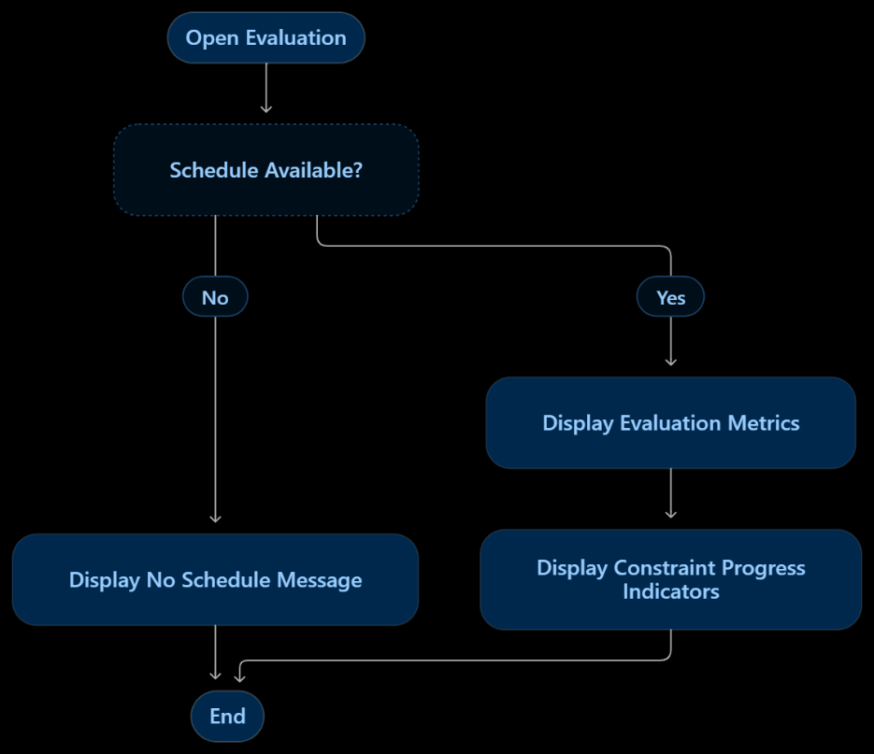
Module Description
MODULE – 4
MODULE – 04 EVALUATION
Purpose
Presents evaluation metrics when a schedule exists in session state.
Implemented features
Checks whether a schedule is present.
Displays a constraint satisfaction rate.
Displays backtracking steps and execution time.
Shows progress indicators for hard and soft constraints.

Slide 22
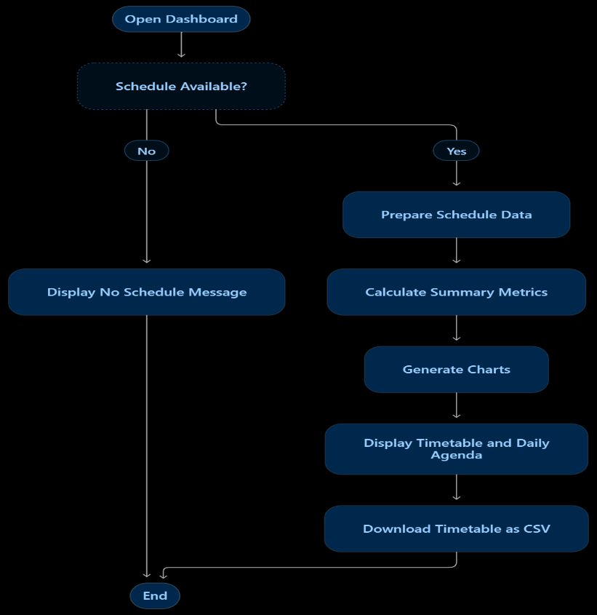
Module Description
MODULE – 5
MODULE – 05 DASHBOARD AND ANALYTICS
Purpose
Displays the generated schedule and summarizes study workload through tables, charts, and a downloadable timetable.
Implemented features
Total scheduled hours and study-day span.
Pre-exam focus and mixed-study hour summaries.
A donut chart showing hours allocated per subject.
A stacked bar chart showing daily workload.
A timetable grid and daily agenda.
CSV export of the timetable.

Slide 23
Results & Discussion
StudySync AI successfully demonstrates a Python and Streamlit-based study planning application that collects student details, subject priorities, difficulty levels, examination dates, study-hour requirements, and availability to generate a structured timetable using a CSP-based two-pass scheduling approach. The application provides an interactive dashboard with timetable summaries, subject-wise study hours, daily workload visualizations, and CSV export functionality. The system helps organize study sessions, simplifies manual timetable preparation, and supports effective time management. However, schedules may remain incomplete when available time slots cannot accommodate all requirements. Future enhancements include implementing recursive backtracking with MRV, dynamic rescheduling, and comprehensive testing to improve scheduling efficiency and reliability.

Slide 24
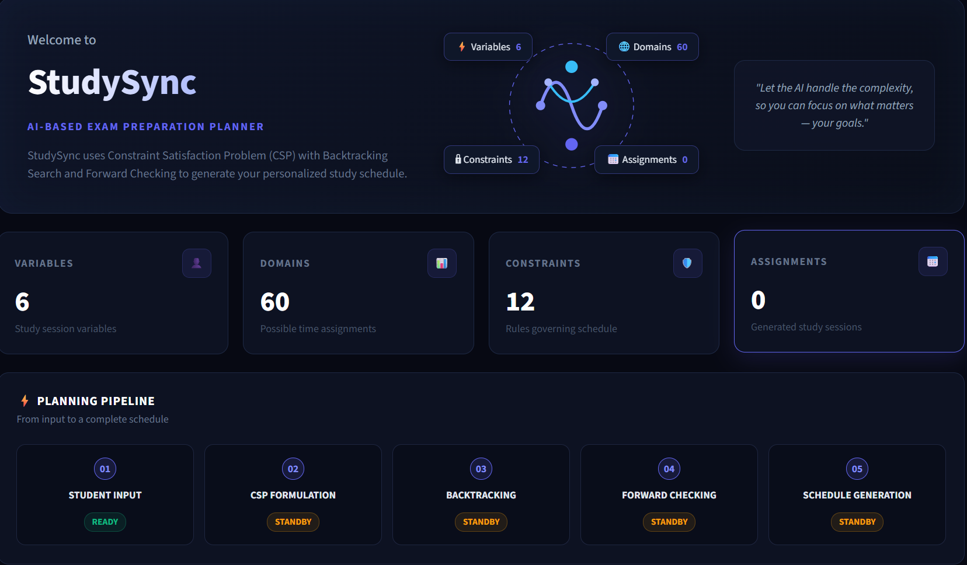
User Interface/ Screenshots

Slide 25
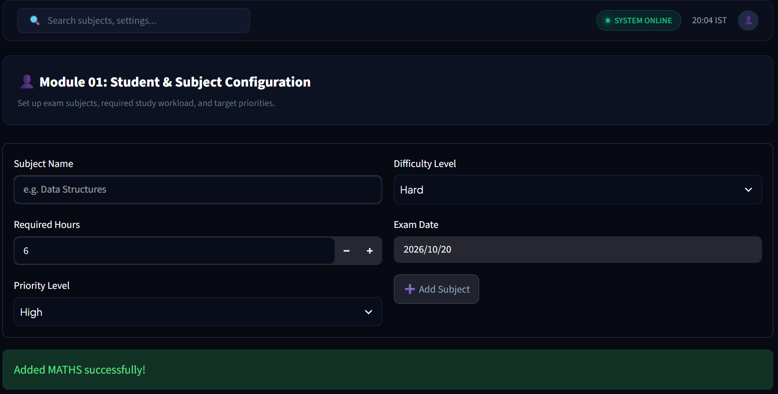
User Interface/ Screenshots

Slide 26
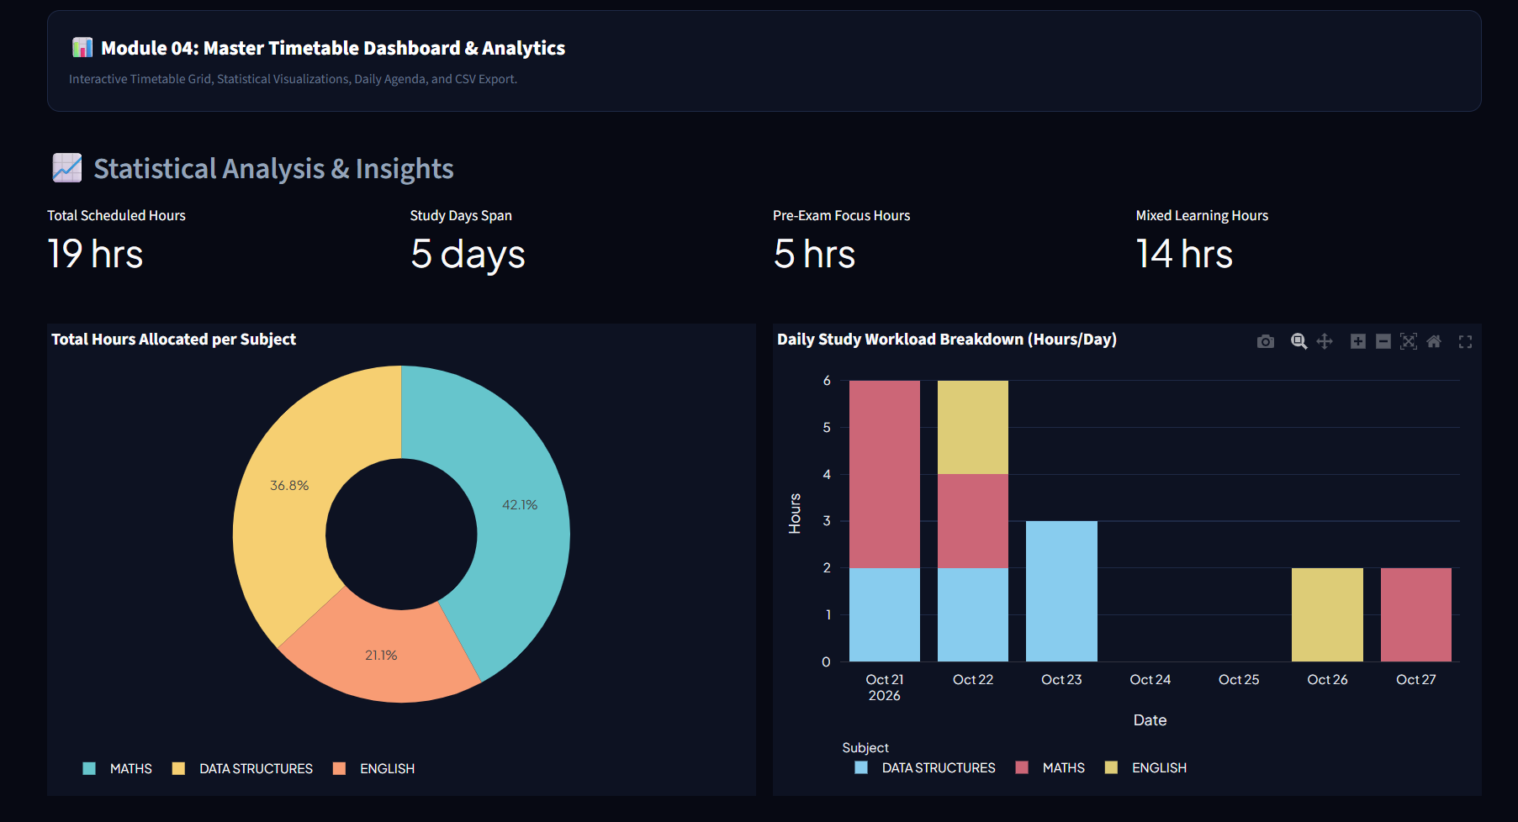
User Interface/ Screenshots

Slide 27
Conclusion
StudySync AI demonstrates the application of classical Artificial Intelligence techniques to personalized study planning through CSP-based scheduling. The system integrates student preferences, subject priorities, examination deadlines, and available study hours to generate structured timetables. Its interactive dashboard provides clear workload visualization and schedule export, supporting improved organization and time management. Future enhancements will focus on advanced search algorithms, dynamic rescheduling, and improved scheduling accuracy to make the system more efficient and adaptable.

Slide 28
Future Work
Advanced AI Algorithms: Implement recursive backtracking and Minimum Remaining Values (MRV) heuristics to improve scheduling.
Dynamic Rescheduling: Automatically update timetables when examination dates, availability, or priorities change.
Personalized Recommendations: Suggest study durations and revision sessions based on subject difficulty and deadlines.
Smart Notifications: Integrate reminders for upcoming examinations and planned study sessions.

Slide 29
References
[1] S. Russell and P. Norvig, Artificial Intelligence: A Modern Approach, 4th ed. Hoboken, NJ, USA: Pearson, 2021.
[2] A. K. Mackworth, “Consistency in Networks of Relations,” Artificial Intelligence, vol. 8, no. 1, pp. 99–118, 1977.
[3] R. M. Haralick and G. L. Elliott, “Increasing Tree Search Efficiency for Constraint Satisfaction Problems,” Artificial Intelligence, vol. 14, no. 3, pp. 263–313, 1980.
[4] Streamlit, “Streamlit Documentation.” [Online]. Available: https://docs.streamlit.io/. Accessed: Oct. 13, 2026.
[5] Python Software Foundation, “Python Documentation.” [Online]. Available: https://docs.python.org/3/. Accessed: Oct. 13, 2026.

Slide 30
Thank You

