Slide 1

Department of Computer Science and Engineering
(Cyber Security)
CS23533– Foundations of Artificial Intelligence
2026-2027
StudySync AI: An Intelligent Exam Preparation Planner using Constraint Satisfaction Problem (CSP)
REVIEW - 2
Dr. BHUVANA PhD.,
Assistant Professor (SG)
NAREN KARTIC B
241901065

Slide 2
Problem Statement and Motivation
Problem Statement
Students often struggle to create effective study schedules due to multiple subjects, examination deadlines, limited study hours, and conflicting priorities. Poor planning can lead to stress, incomplete preparation, and inefficient time management.
StudySync AI addresses this problem by applying classical Artificial Intelligence techniques, particularly Constraint Satisfaction Problems (CSP) and search algorithms, to support systematic and efficient study planning.

Slide 3
Objectives
Project Objectives
Develop a user-friendly study-planning application using Python and Streamlit.
Model academic scheduling as a Constraint Satisfaction Problem (CSP).
Apply classical AI search techniques, such as Backtracking and Minimum Remaining Values (MRV), to find feasible study schedules.
Validate inputs and identify scheduling conflicts.
Generate organized study plans that improve time management and exam preparation.

Slide 4
Objectives
Measurable Objectives and Expected Outcomes
Provide a clear interface for entering academic details.
Check whether generated schedules satisfy all defined constraints.
Reduce scheduling conflicts and improve study-time organization.
Objectives Completed So Far
Designed the StudySync AI landing page and user interface.
Created the four-stage workflow: Understand, Constrain, Search, and Validate.
Displayed the proposed AI planning pipeline.

Slide 5
Objectives
Pending Objectives
Implement and test the complete CSP-based scheduling algorithm.
Integrate Backtracking and MRV into the working planner.
Validate generated schedules and display the final study plan.

Slide 6
Project Progress Since Review 1
Work Completed After Review 1
Design and Development
Designed the StudySync AI landing page using Streamlit.
Developed a dark-themed user interface with a structured layout and feature cards.
Designed the four-stage workflow: Understand, Constrain, Search, and Validate.
Created a visual representation of the proposed AI planning pipeline.

Slide 7
Project Progress Since Review 1
Model Development
Identified Constraint Satisfaction Problems (CSP) as the core AI approach.
Planned the use of Backtracking and Minimum Remaining Values (MRV) for scheduling.
Defined the proposed workflow for input processing, constraint handling, search, and schedule validation.

Slide 8
Project Progress Since Review 1
Milestones Achieved
Completed the initial interface design.
Established the system architecture and module structure.
Prepared the project report sections, including the introduction, literature review, and system design.
Current Implementation Status
The landing page and workflow visualization are developed.
The CSP scheduling algorithm, complete study-plan generation, and schedule validation are pending implementation and testing.

Slide 9
Literature Survey
S. No. | Author(s) & Year | Paper Title | Methodology / Algorithm | Limitations
1 | J. Pablo Rosas Baldazo, Yasmin A. Rios-Solis, Romeo Nigenda, 2024 | Scheduling personalized study plans considering the stress factor | Educational Planning Problem(EPP) | Focuses mainly on stress and scheduling, with limited consideration of other changing student preferences and learning conditions.
2 | Sean A. Mochocki, Mark G. Reith, Gilbert L. Peterson , 2025 | Personalized Learning Path Problem Variations: Computational Complexity and AI Approaches | Backtracking, Branch-and-Bound, Constraint Satisfaction | The approach was evaluated using a relatively small student dataset and requires further real-world validation of learning outcomes.

Slide 10
Literature Survey
S. No. | Author(s) & Year | Paper Title | Methodology / Algorithm | Limitations
3 | Amir Hossein Nabizadeh, Jose Paulo Leal, Rajiv Ratn Shah , 2020 | Learning Path Personalization and Recommendation Methods: A Survey of the State-of-the-Art | Learning-path personalization; course generation; course sequencing | Different studies use different parameters and evaluation methods, making comparison difficult; many approaches also lack dynamic adaptation and extensive real-world validation.
5 | Marco Antonio Cruz-Chávez, Mireya Flores-Pichardo, Alina Martínez-Oropeza, Pedro Moreno-Bernal, and Martín H. Cruz-Rosales, 2016 | Solving a Real Constraint Satisfaction Model for the University Course Timetabling Problem: A Case Study | Constraint Satisfaction Problem (CSP) model and Constructive Approach Algorithm (CAA) | The study focuses on course scheduling at a specific university faculty, including classroom and teacher allocation. Its model may require adaptation for individual students' study hours, subject priorities, and personal learning preferences.

Slide 11
Research Gap and Project Response
1. Literature findings
AI supports personalised study planning
CSP helps satisfy scheduling constraints
2. Limitations
Existing methods maybe complex
Dynamic rescheduling remains challenging
3. Refined research gap
A simple study planner is needed to organize study time, handle constraints, and detect conflicts using classical AI without ML or deep learning.
4. Progress toward the solution
Streamlit interface designed
CSP workflow designed

Slide 12
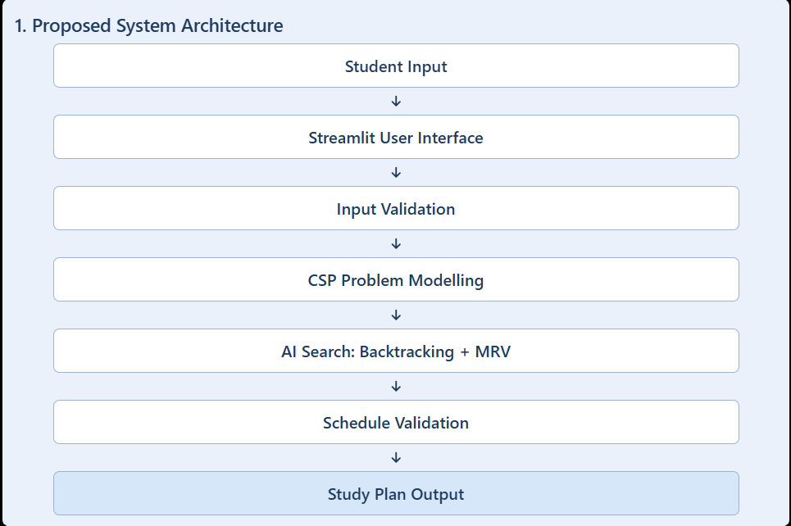
System Architecture / Proposed System

Slide 13
System Architecture / Proposed System
2. Component Interaction and Data Flow
• Input: Collect subjects, exam dates, priorities, and available study hours.
• Validation: Check input completeness and validity.
• CSP Model: Represent study sessions as variables, time slots as domains, and scheduling rules as constraints.
• AI Search: Search for a feasible schedule using Backtracking and MRV.
• Output: Validate and display the study plan, or request input adjustments if no feasible solution is found.

Slide 14
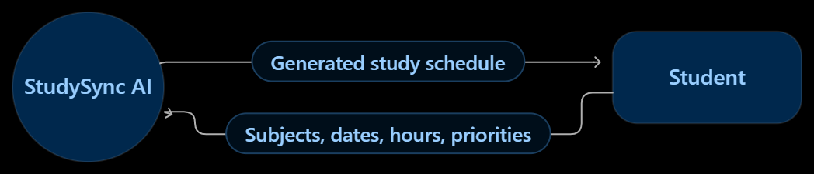
DFD Diagram
Data Flow Diagram (DFD – Level 0)
The student provides academic details to StudySync AI. The system processes these details, generates a schedule, validates it, and returns the study plan.

Slide 15
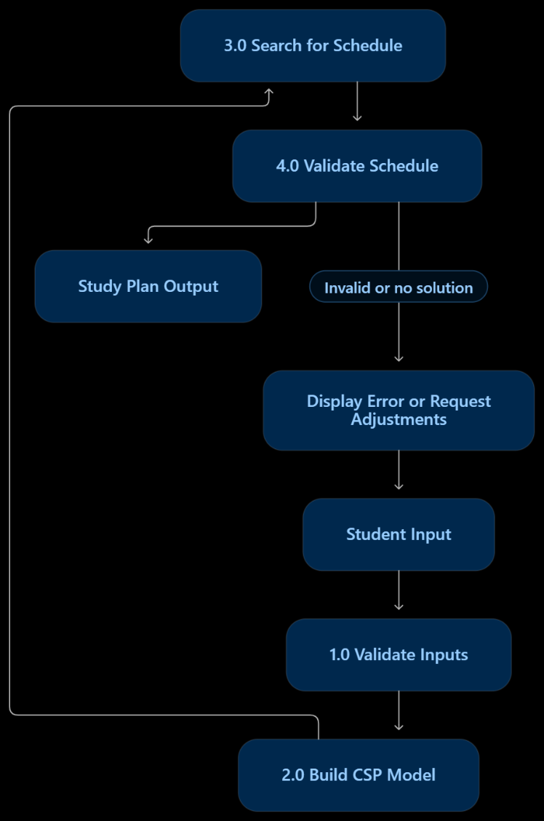
DFD Diagram
Data Flow Diagram (DFD – Level 1)
This diagram expands the system into its main processing stages.

Slide 16
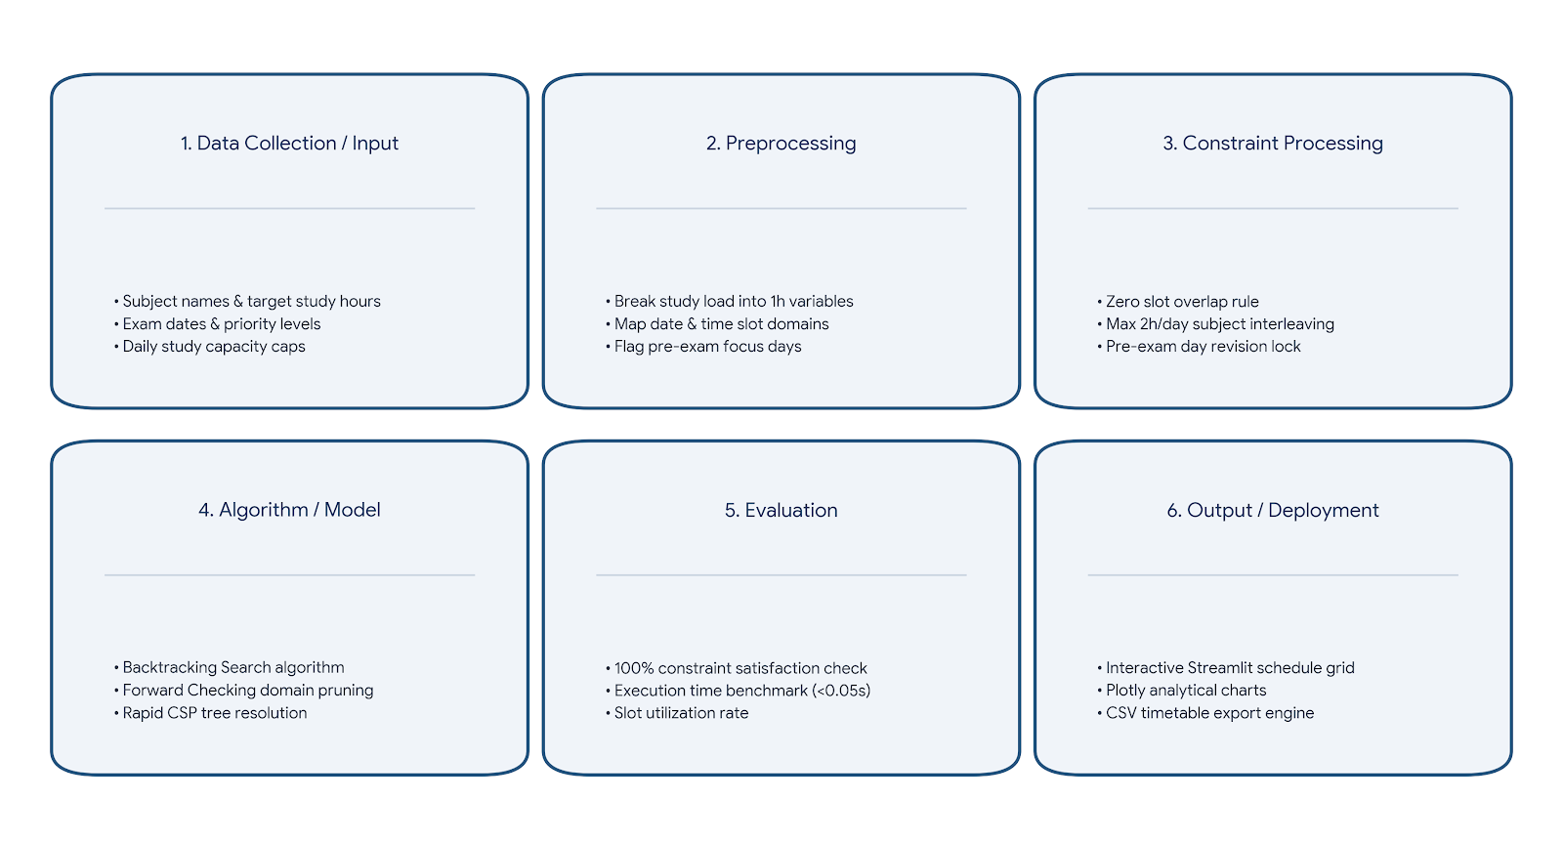
Methodology / Workflow Diagram

Slide 17
Tools and Technologies
Programming Language: Python 3.10+ (Core AI constraint logic and data processing)
Framework / Library:
  Streamlit (Interactive web application interface)
  Pandas & NumPy (Data manipulation and matrix scheduling)
  Plotly Express (Dynamic analytics and visual study distribution charts)

Slide 18
Tools and Technologies
Database: Streamlit Session-State & Flat-File CSV (In-memory schedule caching and downloadable local storage)
Tools / IDE: VS Code, Git & GitHub (Version control and code repository management)
Hardware: Standard Workstation / Laptop (8 GB RAM, Dual-Core CPU or higher)

Slide 19
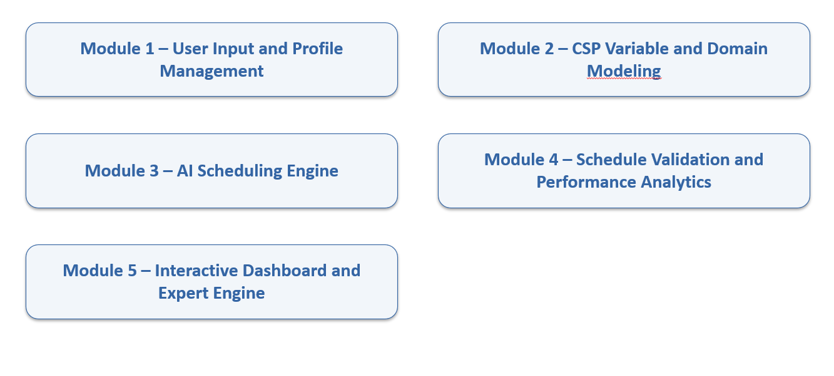
List of Modules
List all project modules.
Mark each module as Completed, In Progress, or Pending.
Font size:24

Slide 20
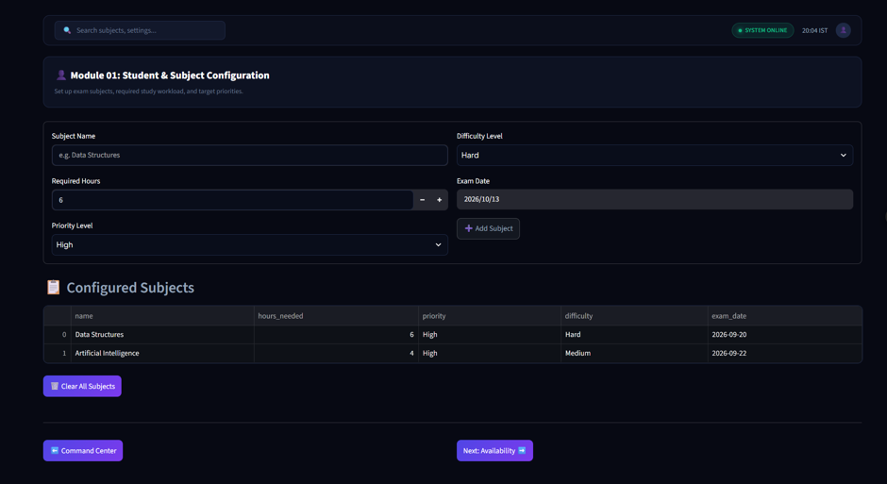
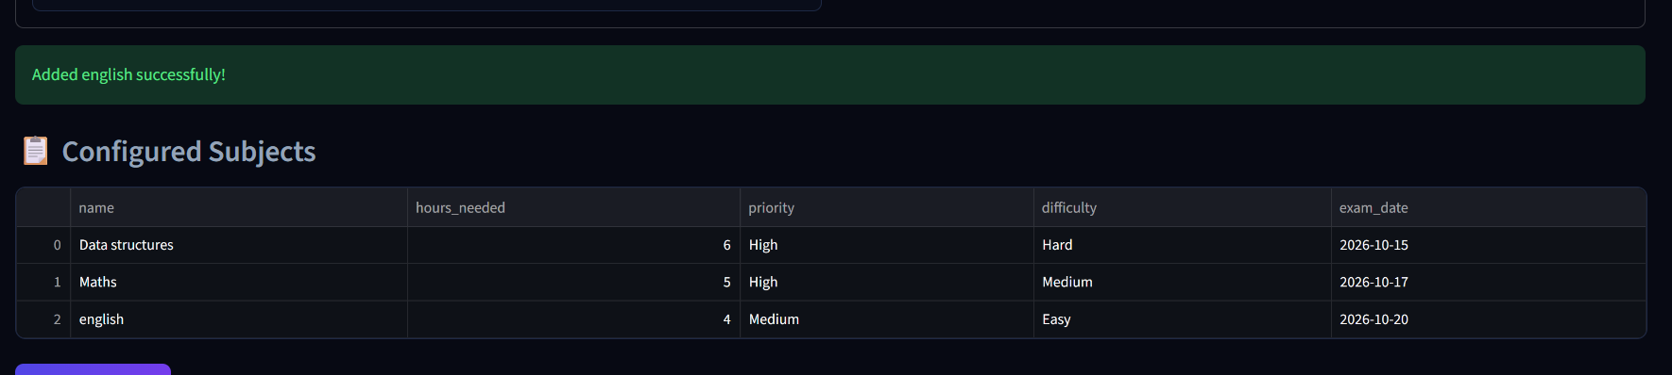
Module Implementation – Part 1

Slide 21
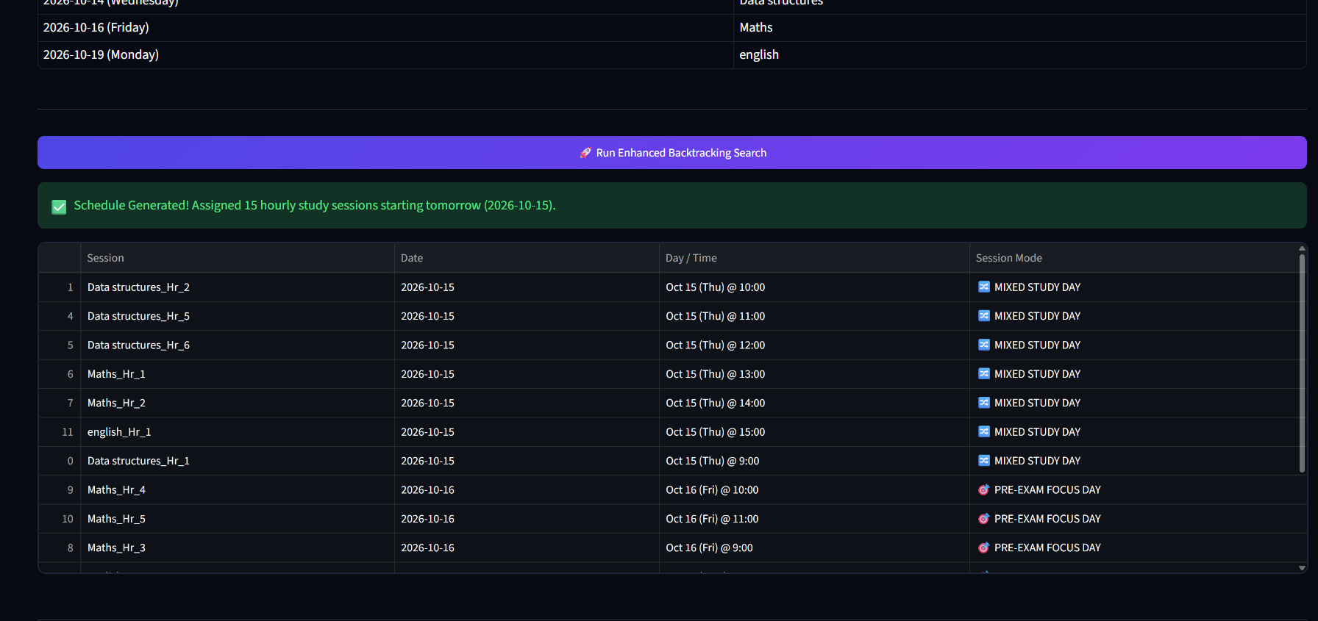
Module Implementation – Part 2

Slide 22
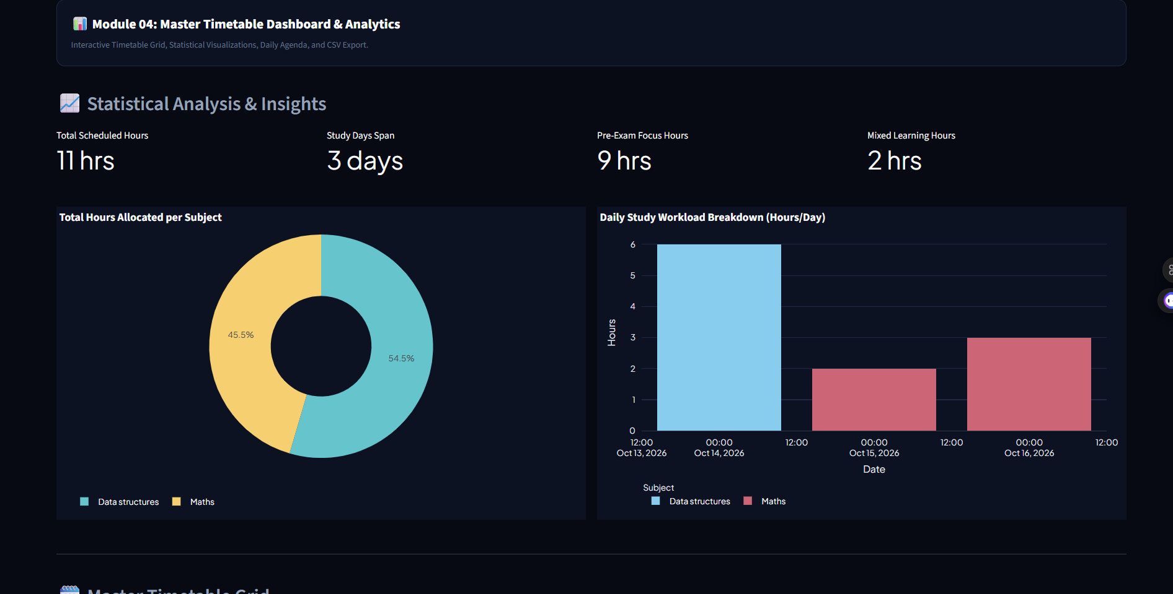
Preliminary Results and Discussion

Slide 23
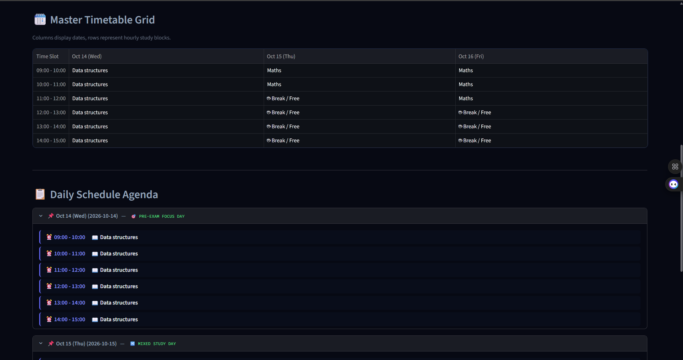
Preliminary Results and Discussion

Slide 24
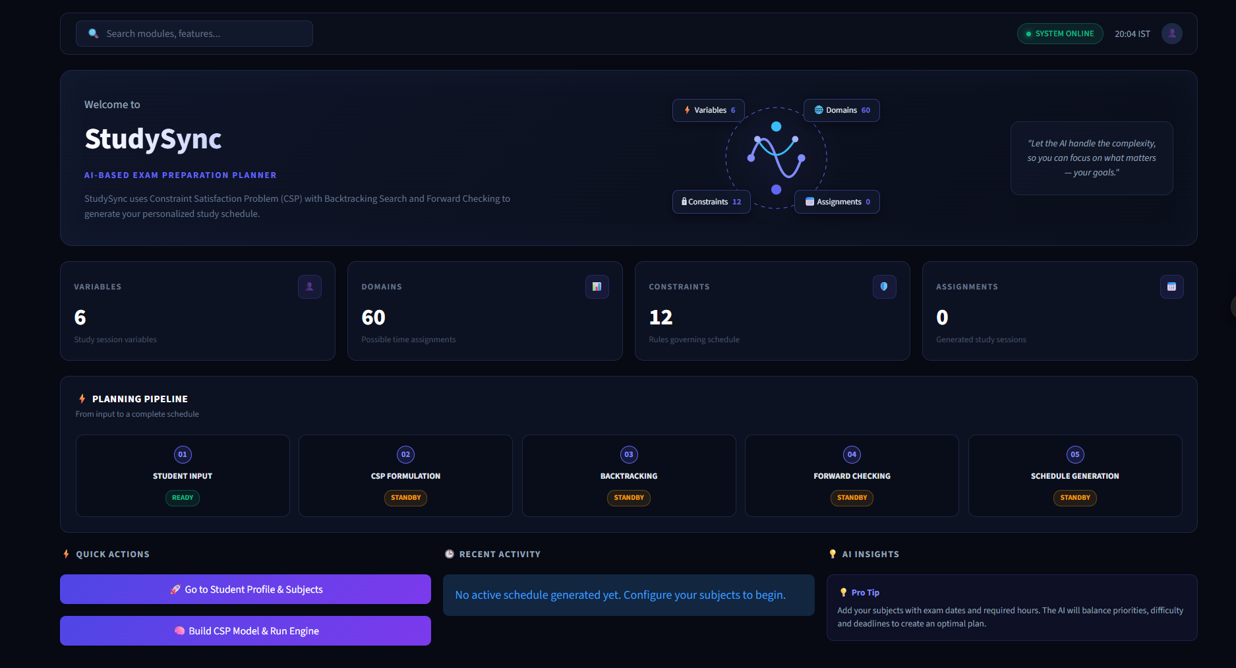
User Interface / Implementation Screenshots
The command center – intro page

Slide 25

User Interface / Implementation Screenshots
The input page – where the exam dates, names, hrs required and priority levels are entered by the user

Slide 26
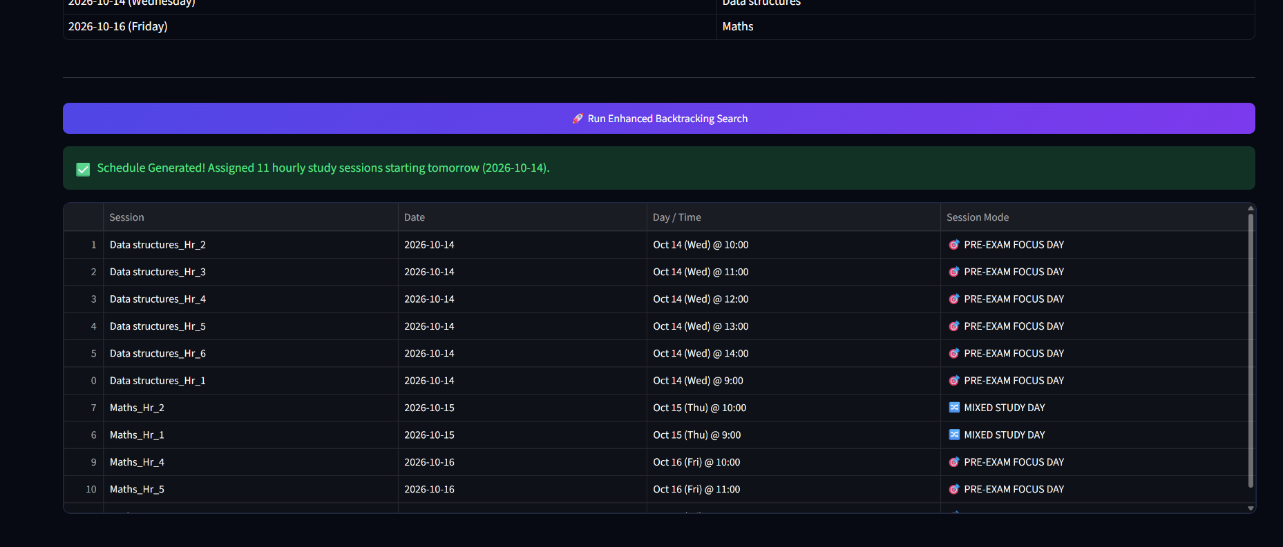
User Interface / Implementation Screenshots
Backtrack search is done and the schedule is generated sucessfully without any clashes

Slide 27
Challenges Faced and Solutions
Challenges Encountered
Designing a user-friendly and attractive Streamlit interface.
Converting academic scheduling requirements into CSP constraints.
Handling conflicting study hours, exam dates, and subject priorities.
Solutions and Workarounds
Used custom CSS to improve the interface design.
Planned a CSP-based model to represent scheduling constraints.
Designed input validation and schedule verification steps.

Slide 28
Work Plan Until Final Review
1. Testing and Evaluation
Perform unit, integration, and functional testing.
Test invalid inputs and conflicting constraints.
Evaluate schedule feasibility and execution time.
Fix identified errors and improve performance.
2. Documentation
Complete the project report and literature survey.
Add system diagrams, application screenshots, and test results.
Finalize references and appendix.

Slide 29
References
[1] S. Russell and P. Norvig, Artificial Intelligence: A Modern Approach, 4th ed. Hoboken, NJ, USA: Pearson, 2021.
[2] A. K. Mackworth, “Consistency in Networks of Relations,” Artificial Intelligence, vol. 8, no. 1, pp. 99–118, 1977.
[3] R. M. Haralick and G. L. Elliott, “Increasing Tree Search Efficiency for Constraint Satisfaction Problems,” Artificial Intelligence, vol. 14, no. 3, pp. 263–313, 1980.
[4] Streamlit, “Streamlit Documentation.” [Online]. Available: https://docs.streamlit.io/. Accessed: Oct. 13, 2026.
[5] Python Software Foundation, “Python Documentation.” [Online]. Available: https://docs.python.org/3/. Accessed: Oct. 13, 2026.

Slide 30
Thank You

