Slide 1
Electricity price prediction
Phase_3 :Development 1

Slide 2
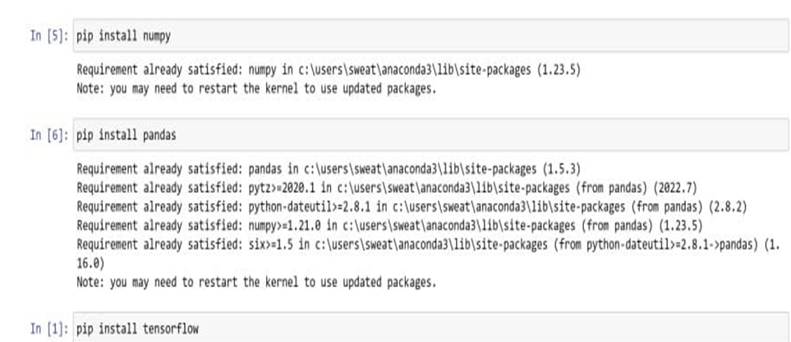
Install Necessary Libraries
Depending On Our Project, It Might Need Libraries Like Numpy, Pandas, Scikit-Learn, Tensorflow.
Install These Libraries Using Package Managers Like Pip Or Conda.

Slide 3
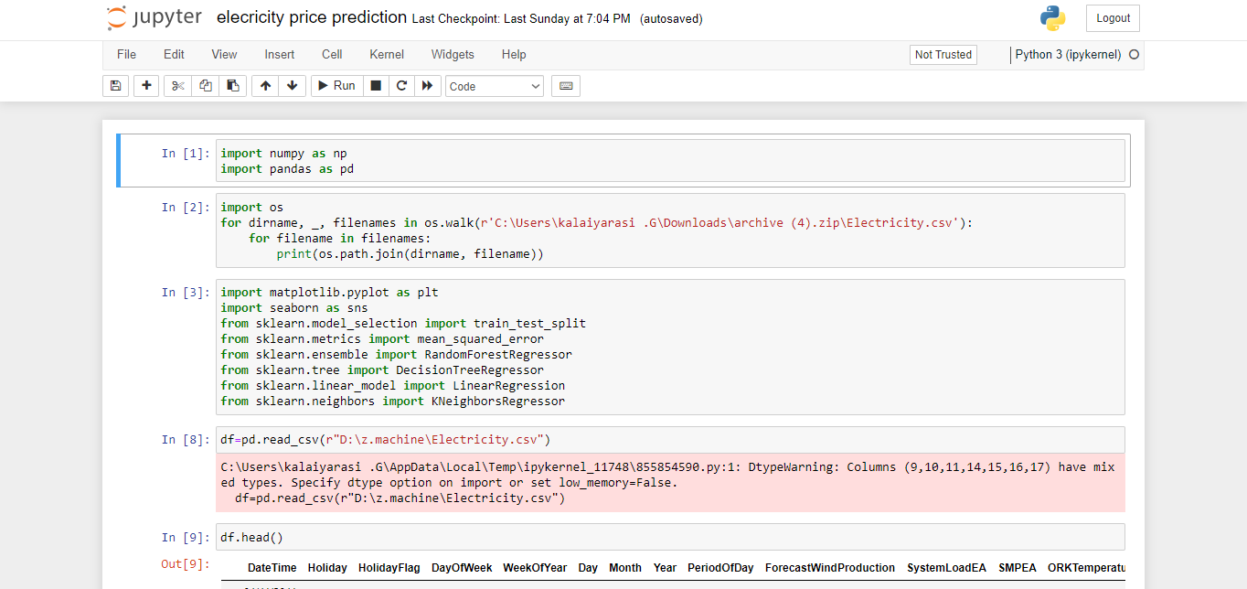
Import Necessary Libraries:
Import libraries like Pandas, NumPy, Matplotlib, Scikit-Learn, and TensorFlow (or PyTorch) for handling data, visualization, and machine learning.

Slide 4
other Libraries
Import libraries like Logistic Regression, seaborn,matplotlib,
K Neighbors Classifier, Decision Tree Classifier, Random Forest Classifier.

Slide 5
Load the Dataset:
Use The pandas Library To Load our Dataset from the kaggle website.
I was Working With A CSV File, I Can Use Pandas With Pd. Read _Csv( ).

Slide 6
DATA EXPLORATION:
Perform Initial Data Exploration To Understand
structure
features
content
Use functions were
head( )
info( )
describe( )
in Pandas for tabular data.

Slide 7
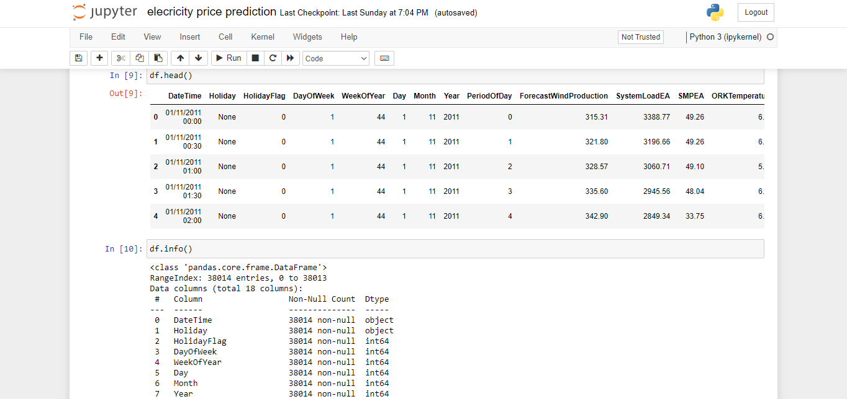
Df.head( )
It is used to display the first few rows of a Pandas DataFrame.

Slide 8
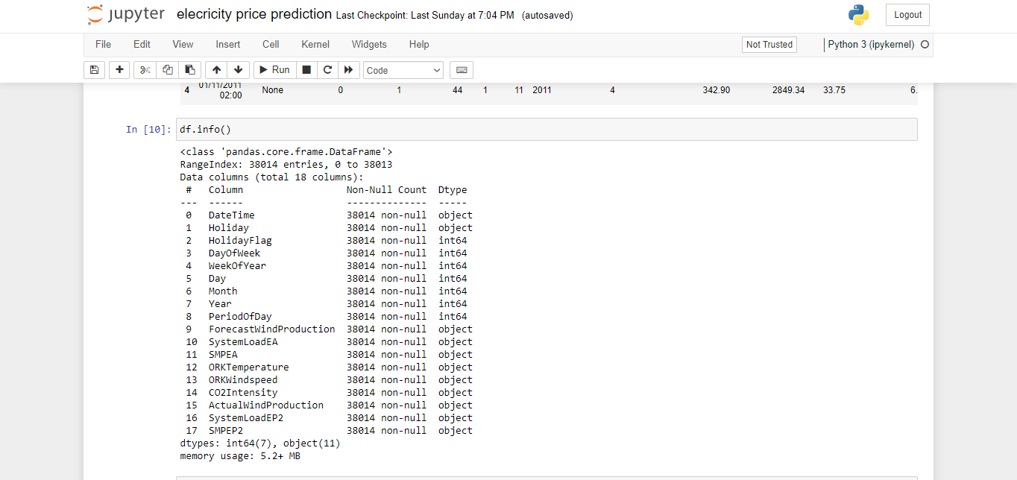
Df.info( )
The df.info() method in Pandas is used to get a concise summary of a DataFrame's structure and content.
It provides valuable information about the DataFrame, including the data types of columns, the
number of non-null values, memory usage, and more.

Slide 9
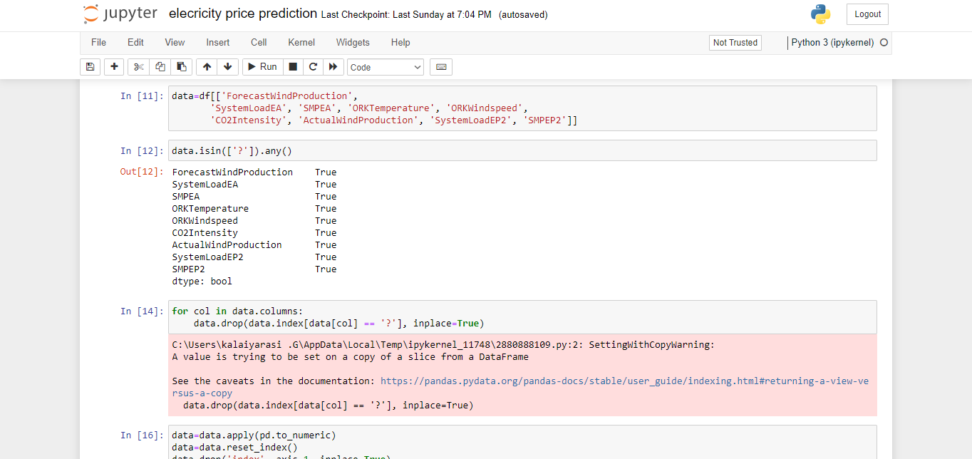
Data=df[[ ]]
In this code, you are selecting specific columns from the DataFrame named 'df' and creating a new DataFrame with only those columns. Here's a breakdown of what's happening
It seems like you are interested in working with data related to wind production forecasts, energy system load, temperature, wind speed, CO2 intensity, and actual wind production, among other variables.

Slide 10
data.isin(['?']).any()
This Code Is Often Used To Identify Missing Or Placeholder Values In A Dataframe.
The '?' Character Is A Common Choice For Representing Missing Or Unknown Data.
If Any Cell In The 'Data' Dataframe Contains A '?', Data.Isin(['?']).Any() Will Return True, Indicating The Presence Of Missing Or Unknown Values In The Dataframe. If All Cells Are Populate With Valid Data, It Will Return False.

Slide 11
clean and filter the DataFrame
The purpose of this code is to remove rows from the DataFrame where any column contains the character '?'.
It effectively filters out rows that contain missing or unknown data marked with '?'.

Slide 12
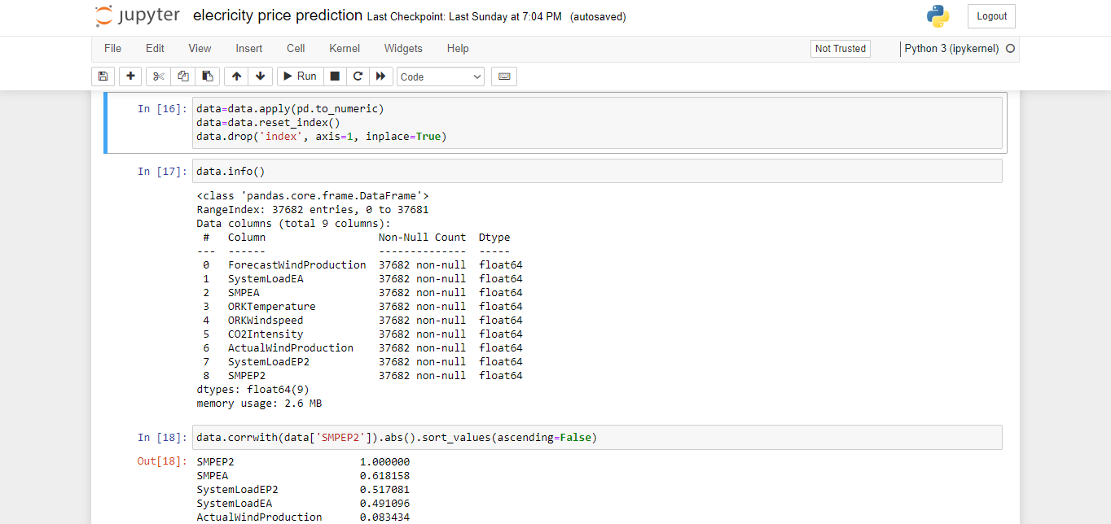
Preprocessing
The purpose of this program is to clean and prepare the 'data' DataFrame by ensuring that all values are in a numeric format, resetting the index to default integers, and removing any extraneous 'index' column.
when working with data that might have mixed data types, non-standard indices, or unnecessary columns.

Slide 13
Data.info( )
The df.info( ) method in Pandas is used to get a concise summary of a DataFrame's
structure and content.
It provides valuable information about the DataFrame, including the data types of columns, the number of non-null values, memory usage, and more.

Slide 14
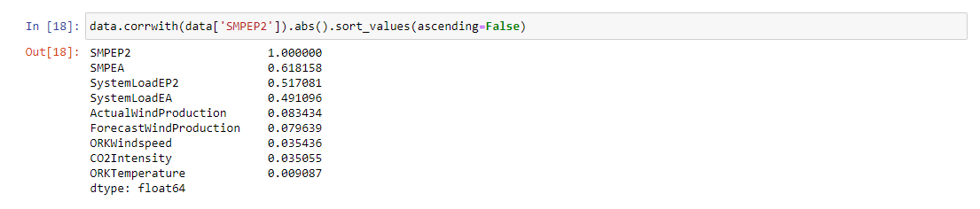
Data analysis
The Purpose Of This Program Is To Calculate And Display A List Of Columns In The 'Data' Dataframe,Sorted By Their Absolute Correlation With The 'SMPEP2' Column.
This Can Be Useful In Data Analysis To Identify Which Columns Are Most Strongly Correlated With 'SMPEP2' And May Provide Insights Into Relationships Between Variables In The Dataset.

Slide 15
Source code:
import numpy as np
import pandas as pd
Import os for dirname, _, filenames in os.walk(r’C:\Users\kalaiyarasi .G\Downloads\archive (4).zip\Electricity.csv’): for filename in filenames: print(os.path.join(dirname, filename))

Slide 16
import matplotlib.pyplot as plt import seaborn as sns from sklearn.model_selection import train_test_split from sklearn.metrics import mean_squared_error from sklearn.ensemble import RandomForestRegressor from sklearn.tree import DecisionTreeRegressor from sklearn.linear_model import LinearRegression from sklearn.neighbors import KNeighborsRegressor
Df=pd.read_csv(r”D:\z.machine\Electricity.csv”)
Df.head()

Slide 17
Df.info()
data=df[[‘ForecastWindProduction’, ‘SystemLoadEA’, ‘SMPEA’, ‘ORKTemperature’, ‘ORKWindspeed’, ‘CO2Intensity’, ‘ActualWindProduction’, ‘SystemLoadEP2’, ‘SMPEP2’]]
Data.isin([‘?’]).any()
For col in data.columns: data.drop(data.index[data[col] == ‘?’], inplace=True)
data=data.apply(pd.to_numeric) data=data.reset_index() data.drop(‘index’, axis=1, inplace=True)

Slide 18
Data.info()
Data.corrwith(data[‘SMPEP2’]).abs().sort_values(ascending=False)

