Slide 1

RateIt
A platform for rating various things of our regular life before we have it.
Naresh Barua
Dip Fazla Imam

Slide 2
Idea Generation:
The idea about our RateIt project is given by our course sir Dr. Md Razib Hayat Khan. We have taken help and idea for this project from our sir. After hearing about the idea about the project we find it something interesting to work with. So we accepted our sir’s advice to work with it.
RateIt is an online platform where we can rate anything of our daily life before we have it. We want to buy a phone but we don’t have any good idea about the mobile. For this we can use RateIt to find out review about the mobile phone. We can rate any product, give stars to it, do a comment on it.

Slide 3
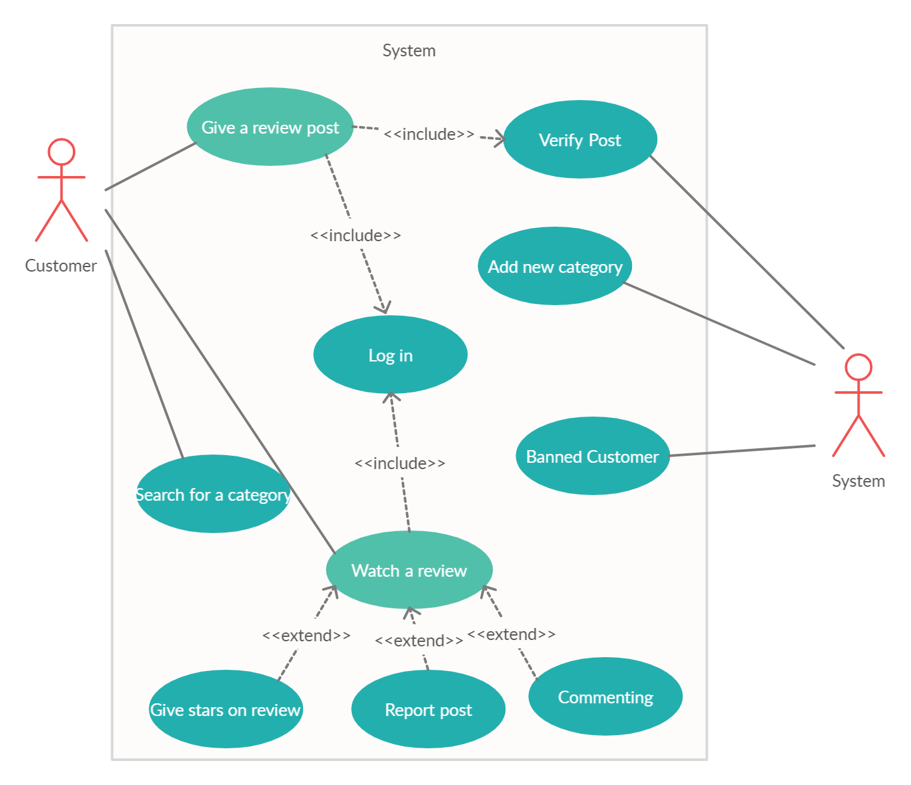
UML Use Case:

Slide 4
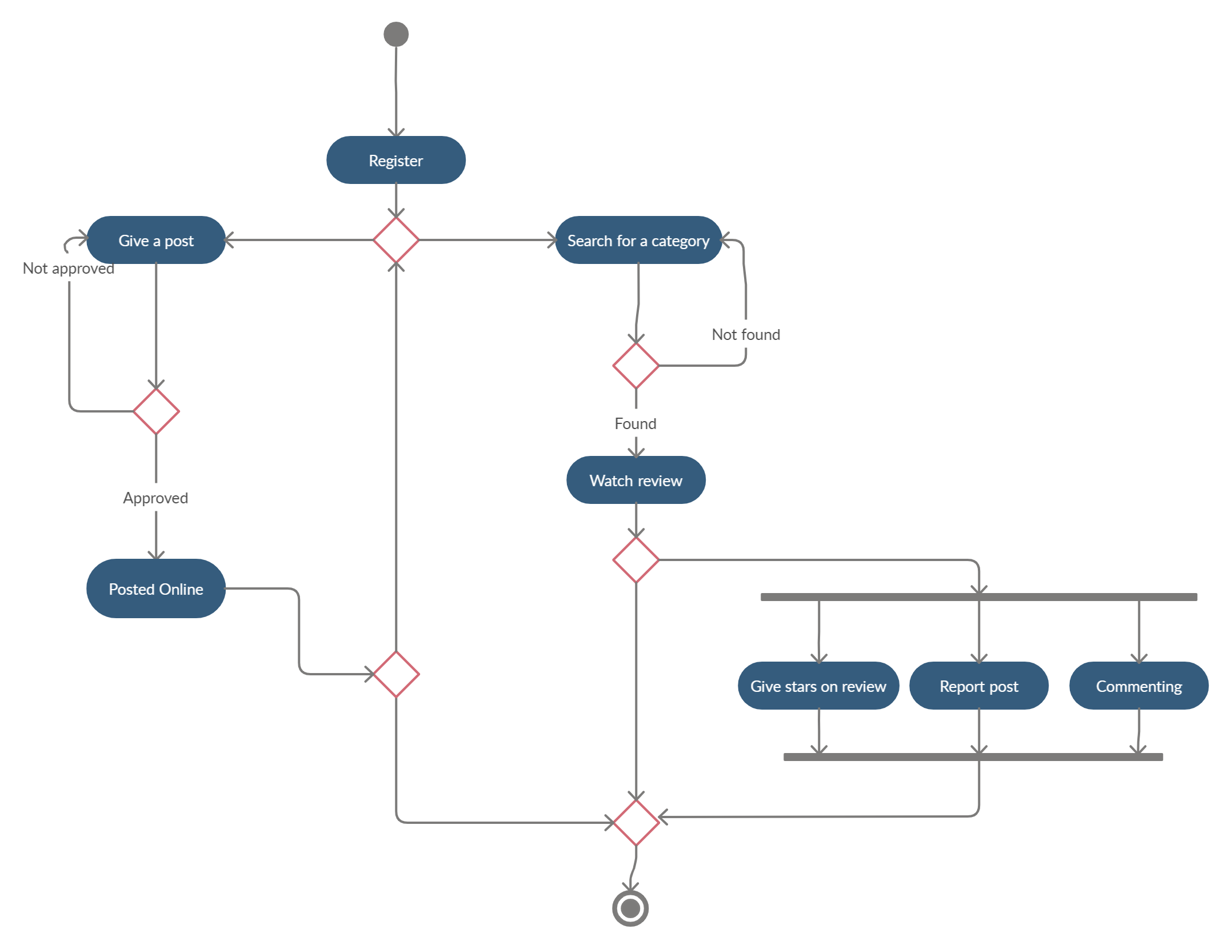
UML Activity Diagram:

Slide 5
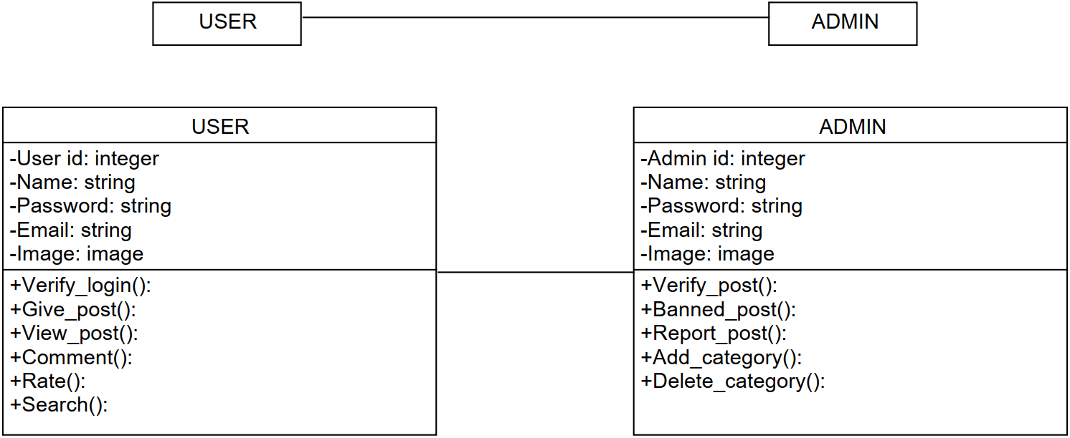
UML Class Diagram:

Slide 6

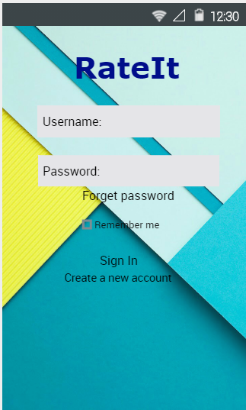
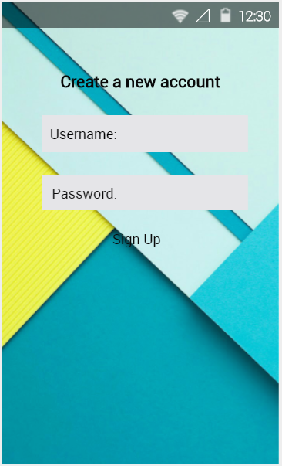
RateIt Mock Design:

Slide 7
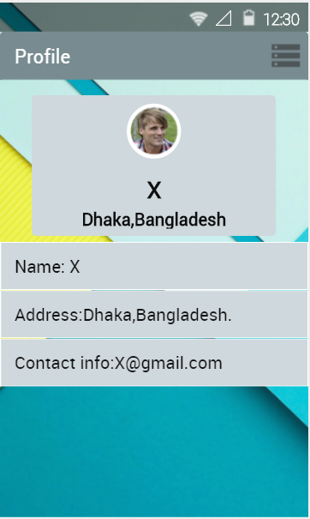
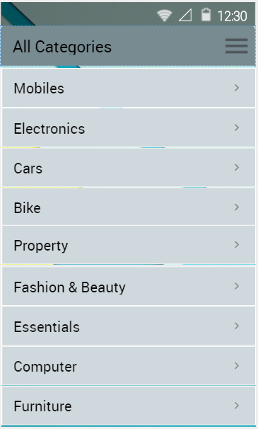
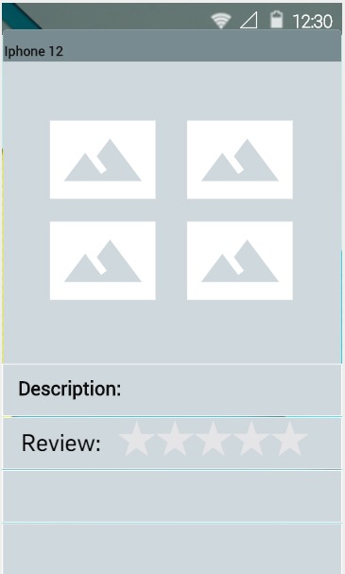
RateIt Mock Design:

Slide 8
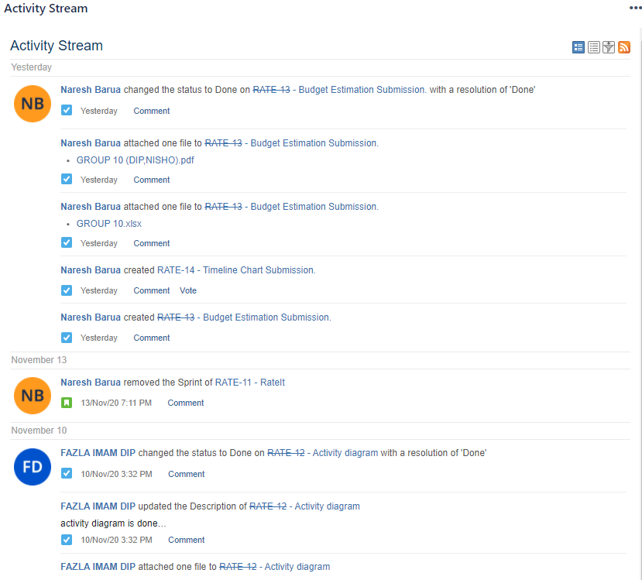
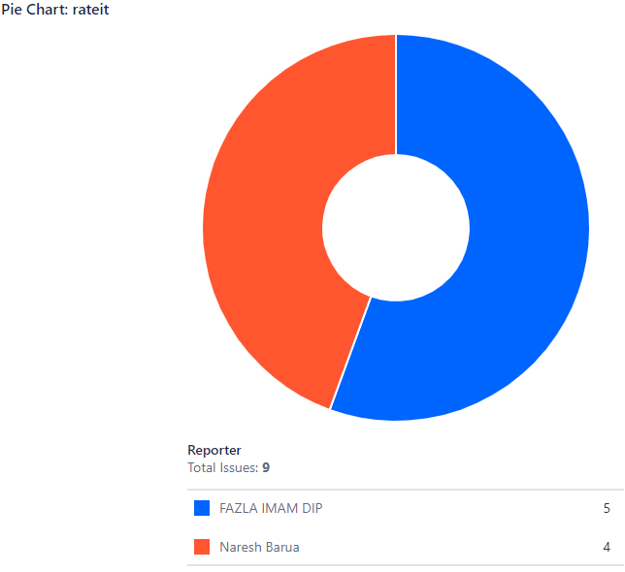
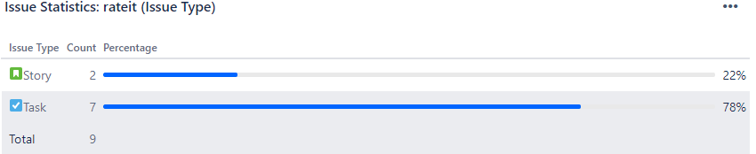
RateIt Jira:

Slide 9
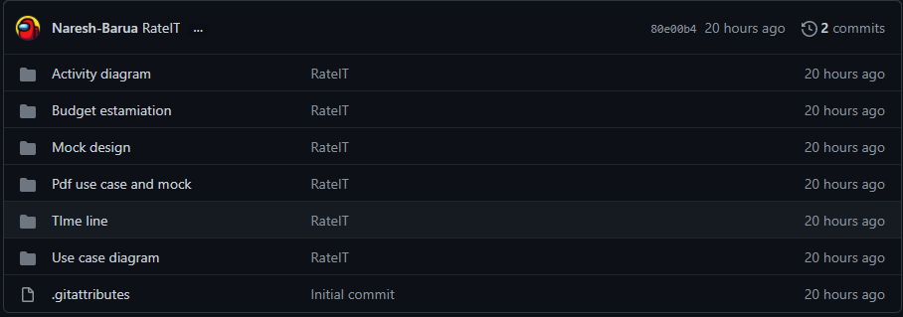
RateIt Git:
https://github.com/Naresh-Barua/Software-Engeneering-Project-

Slide 10
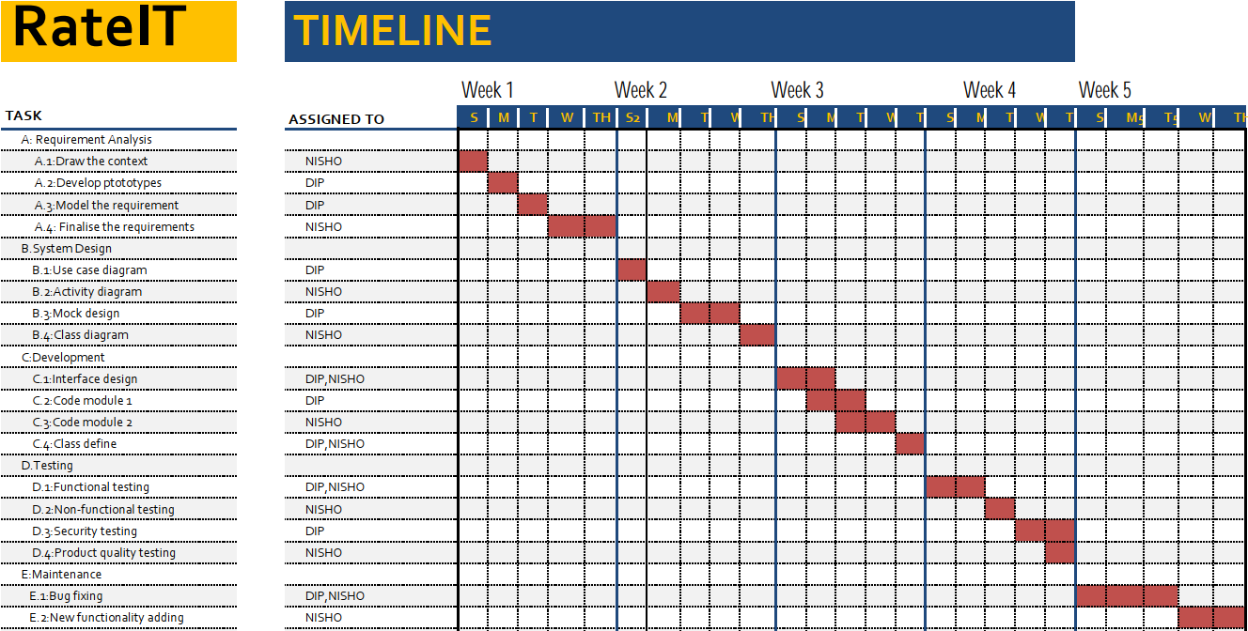
RateIt Timeline:

Slide 11
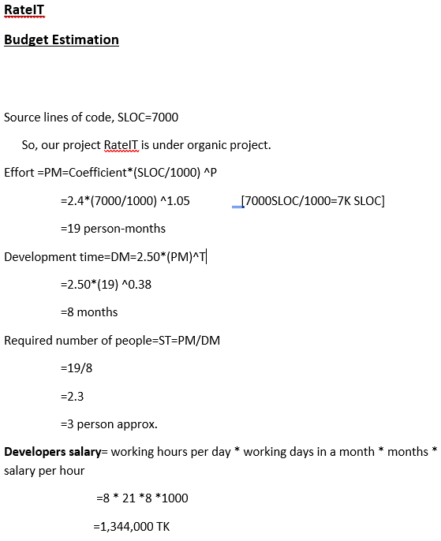
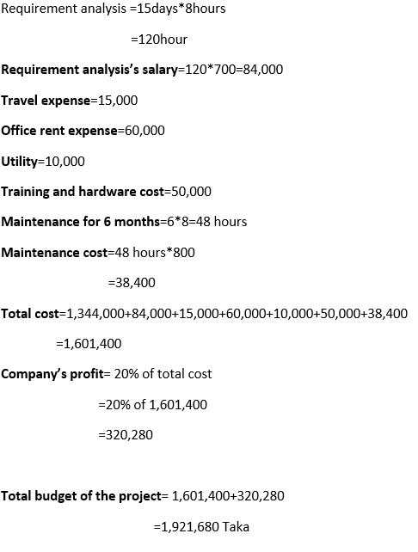
RateIt Budget Estimation

