Slide 1

RateIt
A platform for rating various things of our regular life before we have it.
NARESH BARUA
DIP FAZLA IMAM

Slide 2
INTRODUCTION
RateIt is an online platform where we can rate anything of our daily life before we have it. We want to buy a phone, TV, Bike, Laptop etc. but we don’t have any idea about the product. For this we can use RateIt to find out about the product. We can rate any product, give stars to it, do a comment on it.

Slide 3
Idea Generation:
The idea about our RateIt project is given by our course sir Dr. Md Razib Hayat Khan. We have taken help and idea for this project from our sir. After hearing about the idea about the project we find it something interesting to work with. So we accepted our sir’s advice to work with it.

Slide 4
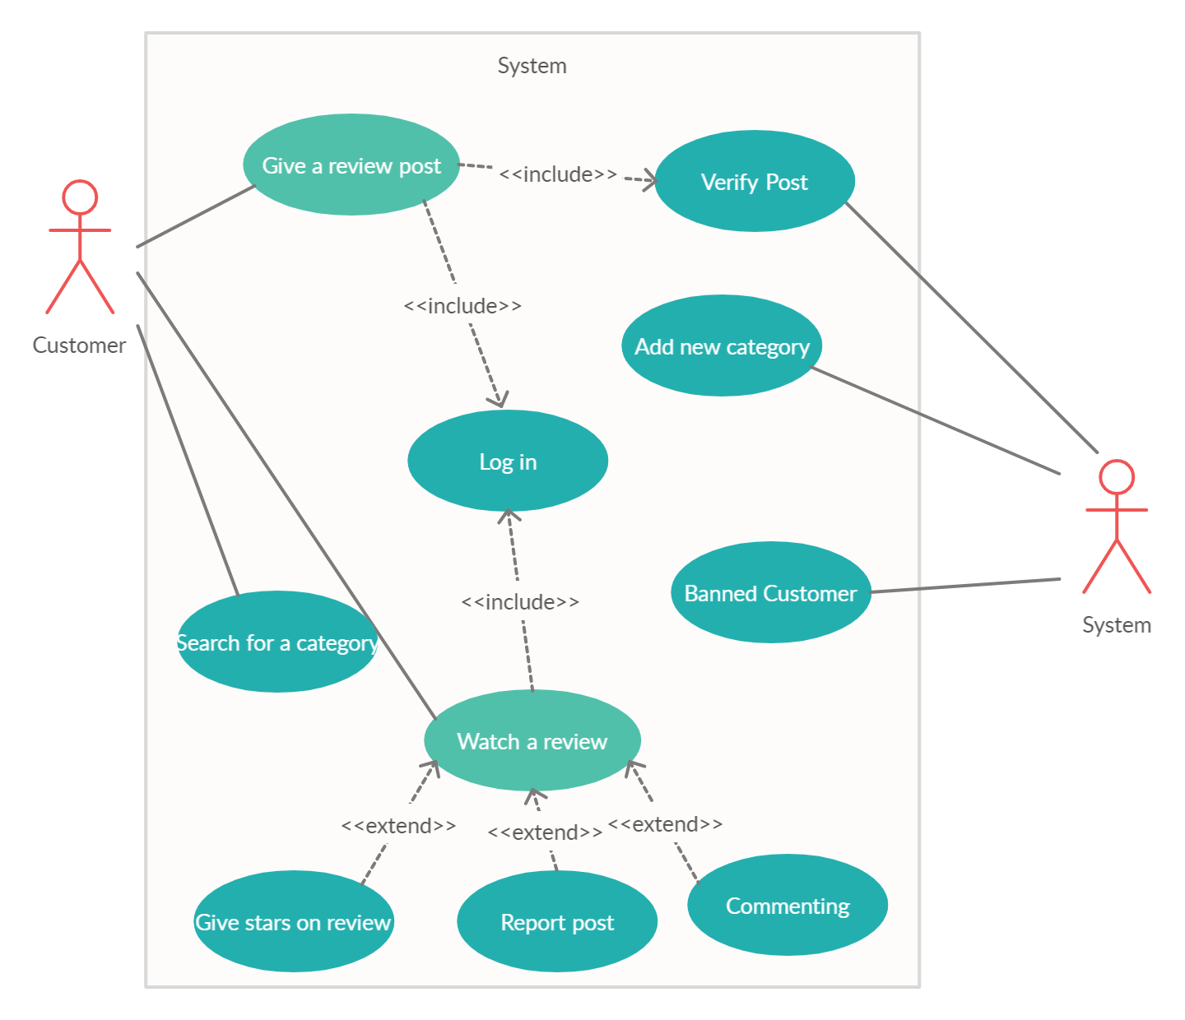
UML Use Case:

Slide 5
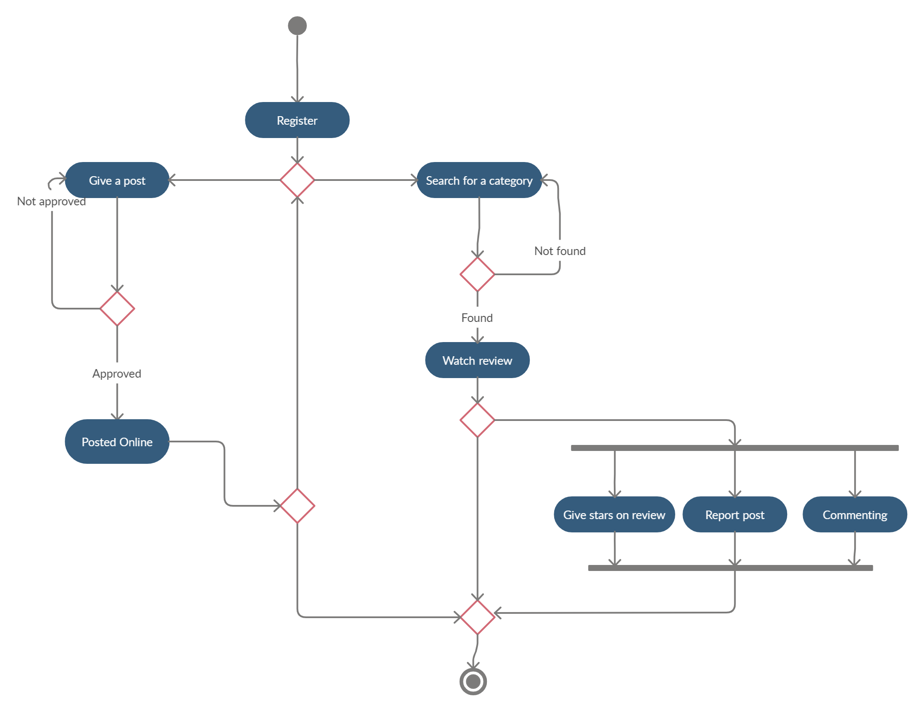
UML Activity Diagram:

Slide 6
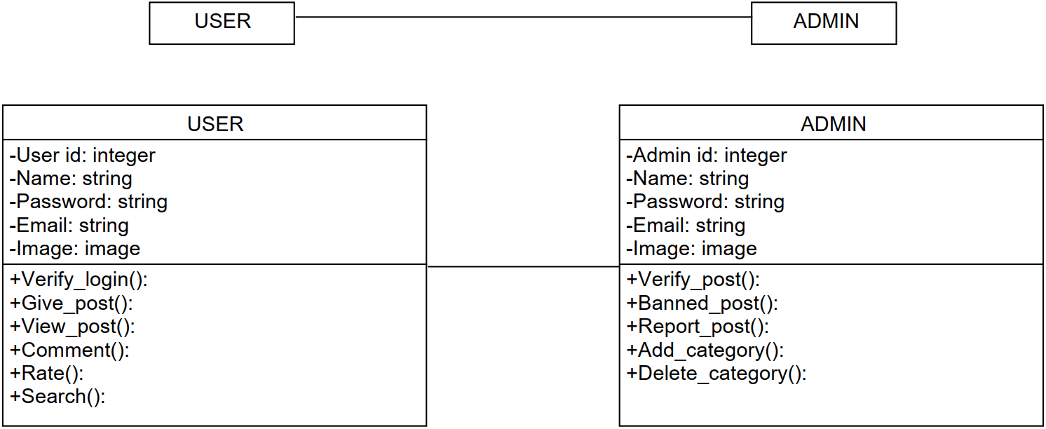
UML Class Diagram:

Slide 7

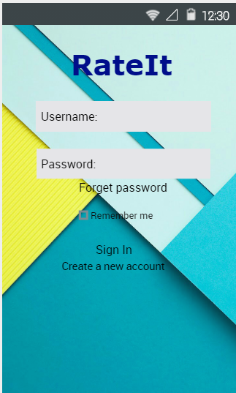
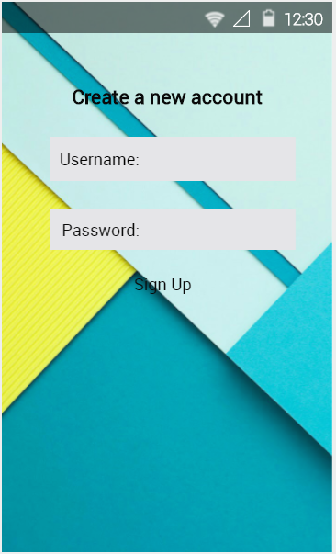
RateIt Mock Design:

Slide 8
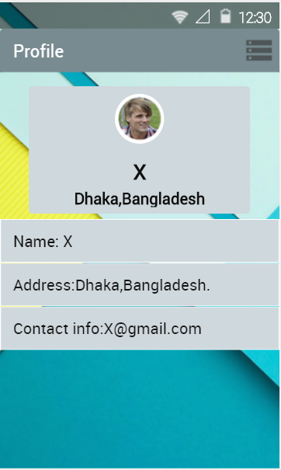
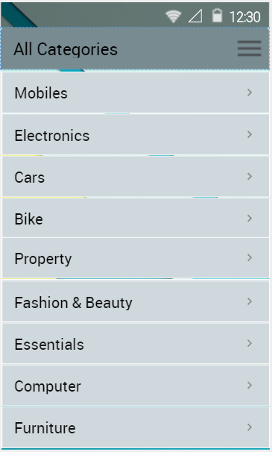
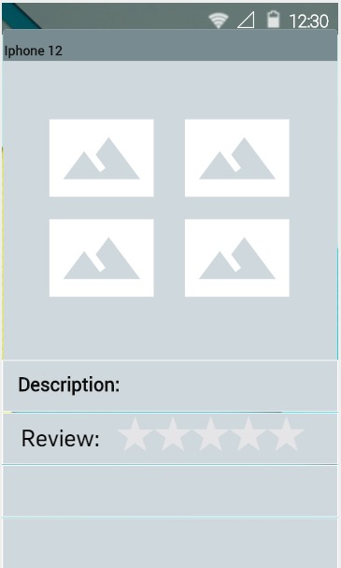
RateIt Mock Design:

Slide 9
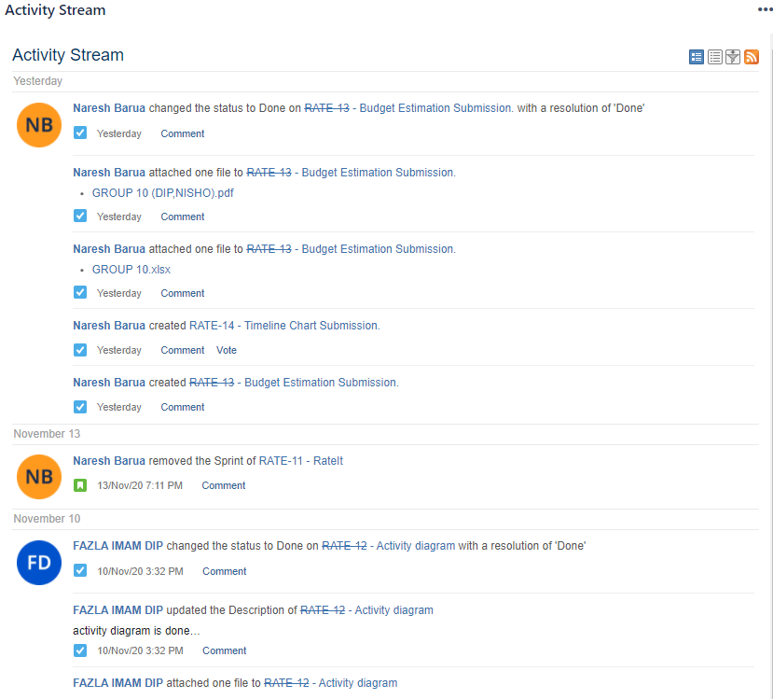
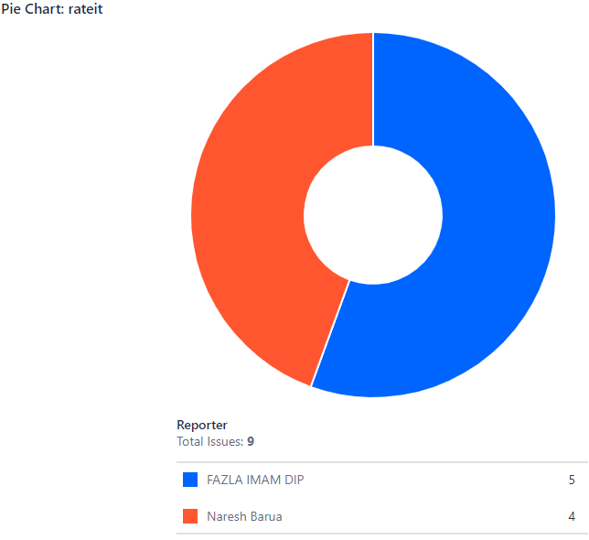
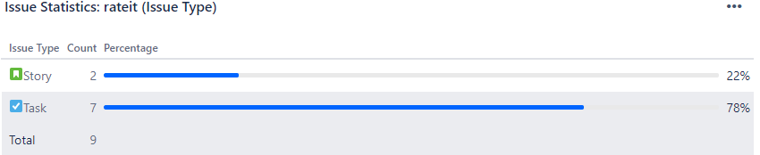
RateIt Jira:

Slide 10
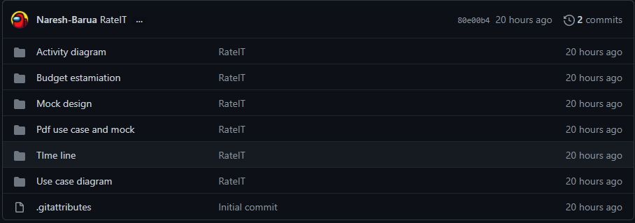
RateIt Git:
https://github.com/Naresh-Barua/Software-Engeneering-Project-

Slide 11
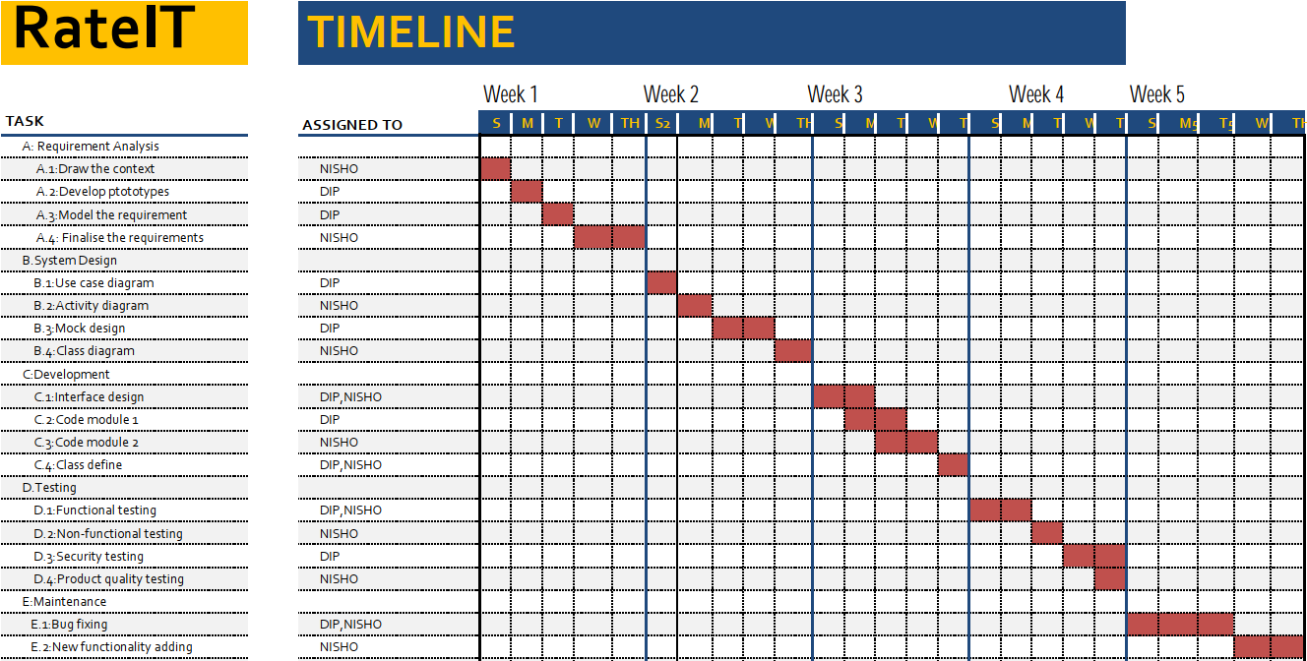
RateIt Timeline:

Slide 12
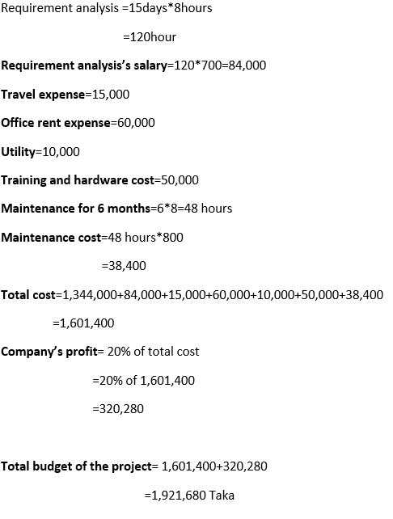
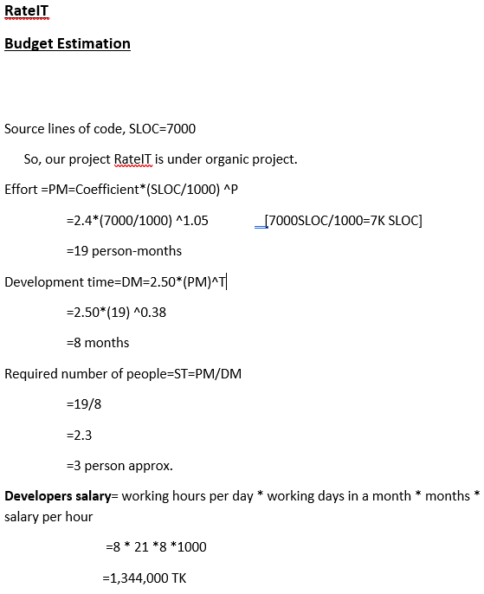
RateIt Budget Estimation

Slide 13
CONCLUSION
RateIT is a project by which people can have idea about the good products as well as the bad products. That will help them to enjoy good products and avoid bad products.

