Slide 1
Introduction to Web Technology
Course Code: CSC 3222
Course Title: WEB TECHNOLOGIES
Dept. of Computer Science
Faculty of Science and Technology
Lecturer No: | 1 | Week No: | 1 | Semester: | Summer 19-20
Lecturer: | Rashidul Hasan Nabil <rashidul@aiub.edu>

Slide 2
Lecture Outline
Course Objectives
Course Logistics
Grading policy
OBE evaluation
Classroom and Course Policies
Lab Work and Assignment
Required software and tools
Learning Objectives
Client/Server model
Three-tier Client Server Architecture
Peer to Peer (P2P)
Internet vs WWW
Uniform Resource Identifier (URI)
Browsers

Slide 3
Lecture Outline(contd.)
HTTP protocol
Process of http
http Steps
HTTP Request Methods
HTML
XML
XHTML
What is the DOM?
DHTML
Book
References

Slide 4
Course Objectives
In this course, we will learn about Web Technology and those branches: HTTP, HTML, CSS, JavaScript and PHP.
To understand, Client-Server based applications architecture.
Design and develop real life and society targeted Client-Server based Web applications.

Slide 5
Course Logistics
Grading policy
Marking Distribution (Midterm and Final term)
Quiz | 20%
Attendance | 10%
Assignment & performance | 10%
Lab Exam | 20%
Term Project | 40%
Total | 100%
Final Grade/ Grand Total
Midterm: | 40%
Final Term: | 60%
Grand Total | 100%

Slide 6
Course Logistics
OBE evaluation
Mid Term Project [Report]
CO1- Describe the increasing importance of web technologies on modern society and environment. [Project Proposal, Background Study, Requirement Analysis – 15 marks]
CO3- Design real life and society targeted Client-Server based Web applications.[Entity Relationship (ER) Diagram, System Images against the Specification – 10 marks ]
Final Term Project[Implementation]
CO2- Apply the fundamental web technologies to obtain business sustainability.[Completeness, Validation, Feature Implementation against the Specification – 15 marks]
CO4- Develop real life and society targeted Client-Server based Web applications.[Concept Understanding, Promptness– 10 marks ]

Slide 7
Course Logistics
Classroom and Course Policies
No make-up Quiz/Assignment will be taken.
At least 80% presence is required by the student to sit for examination. Absent classes must be defended through application and proper documentation to the department.
Student come after 10-15 minutes of due time is considered late.
3 late attendances are considered as one absent.
Late during quiz/presentation are not given additional time.

Slide 8
Course Logistics
Lab Work and Assignment
Every theory class will be followed by a lab class.
We will run and test lab work in every lab class.
There will be an assessment in every lab.
Every one should have github account(version control).
All assignments and project(lab tasks) push in the github repositories.
Please submit your github account in the first lab. [Google form Link]
Deploy your application on www.heroku.com if possible.

Slide 9
Course Logistics
Required software and tools
Text editor to write HTML, CSS, JavaScript, php code. E.g. Sublime Text, Note Pad ++,VS code, atoms, etc.
Modern browser and server need to test them out. E.g. – google chrome(browser), XAMP(apache server).

Slide 10
Learning Objectives
In this lecture , we will learn about Web Technology and few terminology : HTTP, HTML, XML and XHTML.
We will learn about how web technology can help in the Business World as well.

Slide 11
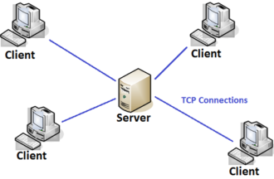
Client/Server model
Client Server Architecture is a computing model in which the server hosts, delivers and manages most of the resources and services to be consumed by the client. This type of architecture has one or more client computers connected to a central server over a network or internet connection. This system shares computing resources.
Client/server architecture is also known as a networking computing model or client/server network because all the requests and services are delivered over a network.

Slide 12
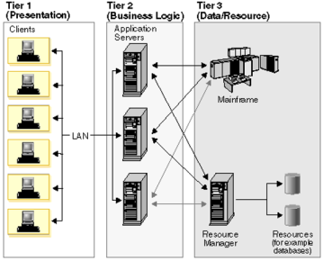
Three-tier Client Server Architecture
The traditional client/server architecture involves two levels, a client level and a server level. Another common design of client/server systems uses three tiers:
A client that interacts with the user
An application server that contains the business logic of the application
A resource manager that stores data.

Slide 13
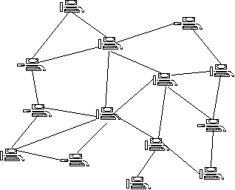
Peer to Peer (P2P)
Distributed application architecture that partitions tasks or work loads between peers.
Peers are equally privileged, equipotent participants in the application.
They are said to form a peer-to-peer network of nodes.

Slide 14
Internet and World Wide Web
Global system of interconnected computer networks .
Use the standard Internet Protocol Suite (TCP/IP).
Serve billions of users worldwide.
Network of networks that consists of millions of private, public, academic, business, and government networks.
Carries a vast range of information resources and services, such as the inter-linked hypertext documents of the World Wide Web and the infrastructure to support electronic mail.
World Wide Web commonly known as the Web(Abbreviated as WWW).
A system of interlinked hypertext documents accessed via the Internet. With a web browser, any one can view web pages that may contain text, images, videos, and other multimedia and navigate between them via hyperlinks.

Slide 15
Internet vs WWW
Internet is global system of interconnected computer networks. In short, the Web is an application running on the Internet.
WWW is one of the services that runs on the Internet. It is a collection of interconnected documents and other resources, linked by hyperlinks and URLs. An application running on the Internet.

Slide 16
WWW function
Viewing a web page on the World Wide Web normally begins
typing the URL of the page into a web browser,
following a hyperlink to that page or resource.
The web browser then initiates a series of communication messages, behind the scenes, in order to fetch and display it.
First, the server-name portion of the URL is resolved into an IP address using the global, distributed Internet database known as the Domain Name System (DNS).
The browser then requests the resource by sending an HTTP request to the Web server at that particular address.
While receiving these files from the web server, browsers may progressively render the page onto the screen as specified by its HTML, Cascading Style Sheets (CSS), or other page composition languages.

Slide 17
WWW standards
Many of the documents are the work of the World Wide Web Consortium (W3C).
Some of the documents are produced by the Internet Engineering Task Force (IETF) and other organizations.
markup languages, especially HTML and XHTML, from the W3C
define the structure and interpretation of hypertext documents
ECMAScript (usually in the form of JavaScript), from Ecma International.
Document Object Model, from W3C.
Uniform Resource Identifier (URI)- a universal system for referencing resources on the Internet, such as hypertext documents and images.
HyperText Transfer Protocol (HTTP)- how the browser and server authenticate each other.

Slide 18
Uniform Resource Identifier (URI)
String of characters used to identify a name or a resource on the Internet.
enables interaction with representations of the resource over a network (typically the World Wide Web) using specific protocols.
Schemes specifying a concrete syntax and associated protocols define each URI.
defined as consisting of four parts, as follows
<scheme name> : <hierarchical part> [ ? <query> ] [ # <fragment> ]
The scheme name consists of a letter followed by any combination of letters
The hierarchical part of the URI is intended to hold identification information hierarchical in nature.
Usually this part begins with a double forward slash ("//"), followed by an authority part and an optional path.

Slide 19
Uniform Resource Identifier (Contd.)
The path part is a sequence of segments separated by a forward slash ("/").
conceptually similar to directories.
Each segment can contain parameters separated from it using a semicolon (";"), though this is rarely used in practice.
The query is an optional part separated with a question mark
which contains additional identification information which is not hierarchical in nature.
commonly organized as a sequence of <key>=<value> pairs separated by a semicolon or by an ampersand
e.g. Semicolon: key1=value1;key2=value2;key3=value3 Ampersand: key1=value1&key2=value2&key3=value3
The fragment is an optional part separated from the front parts by a hash ("#").
holds additional identifying information that provides direction to a secondary resource
e.g. a section heading in an article identified by the remainder of the URI.

Slide 20
Uniform Resource Identifier (Example)
http://en.wikipedia.org/wiki/URI?page=2&frame=1#Examples _of_URI_references
"http" specifies the 'scheme' name
"en.wikipedia.org" is the 'authority‘
"/wiki/URI" the 'path' pointing to this article
“page=2&frame=1” is the query
"#Examples _of_URI_references " is a 'fragment' pointing to this section

Slide 21
Browsers
A web browser or Internet browser is a software application for retrieving, presenting, and traversing information resources on the World Wide Web. An information resource is identified by a Uniform Resource Identifier (URI) and may be a web page, image, video, or other piece of content.
e.g. Internet Explorer, Netscape, Mozilla Firefox, Opera, Google Chrome, Apple Safari

Slide 22
HTTP protocol
HTTP stands for Hyper Text Transfer Protocol
Communication between client and web servers is done by sending http Requests and receiving http Responses.
http is Connectionless: The http client initiates an http request and after a request, the client waits for the response. The server processes the request and sends back response to the client. So client and server knows about each other only during current request and response.
http is stateless: The server and client are aware of each other only during a current request. Afterwards, both of them forget about each other.

Slide 23
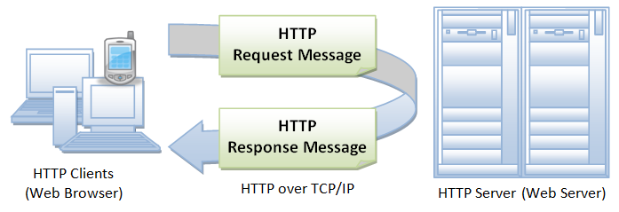
HTTP protocol
Process of http
An HTTP client sends a request message to an HTTP server. The server, in turn, returns a response message

Slide 24
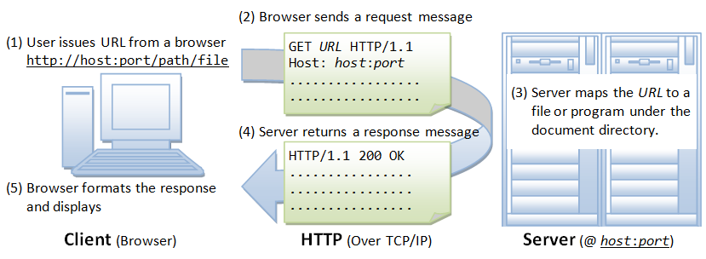
HTTP protocol
http Steps
Whenever you issue a URL from your browser to get a web resource using HTTP, e.g. http://www.abc.com/index.html, the browser turns the URL into a request message and sends it to the HTTP server.

Slide 25
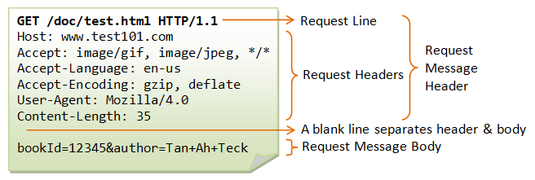
HTTP protocol
http Steps(continue)
The HTTP server interprets the request message, and returns you an appropriate response message, which is either the resource you requested or an error message.
A URL (Uniform Resource Locator) is used to uniquely identify a resource over the web. URL has the following syntax: protocol://hostname:port/path-and-file-name
As mentioned, whenever you enter a URL in the address box of the browser, the browser translates the URL into a request message according to the specified protocol; and sends the request message to the server.

Slide 26
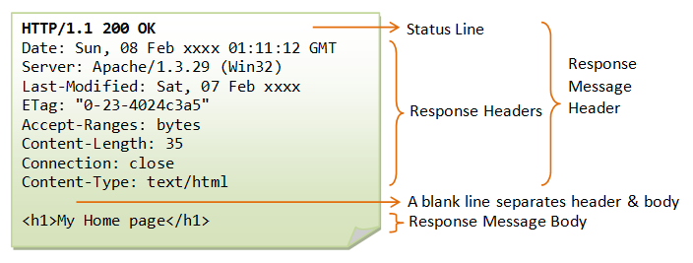
HTTP protocol
http Steps(continue)
The server interprets the request received, maps the request into a file under the server’s document directory, and returns the file requested to the client. Or
The server interprets the request received, maps the request into a program kept in the server, executes the program, and returns the output of the program to the client. If the request not be satisfied, server returns an error message.
Common status code ”200 OK”, ”404 Not Found”, ”403 Forbidden”, ”500 Internal Server Error

Slide 27
HTTP protocol
HTTP Request Methods
GET: A client can use the GET request to get a web resource from the server.
POST: Used to post data up to the web server. HTML form uses POST request.
PUT: Ask the server to store the data.
DELETE: Ask the server to delete the data.

Slide 28
What is HTML?
HTML stands for Hyper Text Markup Language
HTML describes the structure of a Web page
HTML consists of a series of elements
HTML elements tell the browser how to display the content
HTML elements are represented by tags
HTML tags label pieces of content such as ”heading”, ”paragraph”, ”table”, and so on
Browsers do not display the HTML tags, but use them to render the content of the page

Slide 29
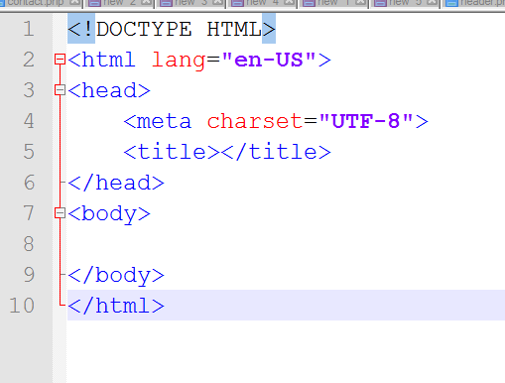
HTML Tags and Example
HTML tags are element names surrounded by angle brackets:
<tagname>content goes here...</tagname>

Slide 30
HTML Documents = Web Pages
HTML documents describe web pages
HTML documents contain HTML tags and plain text
HTML documents are also called web pages
e.g.
<html> <body> <h1>My First Heading</h1> <p>My first paragraph.</p> </body> </html>

Slide 31
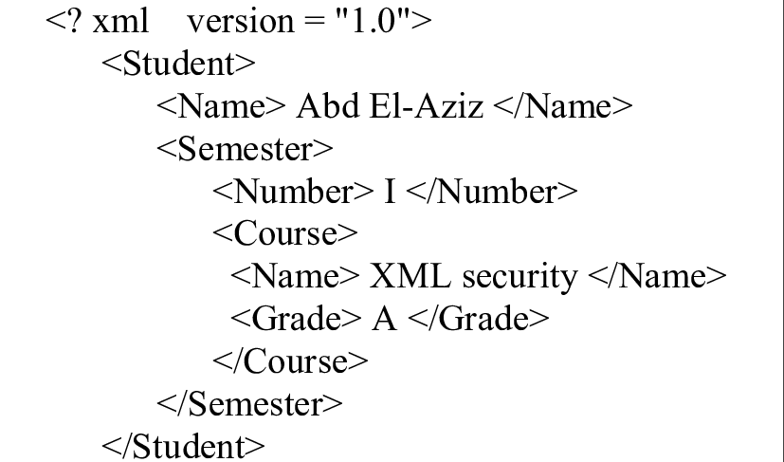
XML
XML stands for eXtensible Markup Language.
XML was designed to store and transport data.
XML was designed to be both human- and machine-readable.

Slide 32
What is XML?
XML was designed to carry data, not to display data
XML tags are not predefined. You must define your own tags
XML is designed to be self-descriptive
XML is a W3C Recommendation
Maybe it is a little hard to understand, but XML does not DO anything. XML was created to structure, store, and transport information.
XML is the most common tool for data transmissions between all sorts of applications.

Slide 33
XML Documents Form a Tree Structure
XML Documents Form a Tree Structure
XML documents must contain a root element. This element is "the parent" of all other elements.
The elements in an XML document form a document tree.
The tree starts at the root and branches to the lowest level of the tree.
All elements can have sub elements (child elements):

Slide 34
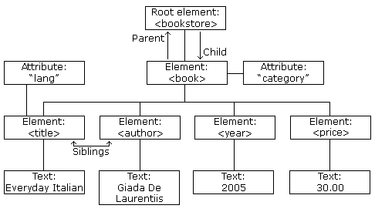
XML Tags and Example
An XML element is everything from (including) the element's start tag to (including) the element's end tag.
An element can contain: other elements, text, attributes or a mix of all of the above...

Slide 35
XML Naming Rules
XML elements must follow these naming rules:
Names can contain letters, numbers, and other characters
Names cannot start with a number or punctuation character
Names cannot start with the letters xml (or XML, or Xml, etc)
Names cannot contain spaces
Any name can be used, no words are reserved.
XML Syntax
All XML Elements Must Have a Closing Tag
XML Tags are Case Sensitive
XML Elements Must be Properly Nested
XML Documents Must Have a Root Element
XML Attribute Values Must be Quoted

Slide 36
XHTML
XHTML stands for EXtensible HyperText Markup Language
XHTML is almost identical to HTML
XHTML is stricter than HTML
XHTML elements must be properly nested
<b><i>bold and italic</b></i> is wrong
XHTML documents must be well-formed
<html>
<head> ... </head>
<body> ... </body>
</html>
Tag names must be in lowercase.
All XHTML elements must be closed.

Slide 37
XHTML - Why?
XHTML is a combination of HTML and XML (EXtensible Markup Language).
XHTML consists of all the elements in HTML 4.01, combined with the strict syntax of XML.
The following HTML code will work just fine if you view it in a browser (even if it does NOT follow the HTML rules):
<html> <head> <title>This is bad HTML</title> <body> <h1>Bad HTML <p>This is a paragraph </body>

Slide 38
XHTML - Why? (contd.)
XML is a markup language where everything must be marked up correctly, which results in "well-formed" documents.
Today's market consists of different browser technologies, some browsers run on computers, and some browsers run on mobile phones or other small devices. The last-mentioned do not have the resources or power to interpret a "bad" markup language.
Combining the strengths of HTML and XML, W3C recommended a markup language i.e XHTML.

Slide 39
HTML vs XHTML
XHTML elements must be properly nested
XHTML elements must always be closed
XHTML elements must be in lowercase
XHTML documents must have one root element

Slide 40
What is the DOM?
a standard for accessing documents like XML and HTML
"The W3C Document Object Model (DOM) is a platform and language-neutral interface that allows programs and scripts to dynamically access and update the content, structure, and style of a document."
The DOM is separated into 3 different parts / levels:
Core DOM - standard model for any structured document
XML DOM - standard model for XML documents
HTML DOM - standard model for HTML documents
The DOM defines the objects and properties of all document elements, and the methods (interface) to access them.

Slide 41
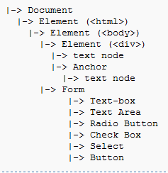
DOM application and Example
When an HTML page is rendered in a browser, the browser parses the markup (e.g. HTML), downloaded from the web-server into an in-memory DOM.
The DOM is used to construct additional internal structures used to display the page in the browser window.
The nodes of every document are organized in a tree structure, called the DOM tree.
The topmost node in the DOM tree is the Document object. Each node has zero or more children.

Slide 42
DHTML
DHTML stands for Dynamic HTML, it is totally different from HTML.
The DHTML is based on the properties of the HTML, JavaScript, CSS, and DOM (Document Object Model which is used to access individual elements of a document) which helps in making dynamic content.
The DHTML make use of Dynamic object model to make changes in settings and also in properties and methods.

Slide 43
DHTML Example(Changing HTML Content)
The HTML document above contains an <h1> element with id="id01"
We use the HTML DOM to get the element with id="id01"
A JavaScript changes the content (innerHTML) of that element to "New Heading"
<!DOCTYPE html> <html> <body> <h1 id="id01">Old Heading</h1> <script> var element = document.getElementById("id01"); element.innerHTML = "New Heading"; </script> </body> </html>

Slide 44
DHTML Example(Changing HTML Style)
The following example changes the style of a <p> element:
<html> <body> <p id="p2">Hello World!</p> <script> document.getElementById("p2").style.color = "blue"; </script> <p>The paragraph above was changed by a script.</p> </body> </html>

Slide 45
Books
W3Schools Online Web Tutorials; URL: http://www.w3schools.com
PHP Documentation; URL: http://www.php.net/docs.php
Sams Teach Yourself Ajax JavaScript and PHP All in One; Phil Ballard and Michael Moncur; Sams Publishing; 2010
JavaScript Phrasebook; Christian Wenz; Sams Publishing; 2007
PHP and MySQL Web Development, 4/E; Luke Welling and Laura Thomson; Addison-Wesley Professional; 2009
JavaScript for Programmers Paul J. Deitel and Harvey M. Deitel; Prentice Hall; 2009
Beginning PHP5, Apache, and MySQL Web Development; Elizabeth Naramore, Jason Gerner, Yann Le Scouarnec, Jeremy Stolz and Michael K. Glass; Wiley Publishing; 2005
XML in a Nutshell, 3/E; Elliotte Rusty Harold and W. Scott Means; O'Reilly Media; 2004

Slide 46
References
https://www.ntu.edu.sg/home/ehchua/programming/webprogramming/HTTP_Basics.html
https://developer.mozilla.org/enUS/docs/Web/HTTP/Status
https://www.w3schools.com/html/html_intro.asp
https://www.w3schools.com/html/html_xhtml.asp

