Slide 1
PHP Form Validation
Course Code: CSC 3222
Course Title: WEB TECHNOLOGIES
Dept. of Computer Science
Faculty of Science and Technology
Lecturer No: | 3 | Week No: | 3 | Semester: | Summer 19-20
Lecturer: | Rashidul Hasan Nabil <rashidul@aiub.edu>

Slide 2
Lecture Outline
Learning Objectives
PHP Form Handling
PHP Form Validation
Books and References

Slide 3
Learning Objectives
In this lecture , we will learn more details about HTML form elements i.e. different type of form, designing different type of HTML form.
We will also learn HTTP GET and POST.
Handling form data using $_GET or $_POST methods and validations form data using PHP.

Slide 4
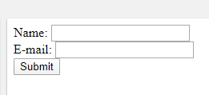
PHP Form Handling
The PHP superglobals $_GET and $_POST are used to collect form-data.
The example displays a simple HTML form with two input fields and a submit button using “get” and “post”
And See the difference.
<html> <body> <form action="welcome.php" method="post"> Name: <input type="text" name="name"><br> E-mail: <input type="text" name="email"><br> <input type="submit"> </form> </body> </html>

Slide 5
PHP Form Handling
HTTP GET
The same result could also be achieved using the HTTP GET/POST method:
Welcome_get.php file
<html> <body> Welcome <?php echo $_GET["name"]; ?><br> Your email address is: <?php echo $_GET["email"]; ?> </body> </html>

Slide 6
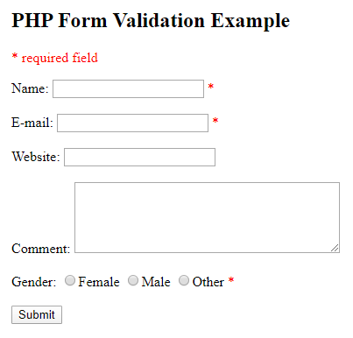
PHP Form Validation
Proper validation of form data is important to protect your form from hackers and spammers!
Lets consider the example.

Slide 7
PHP Form Validation
The validation rules for the form above are as follows:
Field | Validation Rules
Name | Required. + Must only contain letters and whitespace
E-mail | Required. + Must contain a valid email address (with @ and .)
Website | Optional. If present, it must contain a valid URL
Comment | Optional. Multi-line input field (textarea)
Gender | Required. Must select one
$_SERVER["PHP_SELF"] is a super global variable that returns the filename of the currently executing script and sends the submitted form data to the page itself, instead of jumping to a different page.
<form method="post" action="<?php echo htmlspecialchars($_SERVER["PHP_SELF"]);?>">

Slide 8
PHP Form Validation
When your validation is passed, the hold the data in object.
Now write a class for student using name, email, etc. attributes(See the form).
Use this student object to hold the student data.

Slide 9
Books
W3Schools Online Web Tutorials; URL: http://www.w3schools.com
PHP Documentation; URL: http://www.php.net/docs.php
Sams Teach Yourself Ajax JavaScript and PHP All in One; Phil Ballard and Michael Moncur; Sams Publishing; 2010
JavaScript Phrasebook; Christian Wenz; Sams Publishing; 2007
PHP and MySQL Web Development, 4/E; Luke Welling and Laura Thomson; Addison-Wesley Professional; 2009
JavaScript for Programmers Paul J. Deitel and Harvey M. Deitel; Prentice Hall; 2009
Beginning PHP5, Apache, and MySQL Web Development; Elizabeth Naramore, Jason Gerner, Yann Le Scouarnec, Jeremy Stolz and Michael K. Glass; Wiley Publishing; 2005
XML in a Nutshell, 3/E; Elliotte Rusty Harold and W. Scott Means; O'Reilly Media; 2004

Slide 10
References
https://www.w3schools.com/php/php_forms.asp

