Slide 1
PHP Session and Cookie
Course Code: CSC 3222
Course Title: WEB TECHNOLOGIES
Dept. of Computer Science
Faculty of Science and Technology
Lecturer No: | 5 | Week No: | 5 | Semester: | Summer 19-20
Lecturer: | Rashidul Hasan Nabil <rashidul@aiub.edu>

Slide 2
Lecture Outline
Learning outcome
What is a Cookie?
Example of cookie
Delete a Cookie
PHP Session
Example of session
Uses of session
Books and References

Slide 3
Learning outcome
In this lecture, we will learn temporary storage like Session & Cookie and their usage using PHP.

Slide 4
What is a Cookie?
A cookie is often used to identify a user. A cookie is a small file that the server embeds on the user's computer.
Each time the same computer requests a page with a browser, it will send the cookie too.
With PHP, you can both create and retrieve cookie values.
setcookie(name, value, expire, path, domain, secure, httponly);
Note: The setcookie() function must appear BEFORE the <html> tag.

Slide 5
Example of Cookie
<?php $cookie_name = "user"; $cookie_value = "Alex Porter"; setcookie($cookie_name, $cookie_value, time() + (86400 * 30), "/"); ?> <html> <body> <?php if(!isset($_COOKIE[$cookie_name])) { echo "Cookie named '" . $cookie_name . "' is not set!"; } else { echo "Cookie '" . $cookie_name . "' is set!<br>"; echo "Value is: " . $_COOKIE[$cookie_name]; } ?> </body> </html>

Slide 6
Delete a Cookie
<?php // set the expiration date to one hour ago setcookie("user", "", time() - 3600); ?>
Check if Cookies are Enabled
<?php if(count($_COOKIE) > 0) { echo "Cookies are enabled."; } else { echo "Cookies are disabled."; } ?>

Slide 7
PHP Session
A session is a way to store information (in variables) to be used across multiple pages.
Unlike a cookie, the information is not stored on the users computer.
Session variables hold information about one single user, and are available to all pages in one application.
A session is started with the session_start() function.
Session variables are set with the PHP global variable: $_SESSION.
The session_start() function must be the very first thing in your document. Before any HTML tags.

Slide 8
Example of session
<?php session_start(); ?> <!DOCTYPE html> <html> <body> <?php // to change a session variable, just overwrite it $_SESSION["favcolor"] = "yellow"; print_r($_SESSION); ?> </body> </html>
To remove or destroy session.
<?php // remove all session variables session_unset(); ?>

Slide 9
Uses of session
PHP Login Form with Sessions
Creating a multi-page registration form using PHP and session.
Creating a multi-page order form using PHP and Sessions.
More details, we will see in the lab class.

Slide 10
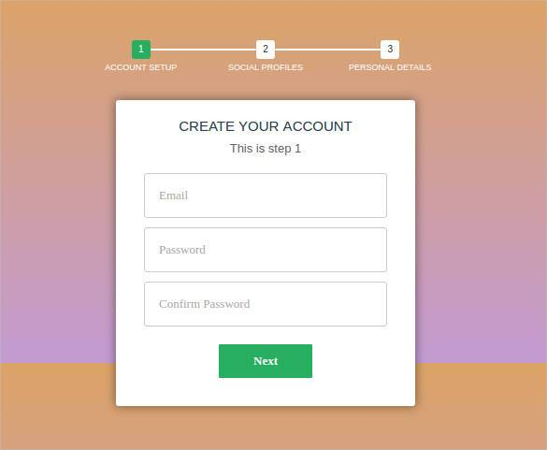
Uses of session

Slide 11
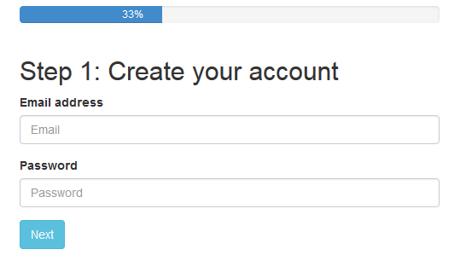
Uses of session

Slide 12
Books
W3Schools Online Web Tutorials; URL: http://www.w3schools.com
PHP Documentation; URL: http://www.php.net/docs.php
Sams Teach Yourself Ajax JavaScript and PHP All in One; Phil Ballard and Michael Moncur; Sams Publishing; 2010
JavaScript Phrasebook; Christian Wenz; Sams Publishing; 2007
PHP and MySQL Web Development, 4/E; Luke Welling and Laura Thomson; Addison-Wesley Professional; 2009
JavaScript for Programmers Paul J. Deitel and Harvey M. Deitel; Prentice Hall; 2009
Beginning PHP5, Apache, and MySQL Web Development; Elizabeth Naramore, Jason Gerner, Yann Le Scouarnec, Jeremy Stolz and Michael K. Glass; Wiley Publishing; 2005
XML in a Nutshell, 3/E; Elliotte Rusty Harold and W. Scott Means; O'Reilly Media; 2004

Slide 13
References
https://www.codeofaninja.com/2013/03/php-login-script.html
https://html.form.guide/php-form/php-order-form.html
https://www.tutorialspoint.com/php/php_login_example.htm
https://codewithawa.com/posts/admin-and-user-login-in-php-and-mysql-database

