Slide 1
“Hello World” in Java !!!
Notes:
Let us get started with Programming in Java

Slide 2
Keywords, Access Specifier etc.
Java Programming has keywords. They have specific meaning and specific purpose.
Java Programming has specific rules and syntax.
Java Programming is case sensitive.

Slide 3
Main Method in Java
Notes:
* We have already executed a simple program and displayed "

Slide 4
Class
A class is Blueprint / Template
It is created with the help of Keyword “class”
Notes:
We will cover this topic in more details in OOPs section, but for now, it is enough to know that class is creates using a keyword class
Let us see an example

Slide 5
Main Method
Method is a collection of statements (one or more statements)
Main is special method that is the starting point of program exection

Slide 6
Data Types in Java
Notes:
Let us look at what is Data Types in Java
Before we get into data types, let us understand what is data

Slide 7

What is Data
Song that you listen
Movie / Video that you watch
Program that you write
In the world of Programming everything is Data – 0’s and 1’s

Slide 8
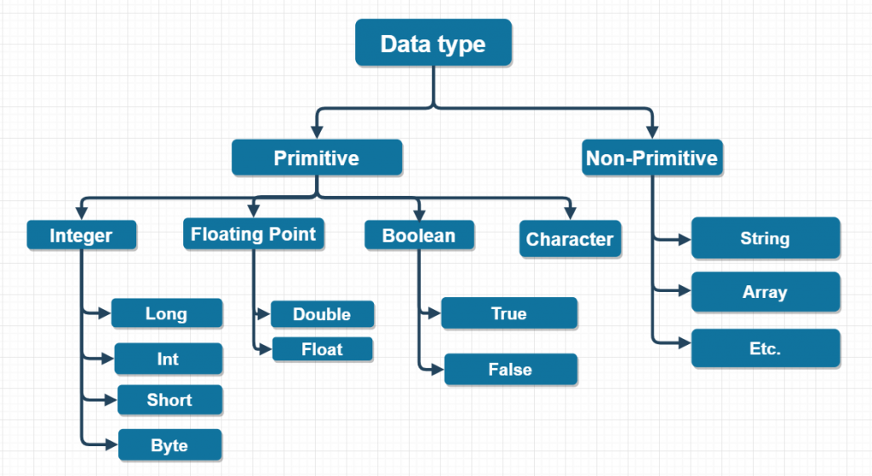
Primitive and Non-Primitive
Notes:
Primitive or Basic form of data
Non – Primitive is Complex data, which is not primitive.

