Slide 2
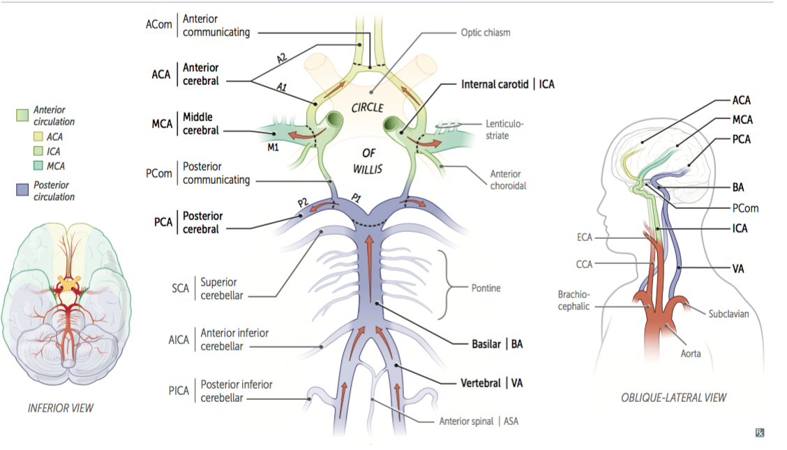
CEREBRAL VASCULAR TERRITORIES
CIRCLE OF WILLIS ( COW)

Slide 3
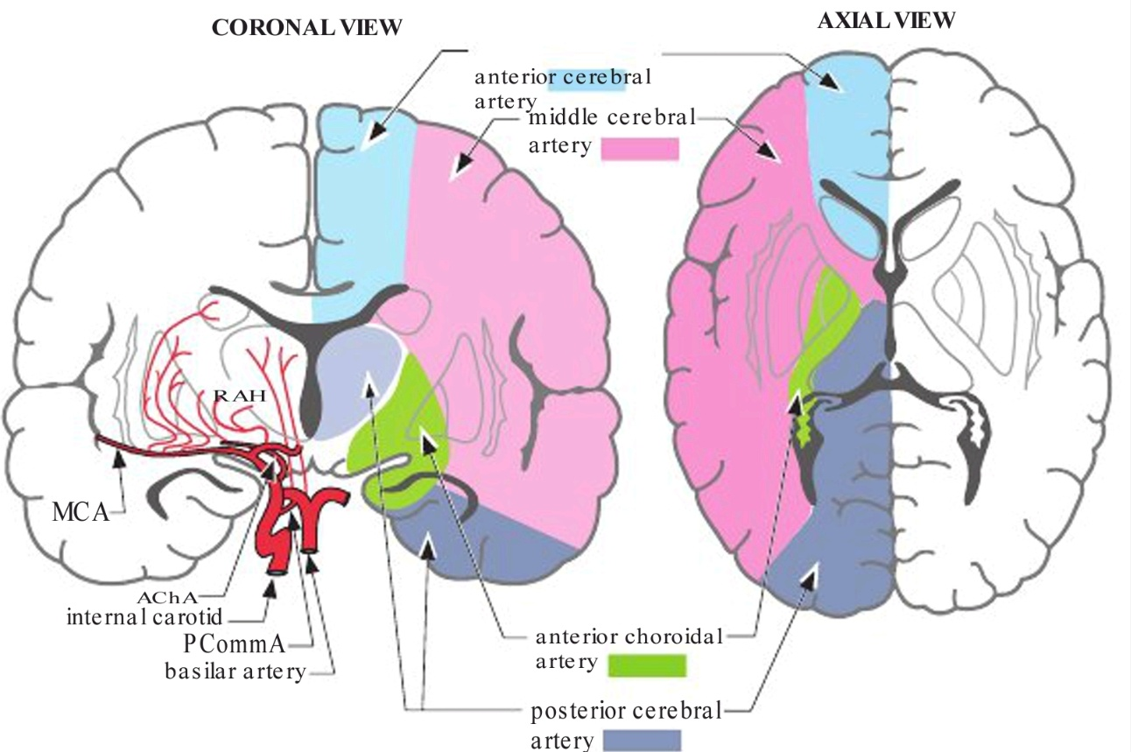
Vascular territories of the cerebral hemisphere

Slide 4
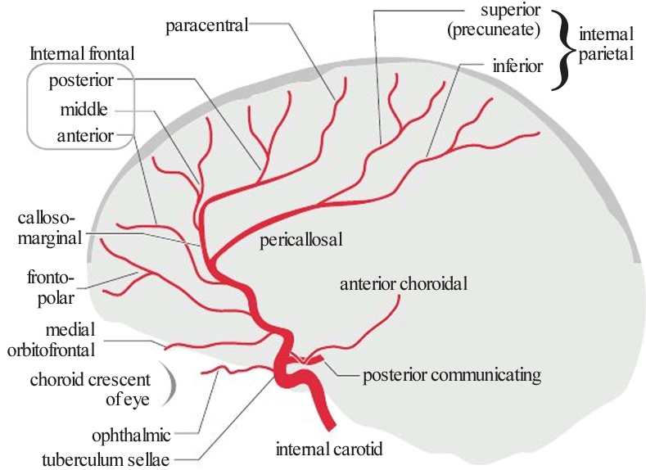
ANTERIOR CIRCULATION
1. Anterior Cerebral Artery ( with its branches)
Recurrent artery of Heubner: typically arises from the area of A1/A2 junction
Medial orbitofrontal artery
Frontopolar artery
Callosomarginal
Internal frontal branches
Anterior
Middle
Posterior
Paracentral artery
Pericallosal artery (continuation of ACA)
Superior internal parietal (precuneate) artery
Inferior internal parietal artery

Slide 5
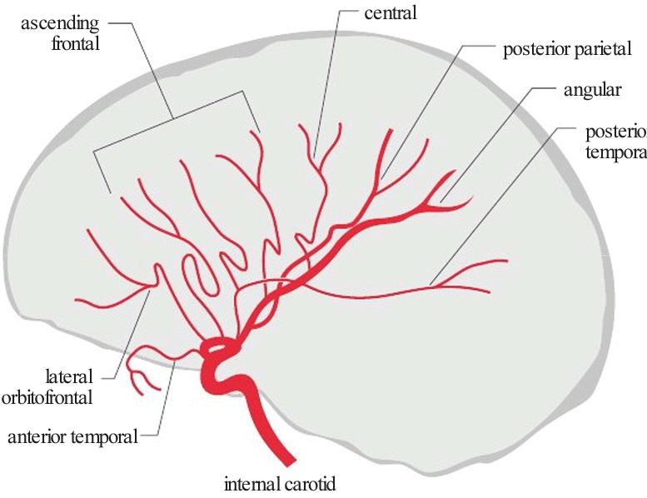
2. Middle Cerebral Artery (with its branches)
Medial and lateral lenticulosriate arteris
Anterior temporal artery
Posterior temporal artery
Lateral orbitofrontal
Ascending frontal ( candelabra)
Precentral ( Prerolandic)
Central ( Rolandic)
Anterior parietal ( Postrolandic)
Posterior parietal
Angular

Slide 6
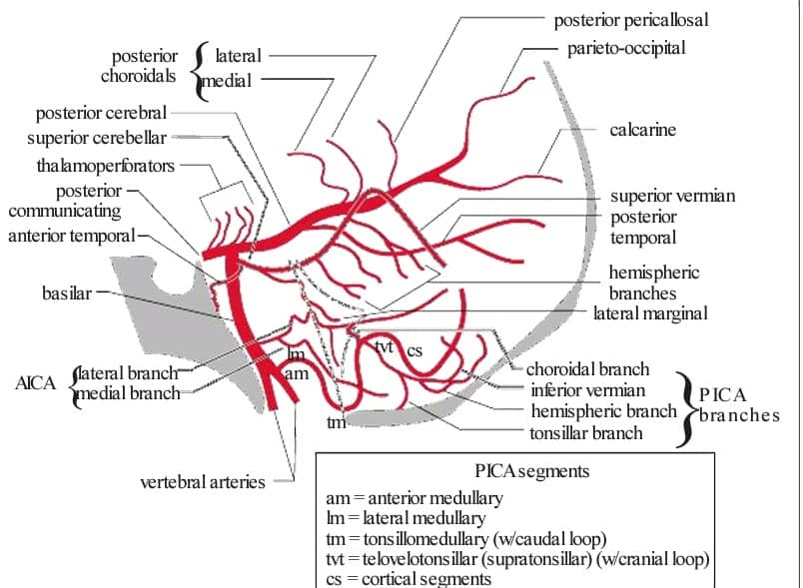
POSTERIOR CIRCULATION
Posterior Cerebral Artery (PCA)
Posterior communicating artery
Medial and lateral posterior choroidal arteries
Calcarine artery
Basilar Artery
Superior Cerebellar Artery (SCA)
Anterior Inferior Cerebellar Artery (AICA)
Posterior Inferior Cerebellar Artery (PICA)

