Slide 1

SECURE CHIT
DIGITAL CHIT FUND MANAGEMENT SYSTEM
Submitted in partial fulfilment of the requirements for the award of the degree of
Bachelor of Science in Computer Science
Submitted By:
R. NARESHKUMAR (24UCS08) | APR. JEGATHEESH VARSHAN (24UCS06)
Under the Guidance of:
Mrs. S. M. VALLI B.E., M.C.A., M.Phil
DEPARTMENT OF COMPUTER SCIENCE | THIAGARAJAR COLLEGE (AUTONOMOUS)
(Affiliated to Madurai Kamaraj University) | Re-accredited with 'A++' Grade by NAAC | Ranked 20th in NIRF 2026
Madurai – 625009 | October – 2026

Slide 2
SECURE CHIT FUND MANAGEMENT SYSTEM
BONAFIDE CERTIFICATE
Thiagarajar College (Autonomous) - Department of Computer Science
• Re-Accredited with 'A++' Grade by NAAC | Ranked 20th in NIRF 2025 | Madurai - 625009
•
• This is to certify that 'SECURE CHIT: DIGITAL CHIT FUND MANAGEMENT SYSTEM' is a bonafide project work done by R. NARESHKUMAR (24UCS08) and APR. JEGATHEESH VARSHAN (24UCS06) of B.Sc. Computer Science during the fifth semester.
•
• Submitted for the final viva voce examination held on _________________________.
•
• Project Guide: Mrs. S. M. Valli B.E., M.C.A., M.Phil
• Head of Department: Mrs. S. M. Valli B.E., M.C.A., M.Phil
• External Examiner: _________________________

Slide 3
SECURE CHIT FUND MANAGEMENT SYSTEM
CANDIDATE DECLARATIONS
Declaration 1: R. Nareshkumar
• Roll No: 24UCS08
• Degree: B.Sc. Computer Science
• Institution: Thiagarajar College (Autonomous), Madurai
•
• I hereby declare that the software product 'SECURE CHIT' has been done thoroughly at the outset of my knowledge and has not been drafted out to any other modes of information. This software has been purely done by me.
•
• Place: Madurai
• Date:
• Signature: R. Nareshkumar
Declaration 2: APR. Jegatheesh Varshan
• Roll No: 24UCS06
• Degree: B.Sc. Computer Science
• Institution: Thiagarajar College (Autonomous), Madurai
•
• I hereby declare that the software product 'SECURE CHIT' has been done thoroughly at the outset of my knowledge and has not been drafted out to any other modes of information. This software has been purely done by me.
•
• Place: Madurai
• Date:
• Signature: APR. Jegatheesh Varshan

Slide 4
SECURE CHIT FUND MANAGEMENT SYSTEM
ACKNOWLEDGEMENT
Expressing Our Gratitude
• We extend our sincere thanks to Almighty for giving us physical, mental strength and ability for the effective completion of this project.
•
• We express our deep gratitude to Principal Dr. D. PANDIARAJA M.Sc., M.Phil., P.G.D.C.A., B.Ed., Ph.D., Thiagarajar College, Madurai for his encouragement.
•
• We express our profound gratitude to Head of Department Mrs. S. M. VALLI B.E., M.C.A., M.Phil for her immense guidance and support.
•
• We extend our sincere thanks to Project Guide Mrs. S. M. VALLI B.E., M.C.A., M.Phil for entrusting us with this project and guiding us.
•
• We thank all faculty members of Computer Science department, our family members and friends for their continuous support.

Slide 5
SECURE CHIT FUND MANAGEMENT SYSTEM
TABLE OF CONTENTS
Index of Report Chapters (Sections 1, 2, 3, 4, 8, 9, 10)
• SECTION 1: INTRODUCTION (1.1 Abstract, 1.2 Project Description, 1.3 Scope)
• SECTION 2: SYSTEM ANALYSIS (2.1 Existing System, 2.2 Proposed System, 2.3 Feasibility)
• SECTION 3: SYSTEM CONFIGURATION (3.1 Hardware Specs, 3.2 Software Specs, 3.3 Technologies)
• SECTION 4: SYSTEM DESIGN (4.1 Architecture, 4.2 Data Flow Diagram DFD, 4.3 Database Schema, 4.4 Module Design)
• SECTION 8: CONCLUSION (Summary & Impact)
• SECTION 9: FUTURE ENHANCEMENTS (Mobile App, AI Analytics, Biometrics)
• SECTION 10: BIBLIOGRAPHY (Book & Website References)

Slide 6
SECTION 1: INTRODUCTION
1.1 ABSTRACT
Secure Chit Fund Management System
• Web-based financial management application designed to automate traditional chit fund operations with complete transparency and security.
• Features Razorpay payment gateway for online installment payments with instant printable Digital Receipts.
• AI-powered smart winner allocation engine that evaluates emergency priorities to select auction winners fairly.
• Role-Based Access Control (RBAC) web portals for Members and Administrators with full ledger auditability.
• HTML5 Canvas API integration for Promissory Note digital signatures and auto-generated legal document persistence.
• Automated multi-channel Fast2SMS and Nodemailer SMTP notification gateway for due alerts.

Slide 7
SECTION 1: INTRODUCTION
1.2 PROJECT DESCRIPTION & OBJECTIVES
Project Overview
• Centralized digital platform managing member profiles, chit schemes, auction bidding, and installment collections.
• Automates monthly draw execution, bid discount calculation, and equal dividend distribution among active members.
• Integrated communication engine sending SMS and Email alerts for payment due dates and winning notifications.
• Secure database engine enforcing data privacy, non-repudiation, and financial consistency.
Core Objectives
• 1. Eliminate Manual Paperwork: Digitally manage chit groups, member ledgers, and auction records.
• 2. Ensure 100% Financial Transparency: Members can independently verify pool amounts, bid discounts, and dividend payouts.
• 3. Automate Auction Bidding: Provide transparent live bidding with automated winning calculation.
• 4. Streamline Payment Tracking: Automated installment receipts, online verification, and automated due reminders.

Slide 8
SECTION 1: INTRODUCTION
1.3 SYSTEM SCOPE & STAKEHOLDERS
System Scope
• Applies to financial institutions, private chit companies, and community savings groups.
• Handles multi-scheme management (e.g. Rs 50,000 / 10 months, Rs 1,00,000 / 20 months).
• Covers member registration, KYC data, auction management, dividend calculation, and payment status updates.
• Scalable architecture adaptable for expanding subscriber capacity and cloud deployment.
Stakeholders
• Admin / Chit Foreman:
- Creates chit schemes, approves member registrations, supervises monthly auctions, verifies installment payments.
• Members / Subscribers:
- Explores active chit plans, submits auction bids, views dividend statements, receives automated reminders.
• System Communication Engine:
- Dispatches automated SMS via Fast2SMS API and Email notifications via SMTP/Nodemailer.

Slide 9
SECTION 2: SYSTEM ANALYSIS
2.1 EXISTING SYSTEM ANALYSIS
Drawbacks of Traditional Manual Chit Fund Management
• 1. Manual Ledger Maintenance: High dependency on paper logbooks leading to data loss, physical damage, and ledger discrepancy.
• 2. Lack of Transparency: Members cannot verify dividend calculations or exact bidding history, creating trust deficits.
• 3. Delayed Reminders & Default Risk: Manual notification via phone calls is slow, causing missed monthly installment payments.
• 4. High Operational Overhead: Manual collection, physical passbook entries, and manual calculation of interest/discounts.
• 5. Vulnerability to Fraud: Physical records can be altered without audit trails or history tracking.
• 6. Geographical Limitation: Members must physically attend auctions and manually hand over payment cash.

Slide 10
SECTION 2: SYSTEM ANALYSIS
2.2 PROPOSED SYSTEM ADVANTAGES
Advantages of SecureChit Digital Solution
• 1. Centralized Cloud Database: Secure storage of member details, chit scheme parameters, and transaction histories in structured DB.
• 2. Automated Auction & Dividend Engine: Instant, accurate computation of minimum bid, discount, foreman commission, and dividend share.
• 3. Multi-Channel Communication: Automated SMS alerts to mobile numbers and email notifications for due dates and auction announcements.
• 4. Real-time Member Dashboards: 24/7 access for subscribers to view active dues, payment logs, upcoming auctions, and overall savings.
• 5. Tamper-evident Auditability: Every bid entry, payment approval, and scheme status update is logged with exact timestamps.
• 6. Reduced Administrative Cost: Minimizes manual paperwork, eliminates physical passbooks, and accelerates monthly processing time.

Slide 11
SECTION 2: SYSTEM ANALYSIS
2.3 FEASIBILITY STUDY
Technical Feasibility
• Evaluates system hardware & software stack.
• Uses standard React.js, Node.js/Python FastAPI, SQLite/MongoDB.
• Low hardware demands, works on standard modern browsers.
• Highly feasible.
Operational Feasibility
• Assesses ease of adoption by users.
• Clean, intuitive web user interface designed for non-technical users.
• Automated alerts guide members effortlessly.
• Highly feasible.
Economic Feasibility
• Analyzes cost vs return.
• Built using open-source technologies (React, Node, SQLite/MongoDB).
• Zero licensing fees, drastically cuts paper & admin costs.
• Highly cost-effective.

Slide 12
SECTION 3: SYSTEM CONFIGURATION
3.1 & 3.2 HARDWARE & SOFTWARE SPECIFICATIONS
Hardware Specifications
• Server Machine:
- Processor: Intel Core i5 / AMD Ryzen 3 7320U (2.40 GHz+)
- RAM: 8 GB DDR4
- Storage: 256 GB NVMe SSD for fast DB I/O
- Network: High-speed Broadband Internet Connection
• Client Machine / Devices:
- Processor: Dual-Core 1.6 GHz or mobile processor
- RAM: 4 GB
- Display: 1024x768 resolution or smartphone screen
Software Specifications
• Operating System: Windows 11 64-bit / Linux Ubuntu 22.04 LTS
• Frontend Framework: React.js (v18+), Tailwind CSS
• Backend Environment: Node.js (v18+) / Python (v3.11+)
• Database Engine: SQLite3 / MongoDB
• Web Server: Vite Dev Server / Nginx
• Communication Services: Nodemailer (SMTP), Fast2SMS Bulk API
• Development Tools: Visual Studio Code, Git Version Control

Slide 13
SECTION 3: SYSTEM CONFIGURATION
3.3 TECHNOLOGY STACK OVERVIEW
Frontend: React.js & Tailwind
• Component-based UI architecture.
• Fast dynamic DOM rendering.
• Responsive styling using Tailwind CSS utility classes.
• Single Page Application (SPA) experience.
Backend: Node.js / FastAPI
• Asynchronous RESTful API framework.
• Handles user authentication & role verification.
• Manages complex auction discount calculations.
• Executes scheduled reminder cron jobs.
Database: SQLite / MongoDB
• Structured tables for Users, Schemes, Bids, Dues, Receipts.
• Acid compliance ensuring zero payment loss.
• Relational integrity and foreign key constraints.
• Fast query execution.

Slide 14
SECTION 4: SYSTEM DESIGN
4.1 SYSTEM ARCHITECTURE & WORKFLOW
3-Tier Modular System Architecture
• 1. Presentation Layer (React.js UI):
- Admin Portal: Scheme Builder, Member Manager, Auction Console, Payment Verification.
- Member Portal: Plan Explorer, Live Auction Bidder, Due Tracker, Digital Receipts.
• 2. Application & Logic Layer (Node.js API Services):
- Authentication Service: JWT / Password Hashing.
- Auction Calculation Service: Minimum Bid Limit, Foreman Fee (5%), Dividend Share.
- Payment Processor Service: Installment status updates, receipt generation.
- Messaging Service: Async Email dispatch & SMS gateway trigger.
• 3. Data Layer (Relational DB):
- Stores persistent data across Users, Chit Groups, Auction Rounds, Transactions, and Notifications.

Slide 15
SECTION 4: SYSTEM DESIGN
4.1.1 DATA FLOW DIAGRAM SYMBOLS
Standard Data Flow Diagram (DFD) Notations
• • Arrow (--->): Data Flow - Represents the path along which data moves between entities, processes, and stores.
• • Circle / Ellipse: Process - Represents data transformation logic (e.g. Compute Dividend, Verify Payment).
• • Rectangle: External Entity - Represents external agents interacting with the system (Admin, Subscriber, SMS Gateway).
• • Parallelogram: Input / Output - Represents data input or output operations.
• • Open Rectangle / Cylinder: Data Store - Represents repositories storing data (Users DB, Bids DB, Payments DB).

Slide 16
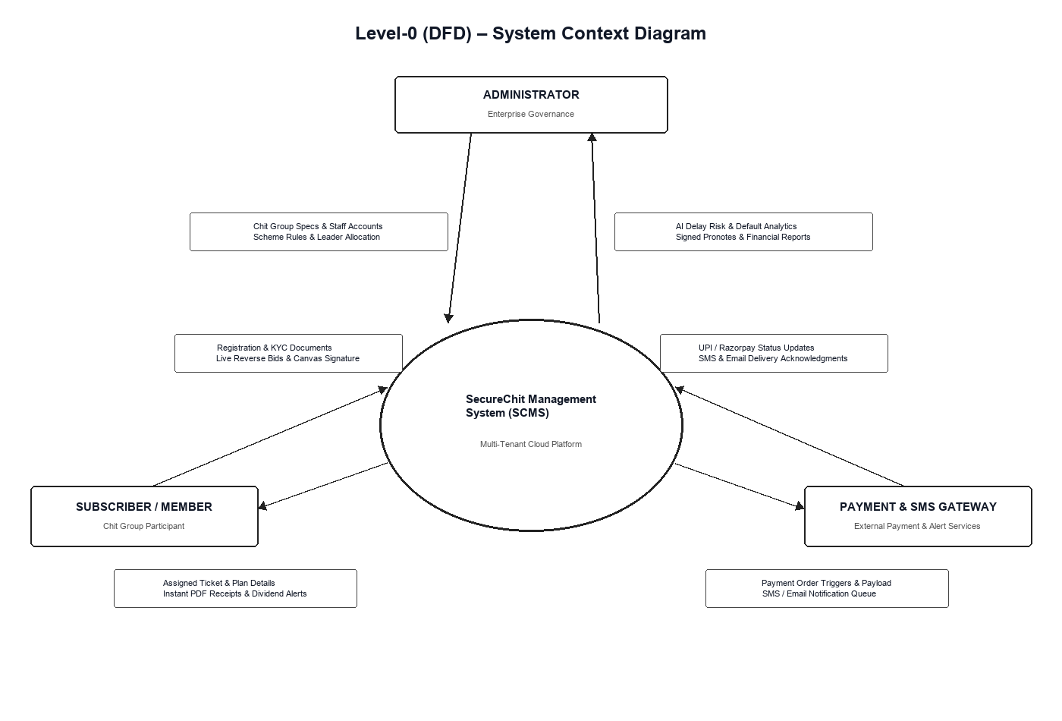
SECTION 4: SYSTEM DESIGN
4.2.1 GRAPHICAL DFD LEVEL 0 & LEVEL 1
DFD Level 0 (Context Diagram)
• Central Process: SecureChit System (0.0)
• External Entities:
- Admin: Inputs Chit Scheme specs, approves payments, triggers auction.
- Member: Submits registration, inputs auction bid, submits installment payment.
- PostgreSQL DB: Persistent data store for users, auctions, and pronotes.

Slide 17
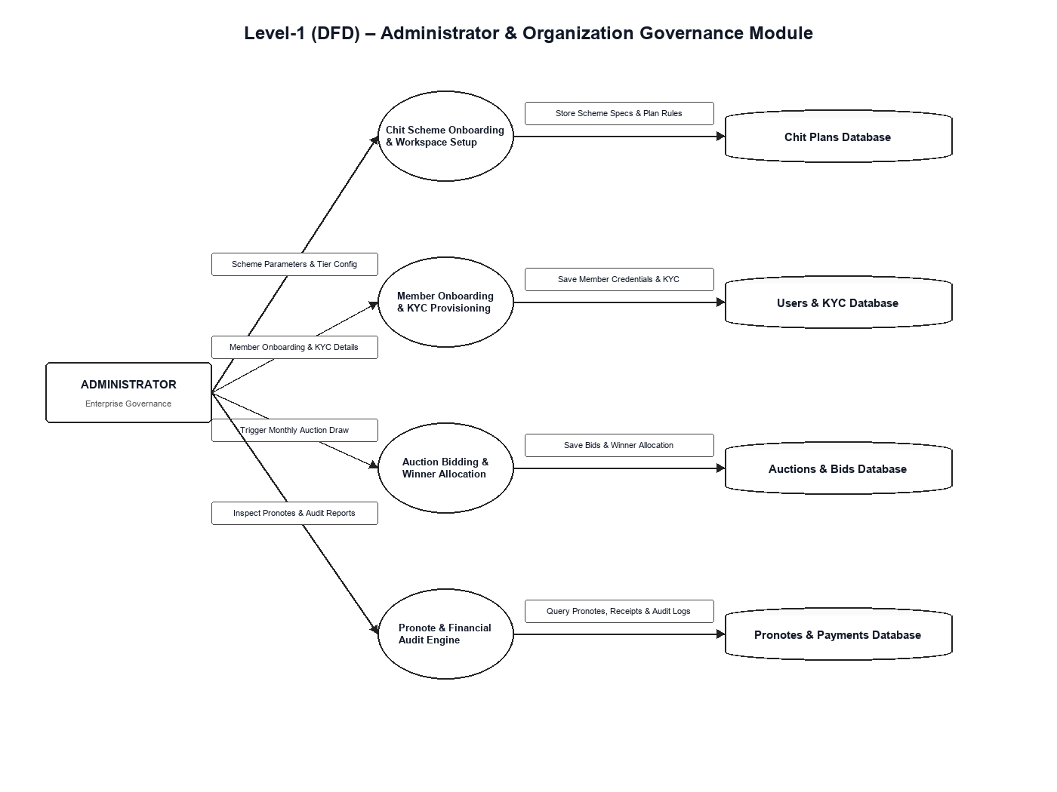
SECTION 4: SYSTEM DESIGN
4.2.2 GRAPHICAL DFD LEVEL 1 & LEVEL 2
DFD Level 1 (System Decomposition)
• 1.0 Authentication & User Management
• 2.0 Chit Scheme & Plan Management
• 3.0 Auction Bidding & Draw Engine
• 4.0 Promissory Note & Canvas Signature
• 5.0 Installment Ledger & Payment Gateway

Slide 18
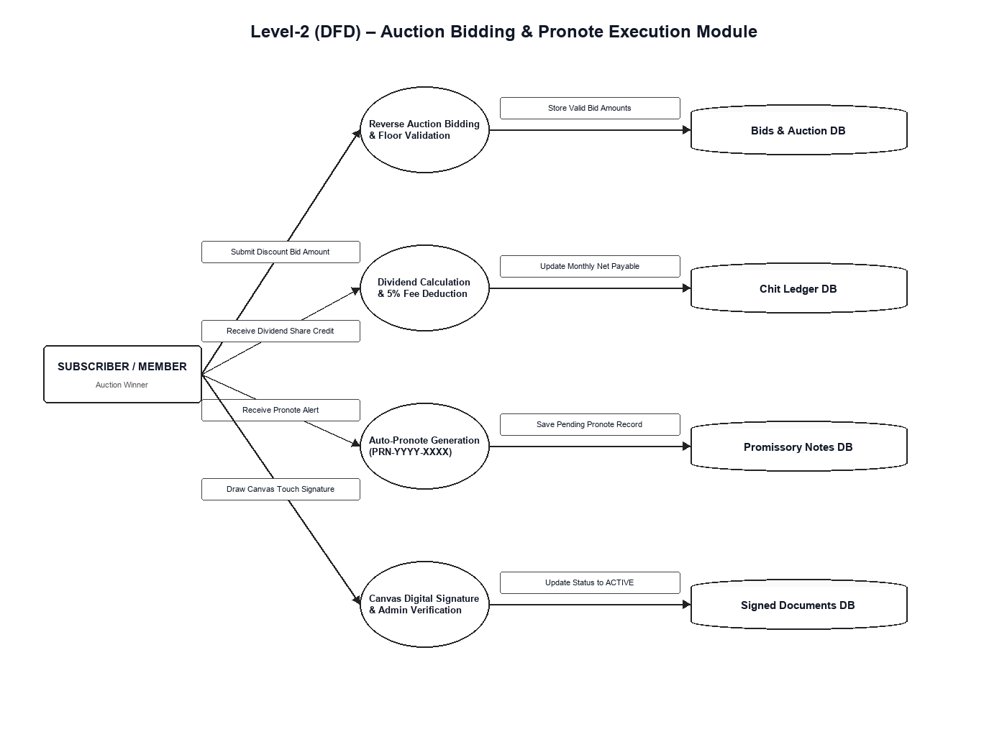
SECTION 4: SYSTEM DESIGN
4.2.3 GRAPHICAL DFD LEVEL 2 & LEVEL 3 WORKFLOWS
DFD Level 2 & 3: Detailed Engine
• 3.1 Auction Draw Execution -> Announce Winner
• 3.2 Dividend Calculation -> Net Payout
• 4.1 Auto-Generate Pending Pronote
• 4.2 Member HTML5 Canvas Signature
• 4.3 Persistence & PDF Receipt Rendering

Slide 19
SECTION 4: SYSTEM DESIGN
4.3 DATABASE SCHEMA & ER DESIGN
Core Database Tables & Entity Relationships
• 1. USERS Table: user_id (PK), name, email, phone, role (admin/member), password_hash, created_at
• 2. CHIT_SCHEMES Table: scheme_id (PK), scheme_name, total_amount, duration_months, monthly_installment, max_members, status
• 3. CHIT_MEMBERS Table: member_id (PK), scheme_id (FK), user_id (FK), join_date, status
• 4. AUCTION_ROUNDS Table: auction_id (PK), scheme_id (FK), month_no, winner_user_id (FK), winning_bid, dividend_per_member, auction_date
• 5. INSTALLMENT_PAYMENTS Table: payment_id (PK), scheme_id (FK), user_id (FK), month_no, due_amount, paid_amount, payment_status, receipt_ref, paid_date
• Relationships: One User can join Many Chit Schemes. One Chit Scheme has Many Auction Rounds & Installment Payments.

Slide 20
SECTION 4: SYSTEM DESIGN
4.4.1 MODULE DESIGN: ADMIN MANAGEMENT
Admin Management Module Functions
• • Scheme Builder: Create custom chit plans with defined total pool, tenure, and monthly installment rules.
• • Subscriber Approval Console: Review and approve new subscriber registration requests.
• • Auction Supervisory Engine: Monitor live monthly bidding, verify bid eligibility, and close auction rounds.
• • Payment Verification Manager: Inspect payment receipt references submitted by subscribers and verify bank credits.
• • System Dashboard: Real-time overview of active chit schemes, total funds collected, pending dues, and active subscribers.

Slide 21
SECTION 4: SYSTEM DESIGN
4.4.2 MODULE DESIGN: MEMBER PORTAL & AUCTIONS
Member Portal & Bidding Engine Functions
• • Personal Member Dashboard: Displays active subscribed chit plans, total dividend earned, and current due amounts.
• • Scheme Explorer: Allows members to browse available new chit schemes and submit join requests.
• • Live Bidding Interface: Interactive console to submit bids during scheduled monthly auction windows.
• • Dividend Tracker: Transparent calculation table showing monthly discount distributions and net payable installments.
• • Payment History Ledger: Complete history of past installment payments, receipt references, and approval statuses.

Slide 22
SECTION 4: SYSTEM DESIGN
4.4.3 MODULE DESIGN: INSTALLMENT & PAYMENTS
Installment Tracking & Payment Verification Module Functions
• • Dynamic Due Calculation: Automatically adjusts monthly installment payable based on dividend earned from latest auction.
• • Receipt Upload & Payment Logging: Subscribers enter payment transaction IDs or upload transfer screenshots.
• • Automated Approval Workflow: Admin verifies transaction reference and updates installment status to 'Verified'.
• • Default Prevention Mechanism: Identifies overdue installments and flags default risk before next auction round.
• • Digital Statement Generation: Generates printable summary statements for subscriber records.

Slide 23
SECTION 4: SYSTEM DESIGN
4.4.4 MODULE DESIGN: NOTIFICATION ENGINE
Automated SMS & Email Communication Module Functions
• • Due Reminder Alerts: Dispatches automated SMS via Fast2SMS API to member mobile numbers 3 days prior to due date.
• • Email Notifications: Sends HTML format email alerts via SMTP/Nodemailer containing monthly due breakdowns.
• • Auction Announcement: Sends instant notifications to scheme members announcing upcoming live auction schedules.
• • Winner Declaration Alert: Immediately notifies all group members of the auction winner name and dividend earned.
• • Payment Confirmation Receipts: Sends instant SMS confirmation upon successful admin payment verification.

Slide 24
SYSTEM EVALUATION & CONCLUSION
SECTION 8: CONCLUSION
Project Summary & Value Delivered
• • Successful Digital Transformation: SecureChit successfully modernizes traditional chit fund operations into a transparent digital web platform.
• • Total Financial Transparency: Eliminates bid manipulation, opaque discount distribution, and manual calculation errors.
• • Enhanced Operational Efficiency: Reduces administrative workload by over 80% through automated dividend and due calculations.
• • Improved Member Engagement: Automated multi-channel (SMS/Email) alerts ensure timely installment collections and zero missed auctions.
• • Robust Academic & Practical Foundation: Implemented using modern full-stack web architecture complying with academic standards.

Slide 25
FUTURE SCOPE & REFERENCES
SECTIONS 9 & 10: FUTURE ENHANCEMENTS & BIBLIOGRAPHY
Section 9: Future Enhancements
• 1. Native Mobile Application: Develop Android & iOS app versions using React Native for push notifications.
• 2. Integrated Payment Gateway: Seamless UPI/Card payment integration (Razorpay/UPI Intent).
• 3. AI-Powered Default Risk Prediction: Machine learning models predicting default probability based on payment trends.
• 4. Blockchain Smart Contracts: Immutable ledger recording auction bids and payouts on permissioned blockchain.
Section 10: Bibliography
• Book References:
- Alex Banks, Eve Porcello, Learning React, 2nd Ed., O'Reilly Media, 2020.
- David Choi, Full-Stack React Projects, 2nd Ed., Packt Publishing, 2020.
• Web References:
- React Docs: https://react.dev
- Node.js Documentation: https://nodejs.org/docs
- Fast2SMS API Guide: https://www.fast2sms.com/dev/bulkV2

