Slide 1
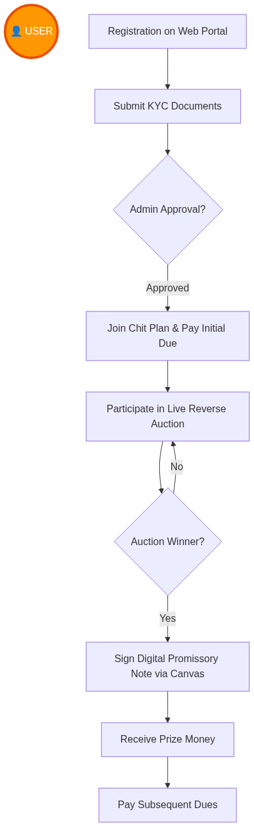
User (Member) Workflow Diagram

Slide 2
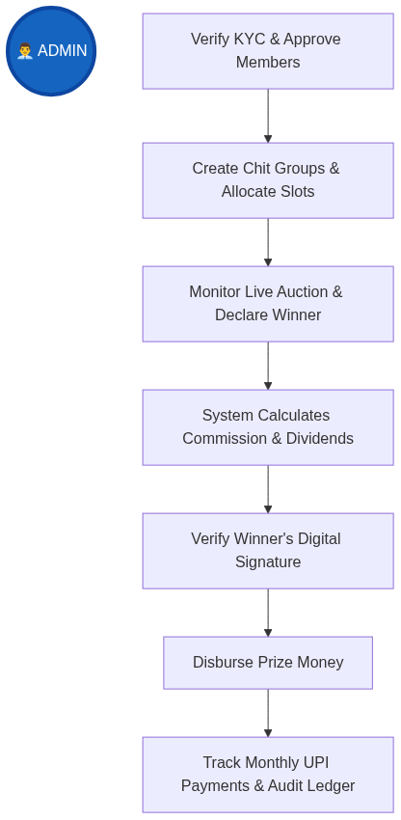
Admin (Foreman) Workflow Diagram

Slide 3
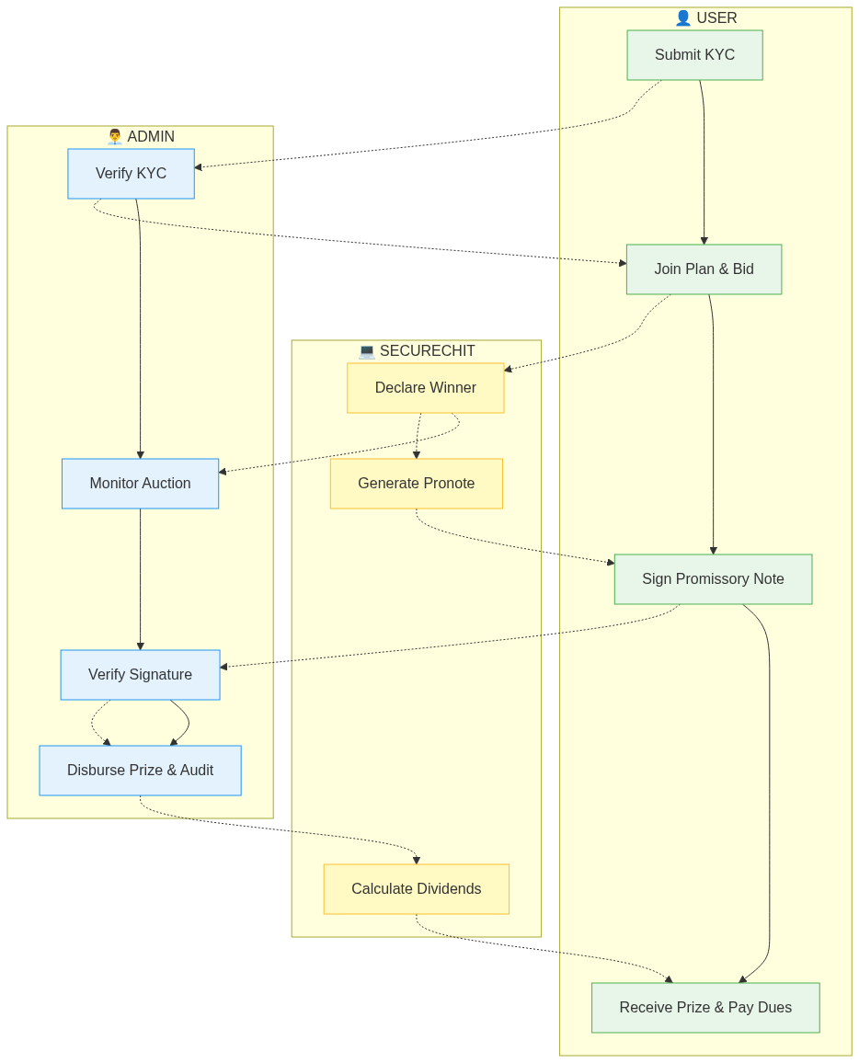
Integrated System Workflow

