Slide 1
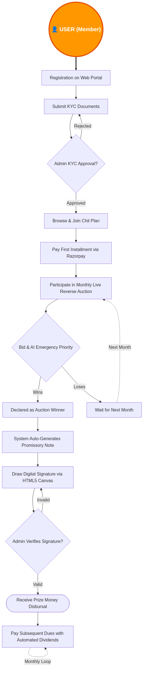
User (Member) Detailed Workflow

Slide 2
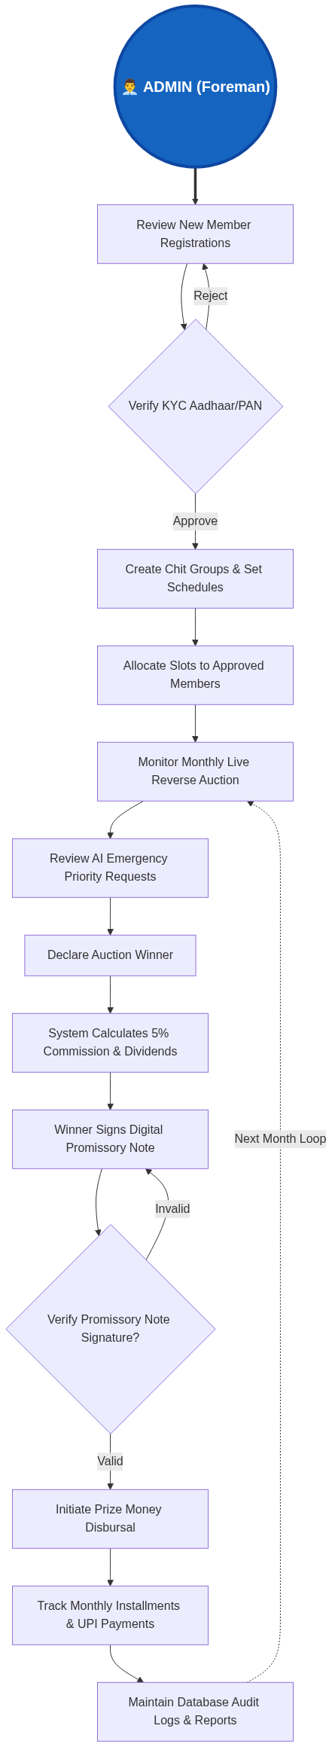
Admin (Foreman) Detailed Workflow

Slide 3
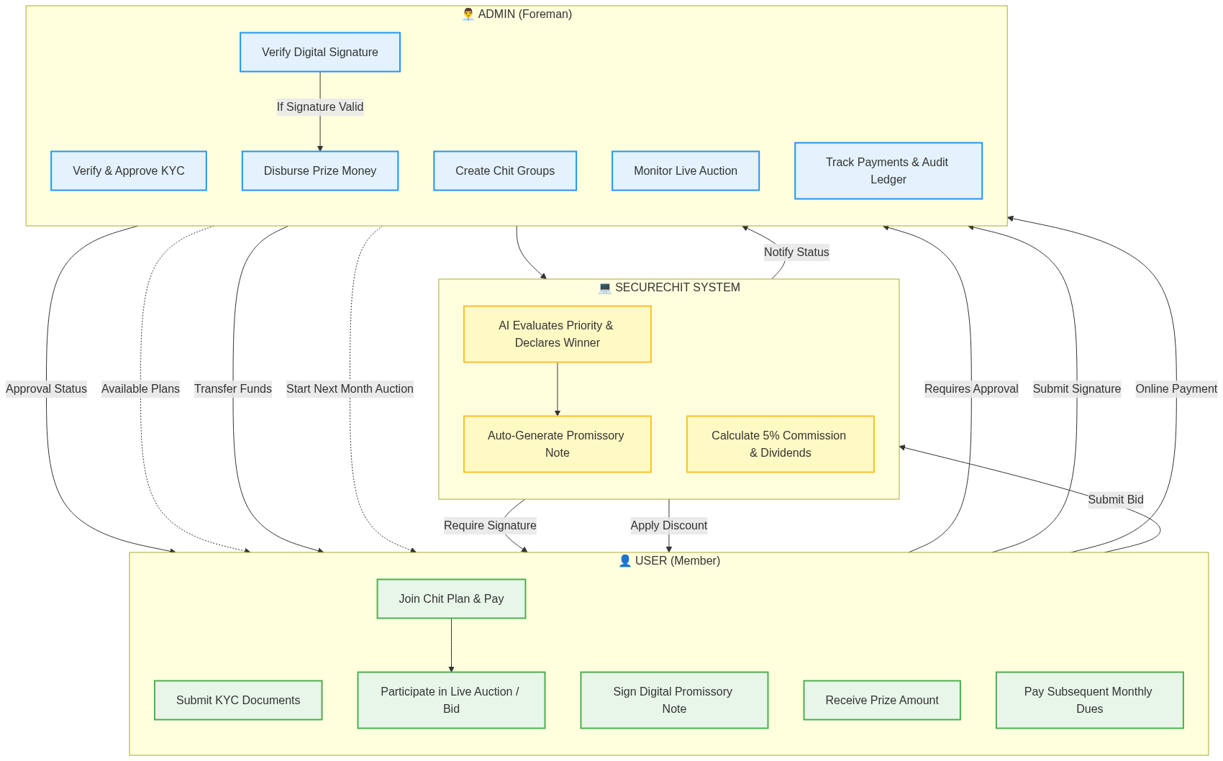
Integrated System Workflow

