Slide 1
User (Member) Detailed Workflow

Slide 2
Admin (Foreman) Detailed Workflow

Slide 3
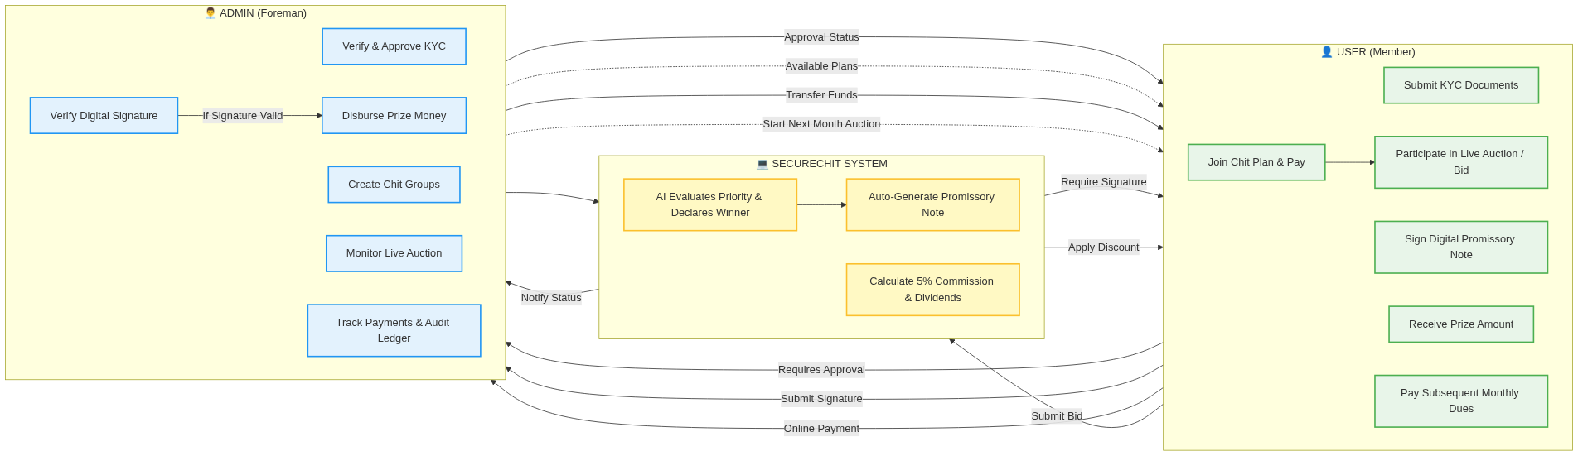
Integrated System Workflow

