Slide 1
DEVOPS INTRODUCTION
DEVOPS

Slide 2
WHAT MARKET GIVES US TO JOB?
SDLC SOFTWARE DEVLOPMENT LIFE CYCLE

Slide 3
WEB BASED APPLICATIONS

Slide 4
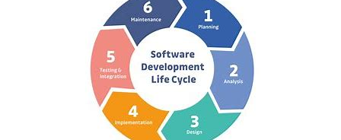
SDLC

Slide 5
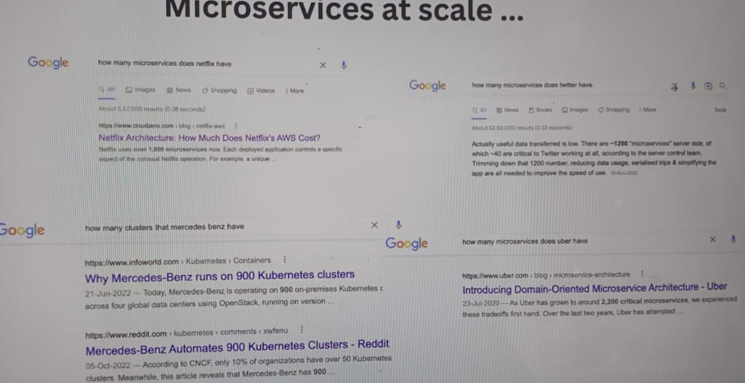
MICRO SERVICES IN WEB APPLICATION

Slide 6
HOW DO WE DEVELOP SUCH PROJECT?
METHODOLOGIES

Slide 7
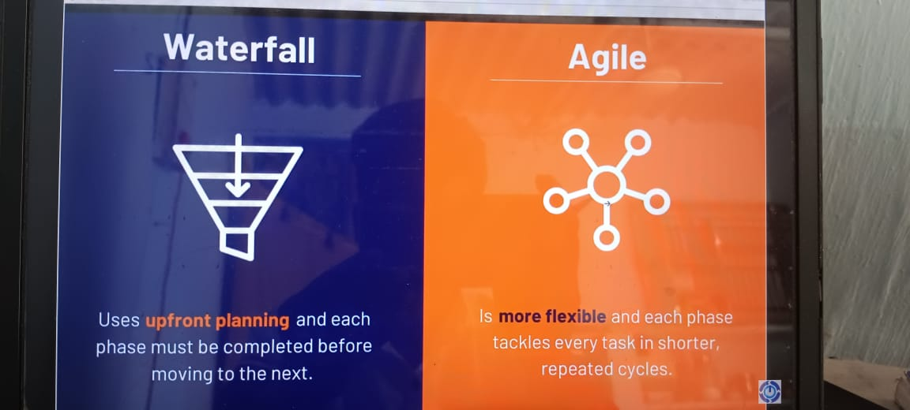
WATERFALL METHODOLOGIES
AGILE METHODOLOGIES

Slide 8
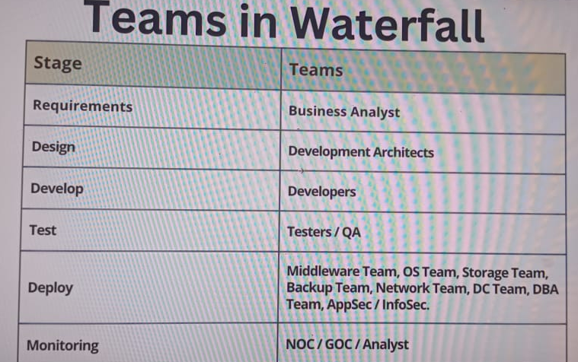
TEAMS IN WATERFALL

Slide 9
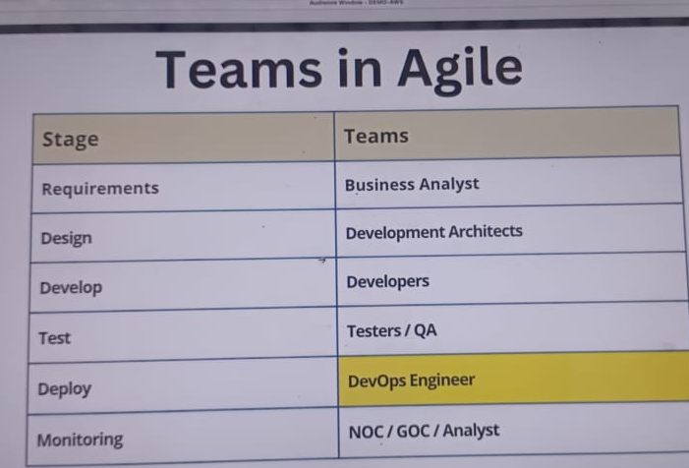
AGILE TEAMS

Slide 10
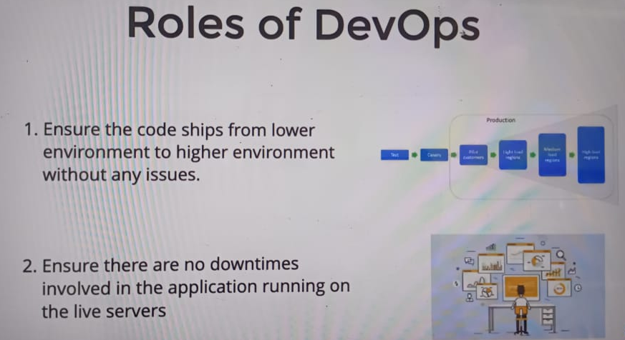
ROLES OF DEVOPS

Slide 11
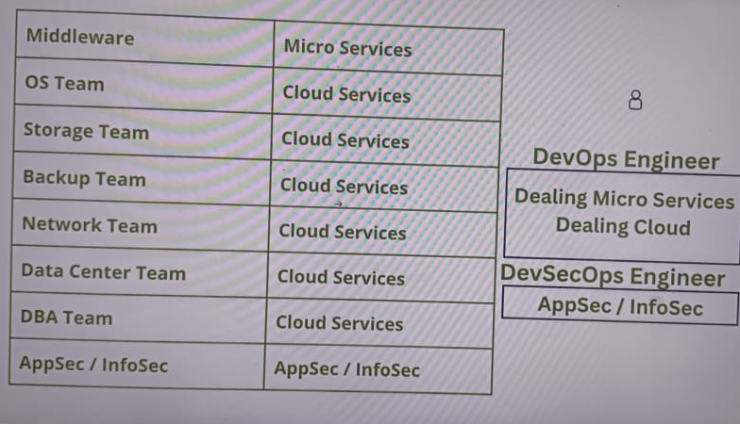
TEAMS REPLACE BY DEVOPS

Slide 12
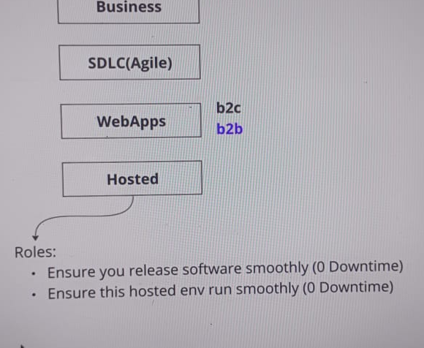
DEVOPS ENGINEER PLACE

Slide 13
TOOLS IN DEVOPS
SCRIPTING
CONFIGUARATION MANAGEMENT
IAC
SHELL
PYTHON
ANSIBLE
TERRAFORM

Slide 14
TOOLS DEVOPS
MONITORING
CI/CD AUTOMATION
CONTAINERSATION
PROMETHEUS
GRAFANA
JENKINS
DOCKER
KUBERNATES

Slide 15
TOOLS IN DEVOPS
VERSION CONTROL
OPERATING SYSTEMS
OPERATING SYSTEMS
GIT
GITHUB
LINUX
AMAZON
UBUNTU

