Slide 1
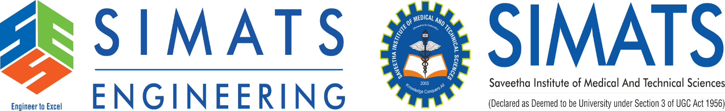
Name:P.Naresh Regno:192424378 course:DSA0304-Natural Language Processing
Morphology And Word Formation In Natural Languages

Slide 2
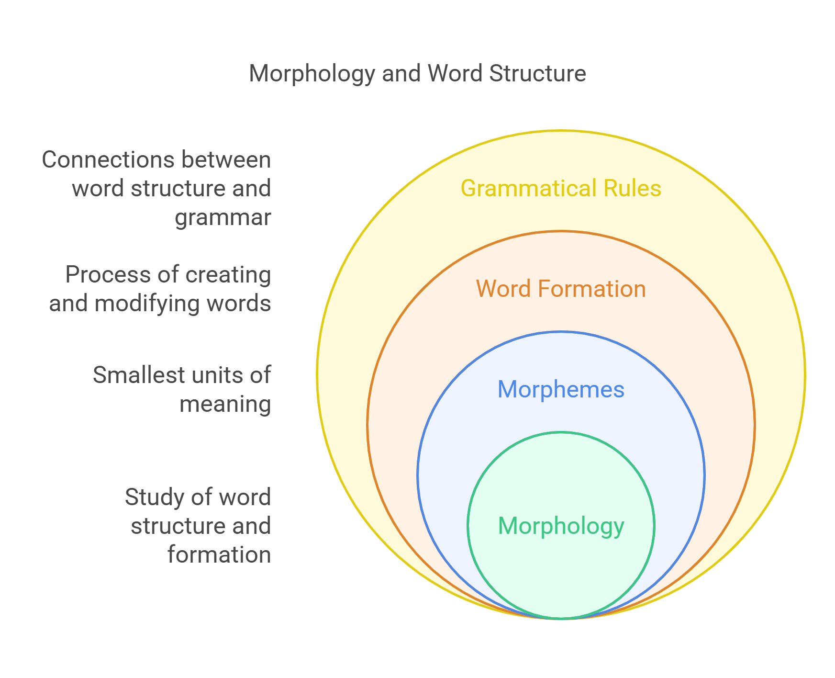
Introduction to Morphology and Word Formation
Morphology is the branch of linguistics that studies the structure of words.
Word formation involves the processes by which new words are created in a language.
Understanding these concepts reveals how languages develop and adapt over time.
Notes:
Image source: https://wordpandit.com

Slide 3
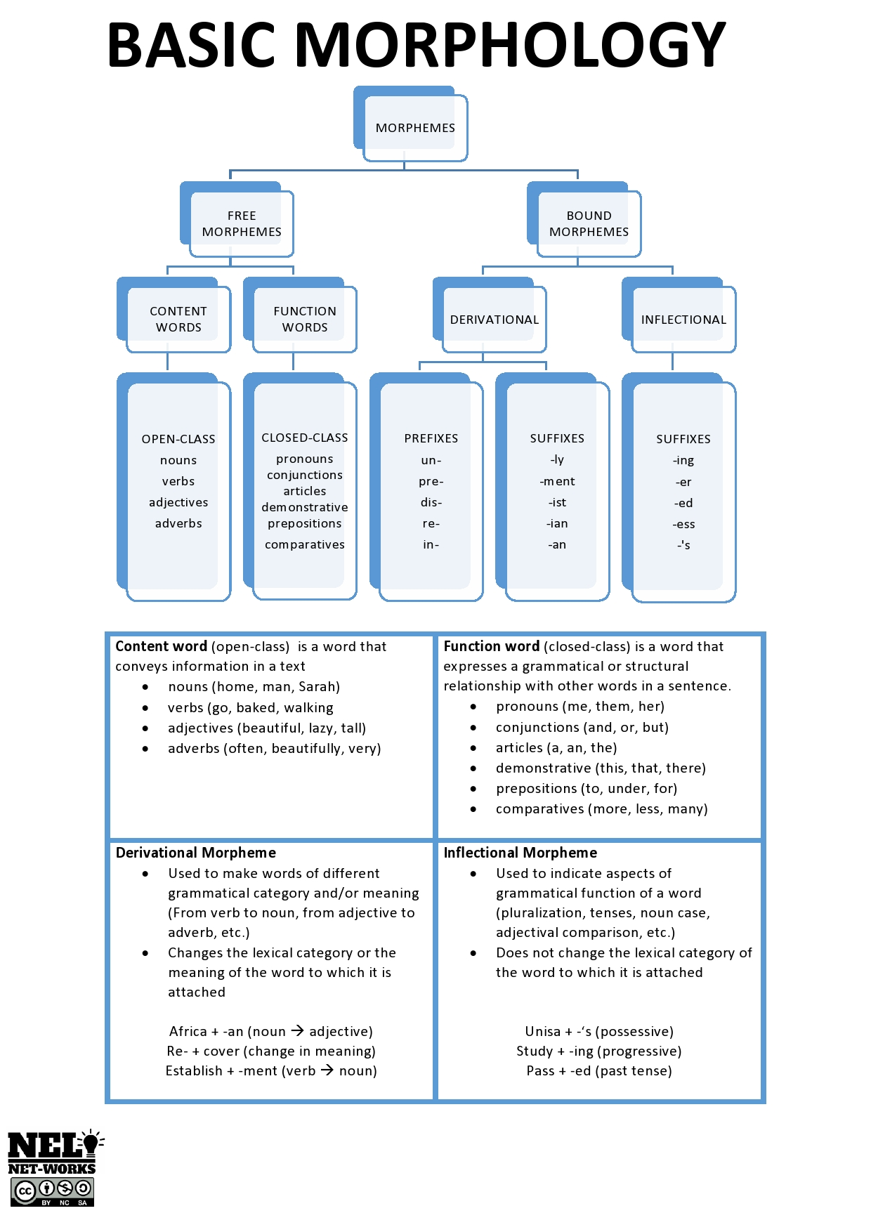
Basic Units of Morphology – Morphemes
Morphemes are the smallest meaningful units in a language.
They can be roots, prefixes, suffixes, or infixes.
The combination of morphemes forms words and conveys specific meanings.
Notes:
Image source: https://www.unisa.ac.za

Slide 4
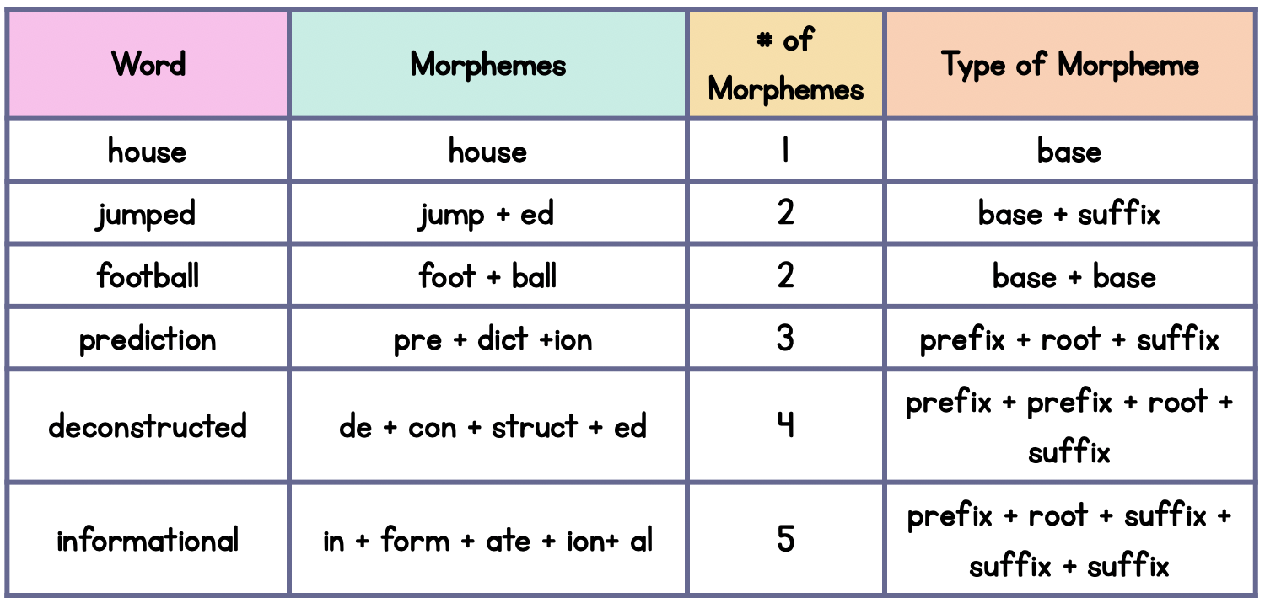
Types of Morphemes
Free morphemes can stand alone as words, like "book" or "run."
Bound morphemes must be attached to other morphemes, such as prefixes "un-" or suffixes "-ed."
The distinction helps explain how complex words are constructed from smaller parts.
Notes:
Image source: https://sarahsnippets.com

Slide 5
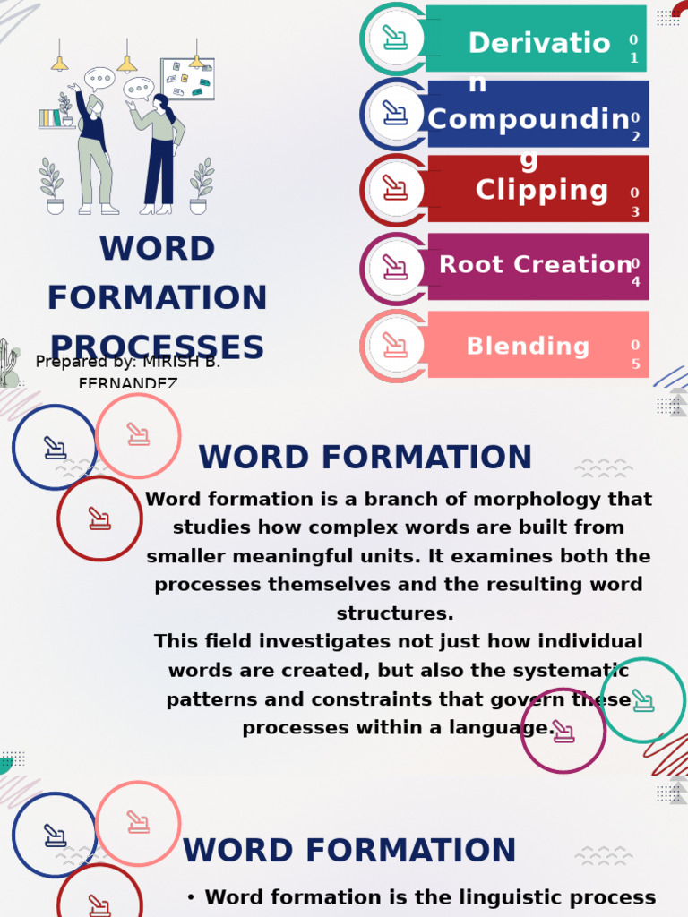
Word Formation Processes
Derivation creates new words by adding affixes to existing words, e.g., "happy" to "unhappy."
Compounding joins two or more free morphemes, as in "notebook" or "sunflower."
Conversion shifts words from one grammatical category to another without adding affixes, like "to run" becoming "a run."
Notes:
Image source: https://imgv2-1-f.scribdassets.com

Slide 6

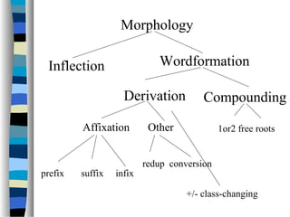
Inflection vs. Derivation
Inflection modifies a word to express grammatical features like tense, number, or case, e.g., "walk" to "walked."
Derivation changes the meaning or part of speech, such as "happy" to "happiness."
Both processes are essential for the grammatical and lexical development of words.
Notes:
Image source: https://image.slidesharecdn.com

Slide 7
Conclusion and Significance
Morphology and word formation are fundamental to understanding how languages create and expand their vocabularies.
They reveal patterns of language change, borrowing, and innovation over time.
Studying morphology aids in language learning, teaching, and computational linguistics applications.
Notes:
Image source: https://www.slidemake.com

