Slide 1
Weather Simulation Lockheed Martin
Garett Wilson
Dania Alvarez
Fackety Occil
Richard Morand
Naresh Kumar

Slide 2
Project analysis slide 2
Project Plan

Slide 3
Project analysis slide 8
Software
Requirements
FUNCTIONAL
NON-FUNCTIONAL
Return simulated extreme weather data.
Allow access to historical weather data.
Accept location, time interval, and type of weather conditions as input.
Temporal resolution of simulated data should be adjustable.
Generate up to 2 hours of weather data.
Return data within seconds of each simultaneous request.
Data returned should vary per request, based on given input.
Expected accuracy of 90% or more.
System must be scalable and secure.
DESIGN CONSTRAINTS
PROCESS CONSTRAINTS
Historical data must come for trusted APIs (NOAA, FAA, AIS)
Focus on Florida region
Return data in standard attribute vs value format (JSON, XML)
Data should be timestamped and include weather parameters critical for air and sea navigation.
Deployed on a cloud service for scalability.
Must be deployed by the end of April 2025.
Cost must not exceed $2000

Slide 4
Project analysis slide 10
System
Architecture

Slide 5
Project analysis slide 8
Datasets
ERA5
ICOADS
1940 to present time span.
~31km (global grid) spatial resolution
Hourly temporal resolution
Global (land and sea) coverage
Temperature, wind speed, pressure, humidity, precipitation, and more parameters.
17th century to present.
Spatial resolution varies (lower resolution)
TR varies (daily, monthly averages, hourly)
Oceanic coverage, some coastal and maritime data.
Sea surface temperature (SST), wind speed, pressure, marine precipitation
GENERAL
Focus on global atmospheric dynamics, weather prediction, climate modeling.
Applications in weather forecasting, climate research, global studies.
Focus on ocean-atmosphere interactions, maritime weather, sea surface conditions.
Applications in marine climate, oceanographic research, historical climate analysis.
APPLICATION

Slide 6
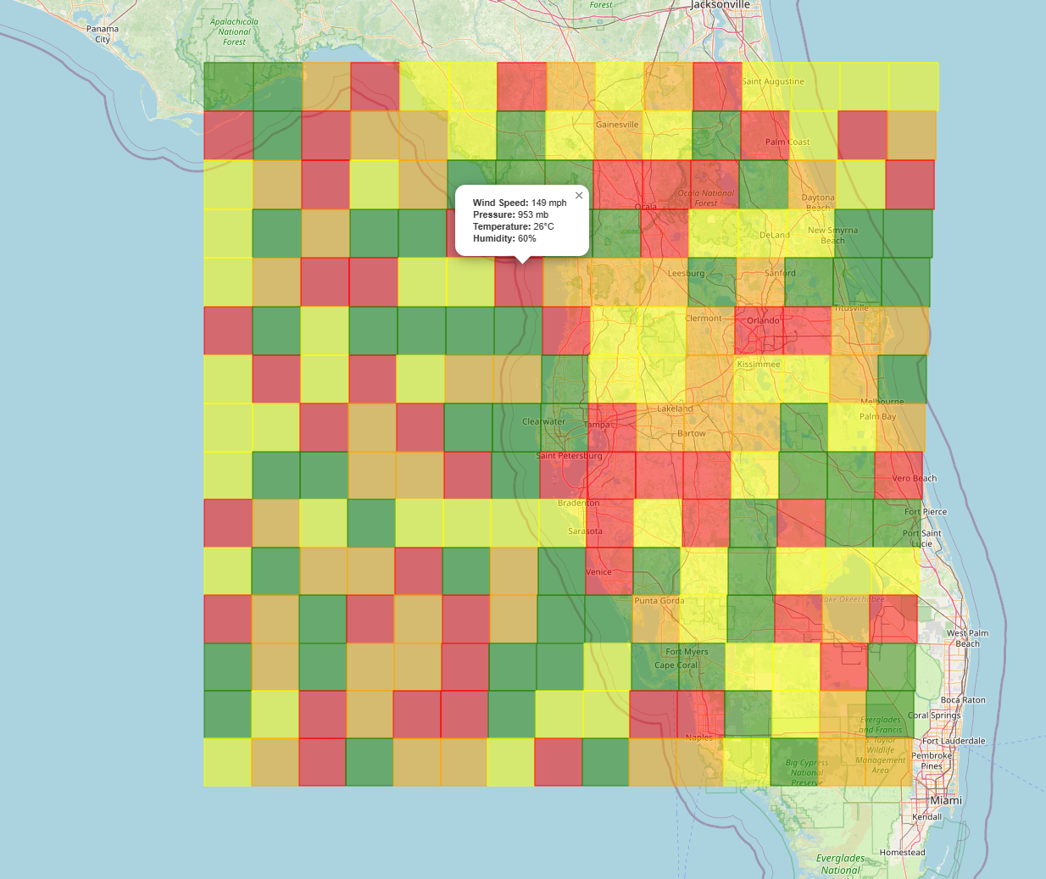
Project analysis slide 10
Cellular
Automata
A cellular automaton is made up of a grid of cells, where each cell has a state.
Each state changes based on a set of predefined rules, and it depends on the current cell state and that of its neighbors.
Simulation advances in discrete time steps, all states being updated at once.
WEATHER SIMULATION
ENVIRONMENT: The grid represents a region over Florida. 15 cells by 15 cells.
Improvement: 3D grid to include altitude.
CELLS: Each cell covers an area of about 19 miles x 19 miles.
STATES: Temperature (sea/land surface), Pressure, Wind Speed, Wind Direction, Humidity, and Terrain type.
Cellular Automaton Grid (15x15) Initialized with random values

Slide 7
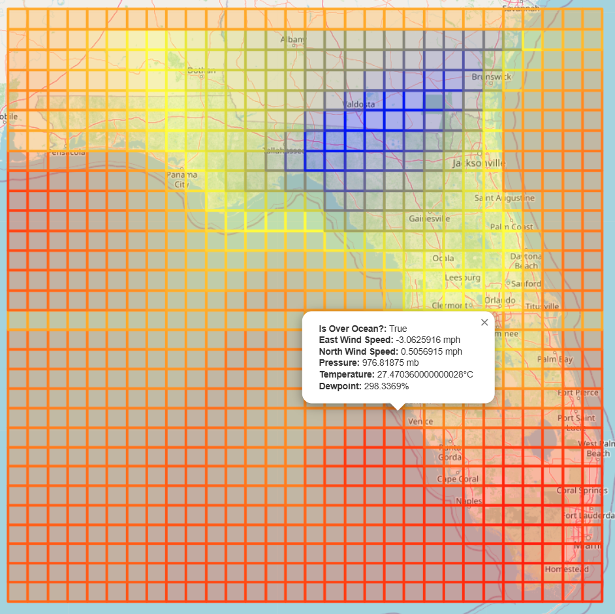
Project analysis slide 10
Weather Simulation
Rules
Hurricanes form over the ocean with temperatures above 27 degrees Celsius. [1]
Pressure ~950 hPa or lower (eye) and higher outside storm area (~1010hPa)
If neighboring cells have high temperatures, the current cell can absorb heat and warm up. Heating factor.
If most neighbors are cooler, it loses heat. Cooling factor.
Oceans heat up and cool down slower compared to land.
Higher pressure in neighbors can increase temperature, lower pressure in neighbors can decrease temperature in current cell.
IMPORTANT CONSIDERATIONS:
Neighboring region should cover a significant area, for simplicity this simulation will try up to a 3-cell radius as computational resources allow.
Focusing on simulating only temperature for now.
[1] Source: WEATHER.GOV
Cellular Automaton Grid Initialized with Hurricane Milton data from 10.10.2024 at 12AM (ERA5)

Slide 8
Project analysis slide 10
Next Steps
Find other research related to weather simulation using Cellular Automata.
Start implementation of simulation using NetLogo or Python.
Collect specific extreme weather data to train/start simulations and compare results.
KEY QUESTIONS:
What is the role of pressure, wind, humidity, and terrain on temperature changes?

