Slide 1


“Employee Management System”
Submitted by : Naresh Babu O
Submission type : Individual
Name: Naresh Babu O
Batch :HDFC API Batch-1
LMS Id :
Program :Full Stack Development
Date: 27/04/2023

Slide 2

Table of contents
Introduction
Project Overview
Architecture Design
User Interface Design
Back-end Development
Front-end Development
Testing
Deployment
Conclusion
Future Work
References
Appendices

Slide 3
Introduction
Title : Employee Management System
1.1 Problem Statement:
The Management need securely access employee data from a database through an API
1.2 Research question: How can we create a secure and efficient API to fetch employee data from a MySQL database using Spring-Boot and Rest-Controller
1.3 Objectives:
To create an API that fetches/Get employee data by ID, and encrypts the date of birth using AES-256,
Additionally, to automate the build and deployment process using Jenkins and Docker.
This code should run from Spring-boot or an Application server such as Tomcat, WebLogic, etc.
1.4 Importance and relevance:
This project enables secure and efficient access to employee data, which is crucial for businesses and organizations to manage their operations effectively

Slide 4
Project Overview
Features:
Employee data management:
The system will allow Administrators to access employee information By employee-ID.
Fetching employee data by ID
Encryption of date of birth
HTTPS configuration with a self-signed certificate
Deployment to Kubernetes
Functionality: API that fetches employee data by ID and returns it in JSON format

Slide 5
Project Overview
Technology Stack:
Technology Stack: The EMS will be built using a variety of technologies, including:
JAVA
Spring Boot
Database: MySQL
REST API
AES-256
Git-hub
Jenkins
Docker
Kubernetes

Slide 6
Back-end Development
Technology details:
JAVA
→ The back-end of the application is built using the Java programming language
Spring Boot
→The Spring Boot framework is used to provide a lightweight, modular approach to building web applications in Java
MySQL
The database used for the EMS is MySQL which store the data of Employee
REST API (Representational State Transfer)
→ REST API provides a standard architecture for building web services that can be accessed through HTTP
AES-256 (Advanced Encryption Standard)
AES-256 is a widely-used symmetric encryption algorithm that uses a 256-bit key to encrypt and decrypt data
Jenkins
→ For continuous Integration with Git Repo and Building of Docker Images
Docker
Docker allows for the creation, packaging, and deployment of applications in a lightweight, portable container environment
Kubernetes
Kubernetes allows for easy deployment of Docker images to a cluster of nodes

Slide 7
Integration and Testing
Integration testing involves testing the interactions between different components of the application to ensure that they work together as expected.
we have used a testing methodology I have used Junit to test individual records and to make sure the retrieved data is correct.
Integration tests can be run as part of the build process using tools Gradle, or manually using testing frameworks like JUnit.
End to End Testing was also performed to test the entire flow of the application, from the client making the request to the server receiving the response.
Additionally, we used POSTMAN to perform functional testing of our APIs by sending different types of requests and validating the response returned by the server. Through these testing methodologies, we ensured that application works as intended and meets the requirements of the project.

Slide 8
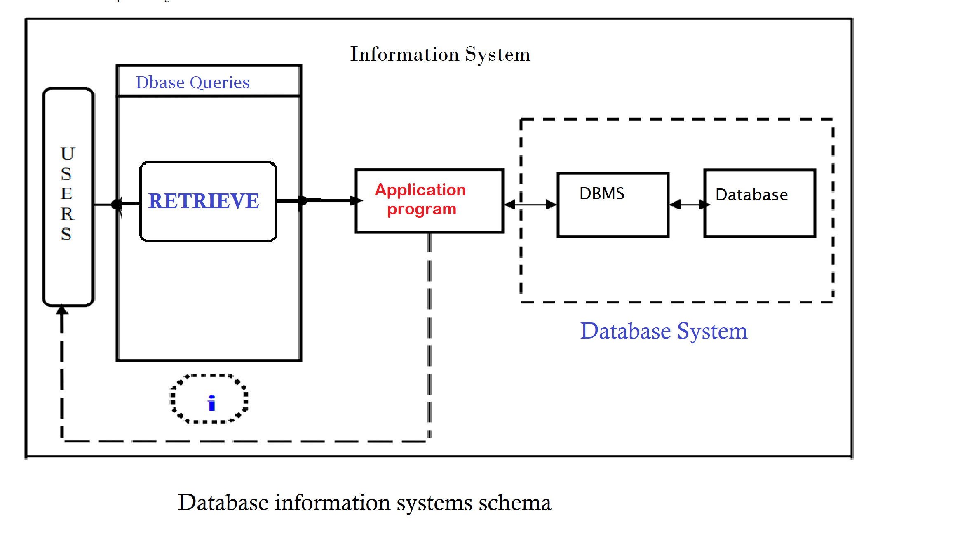
User Interface Design

Slide 9
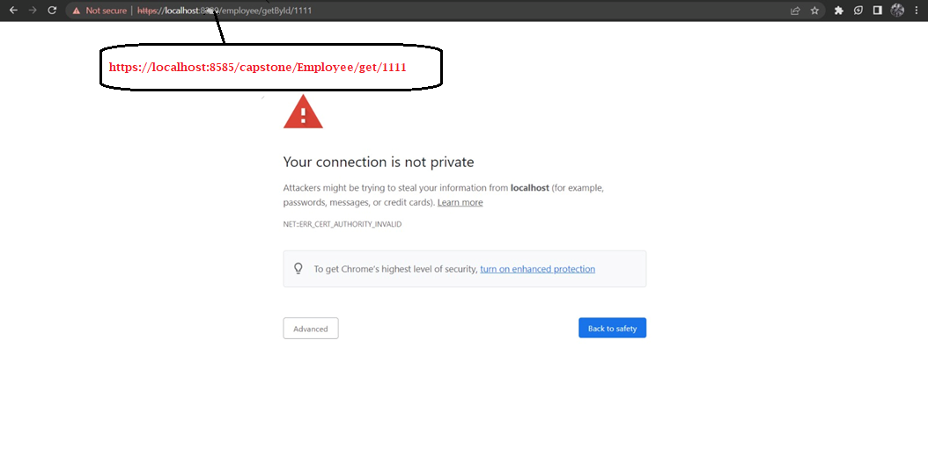
1.Testing For HTTPS in browser
Integration and Testing

Slide 10
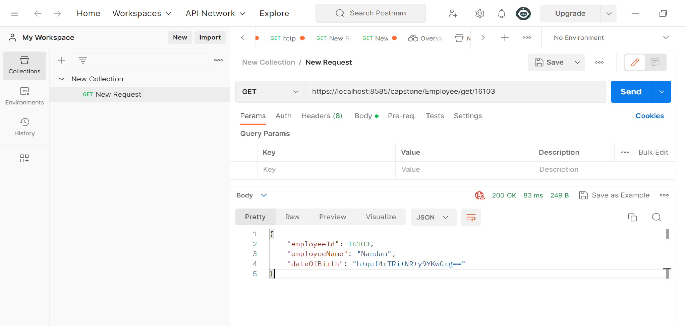
2.Testing Valid web-request and getting value with Encryption
Integration and Testing
a

Slide 11
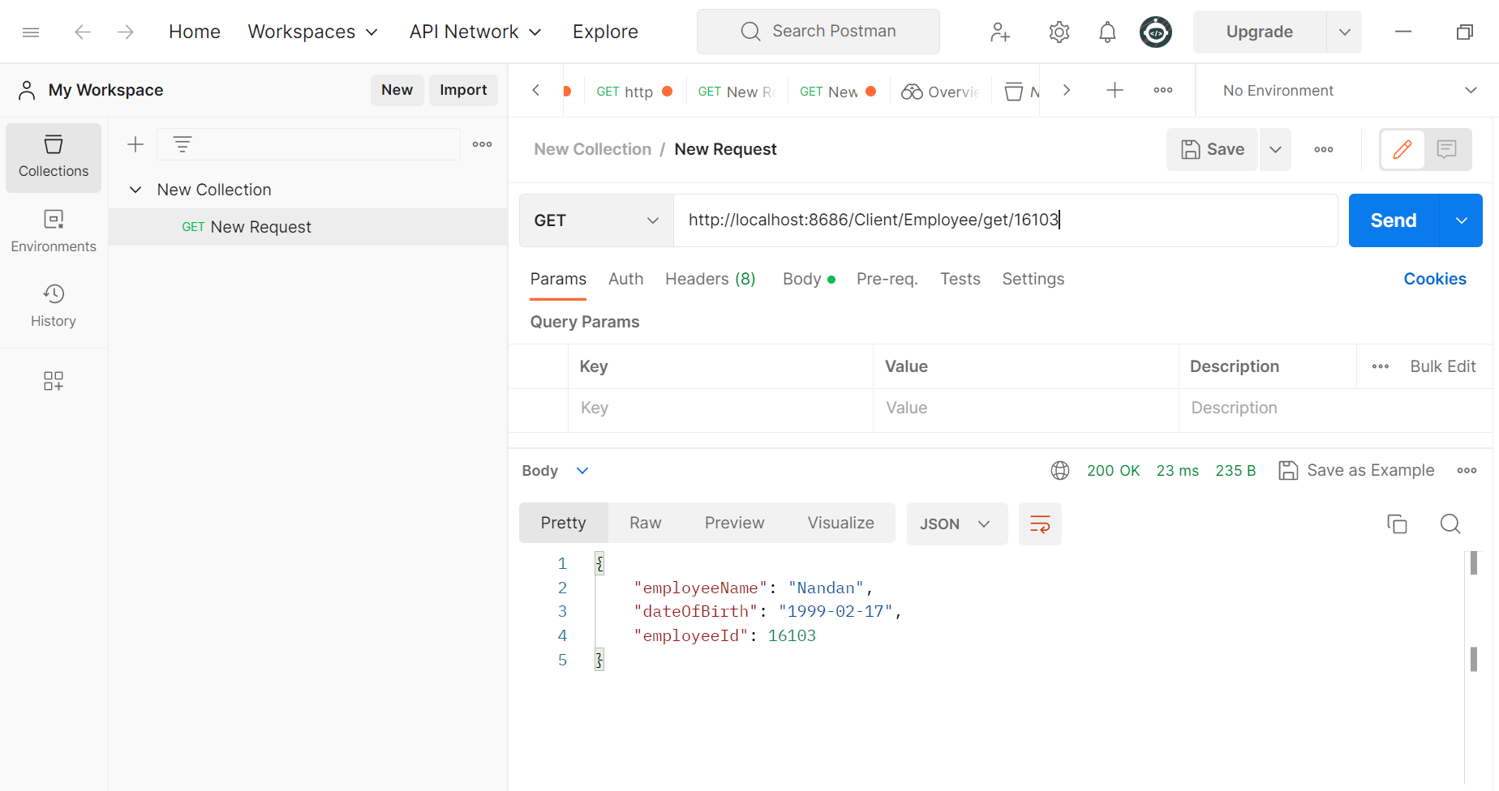
3.Testing Valid web-request and getting value with Decryption
Integration and Testing
a

Slide 12
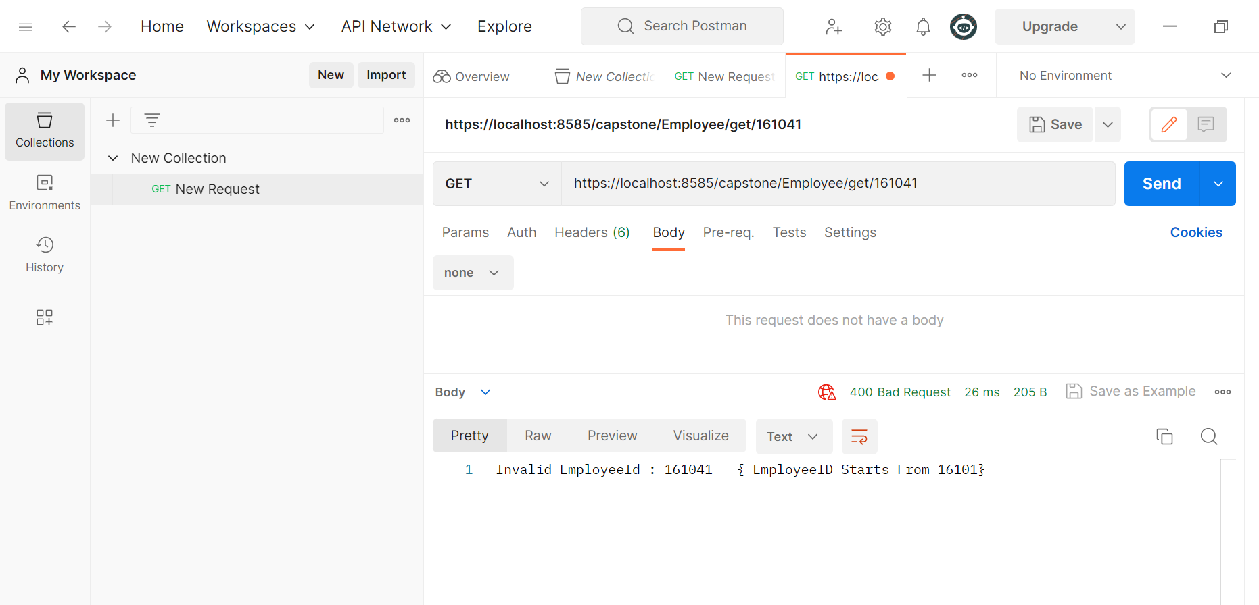
4. Testing for Invalid Web Service Request i.e. Exception
Integration and Testing
a

Slide 13
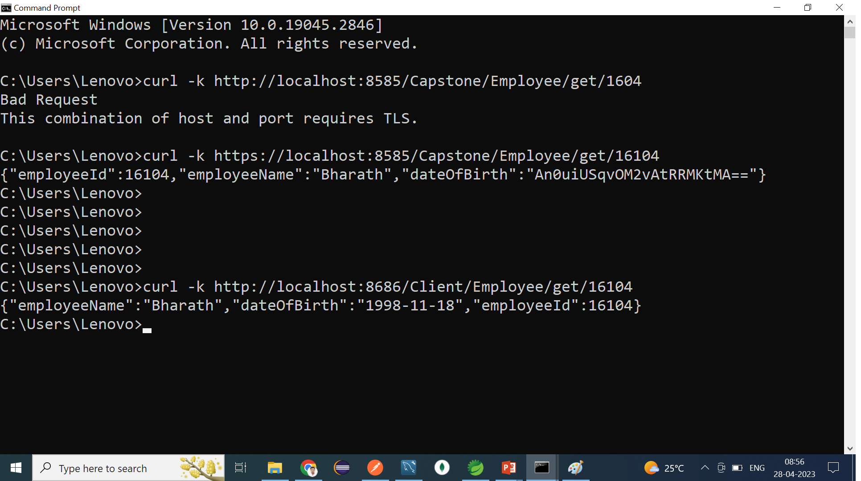
4. Testing using CURL Commands
Integration and Testing
a

Slide 14
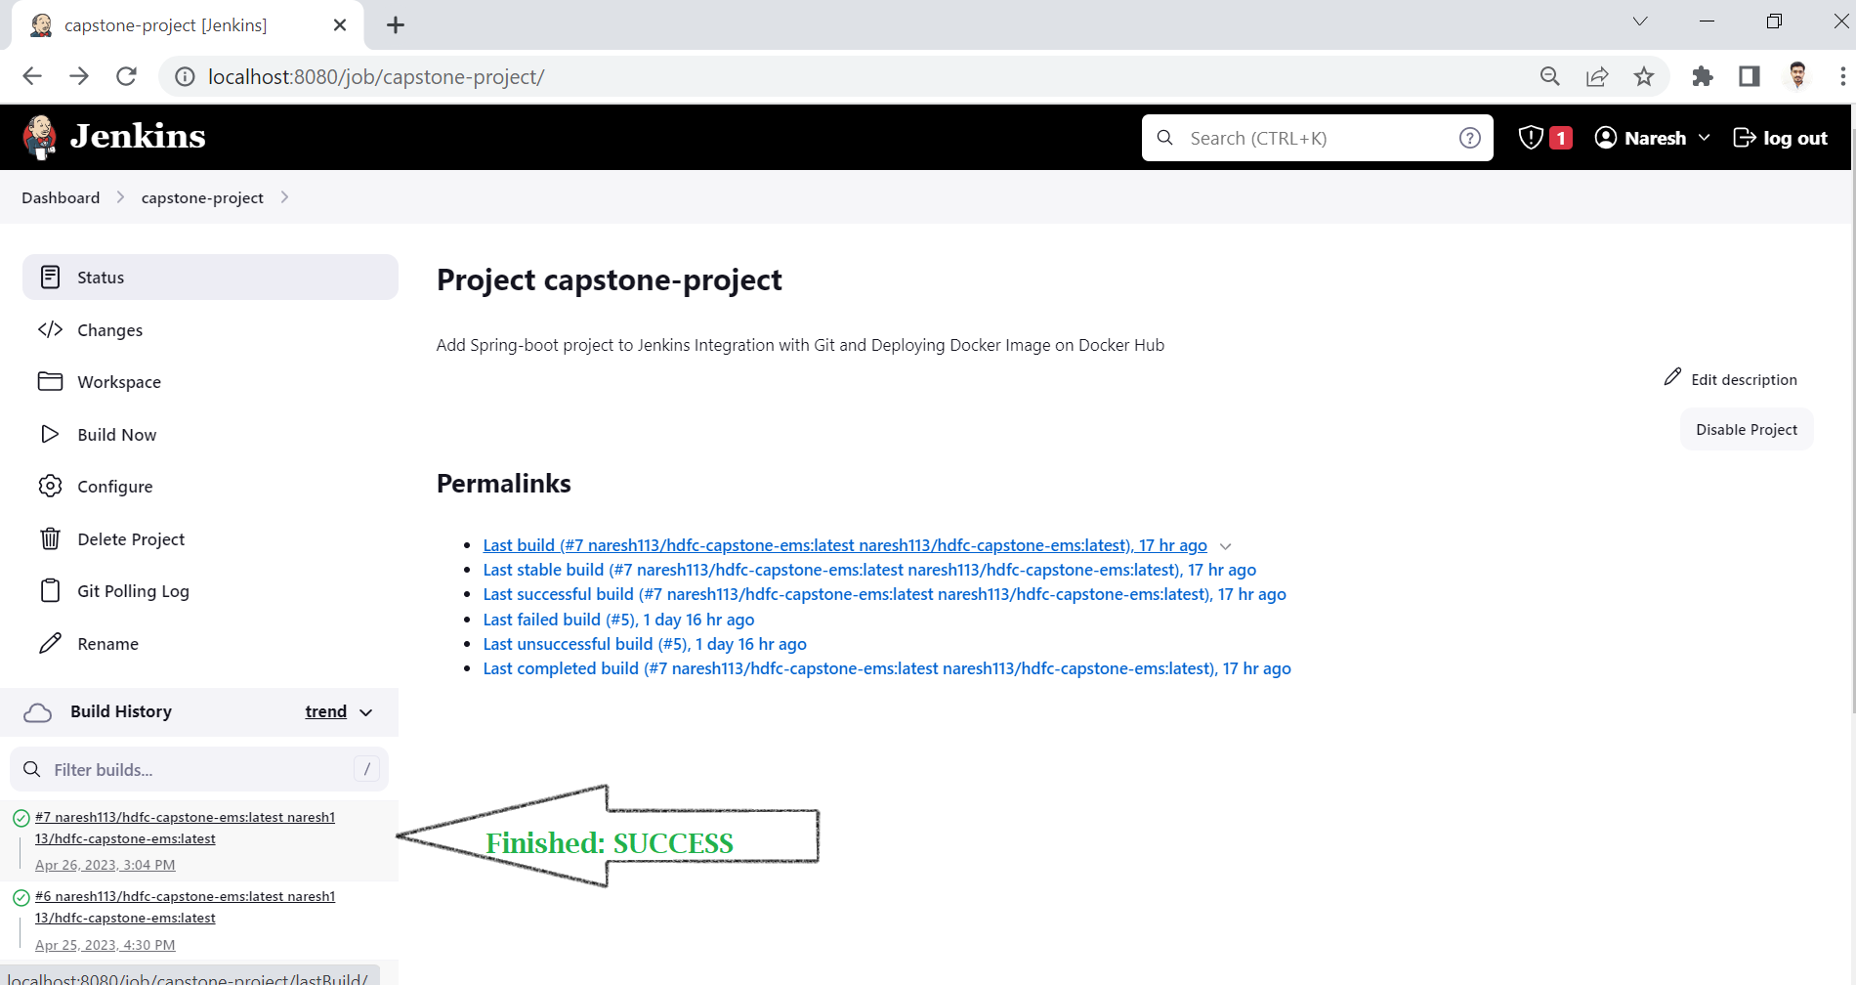
1. Jenkins Integration with Git and Deploying Docker Image on Docker Hub
Deployment

Slide 15
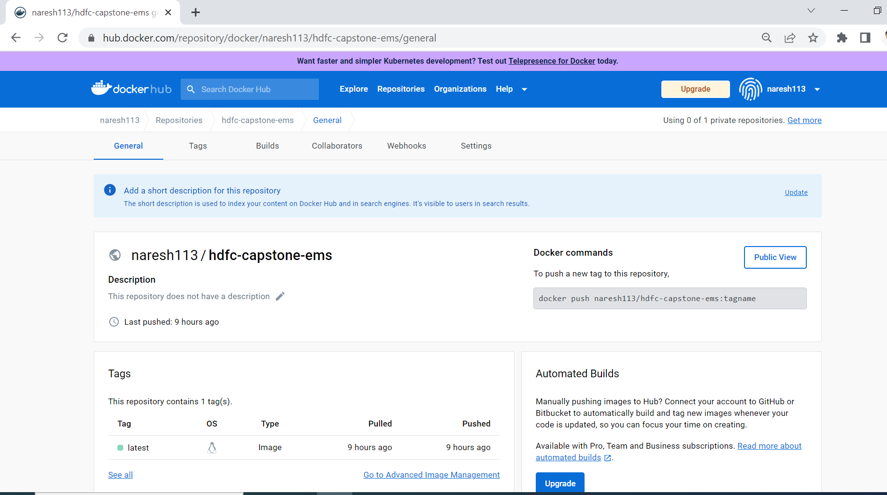
2. Docker-Images Deployment in Docker Repository
Deployment

Slide 16
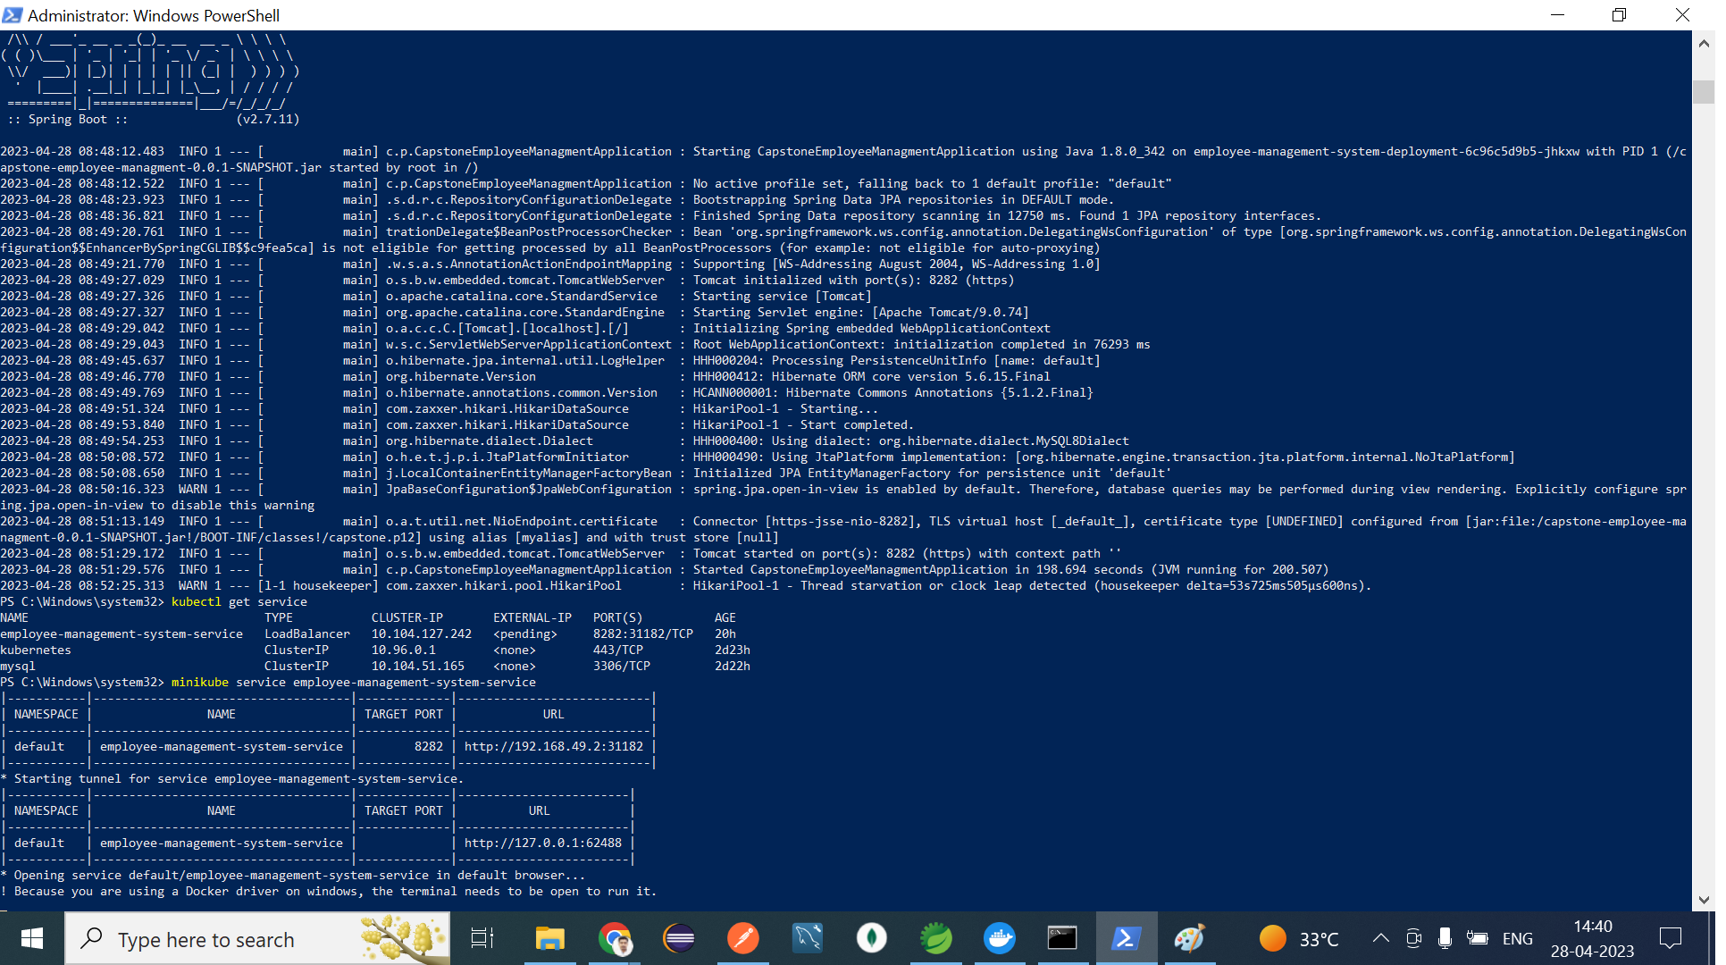
Project Deployeed Using minikube
Deployment

Slide 17
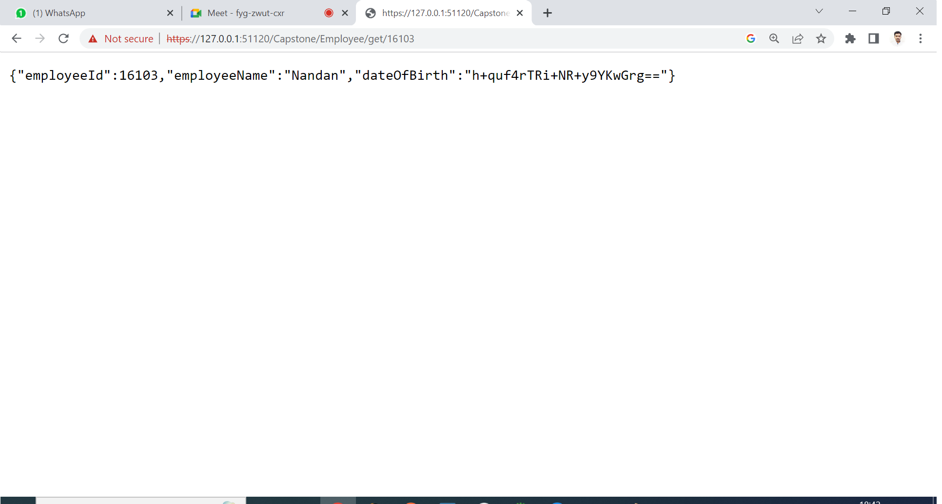
3 Project Runs on port number using Kubernetes
Deployment

Slide 18
Conclusion
The Spring Boot Employee Management Project integrates various tools and technologies to provide a robust and efficient solution for managing employee data.
log files and Postman are used for testing and debugging
HTTPS web service and AES-256 encryption are used for secure communication and data protection, the client program decrypts encrypted data,
Jenkins is used to automate the development and deployment process
And Kubernetes orchestrates the containerized application for high availability and scalability.
These tools work together to provide a seamless and efficient solution for managing employee data in a secure and scalable manner.

Slide 19
References
Creating Log back files: https://simplifyingtechcode.wordpress.com/2021/04/25/spring-boot-logback-for-log-files-archiving/
https://www.baeldung.com/spring-boot-logging
Creating a self-signed Certificate for Secure connection:
https://www.baeldung.com/spring-boot-https-self-signed-certificate
HTTPS Accessing at Endpoint: https://www.thomasvitale.com/https-spring-boot-ssl-certificate/
https://www.youtube.com/watch?v=SbuPNXXvTJA
AES-256 Encryption and Decryption for DateOfBirth: https://www.youtube.com/watch?v=aL-VLzc2bDY
https://www.baeldung.com/java-aes-encryption-decryption
JenkinsIntegrationandDockerBuild : : https://github.com/javeed512/HDFC_JAVA/blob/master/week8/docker_notes.txt
Kubernetes: https://github.com/javeed512/HDFC_JAVA/blob/master/week8/Kubernetes_All_Compoents_Services.txt

