Slide 1
MVC and EF Core

Slide 2
MVC Architcture
Web API /REST
SOLID principle
EF Core

Slide 3
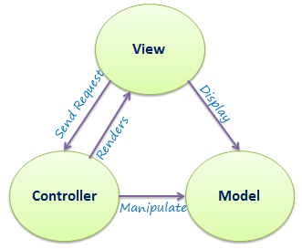
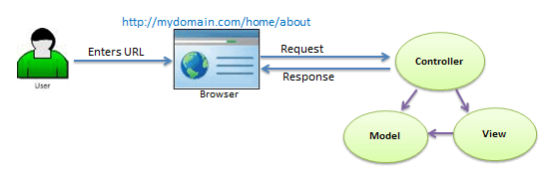
MVC

Slide 4
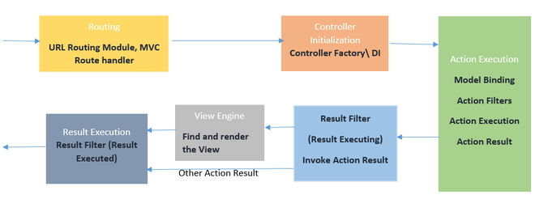
MVC

Slide 5
View
Infarstructure /Cross Cutting Concerns
DI
DB
Logging
Error Handling
Health Check
Resilienece etc.
DTO
Controller
Entity
Service Layer/ Business Layer

Slide 6
https://www.tutorialsteacher.com/mvc/mvc-architecture
https://www.geeksforgeeks.org/asp-net-mvc-life-cycle/
https://www.geeksforgeeks.org/solid-principle-in-programming-understand-with-real-life-examples/

Slide 7
Beginner
View
Controller
Action Method
StateManagement
Filters (Basic use)
Pipeline and Middleware (Intro)

Slide 8
Advanced
SOLID
Dependency Injection
Working with middleware
Authorization and Authentication
Bundling Minification
Hosting

Slide 9
View Engine
• Viewengine is responsible for creating HTML for views.
It converts HTML + Programming language to Pure HTML. To find corresponding view for Action Method
To find view from shared folder.
Used to write C# code on views. Used for HTML helpers
Used in strongly binding view

Slide 10
Razor
Razor is a view engine
Razor is not a new programming language.
View file extension for Razor is .cshtml and .vbhtml
Available in System.Web.Razor namespace
Writing programming language on view is very easy. Easy syntax
"Razor is markup syntax for embedding server-side code into web pages“
It Begin with @ , It can single line, multiline

Slide 11
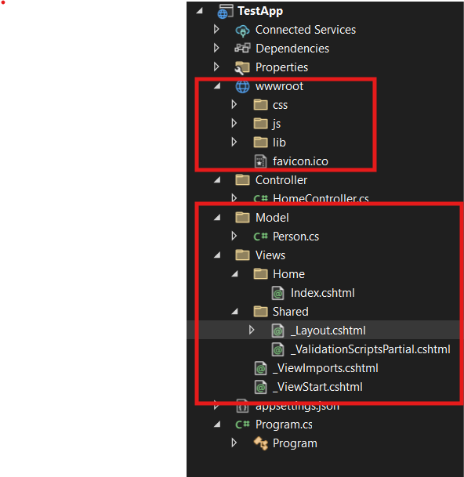
View Components
_ViewStart.cshtml
This is a special file executed before rendering every Razor view in the application.
Its main purpose is to define common configurations (like the layout) so you don’t have to repeat them in every view.
Located in the root of the Views folder (or subfolders).
Example content:
  @{
  Layout = "_Layout";
  }
  Here, the Layout property is assigned to _Layout.cshtml, which applies a consistent layout for all views.

Slide 12
View Components - 2
_ViewImports.cshtml
  This file is used to import namespaces, Razor directives, and custom configurations that you want available in all views.
  Located in the same folder as ViewStart or within specific view folders if needed.
  Commonly used to import things like Tag Helpers or add references.
  Example content:
  @using TestApp
  @namespace TestApp.Pages
  @addTagHelper *, Microsoft.AspNetCore.Mvc.TagHelpers
  _Layout.cshtml
  The _Layout.cshtml file is a key part of the Razor framework in ASP.NET MVC. It's used to define a common layout for your application, like a template that all views share. This ensures consistency across pages (e.g., header, footer, navigation menu) without duplicating code.

Slide 13
View Components - 3
  _Layout.cshtml
  The _Layout.cshtml file is a key part of the Razor framework in ASP.NET MVC. It's used to define a common layout for your application, like a template that all views share. This ensures consistency across pages (e.g., header, footer, navigation menu) without duplicating code.
  Place this file in the Shared folder or another appropriate location.
  Include it in your layout file or individual views to enable validation scripts. Example in _Layout.cshtml:
  @RenderSection("scripts", required: false)
  Then, in your individual views, you can include it:
    @section scripts {
    @Html.Partial("ValidationScripts")
    }

Slide 14
Razor – Conditional Statement, Loops, Directives
Conditional statements (if, else if, ternary operator)
Looping statements (for loop, foreach loop)
How to write html code within Razor code block Directives in Razor

Slide 15
Header→Menu, Login, SIgnUp
_Layout.cshtml
Renderbody()
ContentView.cshmtl
Body
Views /Pages Folder
Abc.com
_Layout.cshtml
_ViewStart.cshtml

Slide 16
Filters
Filters are used to add cross-cutting concerns, such as Logging, Authentication, Authorization, Exception Handling, Caching, etc., to our application. In ASP.NET Core Applications, Filters allow us to execute cross-cutting logic in the following ways:
Before an HTTP request is handled by a controller action method.
After an HTTP request is handled by a controller action method.
After the response is generated but before it is sent to the client.

Slide 17
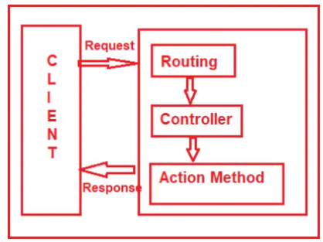
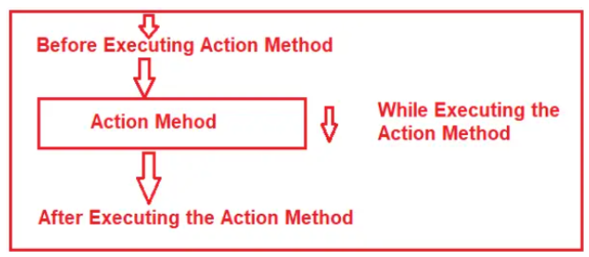
Filters

Slide 18
Filters
Default Filters Execution Order in ASP.NET Core MVC
In ASP.NET Core MVC, filters are executed in a specific order known as the “Default Execution Order“. The default execution order ensures filters are applied properly throughout the request processing pipeline. The default execution order, from the earliest to the latest in the pipeline, is as follows:
Authorization Filters: Authorization filters are executed first. They are responsible for checking whether the current user can access the requested resource or action. If authorization fails, the request will be short-circuited, and the action method will not be executed.
Resource Filters – Execute before model binding.
Action Filters (Before Action Execution): Action filters with “Before Action Execution” logic are executed before the action method is invoked. These filters can perform tasks like logging, input validation, or pre-processing data.
    Action Execution: The action method itself is executed.
    Action Filters (After Action Execution): Action filters with “After Action Execution” logic are executed after the action method completes its execution. These filters can perform tasks like logging, post-processing data, etc.
Result Filters (Before Result Execution): Result filters with “Before Result Execution” logic are executed before the action result is executed. These filters can modify the result or perform additional processing.
  Action Result Execution: The action result, which can be a view or any other result type, is executed.
    Result Filters (After Result Execution): Result filters with “After Result Execution” logic are executed after the action result has been executed. These filters can perform tasks like logging or post-processing of the result.
Exception Filters (If an Exception Occurs): Exception filters are executed if an unhandled exception occurs during the request’s processing. These filters can handle the exception, log it, and return an appropriate error response
    Model Binding: Model binding occurs at this stage. It binds incoming data to action method parameters and executes model validation.

Slide 19
Action Filters
In ASP.NET Core, we can create a Custom Action Filter in two ways: First, by creating a class implementing the IActionFilter interface and providing implementations for [OnActionExecuting] and [OnActionExecuted] methods. Second, by creating a class inheriting from the ActionFilterAttribute class and overriding the [OnActionExecuting] and [OnActionExecuted] methods.
OnActionExecuting: This method is called before the action method is executed
OnActionExecuted: This method is called after the action method executes but before the result is processed.
Note: If you implement the IAsyncActionFilter interface, you need to provide implementations for the OnActionExecutionAsync method.
Real-Time Example to Understand Action Filters in ASP.NET Core MVC:
Let us create one Real-Time Application to understand the need and use of Custom Action Filters in ASP.NET Core MVC Application. We are going to develop one application where we will implement the following functionalities:
Logging: Implementing logging of action method calls, parameters, execution times, etc.
Data Transformation: Modifying the data passed to an action or returned from an action.
Validation: Performing custom validation of action parameters or the request itself.
Error Handling: Implementing custom error handling logic for actions.
Caching: Implementing custom caching strategies for action results.

Slide 20
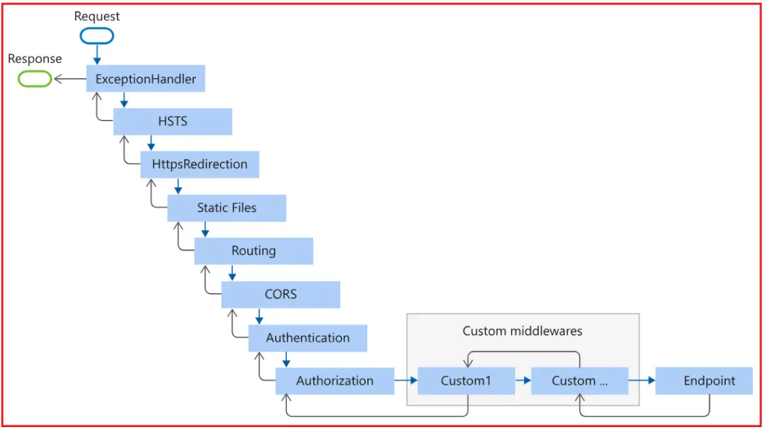
Pipelines
HSTS stands for HTTP Strict Transport Security

Slide 21
Pipelines
Request: This is where the incoming HTTP request enters the pipeline. Each middleware component in the pipeline can inspect, modify, or pass the request to the next component.
ExceptionHandler: This middleware is often used to handle exceptions globally. If an unhandled exception occurs, it handles it, logs it, and returns a proper error response, usually a custom error page or a JSON error message.
HSTS (HTTP Strict Transport Security): This middleware enforces strict security policies, telling browsers to only interact with the application over HTTPS. This means this middleware ensures that the application only serves content over HTTPS and prevents any HTTP requests by enforcing strict transport security policies. This middleware is often used in production environments to enhance security.
HttpsRedirection: This middleware redirects HTTP requests to HTTPS. By redirecting any HTTP request to HTTPS, this middleware ensures that all traffic is encrypted for security.
Static Files: This middleware enables static files like HTML, CSS, JavaScript, and images to be served directly without passing them through the rest of the pipeline. This is useful for files that don’t need processing.
Routing: This middleware maps the incoming request to a route, allowing the application to handle it appropriately. Based on URL patterns and route configurations defined in the application, this middleware determines which controller and action will handle the incoming HTTP request.

Slide 22
Pipelines
CORS (Cross-Origin Resource Sharing): This middleware handles CORS policies (cross-origin requests), allowing or denying requests from different origins. CORS is important for accessing resources from different domains and is essential for APIs used by frontend applications hosted on different origins.
Authentication: This middleware handles the authentication or identity of the user or client making the request by validating credentials (e.g., JWT tokens, cookies, etc.). It ensures that the user is authenticated before reaching certain parts of the application.
Authorization: This middleware determines whether an authenticated user is allowed to access a specific resource or endpoint. It checks if the authenticated user has permission to access the requested resource.
Custom Middlewares (Custom1, Custom…): This represents any custom middleware components you may have added to the pipeline. These custom middleware components can perform various operations on the request or response, such as logging, request modification, caching, modifying headers, custom validation, etc.
Endpoint: This is the target of the request, such as a controller action in MVC, Web API, or a Razor Page. The endpoint processes the request and generates a response.
Response: After the endpoint generates a response, it goes back through the pipeline, allowing each middleware component to modify it before sending it back to the client.

Slide 23
Server Side State Management
ViewBag
ViewData
TempData
Session

Slide 24
Server Side State Management
ViewBag :- ViewBag is a dynamic object to passes the data from the Controller to View. This will pass the data as a property of the object ViewBag. And we have no need to typecast to read the data or for null checking. The scope of ViewBag is permitted to the current request, and the value of ViewBag will become null while redirecting.
ViewData :-ViewData is a dictionary object to pass the data from Controller to View, where data is passed in the form of a key-value pair. Typecasting is required to read the data in View if the data is complex, and we need to ensure a null check to avoid null exceptions. The scope of ViewData is similar to ViewBag, and it is restricted to the current request, and the value of ViewData will become null while redirecting.
TempData :-TempData is a dictionary object to passes the data from one action to another action in the same Controller or different Controllers. Usually, the TempData object will be stored in a session object. Tempdata is also required to typecast and for null checking before reading data from it. TempData scope is limited to the next request, and if we want TempData to be available even further, we should use Keep and Peek.

Slide 25
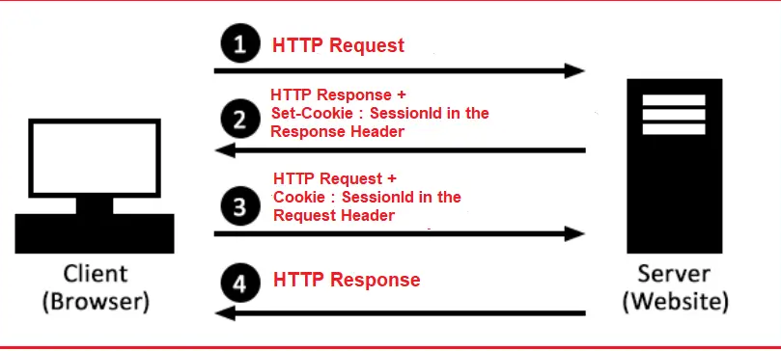
Server Side State Management
Session : - Sessions in Web Applications refer to the mechanism of storing user-specific data temporarily on the server side across multiple requests. Unlike cookies, which are stored on the client side, session data is stored on the server side, enhancing security and reducing the risk of exposing sensitive information. When a user interacts with a web application, a session allows the server to store information relevant to that user during the interaction period. This is useful in stateless HTTP protocols where each request is independent. default session timeout is 20 minutes but can be configured based on business requirements.

Slide 26
Server Side State Management
There are primarily two types of sessions in web applications:
In-Memory or In-Proc Sessions: Data is stored in memory on the web server. This is fast and suitable for small-scale applications but not suitable for large-scale applications or load-balancing environments.
Distributed or Out-Proc Sessions: Data is stored outside the web server process, often using databases or external caching services like Redis or Memcached. This approach is ideal for load-balanced environments to maintain session data consistency.

Slide 27
MVC MISC – AntiForgeryToken
Cross-Site Request Forgery (CSRF), also known as XSRF or Sea Surf, is a type of security attack that exploits the trust that a web application has in an authenticated user’s browser. This allows an attacker to perform actions on behalf of the authenticated user without their knowledge or consent. In a CSRF attack, the attacker tricks the victim into submitting a malicious request to a web application where they are authenticated, exploiting the user’s trust. If this is not clear at the moment, don’t worry; we will try to understand it with an example.
ASP.NET Core generates a unique token called the AntiForgeryToken when a form is rendered. This token is created using the @Html.AntiForgeryToken() helper method in Razor views. The generated token consists of two parts: a hidden field in the form and a cookie. The hidden field ensures the token is sent along with the form data during a POST request while the cookie is stored in the user’s browser. The token is encrypted and securely signed to ensure that it cannot be tampered with by an attacker. So, when we send the request to the server, the token is sent using the hidden form field as well as through the cookie header.
In ASP.NET Core MVC, when a form is submitted, the framework automatically validates the AntiForgeryToken if the [ValidateAntiForgeryToken] attribute is applied to an action method. During validation, the framework compares the token from the hidden field (sent in the POST request) with the token coming from the request header cookie. If the tokens do not match or are missing, ASP.NET Core will throw an exception, preventing the action method from executing, thereby stopping the potential CSRF attack.

Slide 28
Dependency Injection
What are the Different Methods ASP.NET Core Provides to Register a Service with the Dependency Injection Container?
ASP.NET Core provides 3 methods for registering a service with the ASP.NET Core Dependency Injection container. The method we use to register a service will determine its lifetime.
Singleton:
Services registered as Singleton are instantiated once per application and shared throughout its lifetime. It is Ideal for configuration services, logging, or other services where a single instance is sufficient and expensive to create. All requests for the service within the application receive the same instance. The container ensures thread safety when accessing the singleton instance. Exists for the entire duration of the application. This can be achieved by adding the service as a singleton through the AddSingleton method of the IServiceCollection.
Transient:
Services registered as Transient are created each time they are requested. This method is suitable for lightweight, stateless services with short-lived and transient behavior. A new instance is created every time the service is requested, and instances are not shared among different consumers. This can be achieved by adding the service through the AddTransient method of the IServiceCollection.
Scoped:
Services registered as Scoped are created once per request (in a web application, this typically means per HTTP request). It is used for services that should be reused within a single request, maintaining state across different components of the request, but should not be shared across different requests. Instances are disposed of at the end of the request. Common examples include data access operations within a single transaction. This can be achieved by adding the service through the AddScoped method of the IServiceCollection.

Slide 29
Dependency Injection
Dependency Injection (DI) is a design pattern used in ASP.NET Core to manage dependencies in a structured way. It helps make components loosely coupled, testable, and easier to maintain.
. Why Use Dependency Injection?
✅ Decouples components – Avoids hardcoding dependencies.
✅ Improves maintainability – Easier to update dependencies without modifying multiple files.
✅ Enhances testability – Allows mocking dependencies for unit testing.
✅ Built-in support in ASP.NET Core – No need for third-party frameworks.
Transient Lifetime Overview
New instance is created each time the service is injected.
Ideal for stateless services that do not maintain shared state.
Lifetime | Created per | Use case
Transient | Each request | Lightweight, short-lived objects
Scoped | Per HTTP request | Services that maintain state per request
Singleton | App lifetime | Single instance for caching, logging

Slide 30
Dependency Injection
Single object of Ilogger Type
Single Object of IDBOps
Request
New ITestbuiness1, new ITestbuiness2
New ITestbuiness1, new ITestbuiness2
Request
Single Object of IDBOps
New ITestbuiness1, new ITestbuiness2
Request
Test Controller

Slide 31
Logging
Serilog is a powerful logging framework for .NET that provides structured logging, allowing you to capture logs in various formats and send them to different sinks (such as files, databases, or cloud services).
Install Serilog Packages
Serilog
Serilog.AspNetCore
Serilog.Settings.Configuration
dotnet add package Serilog.Sinks.File

Slide 32
EF Core
What is Entity Framework Core?
Entity Framework Core (EF Core) is an open-source, lightweight, extensible, and cross-platform version of Microsoft’s popular Entity Framework data access technology. It is designed to work with .NET Core and .NET Framework applications and provides an Object-Relational Mapper (ORM) that enables .NET developers to work with a database using .NET objects. It eliminates most of the data-access code that developers usually need to write.
What is ORM?
ORM stands for Object-Relational Mapping, a programming technique that allows developers to convert data between incompatible systems, specifically between Object-Oriented Programming Languages (such as C#, Java, etc.) and Relational Databases (such as SQL Server, MySQL, Oracle, etc.).
ORM allows developers to work with data in terms of objects rather than tables and columns. That means ORM automatically creates classes based on database tables, and vice versa is also true. It can also generate the necessary SQL to create the database based on the classes.
As developers, we mainly work with data-driven applications, and the ORM Framework can generate the necessary SQL (to perform the database CRUD operation) that the underlying database can understand. It takes responsibility for opening the connection, executing the command, handling the transaction to ensure data integrity, closing the connection, etc. So, in simple words, we can say that the ORM Framework eliminates the need for most of the data access code we generally write.

Slide 33
EF Core
Simplifies Data Access: ORMs abstract the complexities of data access, allowing developers to interact with the database in an object-oriented rather than writing complex SQL queries.
Reduces Repetitive Code: ORM frameworks automatically generate SQL queries, handle connection management, and perform CRUD operations, reducing the amount of repetitive code developers need to write.
Increased Productivity: Developers can build applications faster by focusing on the application logic rather than data access details.
Cross-Platform Compatibility: ORM frameworks like EF Core work across different platforms and databases, making it easier to develop cross-platform applications.
Increased Performance: ORMs support Lazy Loading, Eager Loading, and Caching to optimize data retrieval operations.
Data Integrity: ORM frameworks include capabilities such as concurrency handling and transactions that help maintain data integrity without extra effort from developers.

Slide 34
EF Core – Dependencies
Supports following Database via Nuget Package -EF Core DB Provider
Microsoft SQL Server: The NuGet Package for Microsoft SQL Server is Microsoft.EntityFrameworkCore.SqlServer, Microsoft.EntityFrameworkCore.Tools
SQLite: The NuGet Package for SQLite is Microsoft.EntityFrameworkCore.Sqlite
MySQL: The NuGet Package for MySQL is Pomelo.EntityFrameworkCore.MySql
PostgreSQL: The NuGet Package for PostgreSQL is Npgsql.EntityFrameworkCore.PostgreSQL
InMemory: The NuGet Package for In-Memory Database is Microsoft.EntityFrameworkCore.InMemory.
Oracle: The NuGet Package for Oracle Database is Oracle.EntityFrameworkCore
MongoDB: The NuGet Package for MongoDB Non-Relational Database is MongoDB.EntityFrameworkCore
EF Core Tools Package is needed for following
Database Connectivity: The EF Core Database Provider package provides the necessary classes and methods to establish a connection with the database.
LINQ Support: This Package also enables LINQ queries to be translated into SQL queries that the database can understand.
Database Migrations: Supports database migrations to update the database schema over time.
CRUD Operations: It also provides APIs (i.e., methods) for performing Create, Read, Update, and Delete operations on the database.

Slide 35
EF Core
Entity Mapping
One-To-One
One-To-Many
Many-To-Many
Schema Mapping
Convention
Annotation
Configuration

Slide 36
EF Core – Create/Update DB Schema
We need to define a Entity Class (Plain Old CLR Object - POCO class). We can define DB schema through entity using following things
Convention – Here UserID and ID property will be mapped to respective column name and as well as primary key in respective table
public class User
{
//convention
public int UserID { get; set; }
}
public class Role
{
//convention
public int ID { get; set; }
}
Annotation – You can map constraints (primary key/ foreign key), table name, column name using annotation
[Table("EFCore_User")]
public class Test
{
[Key]
public int TestID { get; set; }
public int UserID { get; set; }
public int Id { get; set; }
[Column("UserName")]
public string Name { get; set; }
public string Email { get; set; }
}

Slide 37
EF Core – Create/Update DB Schema
Index Annotation
Use namespace and nuget package → using Microsoft.EntityFrameworkCore;
[Index(nameof(UserName), nameof(EmailID), Name = "IX_User_Username_Rating", AllDescending = true)]
public class User
{
//primery key column by convention
[Key]
public long UserID { get; set; }
. Alternatively you can use below code in OnModelCreating Method
protected override void OnModelCreating(ModelBuilder modelBuilder)
  {
  modelBuilder.Entity<User>()
  .HasIndex(u => u.Email)
  .IsUnique();
  }
Not Mapped Annotation → The [NotMapped] attribute in Entity Framework Core tells EF Core to ignore a property or class when mapping your model to the database. It’s perfect for properties that are used only in code—like calculated values or temporary data—that shouldn’t be stored in the database.
    public class Employee
    {
    public int EmployeeId { get; set; }
    public string FirstName { get; set; }
    public string LastName { get; set; }
    [NotMapped]
    public string FullName => $"{FirstName} {LastName}";
    }

Slide 38
EF Core – Create/Update DB Schema
DataBaseGenerated Entity
  The [DatabaseGenerated] attribute in Entity Framework Core is used to control how the value of a property is generated by the database, rather than the application. It’s especially useful for primary keys, timestamps, or computed columns.
  [DatabaseGenerated(DatabaseGeneratedOption.Identity)]
  public int Id { get; set; }
  [DatabaseGenerated(DatabaseGeneratedOption.Computed)]
  public DateTime LastModified { get; set; }
  [DatabaseGenerated(DatabaseGeneratedOption.None)]
  public int CustomId { get; set; }

Slide 39
EF Core – Create/Update DB Schema
Timestamp
The [Timestamp] attribute in Entity Framework Core is used to handle concurrency conflicts—situations where multiple users try to update the same record at the same time. It marks a property (typically a byte[]) as a concurrency token, which EF Core uses to detect if the data has changed since it was last read.
How it works
When you apply [Timestamp] to a property:
EF Core maps it to a row version column in the database (usually rowversion in SQL Server).
Every time a row is updated, the database automatically changes the value of this column.
EF Core includes this column in the WHERE clause of UPDATE and DELETE statements.
If the value has changed since the entity was loaded, EF Core throws a DbUpdateConcurrencyException.
public class Product
{
public int ProductId { get; set; }
public string Name { get; set; }
[Timestamp]
public byte[] RowVersion { get; set; }
}
OR Fluent
modelBuilder.Entity<Product>()
.Property(p => p.RowVersion)
.IsRowVersion();

Slide 40
User
UserName Naresh
ID 1
1 Paresh
Suresh 1
Timestamp → rowid
1 Suresh

Slide 41
EF Core – Create/Update DB Schema
ConcurrencyCheck Attribute
The [ConcurrencyCheck] attribute in Entity Framework Core is used to mark one or more properties as concurrency tokens, helping prevent accidental overwrites when multiple users or processes try to update the same data simultaneously.
How it works
When you apply [ConcurrencyCheck] to a property:
EF Core includes that property in the WHERE clause of UPDATE and DELETE statements.
If the value in the database has changed since the entity was loaded, the operation fails with a DbUpdateConcurrencyException.
public class Product
{
public int ProductId { get; set; }
[ConcurrencyCheck]
public string Name { get; set; }
public decimal Price { get; set; }
}
OR Fluent
  modelBuilder.Entity<Product>()
  .Property(p => p.Name)
  .IsConcurrencyToken();

Slide 42
EF Core – Create/Update DB Schema
DataBaseGenerated Entity
  The [DatabaseGenerated] attribute in Entity Framework Core is used to control how the value of a property is generated by the database, rather than the application. It’s especially useful for primary keys, timestamps, or computed columns.
  [DatabaseGenerated(DatabaseGeneratedOption.Identity)]
  public int Id { get; set; }
  [DatabaseGenerated(DatabaseGeneratedOption.Computed)]
  public DateTime LastModified { get; set; }
  [DatabaseGenerated(DatabaseGeneratedOption.None)]
  public int CustomId { get; set; }
Timestamp
The [Timestamp] attribute in Entity Framework Core is used to handle concurrency conflicts—situations where multiple users try to update the same record at the same time. It marks a property (typically a byte[]) as a concurrency token, which EF Core uses to detect if the data has changed since it was last read.
How it works
When you apply [Timestamp] to a property:
EF Core maps it to a row version column in the database (usually rowversion in SQL Server).
Every time a row is updated, the database automatically changes the value of this column.
EF Core includes this column in the WHERE clause of UPDATE and DELETE statements.
If the value has changed since the entity was loaded, EF Core throws a DbUpdateConcurrencyException.

Slide 43
EF Core – Create/Update DB Schema
DataBaseGenerated Entity
  The [DatabaseGenerated] attribute in Entity Framework Core is used to control how the value of a property is generated by the database, rather than the application. It’s especially useful for primary keys, timestamps, or computed columns.
  [DatabaseGenerated(DatabaseGeneratedOption.Identity)]
  public int Id { get; set; }
  [DatabaseGenerated(DatabaseGeneratedOption.Computed)]
  public DateTime LastModified { get; set; }
  [DatabaseGenerated(DatabaseGeneratedOption.None)]
  public int CustomId { get; set; }
Timestamp
The [Timestamp] attribute in Entity Framework Core is used to handle concurrency conflicts—situations where multiple users try to update the same record at the same time. It marks a property (typically a byte[]) as a concurrency token, which EF Core uses to detect if the data has changed since it was last read.
How it works
When you apply [Timestamp] to a property:
EF Core maps it to a row version column in the database (usually rowversion in SQL Server).
Every time a row is updated, the database automatically changes the value of this column.
EF Core includes this column in the WHERE clause of UPDATE and DELETE statements.
If the value has changed since the entity was loaded, EF Core throws a DbUpdateConcurrencyException.

Slide 44
EF Core – Create/Update DB Schema
Configuration :-
We can override on OnModelCreating while Creating the DBContext Class by inertoing DbContext class of EF Core.
protected override void OnModelCreating(ModelBuilder modelBuilder)
{
#region Relationships
//Fluent expression
modelBuilder.Entity<UserRole>()
.HasOne(i => i.Scope)
.WithMany(i => i.UserRoles)
.HasForeignKey(i => i.ScopeID);
#endregion
#region Properties
modelBuilder.Entity<User>()
.Property(b => b.Name)
.HasMaxLength(100)
.IsRequired();
modelBuilder.Entity<User>()
.Property(b => b.CreatedBy)
.IsRequired();
modelBuilder.Entity<User>()
.Property(b => b.CreatedDate)
.IsRequired()
#endregion
}

Slide 45
EF Core – DB Context Class
What are the Tasks Performed by DbContext in Entity Framework Core?
DbContext class is part of Microsoft.EntityFrameworkCore performs several essential tasks in EF Core. They are as follows:
Entity Tracking: It tracks the state of entities (Added, Modified, Deleted, or Unchanged) and keeps a record of changes that need to be persisted in the database.
Database Interactions: Executes queries, commands, and transactions against the database using the configured provider.
Query Execution: It translates LINQ queries into SQL and executes them against the database.
Change Detection: Identifies changes in the entities and prepares the corresponding SQL commands for execution. That means it generates and executes SQL commands to insert, update, or delete data based on changes to entity objects.
Transaction Management: Manages transactions for multiple operations, ensuring that changes are committed or rolled back as needed.
Lazy Loading: Enables lazy loading of related entities if configured, meaning related data is loaded only when accessed.
Caching: Provides first-level caching of entities during a single DbContext instance’s lifetime, reducing the need for repeated database calls for the same entity.
Concurrency Control: Handles concurrency conflicts using optimistic concurrency, allowing for handling multiple users making changes simultaneously.
Managing Relationships: It manages relationships between entities, including the loading and updating related data.
We have to inherit this class to a custom DbContext class for DB operation using EF Core. Pleas refer the comments in the code to understand more about this class.

Slide 46
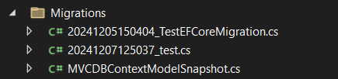
EF Core – Migration – Code First approach
Tools -> NuGet Package Manager -> Package Manager Console and enter the following command:
add-migration “<name>” – It will create C# files with necessary code to run command to create/update schema
update-database – It will apply the changes in the database
Remove-migration – It will remove the migration files from Migrations folder
Get-Migration – It will get list of migration
If you want to make any change to the schema update the entity class through annoptaion, convetion or configuration and then run add-migration command agan

Slide 47
EF Core – AsNoTracking
AsNoTracking() in Entity Framework Core is used to improve query performance by disabling entity tracking. When applied, EF Core does not track changes to the queried entities, reducing memory usage.
✅ Improves Performance – Avoids unnecessary tracking when you don’t need to update entities.
✅ Reduces Memory Usage – Saves memory by skipping entity tracking overhead.
✅ Optimizes Read-Only Queries – Best for scenarios where you are only retrieving data, not modifying it.

Slide 48
EF Core – Set Up
Step 1 →Take a Asp .net Core MVC Application
Step 2 → Add a Class Library for “Entity”
Step 3 → Create User, Role, UserRole, Scope entity class. Follow Annotation, Convention to map properties and classes to Database objects/properties like primery key , foreign key, max length
https://learn.microsoft.com/en-us/ef/core/modeling/relationships/mapping-attributes
Step 4 → Add a Class Library for “Repository”
Step 5 → Install Nuget package “Microsoft.EntityFrameworkCore” in “Repository project”
Step 6 → Create a custom DbContext class in “Repository”. Add relationships and other properties/objects using
OnModelCreating() method (Configuration)
Step 7 → Install Nuget package “Microsoft.EntityFrameworkCore,
Microsoft.EntityFrameworkCore.SqlServer,
Microsoft.EntityFrameworkCore.Tools” in “MVC project”
Step 7 → Add this in MVC project program.cs file Main() method
builder.Services.AddDbContext<ESSPLERPDbContext>(options =>
options.UseSqlServer(builder.Configuration.GetConnectionString("DefaultConnection")));
Step 8 → Add this in “MVC project” program.cs file Main() method
builder.Services.AddDbContext<ESSPLERPDbContext>(options =>
options.UseSqlServer(builder.Configuration.GetConnectionString("DefaultConnection")));
Step 8 → Add ConnectionString AppSettings.json file in “MVC Project”
    "ConnectionStrings": {
    "DefaultConnection": "Server=your_server;Database=your_db;Trusted_Connection=True;MultipleActiveResultSets=true"
    }

Slide 49
EF Core – Set Up 2 (Migration)
Entity Framework Core (EF Core) Migrations is a feature that allows you to manage and apply database schema changes over time, without manually altering the database. It enables version control for your database structure and makes it easier to add, update, or delete tables and columns.
Why Use EF Core Migrations?
✅ Version Control for Schema – Tracks changes in your database structure.
✅ Automates Database Updates – Avoids manual SQL scripts.
✅ Works with Code-First Approach – Lets you define database structure in C# models instead of SQL.
Open Nuget Package Manager console (make sure you select the project where your DbContext class is present)
and use the following command
First Time Migration
  Add-Migration <name>
  Update-Database
    To update schema after changing Entities
    Add-Migration <name>
    Update-Database
    Rolling back specific migration
    Update-Database <name>

Slide 50
User
Role
N
N
1
N
Device

Slide 51
EF Core – Lazy Loading Vs Eager Loading Vs Explicit Loading
1. Lazy Loading
🔹 Loads related data only when accessed.
🔹Reduces initial query size, improving performance.
🔹 Requires the virtual keyword in navigation properties.
2. Eager Loading
🔹 Loads related data immediately with the main entity.
🔹 Uses the Include() method to fetch all necessary data in a single query.
var users = await _context.Users.Include(u => u.UserRoles).ToList();
3. Explicit Loading
🔹 Loads related data manually when required.
🔹 Requires LoadAsync()/ Load() for controlled loading.
🔹 Works best when not all related data is needed immediately.
var user = _context.Users.Find(userId);
_context.Entry(user).Collection(u => u.UserRoles).Load();

Slide 52
CCC
MVC
DTO
Manager/Service
Entity
DataLayer/Repository
CCC -> CROSS CUTTING CONCERN
e.g. Logging, Tracing, Utility functions
DB

