Slide 1
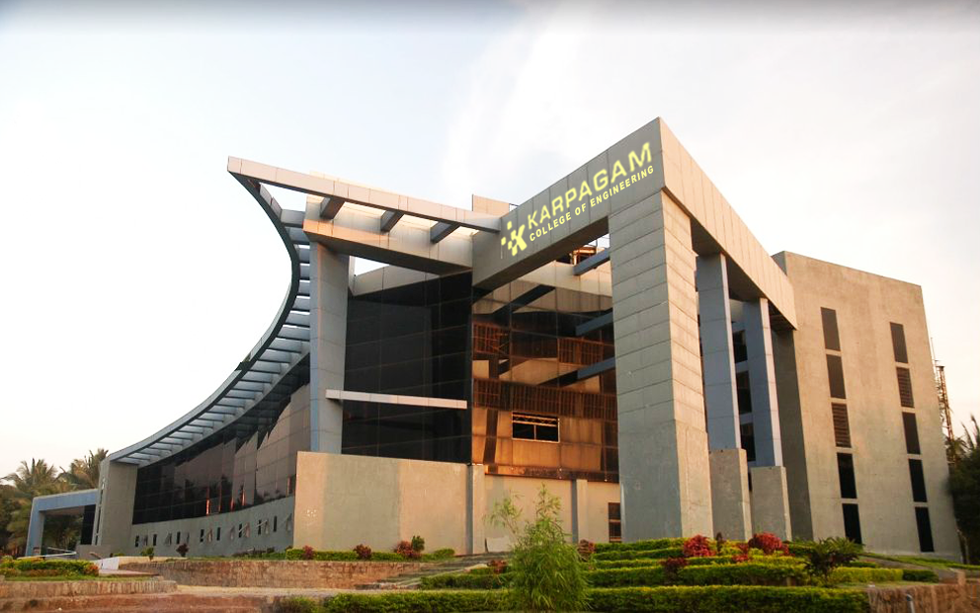

ONLINE VOTING SYSTEM USING FACIAL AUTHENTICATION
GUIDE:
Dr. Kala R (Associate Professor/CSE)
STUDENT NAME:
KALAIMARAN M (20P220)
NARESH KUMAR S (20P230)
PAVAN KUMAR R (20P233)

Slide 2
SLIDE TITLE

Slide 4
SLIDE TITLE
SL.NO

