Slide 1
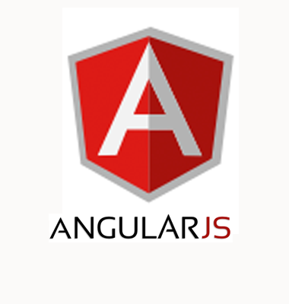
Day 1
Quick Review – JavaScript
AngularJS Introduction
Directives
Data Binding
Modules
Controllers

Slide 2
About Me
Satyanarayana T
About 16 yrs Experience in
  7 years in Java based Enterprise Application Development
  9 years in Training
Technical Trainer and Consultant
+91 9440220062
satyamtd@gmail.com

Slide 3
About Your
Dynamic Web Application Development Experience
  Front-End (UI) Technologies
  Server Side Technologies
Design Patterns Used / Implemented

Slide 4
Development Environment
Development environment: Code Editor + Web Server
  Brackets (brackets.io)
Browser
  Google Chrome
Text Editor
  System Text Editor (Notepad)
IDE
  Netbeans / WebStorm / Eclipse / Dreamweaver / VisualStudio
Browser
  Firefox / Safari / Opera / IE

Slide 5
Quick Review - JavaScript
JavaScript is a scripting language designed primarily for adding interactivity to Web pages and creating Web applications.
<head>
<script>
JavaScript statement(s)
</script>
<script src="mycode.js">
</script>
</head>
<body>
<script>
JavaScript statement(s)
</script>
<body>
internal script - put in <head> section
external JavaScript file
inline script - put in <body> section

Slide 6
Quick Review - Java Script
Values and Types in Java Script
  String / Number / Boolean
  Array, Object, Function
Java Script Object Notation (JSON)
DOM (Document Object Model) Manipulation

Slide 7
What we are building?
We are going to build a basic Restaurant Digital Menu and Ordering Application web application for Customers.
  This will make easier for the customers to navigate and know exactly what they are looking for.
  Customers are able to place an order and able to know Amount for each ordered item.
  Provision for modifying quantity of placed order, cancel an item or an order.
  View Total Bill Amount before ordering FINAL Food Order.
This application is to understand the features of AngularJS.
This application is going to be purely client side, so we aren’t going to store data manipulations in a server.

Slide 8
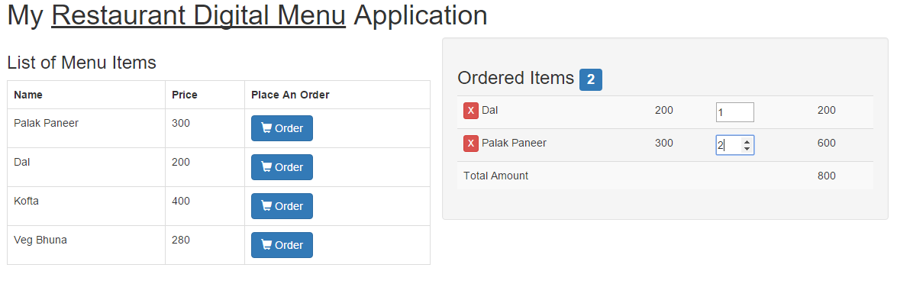

Expected Output

Slide 9
HTML5 Browser Support
How well does your browser support HTML5 family of technologies.
Find out and determine the current level of support for each latest version of the browser using:
  www.html5test.com
  http://fmbip.com/
  http://caniuse.com/

Slide 10
Getting Started
Create a New Project in your workspace.
Create css and js folder in your project root folder
Lets Create a Static web page to display Restaurant Menu Details
<!DOCTYPE html>
<html>
<head>
</head>
<body>
<h1>Restaurant Digital Menu</h1>
</body>
</html>

Slide 11

Cascading Style Sheet
CSS can add style to your pages, enhancing and improving the presentation of your content.
Implementing CSS
  1 – Add in the head section (Style Tag)
  2 – In the Style (Style Attribute)
  3 – Link to external file

Slide 12
Hands On Example - Using Bootstrap
Bootstrap is a HTML, CSS and JS framework aims to ease web development.
It is a collection of CSS classes and tools for Web Sites.
  Download Bootstrap from http://getbootstrap.com/ (OR)
  Use CDN (Content Delivery Network)
Copy bootstrap.css file in css folder
In Web Page, Link the css file
<link rel="stylesheet" href="css/bootstrap.css"/>
Verify the Output

Slide 13
Bootstrap Grid System
Bootstrap 3 includes predefined grid classes for quickly making grid layouts.
Creating Two Column Layout:
Bootstrap grid system is based on 12 columns, so to keep the columns in a one line (i.e. side by side), the sum of the grid column numbers in each row should be equal to 12.
<h1>Restaurant Digital Menu</h1>
<div class="col-sm-6“>
<h3>List of Menu Items</h3>
</div>
<div class="col-sm-6 well“>
<h3>Ordered Items</h3>
</div>

Slide 14
Hands On - Bootstrap
  Presenting list of menu items in tabular format
<table>
<tr><th>Name</th><th>Price</th><th>Place Order</tr>
</table>
  The table class improve the appearance of table in a simple way.
  <table class=“table">
  The table-bordered class add borders to the all table cells.
  <table class=“table table-bordered">
  The table-striped class used for alternate background like zebra-stripes.
  <table class=“table table-bordered
  table-striped">

Slide 15
Hands On Exercise
Display Ordered Items Name, Price, Quantity, Amount and Total Amount in tabular format

Slide 16
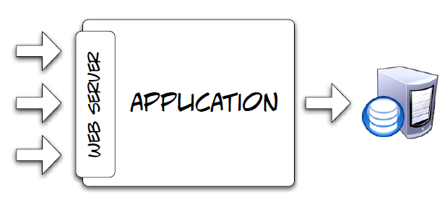
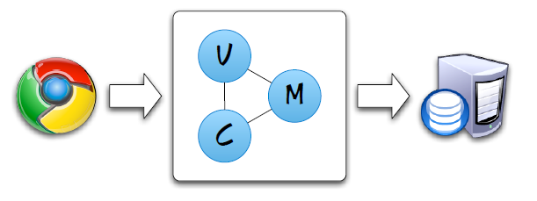
Web Application Development (#1)
Let's take a typical use case where a user enters data in a textbox and clicks on a Submit button.
Traditional Web Application Development
  Server-side web applications, server dictates to the client about what activities to perform and what user interface to display.
  A Web Server with Application Logic.
  An Application accessible over HTTP

Slide 17
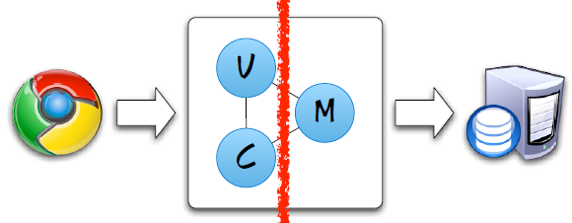
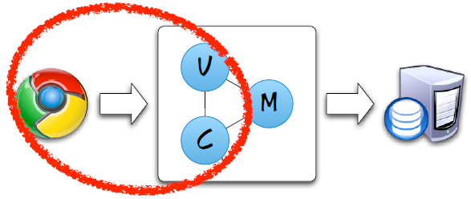
Web Application Development (#2)
Modern Web Application Development
  The user experience can be made better with client-side driven applications than server-side driven applications.
  As you know, using AJAX, the response is rendered in the UI without any page refresh.
Enterprise Application Development: If we separate the code into various components, we would end up with a Model View Controller (MVC) architecture.

Slide 18
Java Script MVC Frameworks
In MVC architecture,
  Model takes care of application data.
  View takes care of presenting data
  Controller coordinates between the Model and the View .
Client-Side MVC Frameworks
  A Framework gives you an architecture and you will need to follow the rules.
  JavaScript MVC frameworks provide developers an API to develop an Client-Side Enterprise Application using MVC.
Java Script Frameworks.
  AngularJS
  KnockoutJS, BackboneJS, EmberJS

Slide 19
What is AngularJS?
AngularJS is an open-source JavaScript MVC framework developed by Google built on top of jQuery Lite.
Implement many Design Patterns e.g.:
  MVC Pattern, Singleton, Dependency Injection etc..,
Developed in 2009 by Miško Hevery and Adam Abrons
They called it Angular because of all the angular brackets in HTML.
It’s a complete client side solution i.e. it all happens within browser, making it an ideal partner with any server technology.
It helps to create Rich Internet Applications and / or Single Page Applications.

Slide 20
Why Angular?
With AngularJS, developer write less code and get more functionality i.e. Simplifies Application Development.
It makes development and testing easier.
  Client-side MVC
  Modular Approach
  Two-way Data Binding
  Dependency Injection
  Routing
  Directives
  Filters
  Controllers
  Services
  Build and Deployment

Slide 21
Where to and Where Not to Use?
Where To Use?
Not every app is a good fit for Angular
Angular was built with the CRUD (data driven) application in mind.
Best suited for SPA development
Where Not To Use?
Games and GUI editors are examples of applications with intensive and tricky DOM manipulation.
In these cases it may be better to use a library with a lower level of abstraction, such as jQuery.

Slide 22
About AngularJS . . .
Visit madewithangular.com
AngularJS Versions
  Visit angularjs.org
  Visit angular.io
Angular 3rd party modules
  ngmodules.org
Frameworks based on AngularJS
  Ionicframework.com

Slide 23
Best Practice - Organizing your code
Developing a Web Application for the following users:
  Customers
  Staff
  Management
  Suppliers
  Admin
  Tele Callers
  Visitors / Guests
Best Practice is Organizing you application using Modules

Slide 24
AngularJS Framework API
Angular API is organized in the form of modules.
A module is a collection of various components of an AngularJS application.
These Components are
  Directives
  Filters
  Services
  Global APIs
  Templates
The default module is ng
Other Modules are: ngRoute, ngAnimate, ngResource, . . .

Slide 25
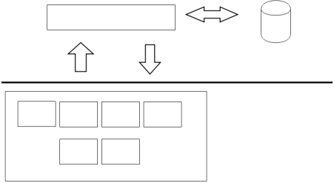
Anatomy of an Angular Application
REST Endpoints
Database
JSON
Server
Client
Views
Controllers
Filters
Directives
Services
Factories
Angular App

Slide 26
Developing an Angular Application
Migrating Our Static Page to Angular Application
Copy angular.js file in js folder of your project
Include “angular.js” script in your web page
<script src="angular.js"></script>
The ng module is loaded by default when an AngularJS application is started.

Slide 27
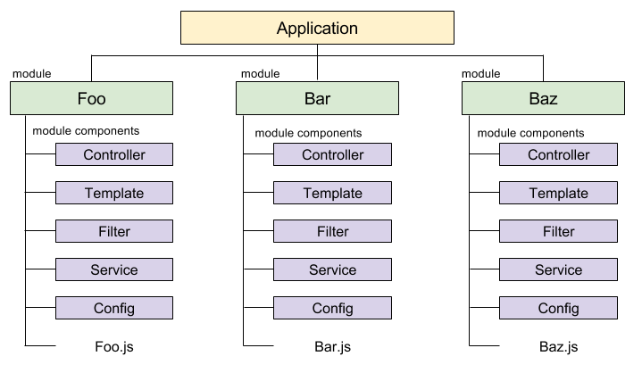
Angular Application Development
AngularJS encourage us to break our code into smaller pieces.
Application is organized in the form of modules.
Modules contain Controllers, Services, Directives, . . . .

Slide 28
Creating a Module
Use angular.module function in ng module.
  This function is used for creating, and retrieving Angular modules.
  All modules (angular core or 3rd party) that should be available to an application must be registered using this mechanism.
angular.module(name, [requires], function);
  When passed two or more arguments, a new module is created.
  If passed only one argument, an existing module (the name passed as the first argument to module) is retrieved.
angular.module('myapp',[]);
An app is an instance of a module
var app = angular.module("MyApp", []);

Slide 29
Hands On Example – Creating a Module
Create a java script file menuapp.js file in js folder
Include menuapp.js file in your web page
<script src="js/menuapp.js"></script>
Create a module myMenuApp in menuapp.js file
var app = angular.module("myMenuApp", []);

Slide 30
Directives
Directive is an custom attribute, element or a class that augments an existing DOM element or represents a reusable DOM component.
The ng-app directive is used to bootstrap an Angular Application
  specifies a root module for an AngularJS application.
  Used as an attribute for ANY html tag which designates the boundary of an Angular Application.
  Syntax: <HTML Tag ng-app=“modulename”>
Use myMenuApp module as Angular Application Startup module
<html ng-app=“myMenuApp” >
OR
<div ng-app=“myMenuApp”>

Slide 31
Angular Application Process Flow
Angular Application process flow is called as Bootstrapping an angular application.
Automatic Initialization: Automatic bootstrapping by adding ng-app to the element in your HTML
Manual Initialization: Bootstrapping from the JavaScript. You should call angular.bootstrap() after you’ve loaded or defined your modules.

Slide 32
Automatic Bootstrap Process Flow
In Browser, URI request is made
Angular.js is downloaded
Bootstrap callback is registered by angular
HTML is fully downloaded and angular callback is executed
Angular traverse DOM tree to find ng-app directive
Angular locates the tag containing the ng-app directive and define it’s as the root of Application.
Then AngularJS Instantiates the module and creates an $injector object which is responsible for creating and injecting dependencies.
A scope object called $rootScope is created that will become the context for the app’s model.
Angular compiles the DOM by starting at the ng-app root element registering all the directives and bindings in the HTML

Slide 33
Model in View
Model is responsible for containing data of our application.
The ng-init attribute directive initializes application data in scope object.
Syntax:
<HTML Tag ng-init=“modelname = value”>
Initialize a model “appHeading”
  <body class=“container”>
  <div ng-init="appHeading='My Restaurant Digital Menu Application'">

Slide 34
Data Binding
Data-binding is an automatic synchronization of data between a View (HTML) and Model (simple JavaScript variables).
Angular waits for browser events that might change to the model
When an event occurs, Angular checks for change to the model.
If changes to the model are found, Angular updates the affected bindings within the view
Angular Supports
  One-way data binding: Model to View
  Two-way Data Binding: Model to View and Vice-versa

Slide 35
One-way Data Binding
ng-bind Attribute Directive tells Angular to replace the text content of the specified HTML element with the value of a given model.
Syntax: <HTML Tag ng-bind=“modelname”>
<h1 ng-bind="appHeading"></h1>

Slide 36
Module Dependencies
Modules can list other modules as their dependencies.
Modify our model value with HTML tag.
My <u>Restaurant Digital Menu</u> Application
HTML Content in AngularJS
  By default AngularJS will escape any HTML markup.
  AngularJS will not allow HTML content found in the model in order to prevent HTML injection attacks.
ng-bind-html directive allows all HTML tags entered by users.

Slide 37
Module Dependencies Contd..,
The ng-bind-html directive resides in a separate module (ngSanitize) and requires inclusion of an additional source file: angular-sanitize.js.
Declare dependency of ngSanitize module in current module:
angular.module(‘myMenuApp', ['ngSanitize'])
Applying sanitize in view
<h1 ng-bind-html=“appHeading"></h1>

Slide 38
Module Loading Process
Each module you build is composed of various type of component objects that collaborate to get stuff done.
These objects need to be instantiated and wired together for the app to work.
During Angular bootstrap process, these objects are registered, instantiated and wired together in two phases.
  Configuration Phase: during this phase a module registers its components.
  Run Phase: get executed after the injector is created and are used to kickstart the application.

Slide 39
Hands On Example
Understanding Module Loading Process
Define config and run in application module.
app.config(function() {
console.log("My App Config")
});
app.run(function() {
console.log("My App Run")
})

Slide 40
Hands On Exercise
Create a new Java Script File appcontrollers.js file in JS folder.
Include appcontrollers.js file in your web page
Create a module “CtrlModule” and create following
  Module Configuration block (Phase)
  Module Run Block (Phase)
Use CtrlModule as dependency for myMenuApp module.
Depending on a module implies that the required module needs to be loaded before the application module is loaded.

Slide 41
AngularJS Controllers
Controllers allows us to define data and behaviors to views
A Controller is a component of a module.
controller() function of module object is used to register a controller. Syntax:
mod.controller(“Controller Name”, function() { })
A controller is a constructor function which is instantiated by AngularJS when it encounters ng-controller directive in HTML.
ng-controller directive is used to attach Controller to View.
Attach Controller to DOM :
<div ng-controller=“MenuController">

Slide 42
Model in Controller
When Angular compiles ng-controller directive, it creates
  a new child scope object and
  is available as an injectable parameter to the Controller's constructor function as $scope
  Scope is a JavaScript Object to communicate between controller and view.
  AngularJS uses Scope object to access the model and functions defined in a controller to the view.
Define a model menuitem (JSON format)
c.controller(‘MenuController', function($scope){
$scope.menuitem = {"code":"VG101", "name":"Palak Paneer", "price":300, "description":"This is Item 1 description"}
})

Slide 43
One-way Data Binding using {{ }}
Interpolation or expression used to bind data to html.
Expressions are written inside double braces like {{expression}}.
<tr>
<td>{{menuitem.name}}</td>
<td>{{menuitem.price}}</td>
</tr>
Expressions are much like JavaScript expressions: can contain literals, operators and variables.
  {{ 1 + 2 }}
  {{ a + b }}
  {{ “Naresh” }}

Slide 44
Hands On Exercise
Create a new controller OrderController in Current Module
Define a model orderedItems
Attach OrderController to the View.
Display Total number of ordered items.

Slide 45
Iterating an Array
To repeat a series of elements instead of just one.
The ngRepeat directive instantiates a template once per item from a collection.
Each instance gets its own scope, where the given loop variable is set to the current collection item, and $index is set to the item index or key.
<ul>
<li ng-repeat="e in collection">{{e}} </li>
</ul>

Slide 46
Hands On - JSON Array
Define a data model in MenuController to contain Multiple Menu Item details.
var menuitems = [{"code":"VG101", "name":"Palak Paneer", "price":300, "description":"This is Item 1 description"},
{"code":"NV101", "name":"Chicken Tikka", "price":500, "description":"This is NV Item 1 description"},
{"code":"NV201", "name":"Egg Omlet", "price":200, "description":"This is NV Item 2 description"},
{"code":"VG102", "name":"Dal", "price":250, "description":"This is Item 2 description"}]

Slide 47
Display List of Menu Items
In Menu Controller, Define scope variable
$scope.itemsList = menuitems;
Display Item name and price of all menuitems, Use
ng-repeat to display all menuitems in tabular format
<table class="table table-bordered">
. . .
<tr ng-repeat=“menuitem in itemsList">
<td>{{menuitem.name}}</td> <td>{{menuitem.price}}</td>
</tr>
</table>

Slide 48
Place an Order Functionality
Create a button for each item to place an Order
<td><button class="btn btn-primary“> Order</button></td>
Add shopping cart icon to the button
<td><button class="btn btn-primary glyphicon glyphicon-shopping-cart“> Order</button></td>
Create Click Event for button using ng-click directive
<td><button class="btn btn-primary"
ng-click=“placeOrder(menuitem)"> <span class="glyphicon glyphicon-shopping-cart"></span> Order</button></td>

Slide 49
Sharing data between controllers
Using $rootScope object
Every application has a single root scope.
  Hence it acts like a global variable.
$rootScope is the parent of all scopes, which makes every newly created $scope a descendent!
$rootScope object is available as an injectible parameter.

Slide 50
Hands On Example - $rootScope
Open appcontrollers.js file.
In Module Run Phase function,
  Inject $rootScope object
  Define orderedItems model in $rootScope
c.run(function($rootScope){
$rootScope.orderedItems = [];
})
Comment $scope.orderedItems in Order Controller

Slide 51
Hands On Example – Place Order
Inject $rootScope Object dependency in MenuController
c.controller(“MenuController", function($scope, $rootScope)
Modify function placeOrder in MenuController
$scope.placeOrder = function(menuitem){
var orderedItem = {"name": menuitem.name, "price": menuitem.price, “qty":1}
$rootScope.orderedItems.push(orderedItem);
}

Slide 52
Hands On Example – Ordered Items
Display Ordered Items
<tr ng-repeat="item in orderedItems">
<td>{{item.name}}</td>
<td>{{item.price}}</td>
<td>{{item.qty“}}</td>
<td>{{item.price * item.qty}}</td>
</tr>

Slide 53
Hands On Example – Cancel Order
In View,
Create a button before each item name in cart to remove an item
<td><button class="btn btn-danger
btn-xs">X</button>{{item.name}}</td>
Add click event and event handler
<td><button class="btn btn-xs btn-danger"
ng-click=“cancelOrder($index)">X</button> {{c.name}}</td>

Slide 54
Cancel Ordered Item - Controller
In OrderController,
Inject $rootScope dependency
c.controller(“OrderController", function($scope, $rootScope)
Define a cancelOrder function
$scope.cancelOrder = function(idx){
$rootScope.orderedItems.splice(idx, 1);
}

Slide 55
Hands On Example – Total Amount
Display Total Amount
<tr> <td colspan="3">Total Amount</td>
<td>{{totalAmount()}}</td>
</tr> </table>
In Order Controller, define a function to return totalAmount
$scope.totalAmount = function() {
var tot=0;
angular.forEach($rootScope.orderedItems, function(c) {
tot += c.price * c.qty;
});
return tot;
}

Slide 56
Two Way Data Binding
Data binding is the process that establishes a connection between the application UI and data.
So, data binding has two participants: the model and the UI element.
Two-way data binding means that if you change the value of a model in your view or in your JavaScript controller, everything will be kept up-to-date.
The ng-model directive binds an
  input,
  select,
  textarea or
  custom form control

Slide 57
Hands On Example – Two Way data binding
Apply two way data binding for Quantity data.
Modify quantity from (One-way data Binding)
<td>{{item.qty}}</td>
To Two-way data binding
<td>
<input ng-model=“item.qty" type="number" style="width:50px"/>
</td>

