Slide 1
Spring Framework
Java Center of Excellence

Slide 2
Objectives
What is Spring?
Why Spring Framework?
Major Components of Spring
Core Spring
DI
Bean Wiring
Notes:
For different experience, people will have different expectations. At the beginning of the training itself, it is recommended that the expectations are made clear:
Beginner resources will find most of this very new and heavy
Experienced resources may already be familiar with some or many of these concepts

Slide 3
Plain words…
Spring is an open source, lightweight,
application framework that is intended
to help structure entire applications in a
consistent manner, pulling together
best of breed single-tier frameworks in
a coherent architecture.

Slide 4
Spring Framework Goals
Make J2EE easier to use
Address end-to-end requirements rather than one tier
Provide the best Inversion of Control solution
Provide a pure Java AOP implementation, focused on solving common problems in J2EE
Fully portable across application servers
  Core container can run in any environment, not just an application server
  Some applications don’t need a full application server: just a web container
  But where an app server adds value, take full advantage (no compromises) of all additional advanced functionality

Slide 5
Spring in the Middle Tier
“Non-invasive” framework
  Application code has minimal or no dependency on Spring APIs
  Key principal seen throughout Spring’s design
  More power to the POJO
Facilitate unit testing
  Allow effective TDD
  Allow business objects to be unit tested outside the container
Facilitate OO best practice
  We’re used to implementing “EJB” or “J2EE” applications rather than OO applications.
  It doesn’t have to be this way.
Provide a good alternative to EJB for many applications
Enhance productivity compared to “traditional” J2EE approaches

Slide 6
…Spring in the Middle Tier
Named “beans”—objects—provide a clear point for pluggability
Objects that depend on a given bean depend on its interface(s) and/or class
  Better practice to depend on interfaces
Can change any object’s implementation with zero impact on callers
Notes:
The LegoHypothesis is that software can be put together like Lego, out of lots of small interchangeable components

Slide 7
… Spring in the Middle Tier
The most complete IoC container
  Setter Dependency Injection
    Configuration via JavaBean properties
  Constructor Dependency Injection
    Configuration via constructor arguments
    Pioneered by PicoContainer
  Method Injection
  Dependency Lookup
    Avalon/EJB-style callbacks

Slide 8
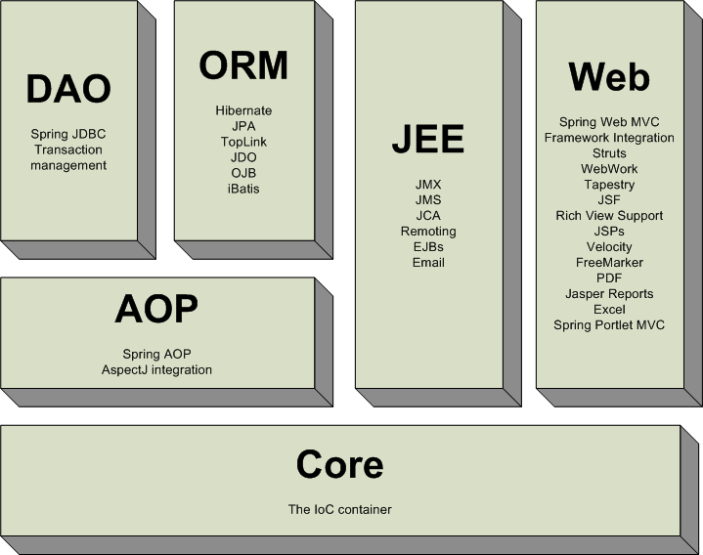
Spring

Slide 9
What is a bean?
Typical java bean with a unique id
In spring there are basically two types
  Singleton
    One instance of the bean created and referenced each time it is requested
  Prototype (non-singleton)
    New bean created each time
    Same as new ClassName()
Beans are normally created by Spring as late as possible

Slide 10
What is a bean definition?
Defines a bean for Spring to manage
  Key attributes
    class (required): fully qualified java class name
    id: the unique identifier for this bean
    configuration: (singleton, init-method, etc.)
    constructor-arg: arguments to pass to the constructor at creation time
    property: arguments to pass to the bean setters at creation time
    Collaborators: other beans needed in this bean (a.k.a dependencies), specified in property or constructor-arg
Typically defined in an XML file

Slide 11
Inversion of Control / Dependency Injection
“objects are passively
given their dependencies instead of creating or looking for dependent
objects for themselves”

Slide 12
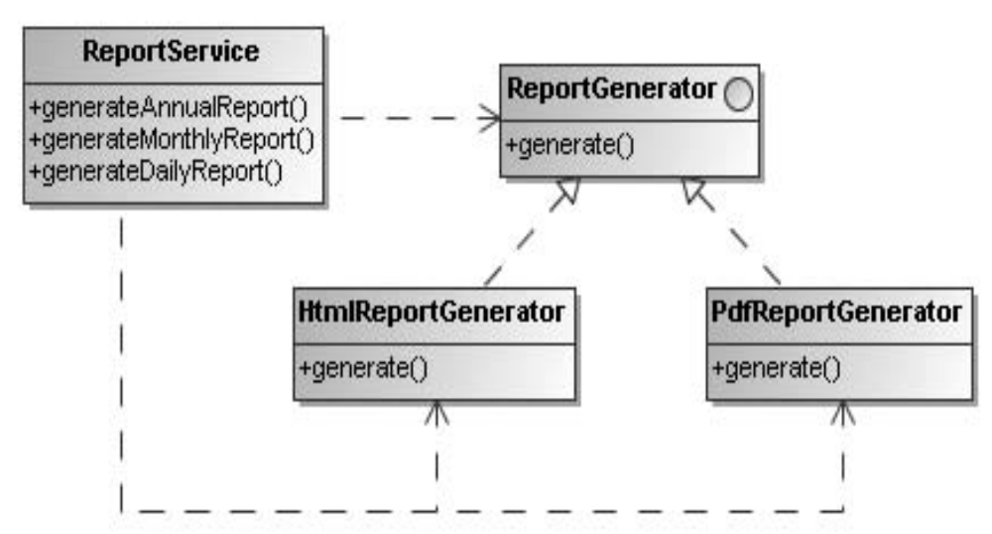
Dependency Injection contd.

Slide 13
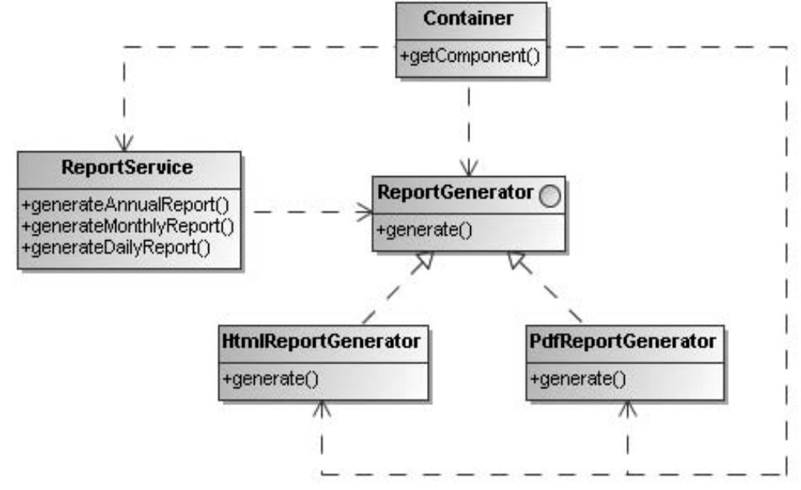
Dependency Injection contd.

Slide 14
Middle Tier: Setter Injection
public class PetStoreImpl implements PetStoreFacade {
private OrderDao orderDao;
private ItemDao itemDao;
...
public void setOrderDao(OrderDao orderDao) {
this.orderDao = orderDao;
}
public void setItemDao(ItemDao itemDao) {
this.itemDao = itemDao;
}
...
public void insertOrder(Order order) {
this.orderDao.insertOrder(order);
this.itemDao.updateQuantity(order);
}
}

Slide 15
Middle Tier: Setter Injection
<bean id="dataSource" class="org.apache.commons.dbcp.BasicDataSource">
<property name="driverClassName" value="... "/>
<property name="url" value="..."/>
<property name="username" value="...“>
<property name="password" value="...“/>
</bean>
<bean id="itemDao" class="org.springframework.samples.jpetstore.dao.ibatis.SqlMapItemDao">
<property name="dataSource" ref="dataSource"/>
<property name="sqlMap" ref="sqlMap"/>
</bean>
<bean id="petStore“
class="org.springframework.samples.jpetstore.domain.logic.PetStoreImpl">
<property name="orderDao" ref="orderDao"/>
<property name="itemDao" ref="itemDao"/>
</bean>

Slide 16
Middle Tier: Constructor Injection
public class PetStoreImpl implements PetStoreFacade {
private OrderDao orderDao;
private ItemDao itemDao;
...
public PetStoreImpl(OrderDao orderDao, ItemDao itemDao) {
this.orderDao = orderDao;
this.itemDao = itemDao;
}
...
public void insertOrder(Order order) {
this.orderDao.insertOrder(order);
this.itemDao.updateQuantity(order);
}
}

Slide 17
Middle Tier: Constructor Injection
<bean id="dataSource" class="org.apache.commons.dbcp.BasicDataSource">
<property name="driverClassName" value="... "/>
<property name="url" value="..."/>
<property name="username" value="...“>
<property name="password" value="...“/>
</bean>
<bean id="itemDao" class="org.springframework.samples.jpetstore.dao.ibatis.SqlMapItemDao">
<property name="dataSource" ref="dataSource"/>
<property name="sqlMap" ref="sqlMap"/>
</bean>
<bean id="petStore“
class="org.springframework.samples.jpetstore.domain.logic.PetStoreImpl">
<constructor-arg ref="orderDao"/>
<constructor-arg ref="itemDao"/>
</bean>

Slide 18
Constructor vs. Setter Injection
Constructor injection enforces a strong dependency contract. In short, a bean cannot be instantiated without being given all of its dependencies.
By only allowing properties to be set through the constructor, you are, effectively, making those properties immutable.
If there are several ways to construct a valid object, it can be hard to come up with unique constructors, since constructor signatures vary only by the number and type of parameters.
Spring doesn’t take sides in this debate and let us choose the injection model that suits you best.

Slide 19
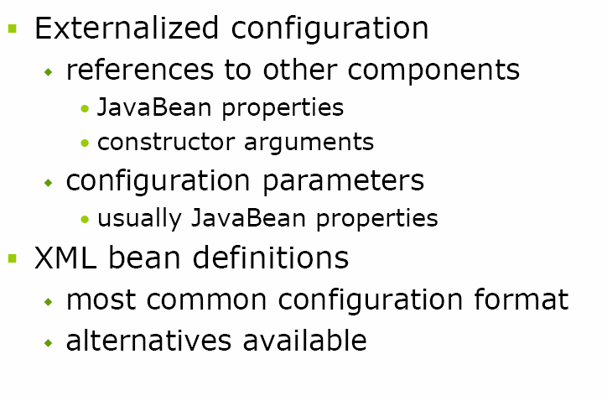
Decoupling

Slide 20
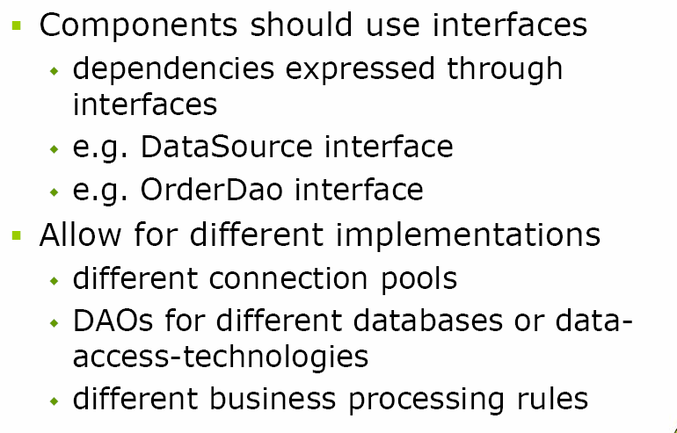
Decoupling

Slide 21
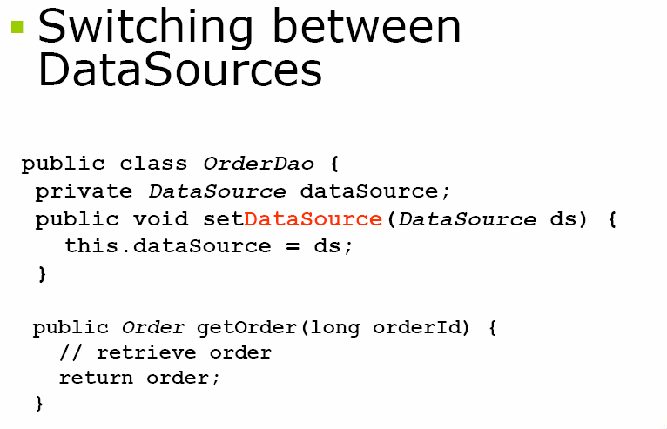
Decoupling

Slide 22
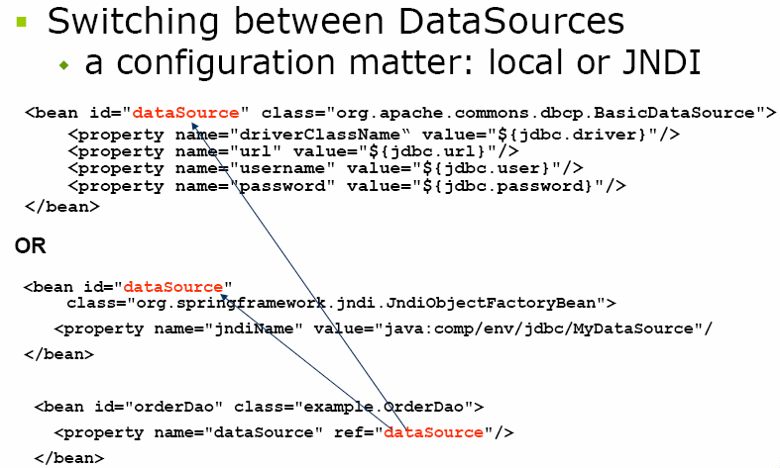
Decoupling

Slide 23
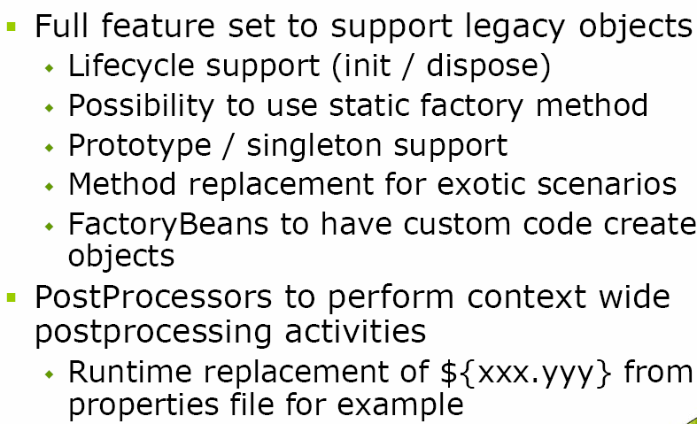
Other DI Features

Slide 24
Middle Tier: Dependency Injection
Dependencies are expressed in pure Java
Push configuration (container injects dependencies) is much better than pull configuration (objects look up dependencies)
  No ad hoc lookup
  Code is self-documenting, describing its own dependencies
  Can apply consistent management strategy everywhere
  Easy to test
    No JNDI to stub, properties files to substitute, RDBMS data to set up…

Slide 25
Middle Tier: Dependency Injection
Properties & Constructor Arguments injected are:
  Configuration values (i.e. something like a timeout integer value)
  Dependencies on collaborators (i.e. the reference to accountDao in the example)
Can run many existing classes unchanged
“Autowiring”
Trivial to test application classes outside the container, without Spring
Can reuse application classes outside the container
Hot swapping, instance pooling (with AOP)

Slide 26
Spring in the Middle Tier
Advanced IoC features
  Manage lists, maps or sets, with arbitrary nesting
  Create objects using new or from factory methods
  Method Injection
    Container can override abstract or concrete methods at runtime
    Can use to avoid dependence on Spring (override isolates dependency on Spring API)
  Nearly any existing Java object can be used in a Spring context
  Leverages standard JavaBeans PropertyEditor machinery
    Register custom property editors
  Many hooks to customize container behaviour

Slide 27
Other DI Features

Slide 28
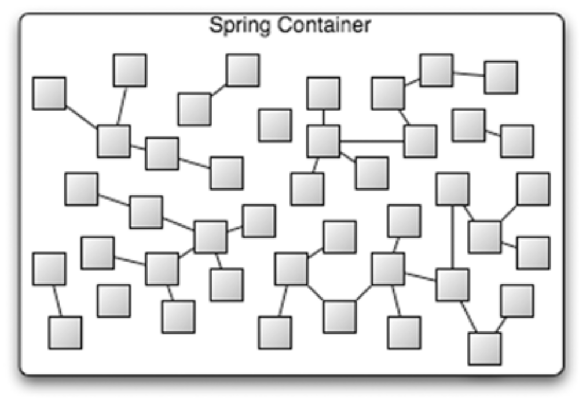
Bean Wiring
Spring, A Container

Slide 29
Bean Wiring
Act of creating the association between application components
Spring Wiring:-
  Controlling the Wiring
    Configure Bean’s Properties
  Configuring
    Externalize Deployment Configuration in separate files
  Life Cycle Management
    Manage Life cycle of Beans
  AutoWiring:-
    Can be by 4 ways byName, byType, constructor, autodetect
    <bean id=“company” class=“com.uhg.india”
        autowire=“autowire type” />

Slide 30
Bean Factory
Simplest & provides basic form of DI.
Handles lifecycle of bean.
create associations between collaborating objects
Commonly used implementation is org.springframework.beans.factory.xml.XmlBeanFactory
Works with org.springframework.core.io.Resource
Beans get lazily loaded

Slide 31
Application Context
Application contexts provide a means for resolving text messages, including support for internationalization (I18N) of those messages.
Application contexts provide a generic way to load file resources, such as images.
Application contexts can publish events to beans that are registered as listeners.
Commonly used implementations are
  ClassPathXmlApplicationContext
  FileSystemXmlApplicationContext
  XmlWebApplicationContext
Preloads all singleton beans upon context startup

Slide 32
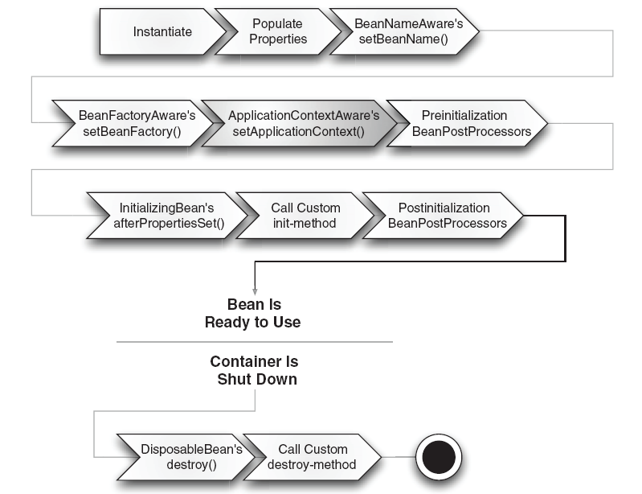
Bean’s Life Cycle (App Context)

Slide 33
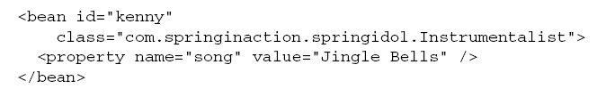
Injecting Simple Values
<property> is used to inject simple values (int, String, Boolean, float, Double, etc.)

Slide 34
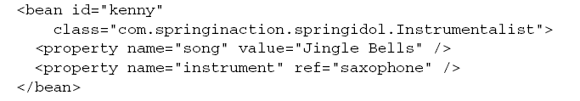
Referencing Other Beans

Slide 35
Autowiring
byName
byType
Constructor
Autodetect
One can set a default autowiring for all beans within the Spring context by setting default-autowire on the root <beans> element
Notes:
Autodetect Attempts to autowire by constructor first and then using byType

Slide 36
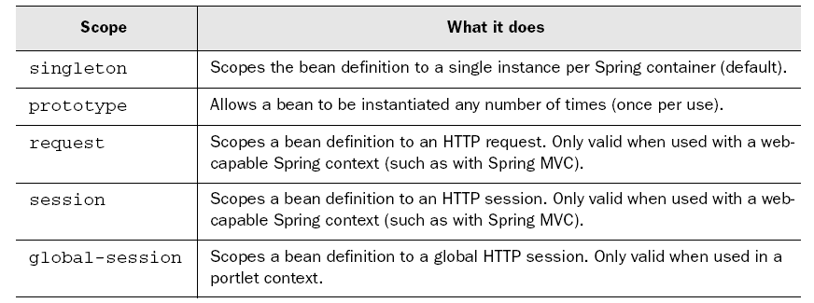
Bean Scoping

Slide 37
Questions

