Slide 1
Spring Framework

Slide 2
Agenda
  Overview
  Spring Believes and Features
  Basic Wiring
  Inversion of Control,Dependency Injection
  Code snippet
  AOP
  Spring MVC

Slide 3
Spring Framework
  Framework:-
    is a basic conceptual structure used to solve a complex issue
    configure, compose complex application from simpler components
  Spring Framework:-
  Light-weight framework for the development of enterprise-ready appln.
  used to configure
      declarative transaction management,
      remote access to your logic using RMI or web services, mailing facilities
      various options in persisting data to a database
  used in modular fashion
      allows to use in parts and leave the other components which is not required by the application

Slide 4
Spring Framework
A lightweight framework that addresses each tier in a Web application.
  Presentation layer – An MVC framework that is most similar to Struts but is more powerful and easy to use.
  Business layer – Lightweight IoC container and AOP support (including built in aspects)
  Persistence layer – DAO template support for popular ORMs and JDBC
Reduces code and speeds up development
Removes common code issues like leaking connections and more.
Spring config contains implementation classes while your code should program to interfaces.

Slide 5
Spring Believes
  OO design
  J2EE - easier to use.
  JavaBeans - a Great way of configuring applications.
  Interfaces - reduces the complexity cost.
  Checked exceptions - are overused in Java. Spring shouldn't force you to catch exceptions you're unlikely to be able to recover from.
  Testability - easier to test.
  Application code - ''not'' depend on Spring APIs
  Not compete with - Good existing solutions, but should foster integration

Slide 6
Spring Features
  Easier to maintain Simplicity
    as Good Design is M. Imp than underlying technologies
  Decoupled
    Java beans loosely coupled through the interface is a good model
  Testability
    easier to test code as Spring application is developed with POJO, no need of J2EE Container to be started as we are testing POJO
  Framework
    Inversion Of Control and Dependency Injection
    Aspect Oriented Framework
  Lightweight
    Size and overhead single jar file around 1 MB (less than 2 MB)
    Processing overhead required by spring is negligible

Slide 7
Spring Features
Non Intrusive Framework
    Objects in spring enabled application have no dependencies on spring specific classes. i.e. Application code has minimal or no dependency on Spring APIs
Inversion Of Control
    Objects are passively given their dependent instead of creating or looking for dependent objects for themselves.
    Container gives the dependencies to the object at instantiation without waiting to be asked
Dependency Injection
    Injecting via setter and/or via constructor
Aspect Oriented
    dividing application based on functionality (aspect)

Slide 8
Spring Features
  Services
  Transaction Management
    provides a generic abstraction layer for transaction management
    allowing the developer to add the pluggable transaction managers
    making it easy to demarcate transactions without dealing with low-level issues
    is not tied to J2EE environments and it can be also used in container less environments
  Integration with Hibernate, JDO, and iBATIS:
    provides best Integration services with Hibernate, JDO and iBATIS
  MVC Framework
    comes with MVC web application framework, built on core Spring functionality.
    is highly configurable via strategy interfaces, and accommodates multiple view technologies like JSP, Velocity, Tiles, iText, and POI.
    other frameworks can be easily used instead of Spring MVC Framework i.e struts

Slide 9
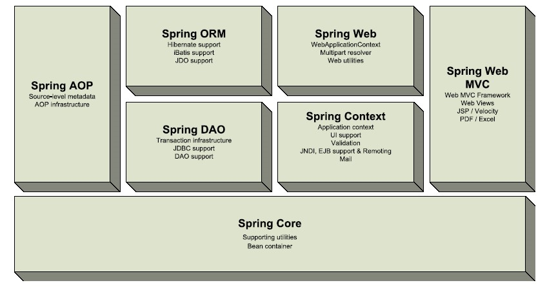
Spring Components

Slide 10
Spring Components
Spring Web
    The Spring Web module is part of Spring’s web application development stack, which includes Spring MVC.
Spring DAO
    The DAO (Data Access Object) support in Spring is primarily for standardizing the data access work using the technologies like JDBC, Hibernate or JDO.
Spring Context
    builds on the beans package to add support for message sources and for the Observer design pattern,
    the ability for application objects to obtain resources using a consistent API.

Slide 11
Spring Components
  Spring Web MVC
    provides the MVC implementations for the web applications.
  Spring Core
    is the most import component of the Spring Framework.
    provides the Dependency Injection features.
    BeanFactory is a factory pattern which separates the dependencies like
    initialization
    creation and
    access of the objects from your actual program logic.

Slide 12
Spring Container/Context
Is at core of Spring Framework
Uses IOC
Uses Wiring
2 distinct types:-
  BeanFactory
    org.springframework.beans.factory.BeanFactory interface
  ApplicationContext
    org.springframework.context.ApplicationContext interface

Slide 13
BeanFactory Vs. ApplicationContext
simplest container build on notion of a BeanFactory by
provides basic support of DI providing application fw services:-
1. resolves message from property file
2. publish application events
implementation of Factory DP resolve Text Message with I18 N
responsibilities generic way to load file resources
  create and dispense beans publish events to registered listeners
general purpose factory AC is preferred over BF
where resources are scarce Good
Lazily Loading preloads all singleton on startup

Slide 14
Beans Life Cycle
Bean Life Cycle
  BeanFactory Context Vs Application Context
Wiring
  Piecing together beans with in Spring Container
  Spring Container supports wiring through XML
  load xml from/by
    XmlBeanFactory - java.io.InputStream
    ClassPathXmlAC - classpath
    FileSystemXmlAC - file system
    XmlWebAC - web application

Slide 15
Spring Basic wiring
Act of creating the association between application components
Spring Wiring:-
  Controlling the Wiring
    Configure Bean’s Properties
  Configuring
    Externalize Deployment Configuration in separate files
  Life Cycle Management
    Manage Life cycle of Beans
  AutoWiring:-
    Can be by 4 ways byName, byType, constructor, autodetect
    <bean id=“company” class=“com.uhg.india”
        autowire=“autowire type” />

Slide 16
Beans
Prototyping Singleton
define a blue print by default all spring beans
Beans are created based on this always give the exact same instance
Avoid when resources are scarce useful when need of unique instance
        of bean each time it is asked for
<bean id=“company” <bean id=“company”
    class=“com.uhg.India” class=“com.uhg.India”
    singleton=“false” /> singleton=“true” />

Slide 17
Inversion of Control
Dependency injection
Beans define their dependencies through constructor arguments or properties
The container provides the injection at runtime
“Don’t talk to strangers”
Also known as the Hollywood principle –
“don’t call me I will call you” – container callbacks
Decouples object creators and locators from application logic
Easy to maintain and reuse
Testing is easier

Slide 18
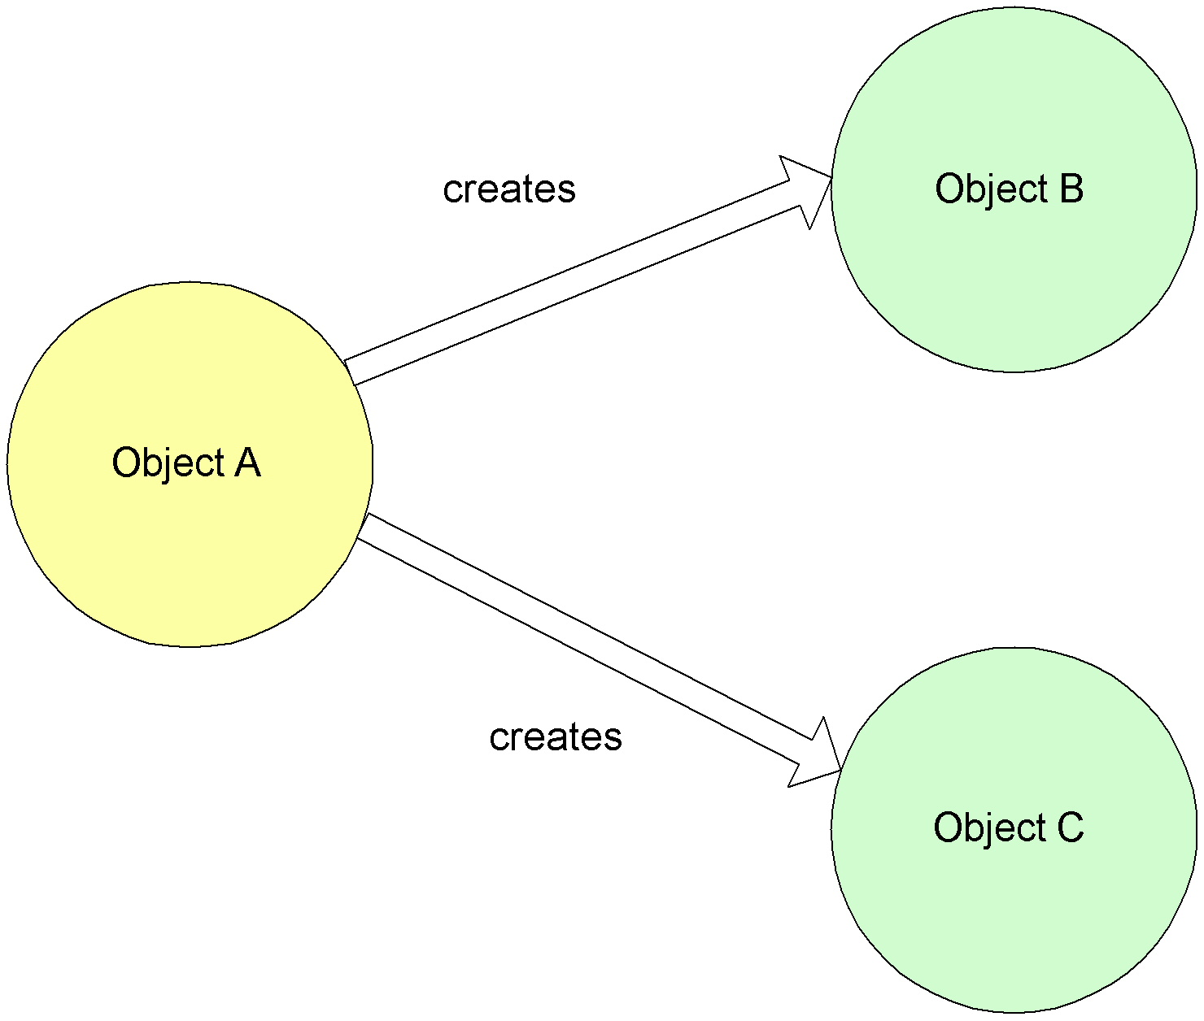
Non-IOC/Dependency Injection

Slide 19
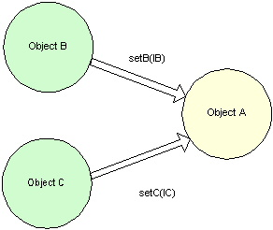
IOC/Dependency Injection

Slide 20
Dependency lnjection
Injecting Dependencies in Spring:-
via setter methods . via constructor
1. via setter methods:-
    via referencing other beans/inner beans/wiring collections/properties
<bean id="service" class="com.mycompany.service.ServiceImpl">
<property name="timeout"><value>30</value>
</property>
<property name="accountDao"><ref local="accountDao"/>
</property>
</bean>

Slide 21
Dependency Injection via Constructor
2. via Constructor Injection:-
    Enforces strong dependency
    Bean cannot instantiate without being given all of its dependencies
    Immutability
public class ServiceImpl implements Service {
private int timeout;
private AccountDao accountDao;
public ServiceImpl (int timeout, AccountDao accountDao) {
this.timeout = timeout;
this.accountDao = accountDao;
}
}

Slide 22
Dependency Injection via - Constructor
2. via Constructor Injection:-
  <bean id="service" class="com.mycompany.service.ServiceImpl">
  <constructor- arg index=“0”>
  <value>30</value>
  </constructor-arg >
  <constructor- arg index=“1”>
  <ref local="accountDao"/>
  </constructor-arg >
  </bean>

Slide 23
Configuring Spring
web.xml:-
<?xml version="1.0" encoding="UTF-8"?>
<!DOCTYPE web-app PUBLIC "-//Sun Microsystems, Inc.//DTD Web Application 2.3//EN" "http://java.sun.com/dtd/web-app_2_3.dtd">
<web-app id="WebApp">
<display-name>IAMC_WEB</display-name>
<context-param>
<param-name>contextConfigLocation</param-name>
<param-value>classpath:springapp-servlet.xml</param-value>
</context-param>
…….

Slide 24
spring-beans.dtd
Add spring-beans.dtd file in WEB-INF directory

Slide 25
Springapp-servlet.xml
…
<beans>
<!-- Create Proxy Bean -->
<bean id="loginDAO" class="com.fid.amc.dao.LoginDAOImpl">
<property name="sessionFactory"><ref bean="sqlMap" /></property>
</bean>
<bean id="loginDAOObject" class="org.springframework.aop.framework.ProxyFactoryBean">
<property name="proxyInterfaces"><value>com.fid.amc.dao.LoginDAO</value></property>
<property name="target"><ref bean="loginDAO" /></property>
</bean>
</beans>
…

Slide 26
Singleton class
public class AMCSpringConfiguration {
private static AMCSpringConfiguration instance=null;
private AMCSpringConfiguration(){
applicationContext = new ClassPathXmlApplicationContext ("springapp-servlet.xml");}
public static AMCSpringConfiguration getInstance(){
if(instance==null){
synchronized(AMCSpringConfiguration.class){
if(instance==null){
instance=new AMCSpringConfiguration();}
}
}
return instance;
}

Slide 27
Singleton class (ctd.)
public ApplicationContext getApplicationContext() {
return applicationContext;
}
public void setApplicationContext(ApplicationContext applicationContext) {
this.applicationContext = applicationContext;
}
}

Slide 28
LoginDAO
public interface LoginDAO {
…
public abstract UserVO loadUserDB(String arnNumber)throws AMCException;
…
}

Slide 29
Java Class
ApplicationContext applicationContext=
AMCSpringConfiguration. getInstance(). getApplicationContext();
LoginDAO dao = (LoginDAO) applicationContext.getBean("loginDAOObject");
UserVO userObject=dao.loadUserDB(arnNumber);
…..

Slide 30
Aspects AOP
AOP complements IoC to deliver a non-invasive framework
Externalizes crosscutting concerns from application code
Concerns that cut across the structure of an object model
AOP offers a different way of thinking about program structure to an object hierarchy
EJB interception is conceptually similar, but not extensible and imposes too many constraints on components
Spring provides important out-of-the box aspects
Declarative transaction management for any POJO
Pooling
Resource acquisition/release

Slide 31
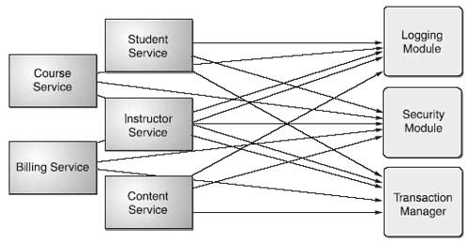
Core Business Concerns Vs Crosscutting Enterprise concerns

Slide 32
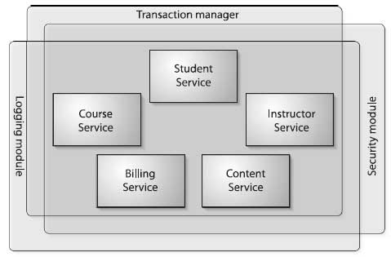
Aspects AOP

Slide 33
Components Of AOP
  Aspect
    unit of modularity for crosscutting concerns
  Join point
    well-defined points in the program flow
  Pointcut
    join point queries where advice executes
  Advice
    the block of code that runs based on the pointcut definition
  Weaving
    can be done at runtime or compile time. Inserts the advice (crosscutting concerns) into the code (core concerns).
  Aspects can be used as an alternative to existing technologies such as EJB.
    Ex: declarative transaction management, declarative security, profiling, logging, etc.
  Aspects can be added or removed as needed without changing your code.

Slide 34
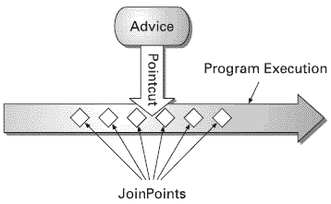
AOP
Pointcut - defines which joinpoint gets advice

Slide 35
EJB
Spring can be used to support existing EJB as well.
EJB is a standard/specification
      Wide Industry support
      Wide adoption
      Tool ability
Complexities of EJB:-
  Writing an EJB is overly complicated
    At least 4 files Home, Remote, Bean Implementation and DD
  Invasive
    in order to use mw services need to use javax.ejb interfaces
  Entity Beans fall short
    Application entity objects are directly coupled with their persistence mechanism

Slide 36
Spring Vs EJB
Feature | EJB | Spring
Transaction Management | JTA | PlatformTransactionManager
Declarative Transaction Support | Through deployment descriptor Cannot declaratively rollback | Through spring configuration file Can declaratively rollback.
Persistence | Support programmatic BMP and declarative CMP | Provides framework for integratibg with persistence technologies like hibernate, JDO etc.
Declarative security | Thru users and roles | No implementation Uses Acegi
Distributed Computing | Provides container managed remote calls | Provides support for calls via RMI, JAX-RPC and web services

Slide 37
Spring MVC Overview
Spring MVC is a framework that simplifies
  development of the Web Tier
  simplifies testing through dependency injection
  simplifies binding request data to domain objects
  simplifies form validation and error handling
  simplifies implementation of multiple view technologies
    JSP, Velocity, Excel, PDF, …
  simplifies multiple page workflow

Slide 38
Spring MVC Overview
The Spring MVC Framework offers a simple interface based infrastructure for handing web MVC architectures
Spring MVC components are treated as first-class Spring beans
Other Spring beans can easily be injected into Spring MVC components
Spring MVC components are easy to test

Slide 39
Spring MVC Overview
1. Controller (org.springframework.web.servlet.mvc.Controller)
  must implement ModelAndView handleRequest(request,response)
2. View (org.springframework.web.servlet.mvc.View)
  must implement void render( model, request, response)
3. Model
  To complete the MVC trio,
    note that the model is typically handled as a java.util.Map which is returned with the view

Slide 40
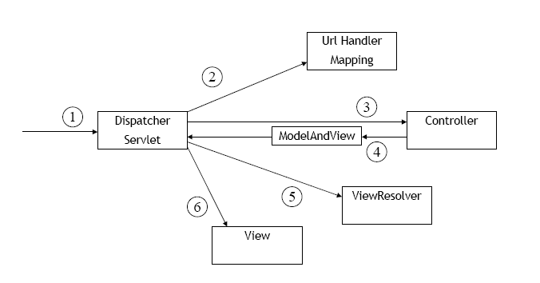
Request Life Cycle

Slide 41
Spring MVC
DispatcherServlet:-
  Spring MVC’s front controller
  Coordinates the entire request lifecycle
  Configured in web.xml
  Loads Spring application context from XML file
      default is < servlet-name >-servlet.xml) that usually contains
  <bean> definitions for the Spring MVC components

Slide 42
Spring MVC
Request moves around
  Dispatcher servlet
  Handler mappings
  Controller
  View Resolvers
Automatically populate model objects from incoming request parameters
Dispatcher servlet
  first Component to receive request
  front controller
      which delegates responsibility for a request to other components of an application to perform actual processing

Slide 43
Spring MVC Request Flow
1. Client sends a request
2. Dispatcher servlet receive the client request
3. Dispatcher servlet
    starts by querying one or more Handler mapping
4. Handler mapping map URL Pattern to Controller objects
5. Once Dispatcher have Controller object
    Dispatches the request to Controller
6. Controller perform little or no business logic itself or delegate to other
7. Upon Completion of business logic
    Controller returns ModelAndView Object to Dispatcher servlet
8. ModelAndView
    contains view object or logical name of a view
9. Dispatcher servlet
    queries ViewResolver to look up the View object
10. Dispatcher servlet
    dispatches the request to view indicated by ModelAndView object

Slide 44
Configuring Dispatcher Servlet in web.xml
web.xml:-
…
<servlet>
<servlet-name> training</servlet-name>
<servlet-class>org.springframework.web.servlet.DispatcherServlet</servlet-class>
</servlet>
<servlet-mapping>
<servlet-name> training</servlet-name>
<url-pattern>*.htm</url-pattern>
</servlet-mapping>
…

Slide 45
Breaking up the application context
3 layered web application :-
  web layer training-servlet.xml
    Bean definition pertaining to controller
  service layer training-service.xml
    Bean definition pertaining to service layer
  persistence layer training-data.xml
    Bean definition pertaining to data layer
Depending on how you deploy ,you have 2 context loaders
    ContextLoaderListener servlet 2.2 (servlet->listener)
    ContextLoaderServlet servlet 2.3 (listener->servlet)
        initialize listeners before servlet

Slide 46
Spring Configuration File
By default spring configuration file location
    /WEB-INF/application-Context.xml
Entry in web.xml:-
    Comma separated lists of path relative to web-application root
<context-param>
<param-name>contextConfigLocation<param-name>
<param-value>/WEB-INF/training-service.xml,/WEB-INF/training-data.xml<param-value>
</context-param>

Slide 47
Spring MVC – Build Home Page
Steps to build Home Page in Spring MVC:-
  write Controller class - performs logic behind homepage
  configure Controller in DispatcherServlet’s context configuration file
  (training-servlet.xml)
  configure View Resolver - to tie to Controller to JSP
  write JSP - render the home page to user

Slide 48
Building the Controller
public class HomeController implements Controller{
public ModelAndView handleRequest ( HttpServleRequest req,HttpServletResponse res) throws Exception {
return ModelAndView (“home”,”message”,welcome);
}
private String welcome;
public void setWelcome(String welcome){
this.welcome=welcome;
}
}

Slide 49
Configuring Controller bean
training-servlet.xml:-
<bean name=“/home.htm”
    class=“com.uhg.india.training.mvc.HomeController” >
    <property name=“welcome” >
    <value>Welcome to Spring Training</value>
    </property>
</bean>
name attribute serves :-
  name of the bean
  URL Pattern for request that should be handled by HomeController bean
Default HandlerMapping
    used by DispatcherServlet is BeanNameUrlHandlerMapping
        Which uses base name as URL pattern

Slide 50
Declaring a View Resolver
<bean id=“viewResolver”
Class=“org.springframework.web.servlet.view.InternalResourceViewResolver”>
<property name=“prefix”><value>/WEB-INF/jsp/</value></property>
<property name=“suffix”><value>.jsp/</value></property>
</bean>
InternalResourceViewResolver prefixes' the view name
  returned from ModelAndView with value from prefix and suffix property

Slide 51
Creating JSP
<html>
<head><title>UHG India</title></head>
<body>Welcome to UHG Spring Training</body>
</html>

Slide 52
Request Life Cycle

Slide 53
Mapping Requests To Controllers
Handler Mappings map a specific controller bean ←----→URL Pattern
      Similar to <servlet-mapping> in web.xml
3 types of Spring HandlerMapping implementation:-
  BeanNameUrlHandlerMapping
    maps controller to URLs based on controller bean name
  SimpleUrlHandlerMapping
    maps controller to URLs using a property collection defined in config file
  CommonsPathMapHandlermapping
    Maps controller to URLs using source metadata placed in controller code
DispatcherServlet by default use BeanNameUrlHandlerMapping

Slide 54
BeanNameURLHandlerMapping
Tell the DispatcherServlet which controller to invoke for a request
Implement the HandlerMapping interface
Spring provides several implementations
BeanNameUrlHandlerMapping
  <bean name="/index.htm"
  class="uhg.controllers.WelcomeController"> …
  <bean name="/manageuhgs.htm"
  class="uhg.controllers.ManageuhgsController"> …
  <bean name="/edituhg.htm"
  class="uhg.controllers.uhgFormController">

Slide 55
BeanNameURLHandlerMapping
Simple approach for mapping a Controller ← to a → URL
<bean id=“beanNameUrlMapping”
class=“org.springframework.web.servlet.handler.BeanNameUrlHandlerMapping” />
<bean name=“/home.htm”
    class=“com.uhg.india.training.mvc.HomeController” >
    <property name=“welcome” >
    <value>Welcome to Spring Training</value>
    </property>
</bean>
Default Handler mapping used by DispatcherServlet
    No need to declare explicitly in context configuration file
Quite simple, but creates
  coupling between Presentation Layers URL and Controller Name

Slide 56
SimpleURLHandlerMapping
map URL Patterns directly to Controller
    without having to name your beans in a special way
    Is wired with a java.util.Properties using props
<bean id="urlMapping"
    class="org.sfw.web.servlet.handler.SimpleUrlHandlerMapping">
    <property name="mappings">
    <props>
    <prop key="/home.htm">HomeController</prop>
    <prop key="/manageuhgs.htm">ManageUHGController</prop>
    <prop key="/edituhg.htm">UHGFormController</prop>
    </props>
    </property>
    </bean>

Slide 57
CommonsPathHandlerMappings
  Maps controller to URLs using source metadata placed in controller code
    uses source level meta-data (a PathMap attribute) compiled into the controller using the Jakarta Commons Atttributes compiler
  /**
  * @@ org.springframework.web.servlet.handler.commonsattributes.PathMap (“/displayProvider.html)
  */
  public class DisplayProviderController extends AbstractCommandController{
  ...
  }

Slide 58
Working With Multiple HandlerMapping
can mix and match handler mappings
All HandlerMapping implements Spring’s Ordered interface
    Set their order property to indicate which has precedence with relation to others
    Lower the value of order property the higher the priority
<bean id=“beanNameUrlMapping” class=“”>
<property name=“order”><value>1</value></property-name>
</bean>
<bean id=“simpleUrlMapping” class=“”>
<property name=“order”><value>1</value></property-name>
<property name=“mappings”>…</property>
</bean>

Slide 59
Controllers
Spring provides many implementations:
  AbstractController
  AbstractCommandController
  ParameterizableViewController
  MultiActionController
  SimpleFormController
  AbstractWizardController

Slide 60
Controllers
DispatcherServlet
    Receive requests from and coordinate business functionality
implement the Controller interface
public ModelAndView handleRequest(HttpServletRequest request,HttpServletResponse response) throws Exception;
return instance of ModelAndView to DispatcherServlet
ModelAndView
  contains the model (a Map) and
      either a logical view name,
      or an implementation of the View interface

Slide 61
View Resolvers
Resolve logical view names returned from controllers into View objects
Implement the ViewResolver interface
Spring provides several implementations
UrlBasedViewResolver
  <bean id="viewResolver"
  class="org.springframework.web.servlet.view.UrlBasedViewResolver">
<property name="prefix" value="/WEB-INF/jsp/"/>
<property name="suffix" value=".jsp"/>
</bean>

Slide 62
BeanNameViewResolvers
<bean id="viewResolver"
class="org.sfw.web.servlet.view.BeanNameViewResolver"/>
<bean id="manageuhgs"
class="org.springframework.web.servlet.view.JstlView">
<property name="url">
<value>/WEB-INF/jsp/manageuhgs.jsp</value>
</property>
</bean>
<bean id="manageuhgsAsExcel“
class="uhg.views.ManageuhgsExcelView"/>

Slide 63
ResourceBundleViewResolver
ResourceBundleViewResolver
<bean id="viewResolver"
class="org.sfw.web.servlet.view.ResourceBundleViewResolver">
<property name="basename">
<value>views</value>
</property>
</bean>
views.properties
  Welcome (class)=org.springframework.web.servlet.view.JstlView
  welcome.url=/WEB-INF/jsp/welcome.jsp

Slide 64
XmlViewResolvers
  <bean id="viewResolver"
  class="org.sfw.web.servlet.view.XmlViewResolver">
  <property name="location"><value>views</value></property>
  </bean>
views.xml
  <bean name="welcome"
  class="org.springframework.web.servlet.view.JstlView">
  <property name="url">
  <value>/WEB-INF/jsp/welcome.jsp</value>
  </property>
  </bean>

Slide 65
View
Renders the output of the request to the client
Implement the View interface
Built in support for:
  JSP, XSLT, Velocity, Freemarker, Excel, PDF, JasperReports

