Slide 1
Weather Prediction
Naresh Sivasai

Slide 2
Overview
In this project we are predicting weather by training data set with different machine learning algorithms and comparing performance of each model.
We will build a model on historic usage rates and observed weather.
Machine Learning models like
DecisionTreeRegressor

Slide 3
Approach
Retrieve the data set from API.
Exploratory data analysis
Train the data set with ML model
Predict the model with Test data
Metrics – Confusion matrix , F1 score, K Fold cross validation.
Retrieve Data
EDA
Train the Model
Performance Evaluation

Slide 4
Feature Engineering
Checked for any missing values in the data set.
Correlation between features.
Set date’ as target and create a new dataset X by dropping this column from original dataset

Slide 5
Implementation
Created the train and test data set.
From SKLearn Imported the ML model.
Performed train data set on those models.
Predicting the model by using test data set.
Evaluated the model by R2 score ,Mean Square error and Root Mean Square error

Slide 6
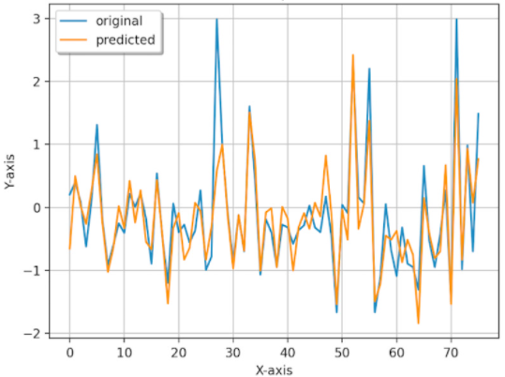
Plot between Test and Predicted

Slide 8
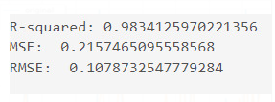
Performance
Following is the performance of models used.

Slide 9
References
https://github.com/yinglung174/Weather-Forecast-And-Prediction-by-Machine-Learning

