Slide 1

FarmMonk Innovations Private Limited

Slide 2



What is Farmify?
Farmify is a agri-fintech product, integrated with supply chain to cover total farm needs for small and marginal farmers in India.
It provides an opportunity for investors to invest in the farms of small and marginal farmers who has less/no access to institutional loans, and in return gives profits from the sale of produce. It is a for-profit organisation.
Who are the players?
Small and marginal farmers
with no/less access to
finance solutions &
marketing linkages
Investors who are willing to
invest by creating impact
by their investments
Market linkage partners for
strong linkages/partnership
with farmify
Farmers
Investors
Partners
https://www.Farmify.in

Slide 3




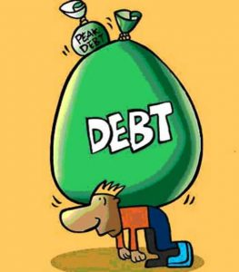
What is the problem?
Banks inability to attract
Provide verbiage
Micro Financers
Provide verbiage
Collateral loans
Provide verbiage
Lack of proper financial assistance
Unable to repay loans / chits
Provide verbiage
https://www.Farmify.in

Slide 4



What is the solution?
1
1. Investor in invest in farms
2. Farmify to release cards to the farmers for the expenses
3. Farmer to provide produce
Investor
4. Farmify to assist farmer to sell produce
5. Provide verbiage
2
6
6. Provide verbiage
6
Farmer
3
4
Partner
5
https://www.Farmify.in

Slide 5
How to implement?
https://www.Farmify.in

Slide 6
Value proposition
Attractive investment option
Impact on neglected agricultural society
8 to 10% returns
Impact on bottom pyramid small & marginal farmers
Financial assistance without conditions/collaterals
Out of risks in weather conditions, price fluctuation, pest control methods, etc.
Selling goods at a better price
Hassle free deals with farmify instead of looking for farmers
Save time meeting agents, dealers, procurement merchants, etc.
Meet the demand with the best deals and quality goods
Investment returns
Credit history of farmers
Investment history of investors
Investor
Farmer
Partner
Farmify
https://www.Farmify.in

Slide 7
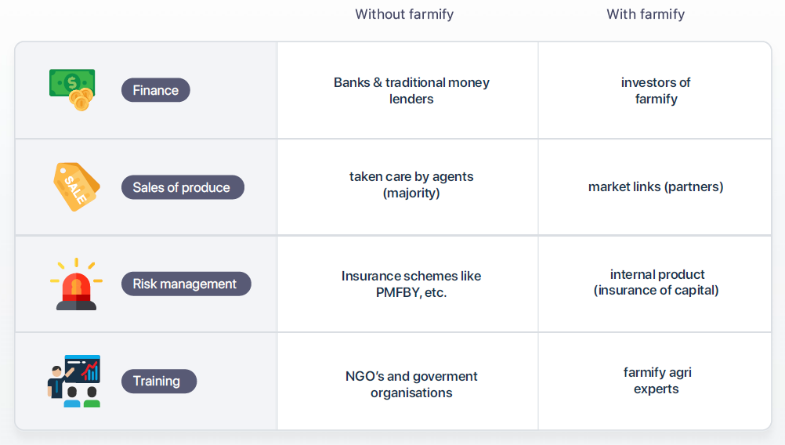
How we make a difference
https://www.Farmify.in

Slide 8
Where are we?
https://www.Farmify.in

Slide 9
What we need?
Angel round to:
1. Validate the core business model
2. Onboard more farmers
3. Manage marketing activities before launching platform
4. Setup risk management fund till we have traditional insurance in place
https://www.Farmify.in

Slide 10
Thank You

