Slide 1

FarmMonk Innovations Private Limited

Slide 2



What is Farmify?
Farmify is a agri-fintech product, integrated with supply chain to cover total farm needs for small and marginal farmers in India.
It provides an opportunity for investors to invest in the farms of small and marginal farmers who has less/no access to institutional loans, and in return gives profits from the sale of produce. It is a for-profit organisation.
Who are the players?
Small and marginal farmers
with no/less access to
finance solutions &
marketing linkages
Investors who are willing to
invest by creating impact
by their investments
Market linkage partners for
strong linkages/partnership
with farmify
Farmers
Investors
Partners
https://www.Farmify.in

Slide 3

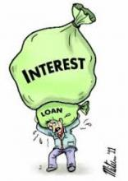


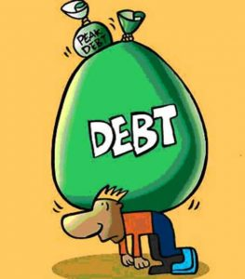
What is the problem?
Banks inability to attract
Though there are a number of banks set up to disburse loans, still a major part of the farming population is neglected.
Local Money lenders
Farmers major non-institutional credit sources often take as high as 60% interest in some areas, which creates a huge burden.
Collateral loans
The lending sources often take more collateral which creates a no other source of credit making farmers life more miserable.
Lack of proper financial assistance
Unable to repay back in time
Though the farmer able to get the input costs anyhow, it may be higher interest rates or losses making him not to pay back actual principal amount with interest which pushes him into a debt cycle.
https://www.Farmify.in

Slide 4



What is the solution?
1
1. Investor/sponsor will log into our platform finds the farmer, select the farmer of his/her choice and funds the farm
2. We will accumulate the money till the whole amount required for the farm gets completed, and distribute a FarmifyAccess Card worth of the farm expense to our farmer with our agent
Investor
2
6
3. Farmer will start farming for the full crop-cycle and ends with the farm produce to sell.
6
4. Farmify will provide the market link/partner who can give a good price for the product if the local market is offering the best price we won't force the farmer to sell for outsiders
Farmer
3
4
5. The partner will take the produce and will give money worth the production of the farmer
6. This will get shared among the farmers, the sponsors, and the platform aggregator farmify.
Partner
5
https://www.Farmify.in

Slide 5
How to implement?
Onboard small or marginal farmer who lack financial assistance from banking sector.
Market the platform as an alternative investment option which can give you good returns and at the same time create an impact in the life of a farmer(the whole thing is transparent as the sponsor can continuously monitor farmer location, identity, and videos, messages of farms)
While onboarding farmers into our platform, measures are taken so that we will also create a credit rating algorithms from the data we have taken from them.
Farmify will provide FAC (Farmify Access Card similar to HDFC food card) to the farmers preloaded with sufficient funds which can be accessed only at authorized farm inputs dealer at local and Mandal level. This card will be reloaded with the money at the required intervals.
Farmify will have complete control on the FAC limiting its access to ATM withdrawals, Online sales, unauthorized POS.
https://www.Farmify.in

Slide 6
How to implement contd.
Farmify field agents or Farmers can periodically provide the status of the farm thru pictures and videos from with in mobile application which the investors can view.
Further Farmify will tie up with private\public satellite monitoring agencies like Harvesting, Satsure, ISRO to collect\track real time progress of the crop thru satellite imagery.
All the crops will be insured under PMFBY (Pradhan Mantri Fasal Bima Yojana) and WBCIS (Weather Based Crop Insurance Scheme), In the event of a natural calamity resulting crop damage, the Insurance will be claimed and returned to Investors.
Farmify will also track the nature of fertilizers and pesticides used in the crop and the same will be printed on the produce for informational purpose.
Farmify will partner with leading agricultural players like BigBasket, RelianceFresh to assist farmers sell their produce at a better price hassle-free.
https://www.Farmify.in

Slide 7
Value proposition
Attractive investment option
Impact on neglected agricultural society
8 to 10% returns
Impact on bottom pyramid small & marginal farmers
Financial assistance without conditions/collaterals
Out of risks in weather conditions, price fluctuation, pest control methods, etc.
Selling goods at a better price
Hassle free deals with farmify instead of looking for farmers
Save time meeting agents, dealers, procurement merchants, etc.
Meet the demand with the best deals and quality goods
Investment returns
Credit history of farmers
Investment history of investors
Investor
Farmer
Partner
Farmify
https://www.Farmify.in

Slide 8
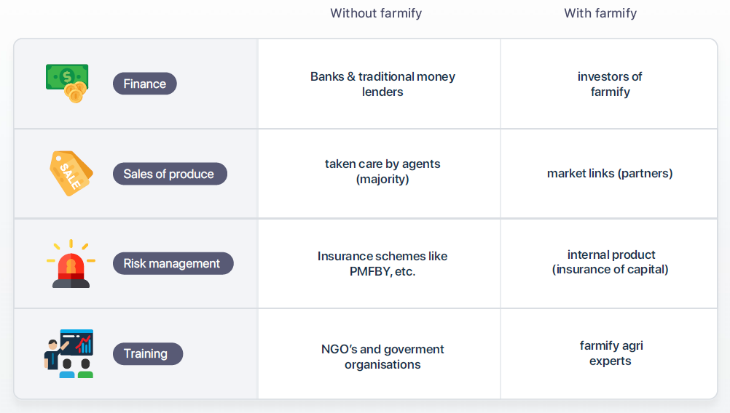
How we make a difference
https://www.Farmify.in

Slide 9

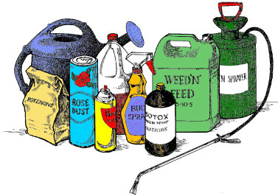
Revenue Generation for Farmify!!
Take a minor share is the profits after the Farmer and Investor.
Commission from fertilizer and pesticide merchants
Commission from the dealers who are purchasing the farmify goods
Commission from the banks by providing a list of potential farmers needing agricultural loans.
Farmers & Investors
Fertilizers & Pesticides
Partners
Bank
https://www.Farmify.in

Slide 10
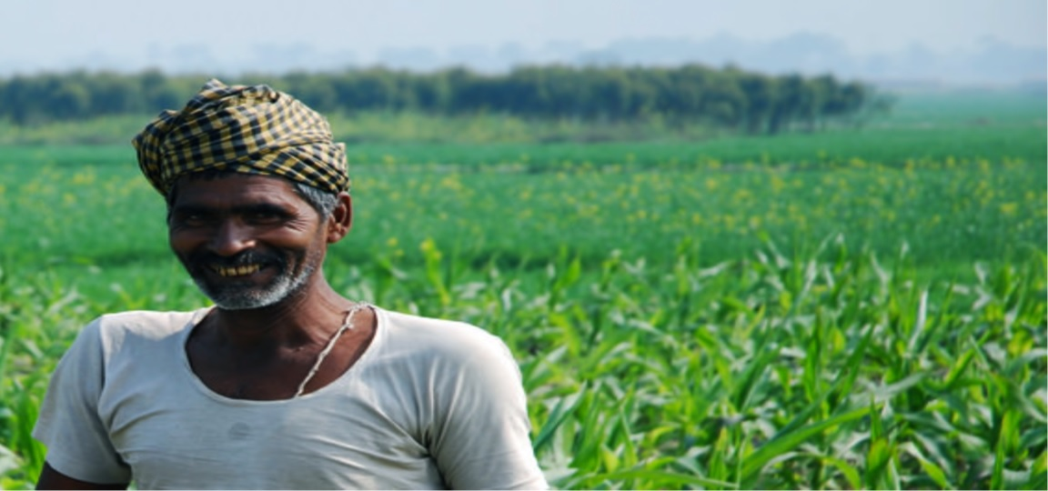
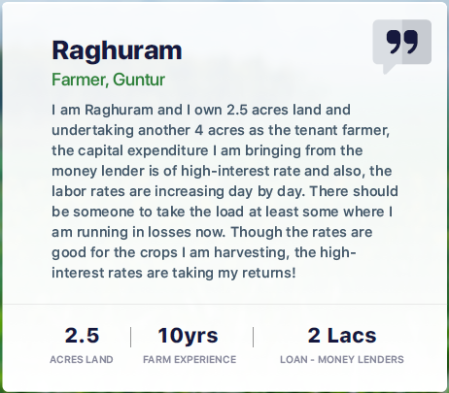
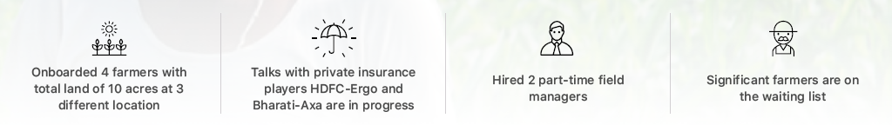
Where are we?
https://www.Farmify.in

Slide 11
Where are we?
Developing the relevant software technology needed to manage the platform
Mobile application for Farmers and Agents to upload farm details.
Mobile application for Investors to search farmer data and invest.
Setting up AWS instances to host the platform.
Interacting with various banks.
Gathering details for the Farmify Access Cards (FAC)
Private crop insurance as an alternative to PMFBY for speedy processing in the event of natural calamity.
https://www.Farmify.in

Slide 12
What are we looking for?
18-24 months of runway to work on:
1) Industry trends to create a category called Mutual Funds for Agriculture
2) Customer base development for both farmers as well as investors
3) Building Product and field operating team
4) Early marketing and sales efforts
5) To tackle with the regulations as part of building the product and partnership efforts with dealers.
https://www.Farmify.in

Slide 13
Thank You

