Slide 1
Machine Learning Approach for Liver Disease Classification and Prediction

Slide 2



Team Details
Team Name: A21
Naresh Bista (Team Leader)
Harsha Surya
College: SPEC
Stream : AI&DS
Year of graduation: 2025
21BK1A7239
College: SPEC
Stream: AI&DS
Year of graduation:2025
21BK1A7223
Gollapally Venu
College: SPEC
Stream: AI&DS
Year of graduation:2025
21BK1A7220
2

Slide 3

Theme
Innovate For Society
Our project on Machine Learning Approach for Liver Disease Classification and Prediction with the theme of "Innovate for Society”. The goal is to Utilizing Machine Learning Algorithms to Improve Diagnostic Accuracy and Early prediction of Liver Disease. This theme fits as it focuses on using machine learning to enhance liver disease prediction, ultimately benefiting public health and societal well-being.

Slide 4
Problem Statement
Liver disease is a growing health concern globally, and early detection is crucial for effective treatment. However, current diagnostic methods are often time-consuming and costly. There is a need for a fast, accurate, and accessible system to predict liver disease using readily available patient data, which can assist healthcare professionals in making timely decisions.
Project aim to develop a machine learning model that accurately predicts liver disease based on patient data, and build a user-friendly web application for easy diagnosis.

Slide 5
Existing solution/Literature Survey
Existing solutions for liver disease classification have explored various machine learning algorithms, from traditional methods like Cat boost, Random forest, XG Boost and Light GBM.
Each method has its strengths and limitations, with newer techniques often outperforming traditional models in terms of accuracy and robustness.
The choice of algorithm depends on factors such as the nature of the dataset, the complexity of the disease, and the computational resources available.
This project will leverage these insights to evaluate and identify the most suitable machine learning algorithm for liver disease classification based on the provided dataset of 1,700 Indian patients.

Slide 6
Proposed solution
This proposed solution will provide an interpretable, efficient, and user-friendly tool for liver disease prediction, addressing the major gaps identified in existing solutions. It will offer real-time predictions and transparency, making it practical for clinical use.
Web-Based Application (Flask Framework)
User Interface: The model will be integrated into a user-friendly web interface using Flask, HTML, and CSS. This will allow users (e.g., doctors, patients) to input relevant medical data and receive predictions in real time.
Real-Time Prediction: The web application will generate instant predictions based on user inputs, providing immediate results and insights.

Slide 7
Innovation in 360°
A 360° innovation approach for liver disease classification and prediction through machine learning involves advancing every aspect of the project from data collection and algorithm development to integration, deployment, and continuous improvement.
This tool will enhance diagnostic accuracy, support healthcare professionals, and ultimately improve patient outcomes, revolutionizing the management and treatment of liver disease.
User Interface and Experience:
Intuitive Dashboards: Develops user-friendly dashboards for healthcare professionals to visualize model predictions, confidence levels, and actionable insights.
Mobile and Web Applications: Creates mobile and web applications for easy access to the model’s functionalities, enabling healthcare professionals and patients to interact with the system from various devices.

Slide 8
Comparison/Advantages of Proposed Solution with Existing
Advantages of Our Solution:
Early Detection: ML models can detect early signs of liver disease, enabling timely interventions and improving patient outcomes.
Accessibility and Scalability: The system can be deployed in various healthcare settings, including low-resource environments, improving access to quality healthcare.
Cost-Effectiveness: Reduces the need for manual analysis and periodic testing, potentially lowering healthcare costs and improving resource utilization.
PATENT FILED: No

Slide 9
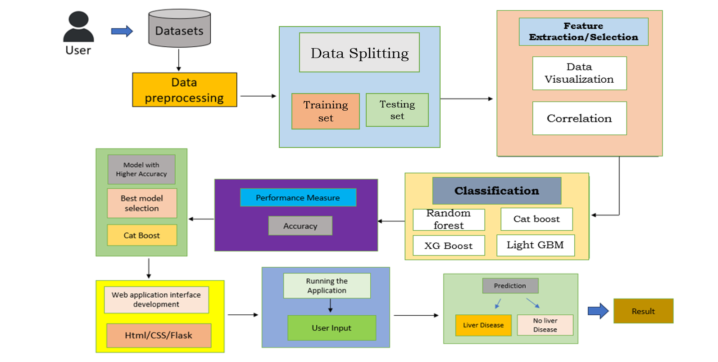
System Architecture

Slide 10
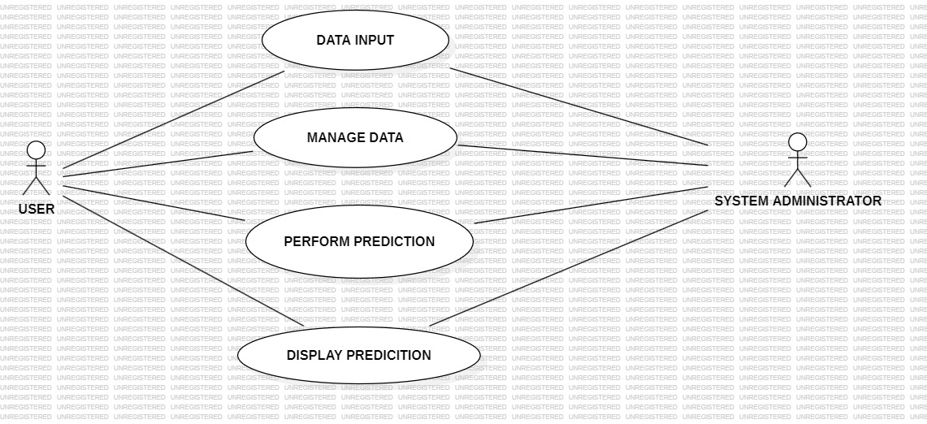
UML Diagram: Use Case Diagram

Slide 11
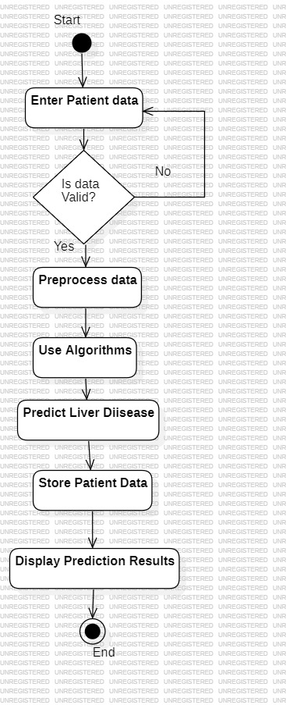
UML Diagram: Activity Diagram

Slide 12
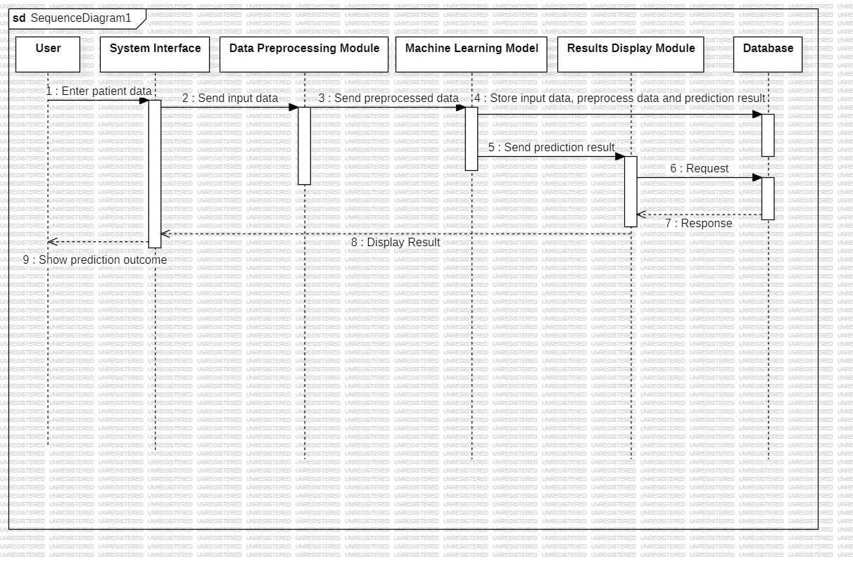
UML Diagram: Sequence Diagram

Slide 13
User Stories
As a healthcare provider, I want to input patient data into the system so that I can get an immediate risk assessment for liver disease.
As a patient, I want to know if I am at risk for liver disease based on my medical history and lifestyle factors so that I can take preventive actions early.
As a medical researcher, I want to analyze the model's output and the factors contributing to liver disease so that I can publish findings and recommend preventive measures.

Slide 14
Sprint Stories
Sprint 1: Data Collection and Preparation
As a data scientist, I want to clean and preprocess the collected data by handling missing values, removing duplicates, and normalizing features so that the data is consistent and ready for analysis and model training.
Sprint 2: Model Development
As a machine learning engineer, I want to experiment with different machine learning algorithms (e.g., Random forest, Cat boost,) so that I can select the one with the best performance for liver disease classification.
Sprint 3: Deployment and Integration
As a software developer, I want to build an API that allows healthcare providers to input patient data and receive predictions from the model so that the model can be used in a clinical setting

Slide 15
Current Functionalities
Data Input:
The system allows healthcare providers to input patient data, including attributes like age, gender, BMI, alcohol consumption, smoking habits, genetic risk, physical activity, diabetes status, hypertension, and liver function test results.
Data Preprocessing:
The system preprocesses the input data by handling missing values, normalizing features, and preparing the dataset for machine learning model training or prediction.
Feature Selection:
The project includes functionality for selecting the most relevant features from the input data that contribute significantly to liver disease prediction.

Slide 16
Model Training:
The system can train a machine learning model using historical patient data. It supports various algorithms, such as Cat Boost, Random forests, and XG Boost.
Model Evaluation:
The project includes functionality to evaluate the trained model using metrics like accuracy, precision, recall, F1-score to determine its effectiveness in predicting liver disease.
Risk Prediction:
The system provides real-time liver disease risk prediction based on input patient data, giving a binary output (e.g., 1 for liver disease, 0 for no liver disease).

Slide 17
User Interface:
There is a user-friendly interface that allows healthcare providers to input data easily and view prediction results. This interface may also provide visualizations and explanations of the model's predictions.
Feedback Mechanism:
The system may include functionality for healthcare providers to provide feedback on the predictions, which can be used to refine and improve the model

Slide 18
Current Progress
Implemented Features:
1.Data Collection and Input
•Implemented: Patient data collection from various sources has been completed. The system allows input of patient data, including attributes such as age, gender, BMI, alcohol consumption, smoking habits, genetic risk, physical activity, diabetes status, hypertension, and liver function test results.
2. Data Preprocessing
• Implemented: The data preprocessing pipeline has been developed to clean and prepare the data. This includes handling missing values, normalizing features, and encoding categorical variables.
3. Feature Selection
• Implemented: Techniques like correlation analysis and feature importance ranking have been utilized to refine the input dataset

Slide 19
4.Model Training
• Implemented: Initial model training has been conducted using various algorithms (e.g., Cat boost, Random forest, XG Boost). A baseline model with satisfactory accuracy has been established.
5. Model Evaluation
• Implemented: The evaluation of the trained model has been performed using metrics like accuracy.
6. User Interface:
• Implemented: A basic user interface has been created to allow healthcare providers to input patient data and view prediction results. The interface also provides visualizations of model performance metric.

Slide 20
Challenges Faced:
1.Data Quality Issues:
• Challenge: Some datasets contained missing or inconsistent values, which required significant preprocessing efforts to clean and standardize the data. Handling missing data without losing valuable information was a challenge.
2. Feature Engineering:
• Challenge: Identifying and creating meaningful features that improve model performance was complex due to the diverse nature of patient data and the need for domain knowledge in healthcare.
3.Model Overfitting:
• Challenge: During the initial training phase, some models showed signs of overfitting, especially with smaller subsets of data. This required further tuning and the implementation of regularization techniques

Slide 21
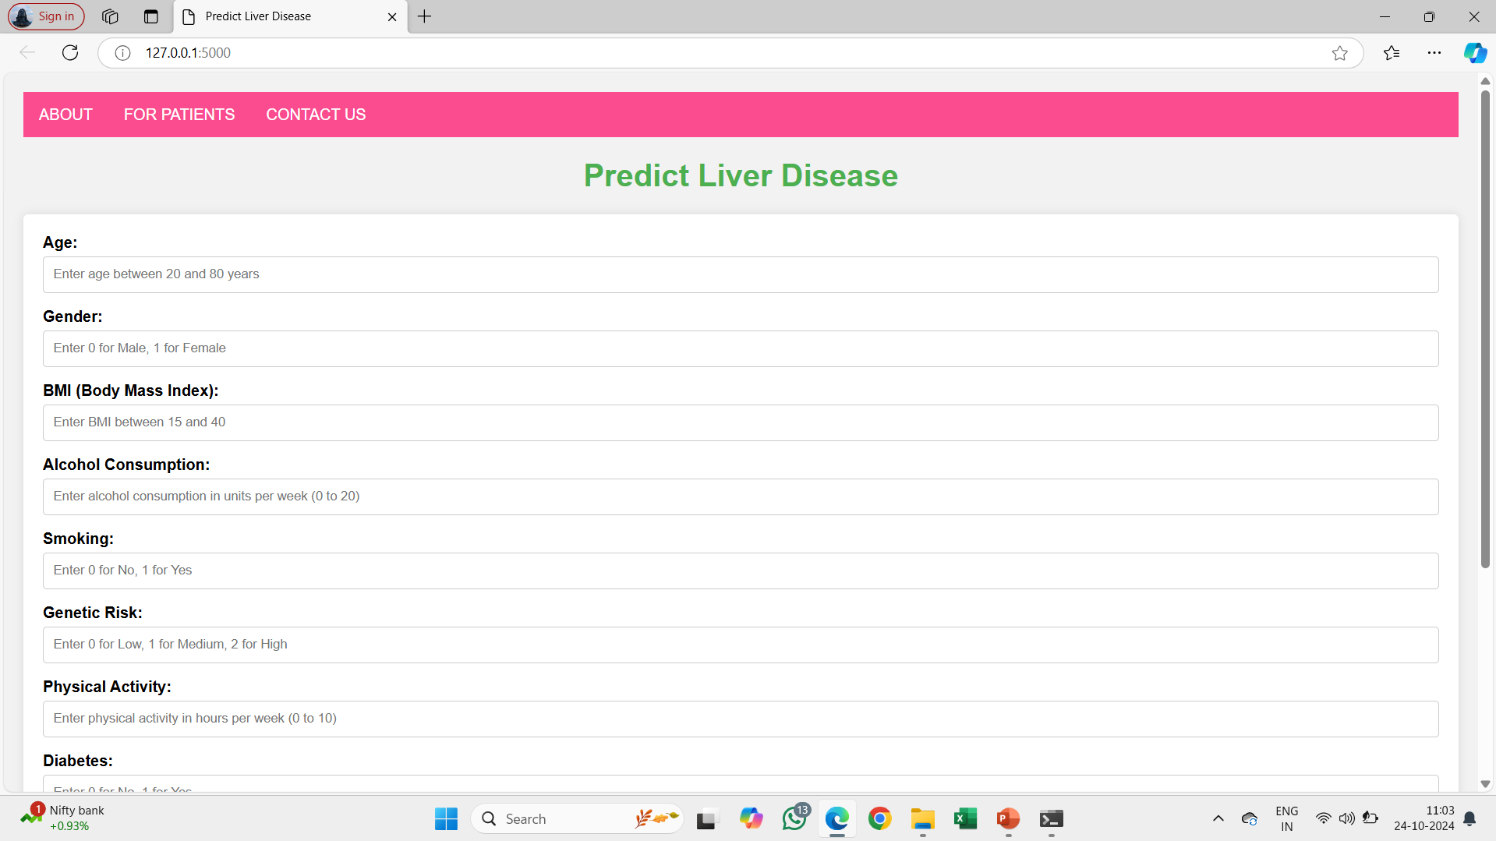
OUTPUT SCREENS

Slide 22
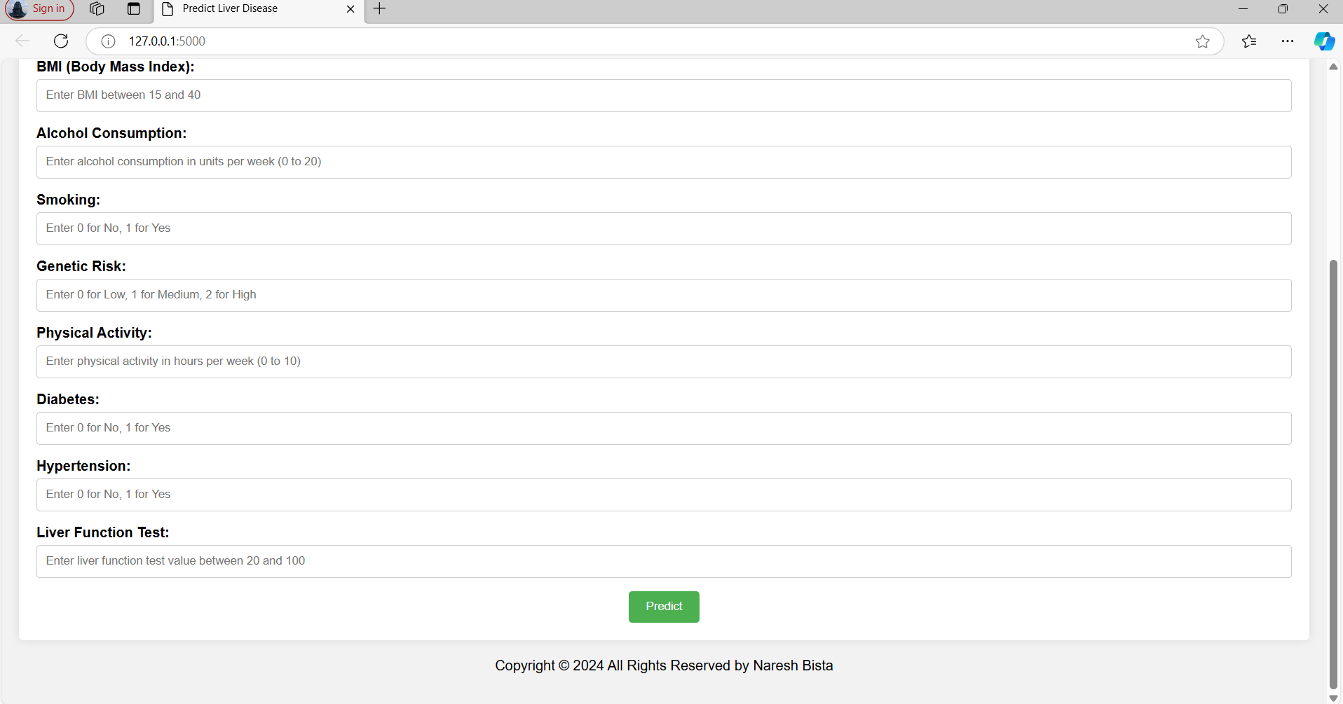

Slide 23
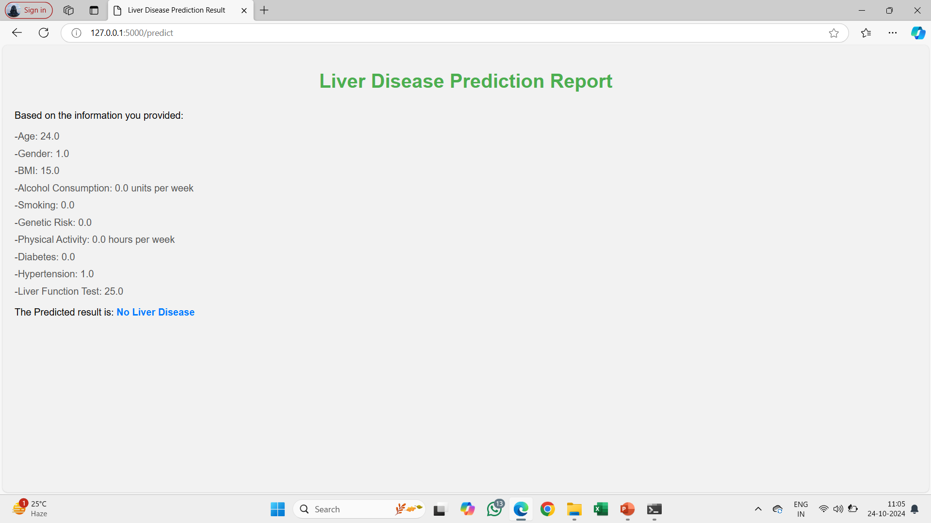

Slide 24

Queries?

Slide 25


