Slide 1
NAAN MUDHALVAN SALESFORCE DEVELOPER
PROJECT TITLE: A CRM Application For Managing Loan App And Fraudulent Prevention
TEAM MEMBERS
NARESH KUMAR G (620120104068) (TEAM LEAD)
SHYAMBABU S (620120104090)
SURYA S (620120104315)
YUVARAJ S (620120104320)
COURSE INSTRUCTOR
Prof.S.DHAMODARAN M.E.,
COLLEGE SPOC
Dr.R.VISHWANATHAN M.E., Ph.D.,

Slide 2
PROJECT GOAL:
The goal of this project is to design, develop, and implement a Customer Relationship Management (CRM) application tailored specifically for managing loan applications and preventing fraudulent activities within a financial institution. This CRM application will serve as a comprehensive tool to streamline the loan application process, improve customer service, and enhance fraud detection and prevention.
PROJECT DESCRIPTION:
CRM For Managing Loan app is about how salesforce software manages various loan applications by maintaining criteria for loan provision, loan limit, loan interest and also generating analytics like on how much time frame it takes to repay the loan. It also ensures that the application is free from fraudulent activities on Loan Apps like unauthorized access, frequent delay in loan repayment.

Slide 3
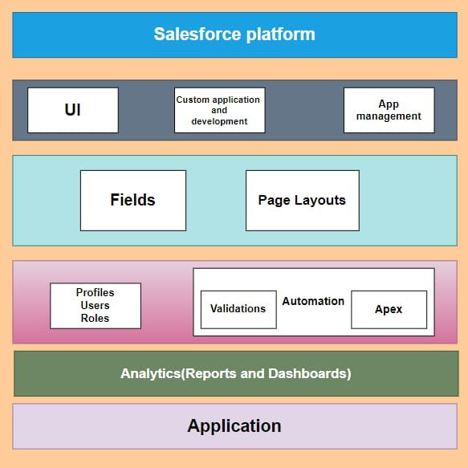
TECHNICAL ARCHITECTURE

Slide 4
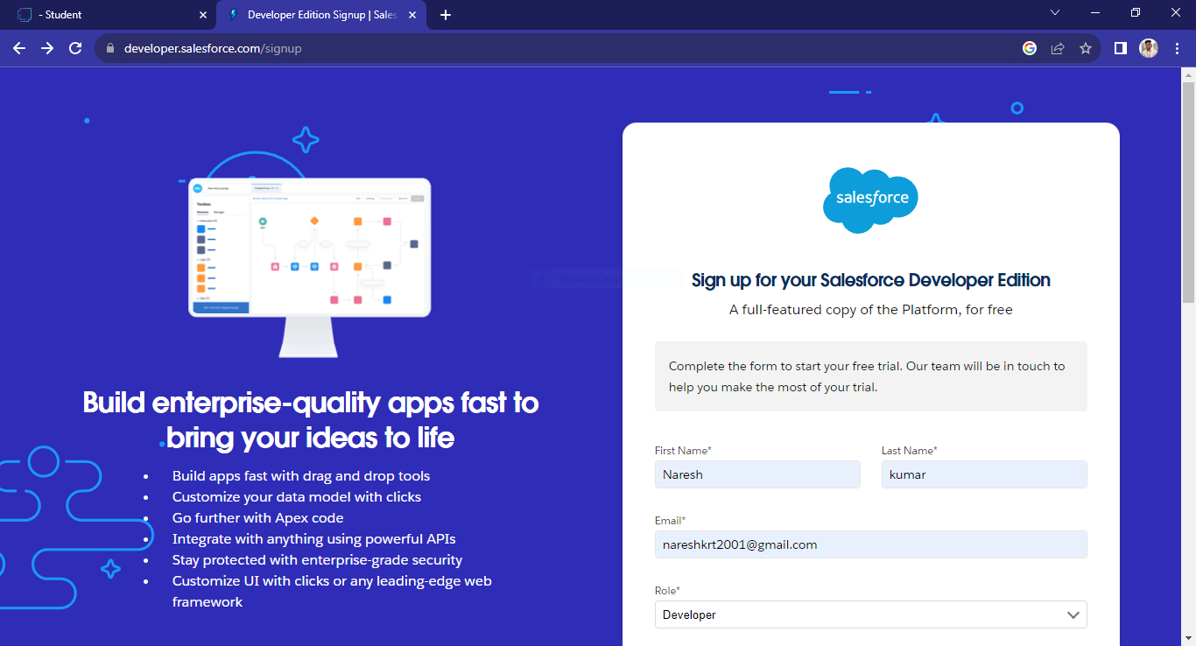
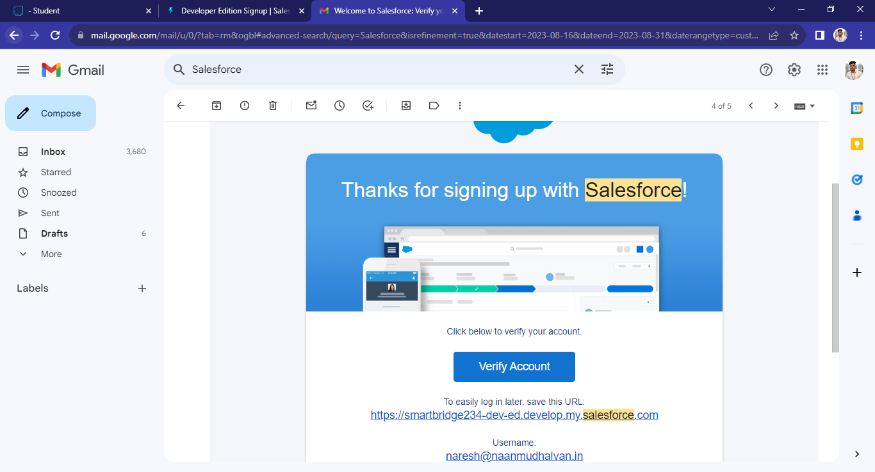
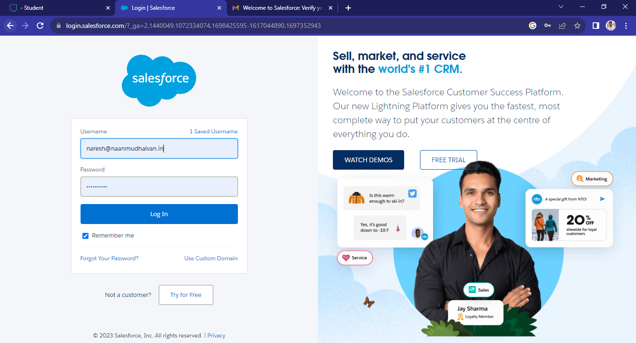
SALESFORCE DEVELOPER ORG:

Slide 5
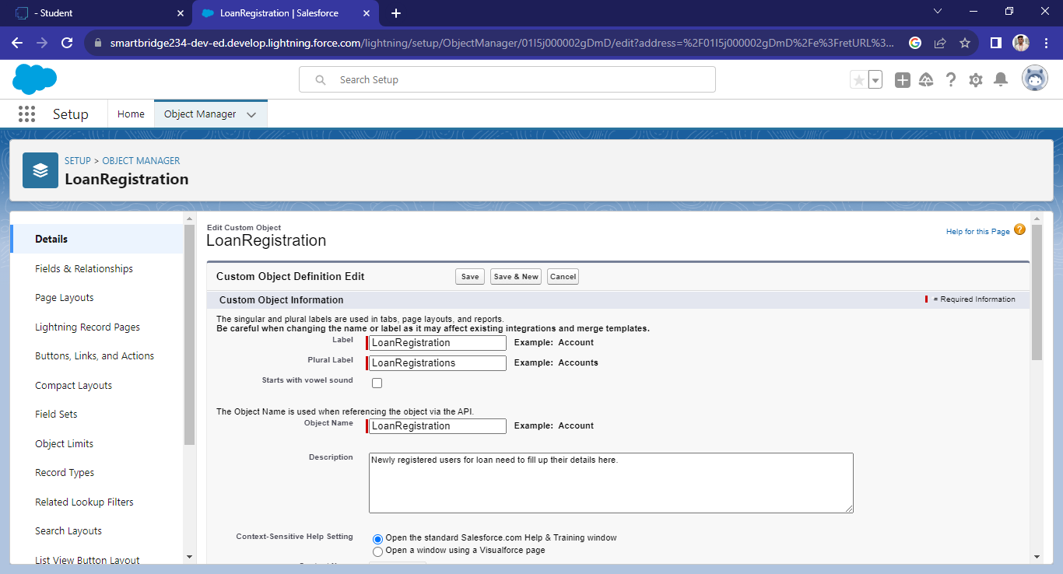
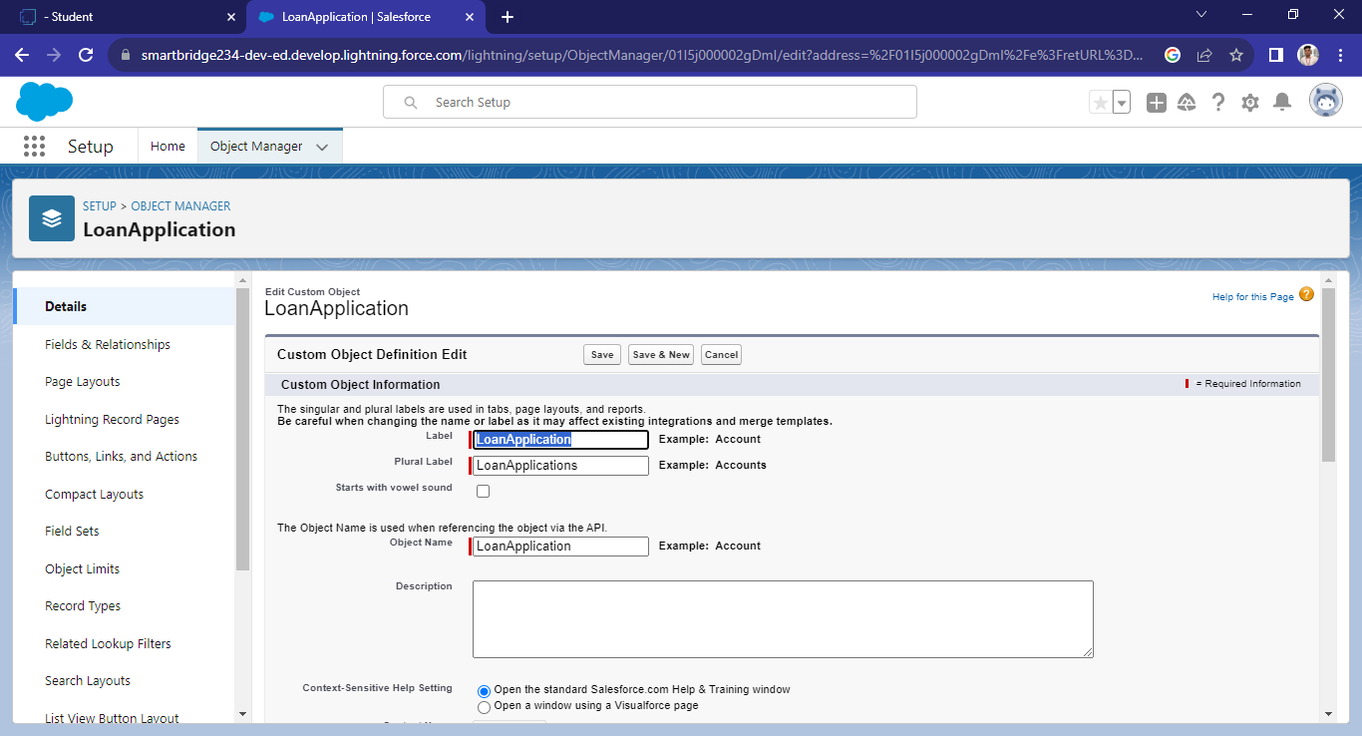
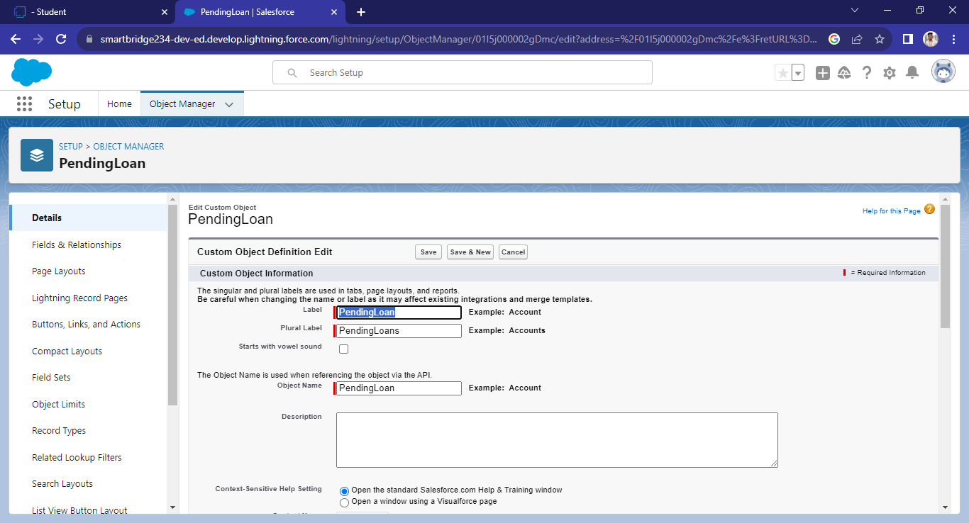


CUSTOM OBJECT CREATION:

Slide 6
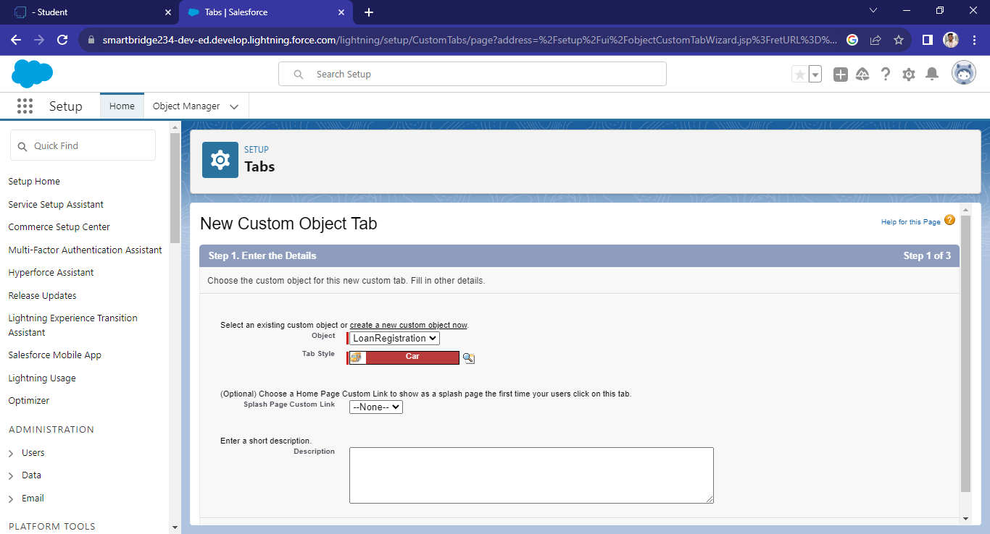
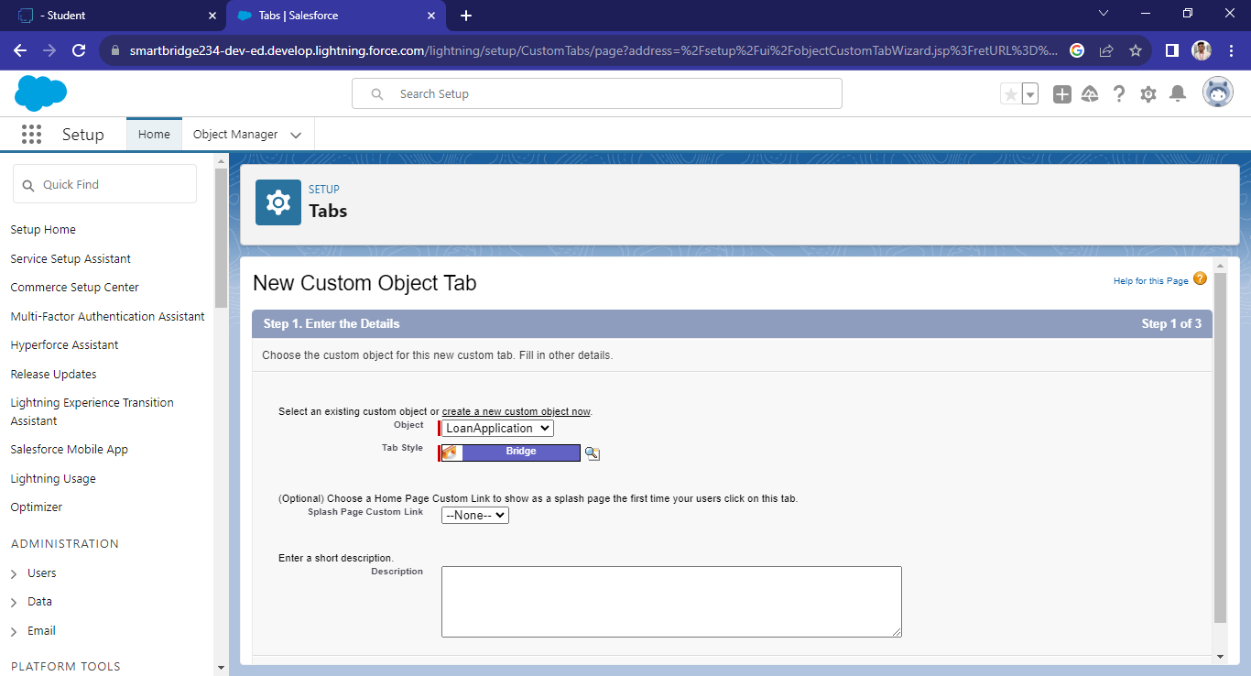
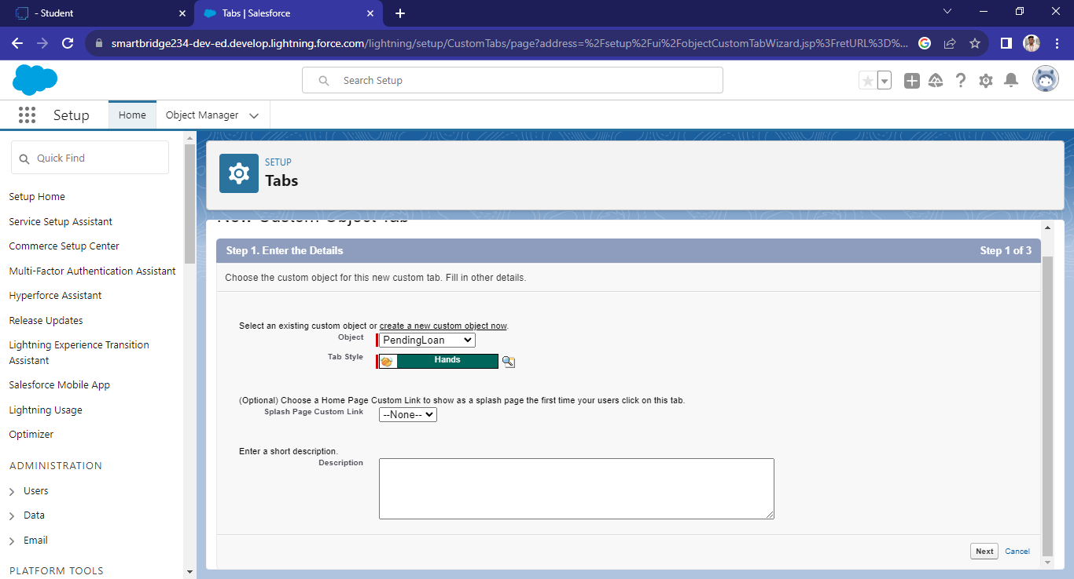
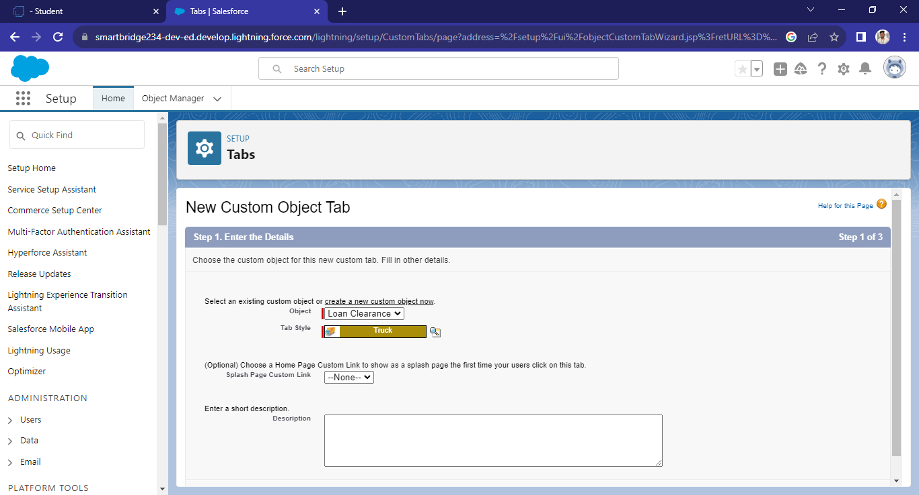
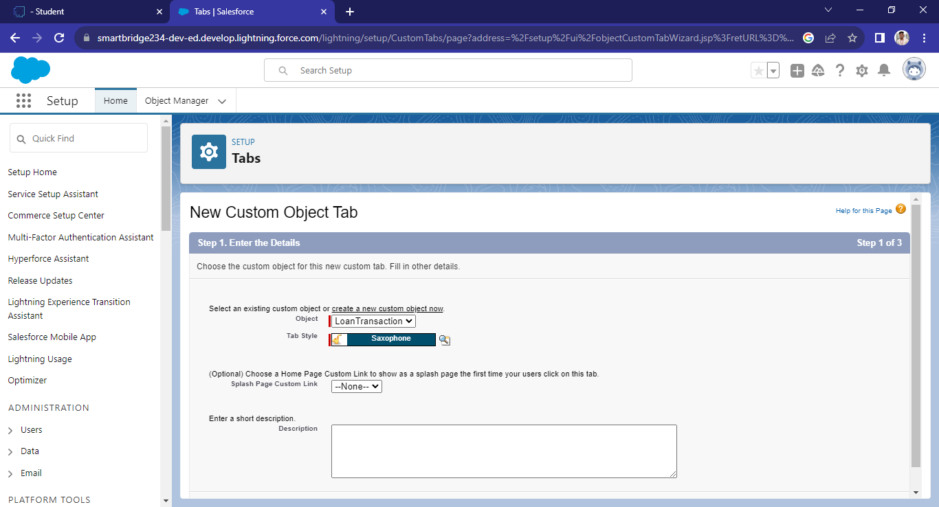
TAB CREATION:

Slide 7
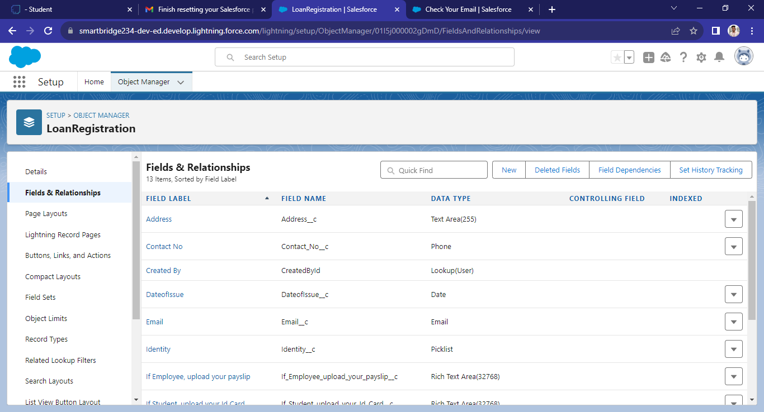
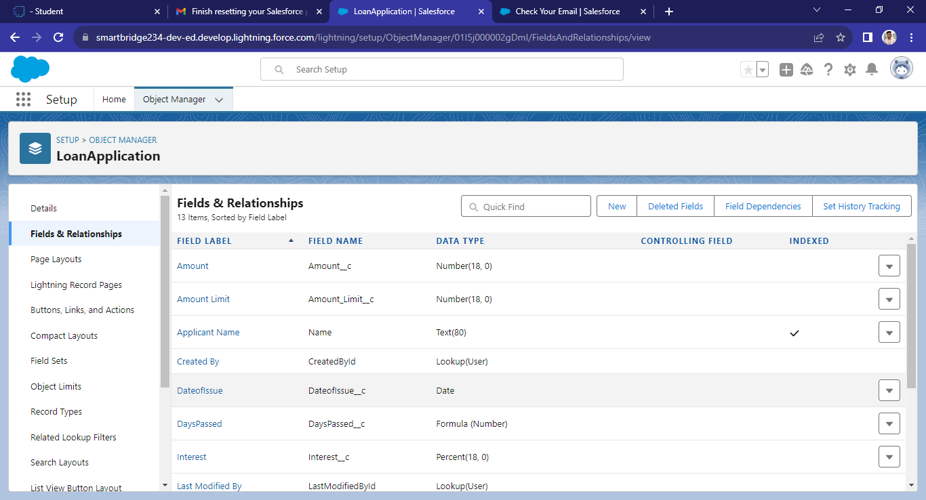
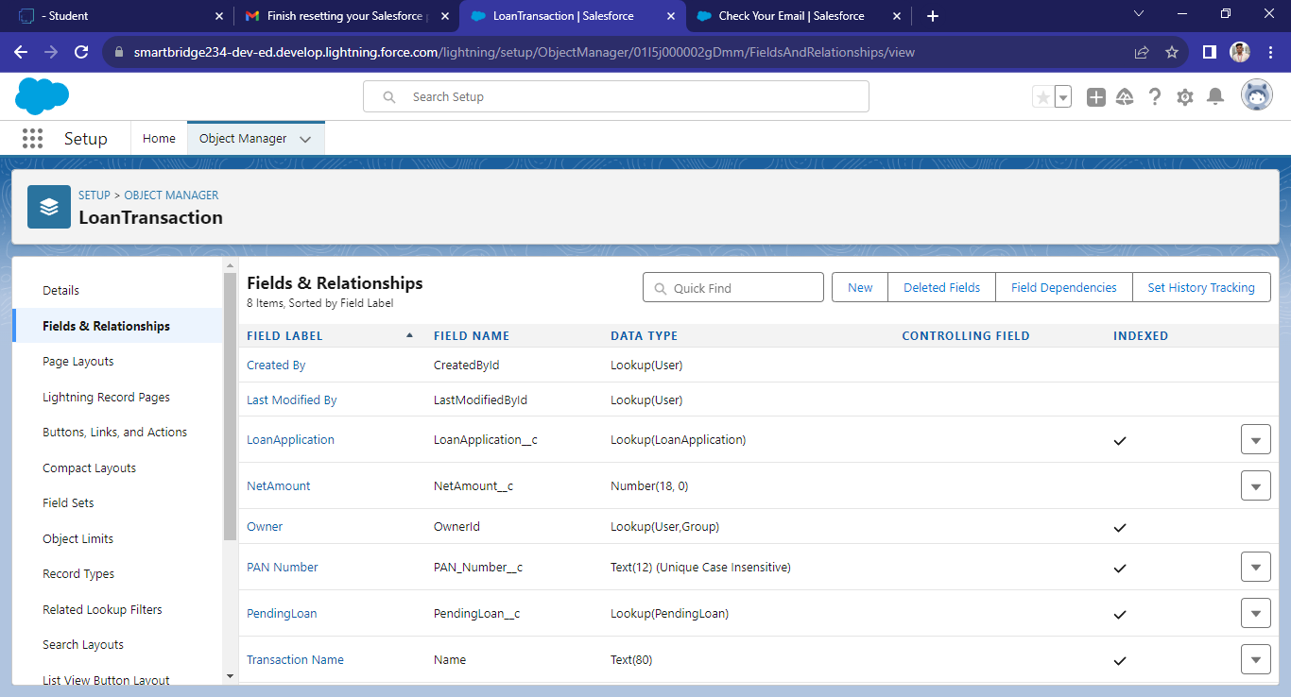
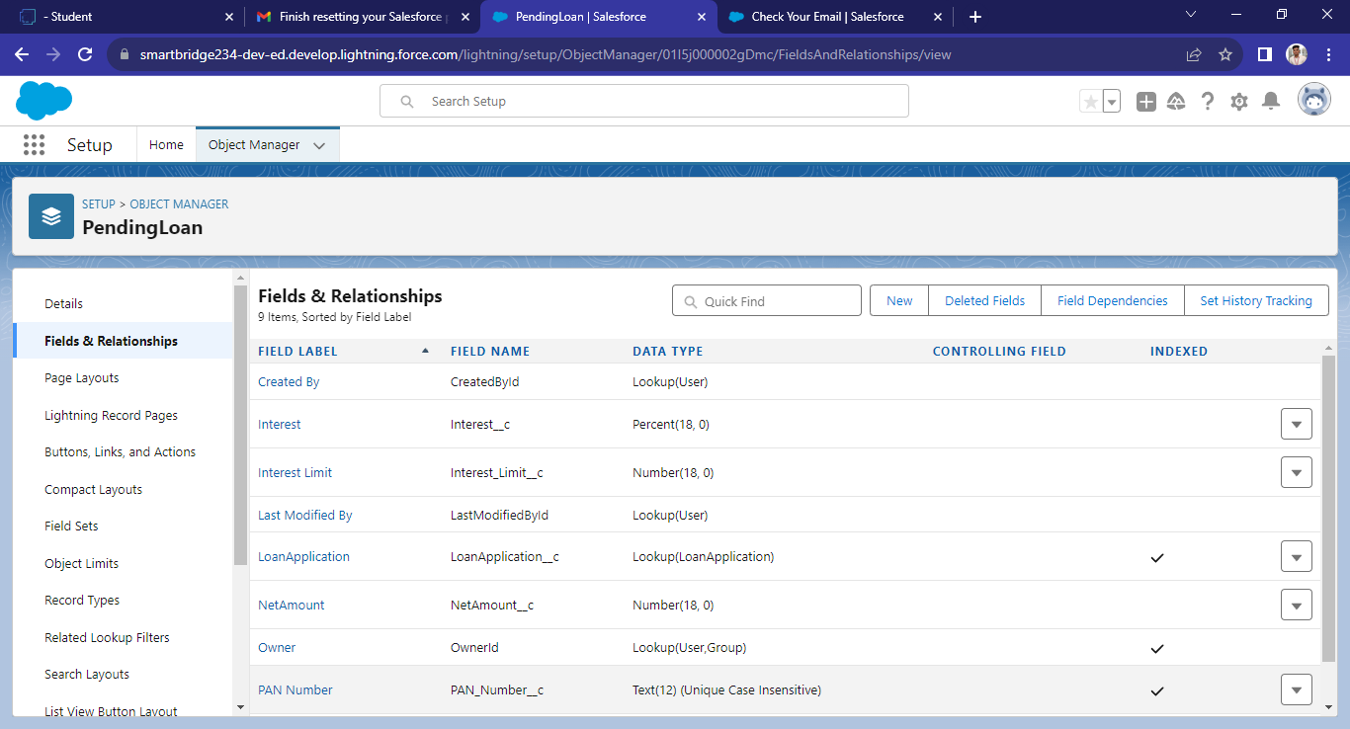
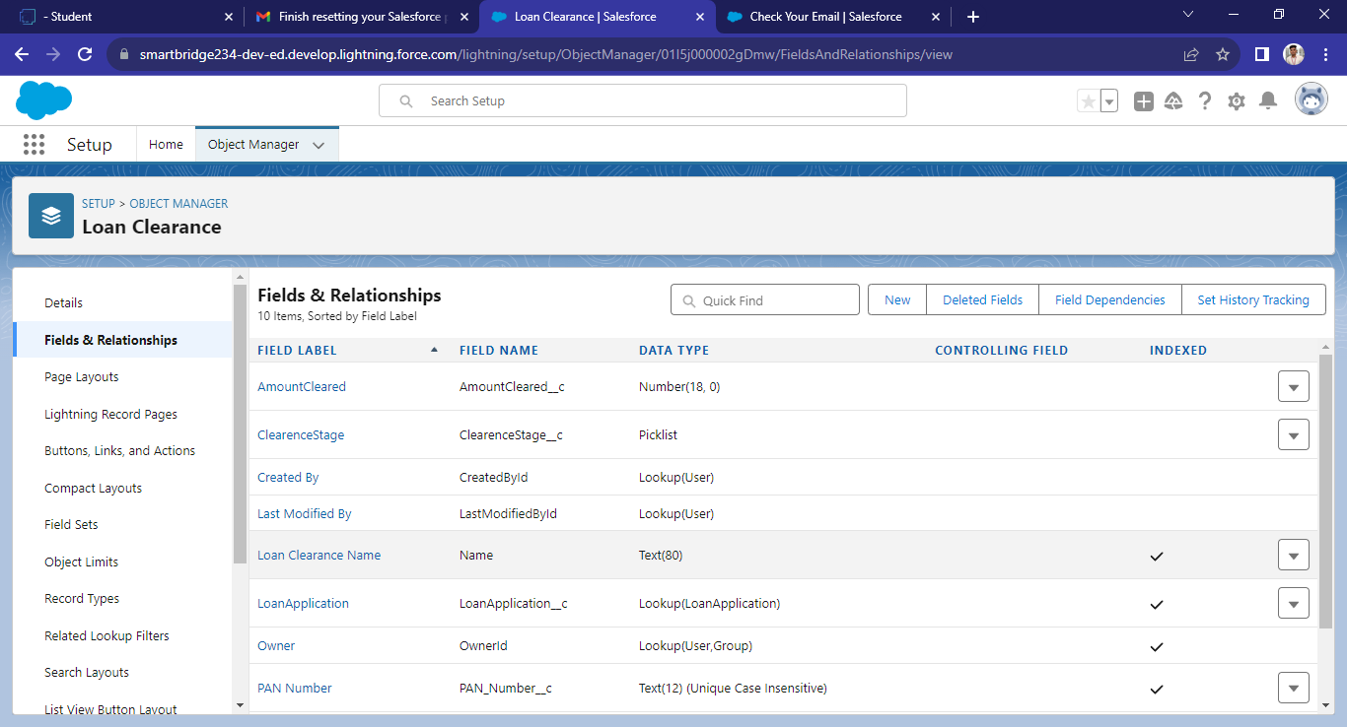
FIELDS AND RELATIONSHIPS:

Slide 8
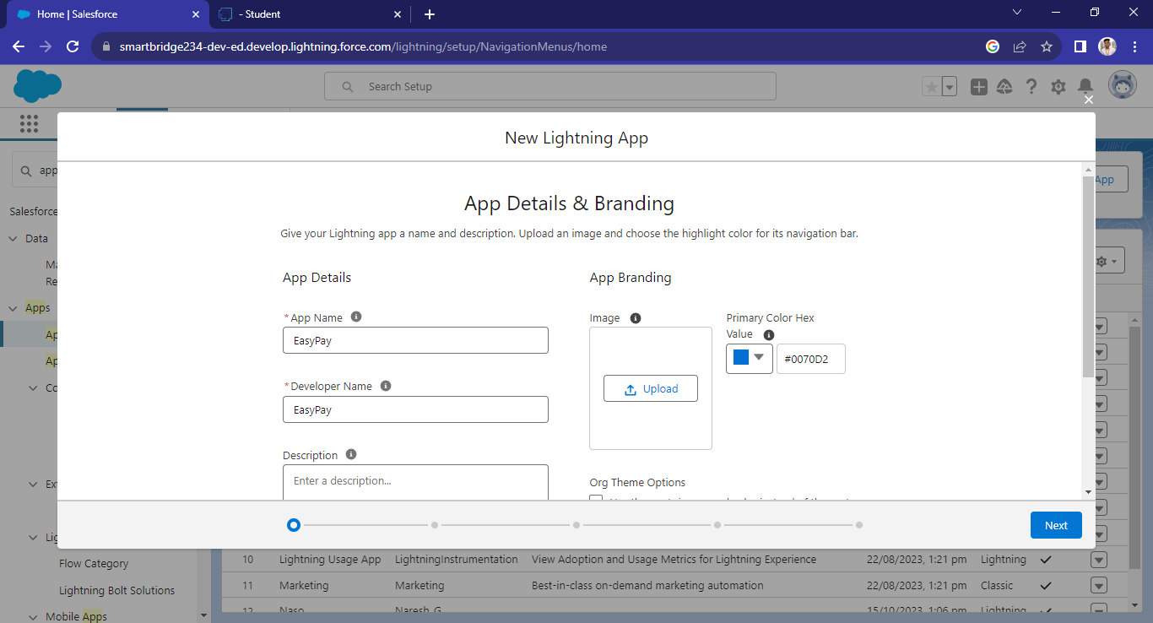
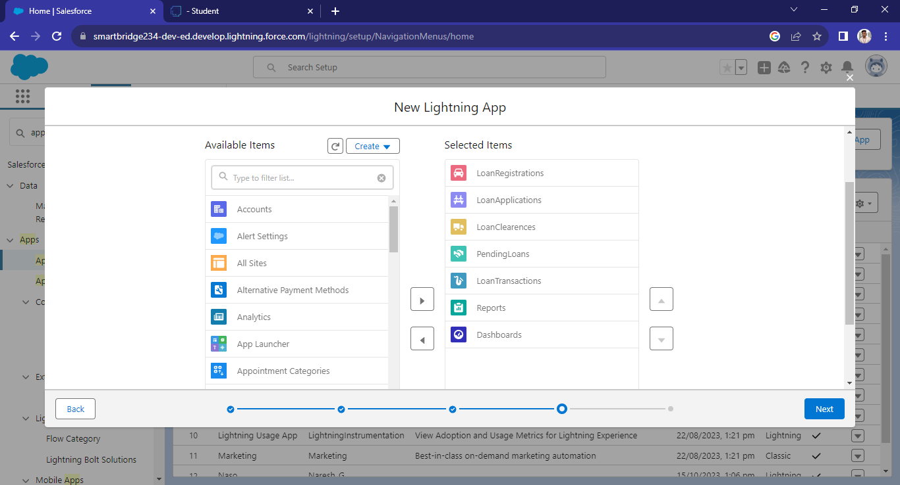
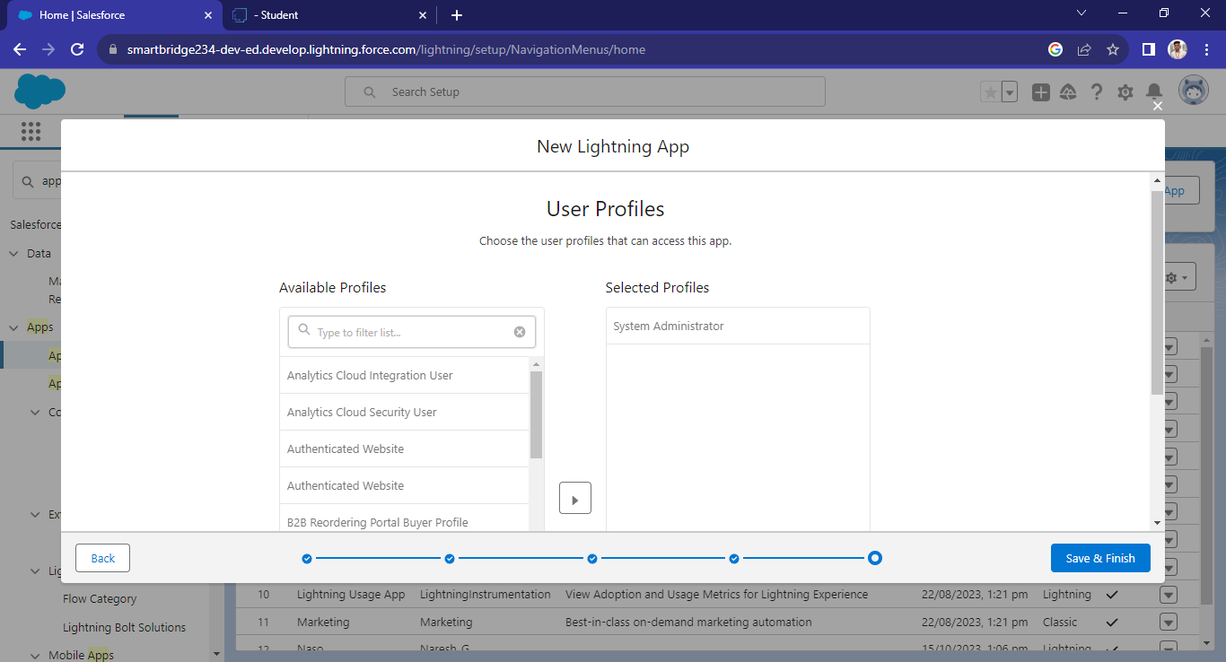
LIGHTNING APP:

Slide 9
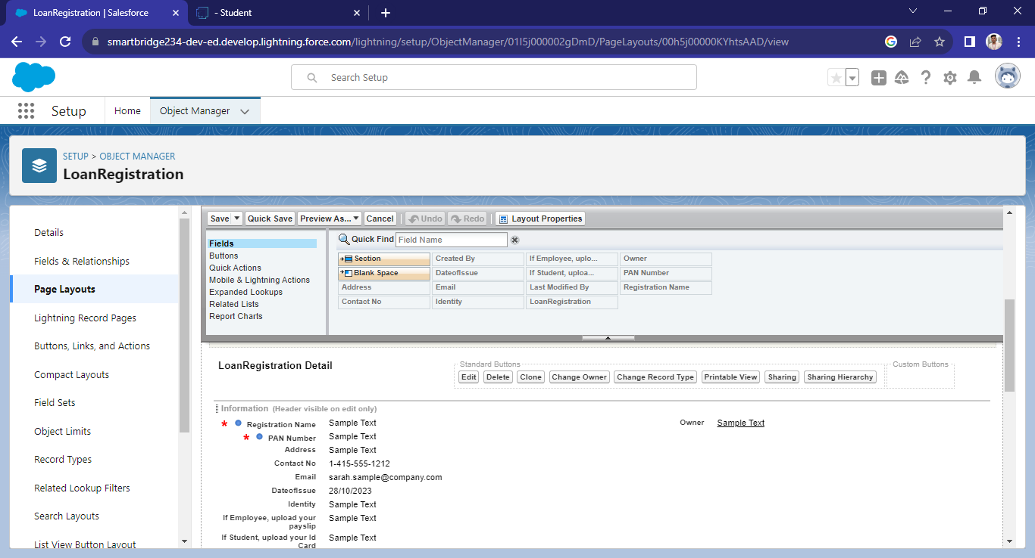
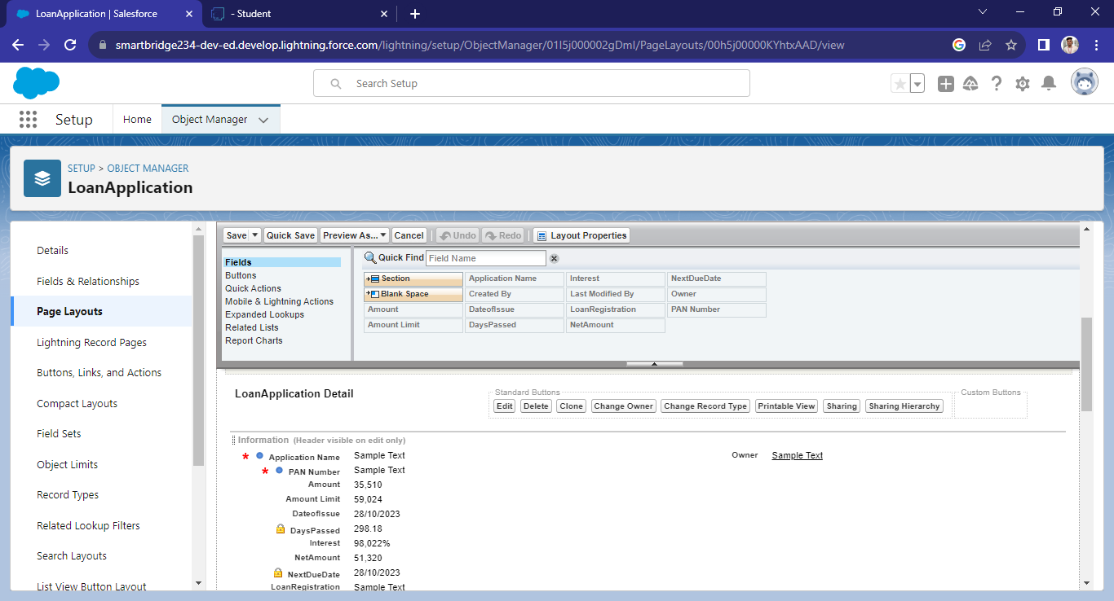
PAGE LAYOUTS:

Slide 10
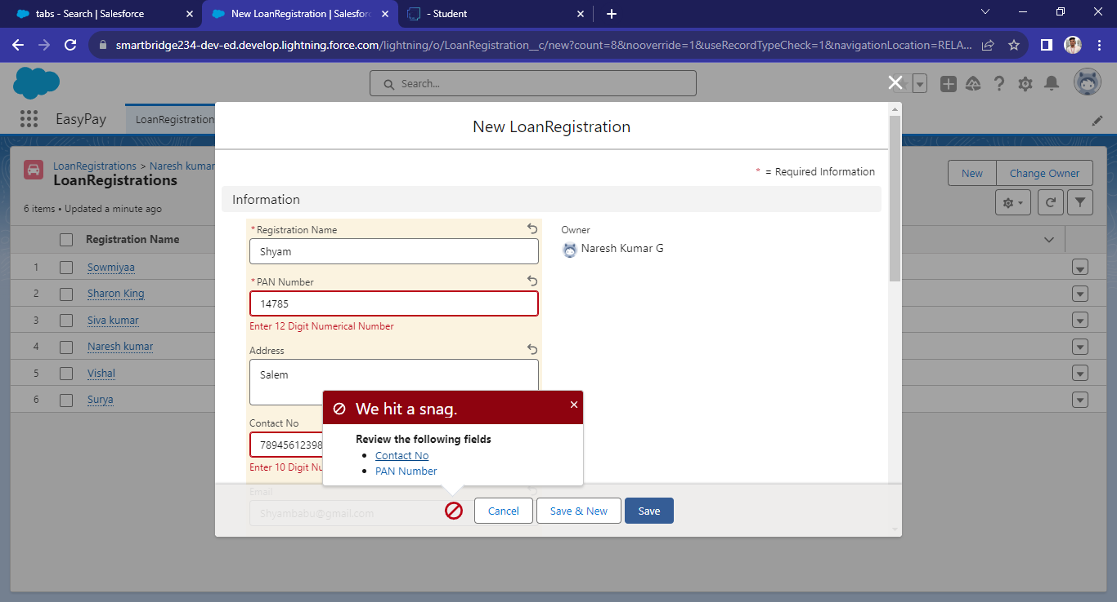
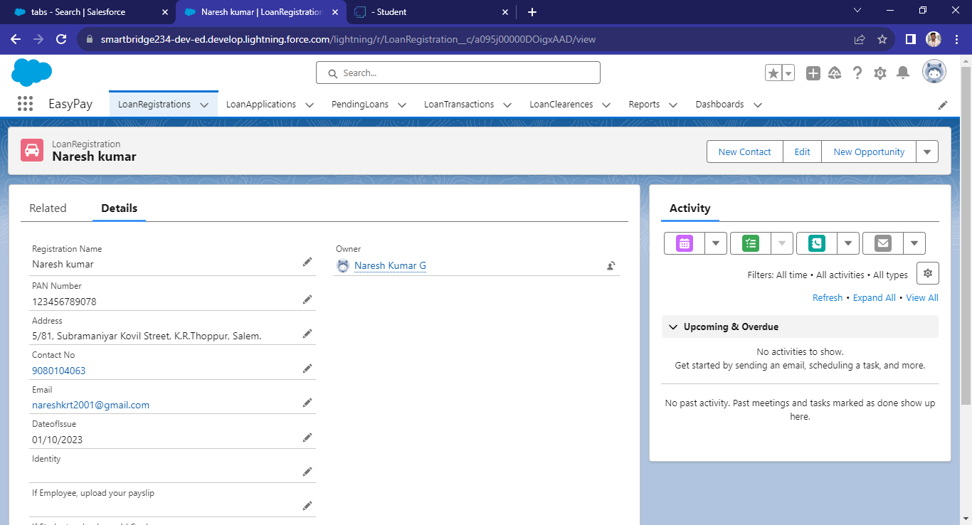
WORKING PROCESS AND USER ADAPTION:
LOAN REGISTRATION

Slide 11
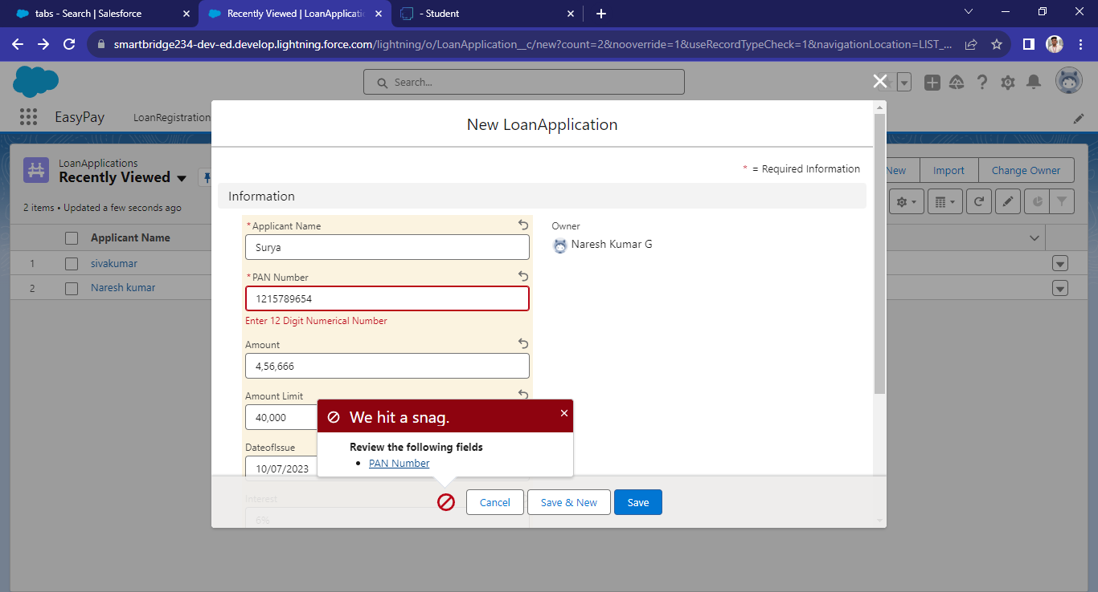
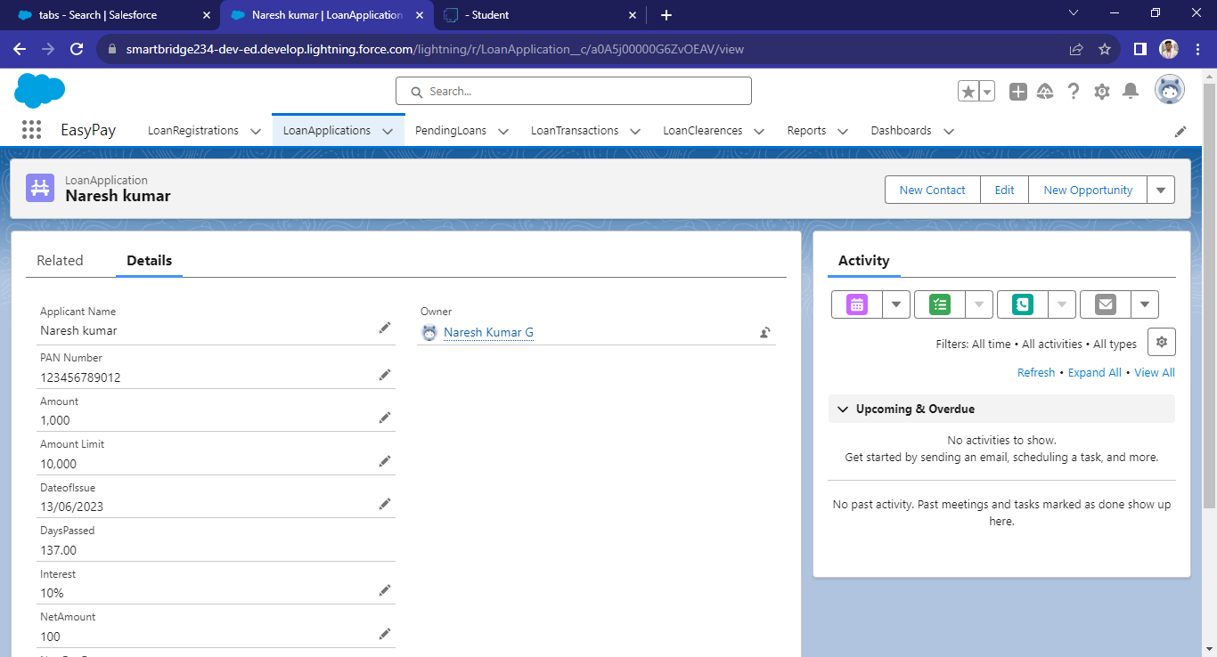
WORKING PROCESS AND USER ADAPTION:
LOAN APPLICATION

Slide 12
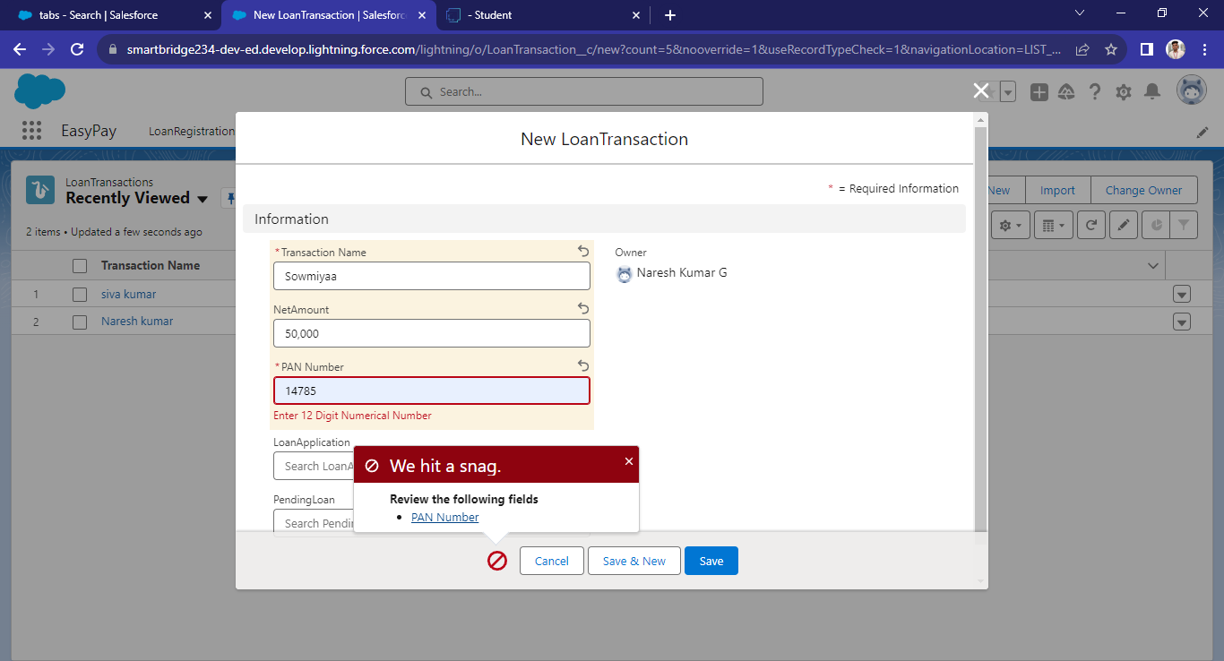
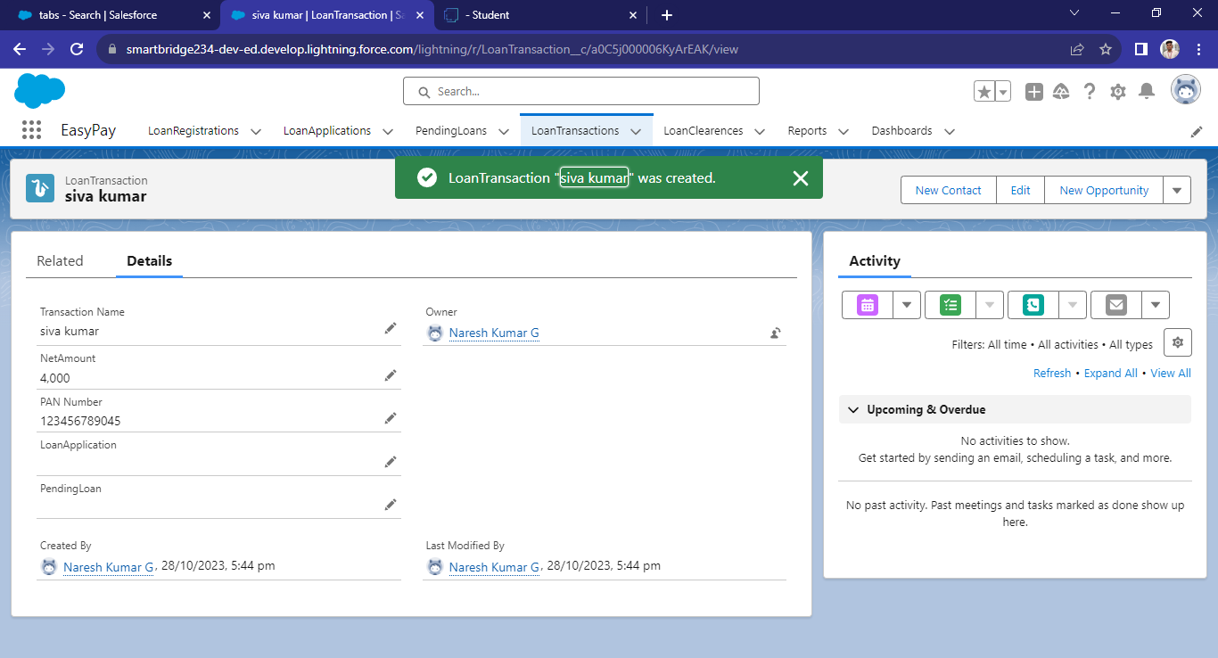
WORKING PROCESS AND USER ADAPTION:
LOAN TRANSACTION

Slide 13
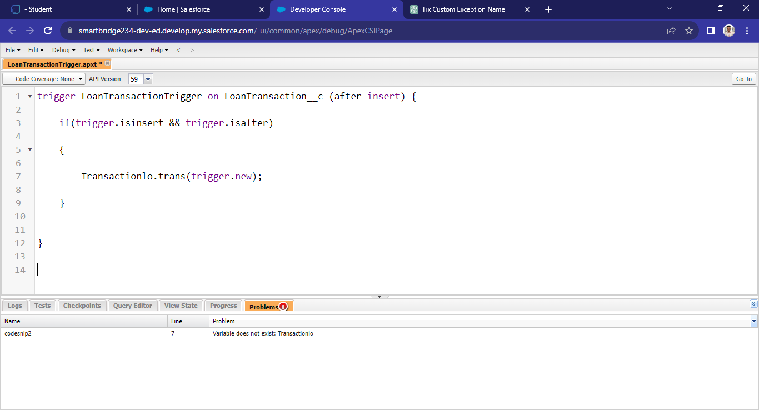
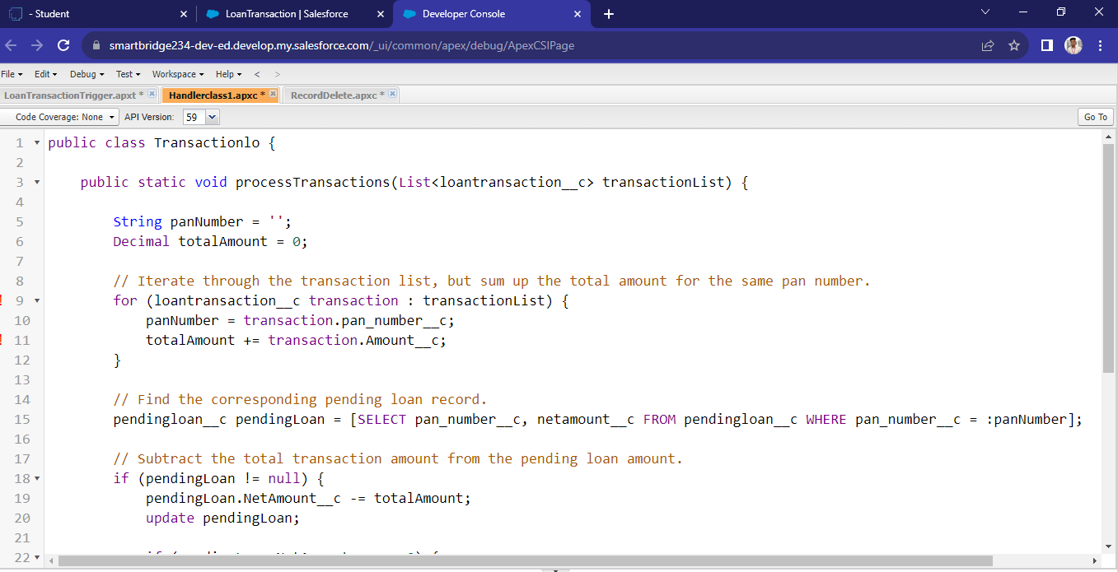
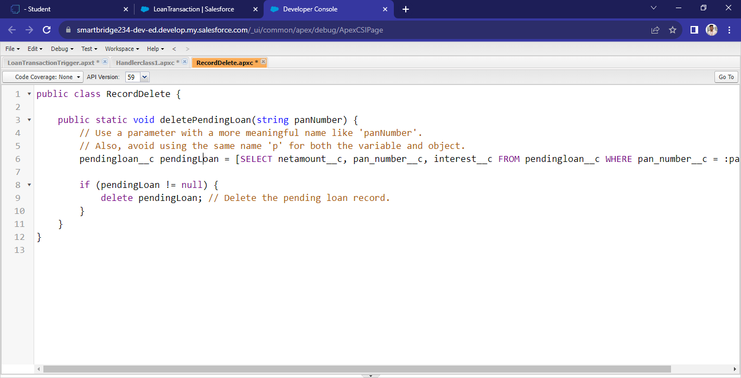
APEX:

Slide 14
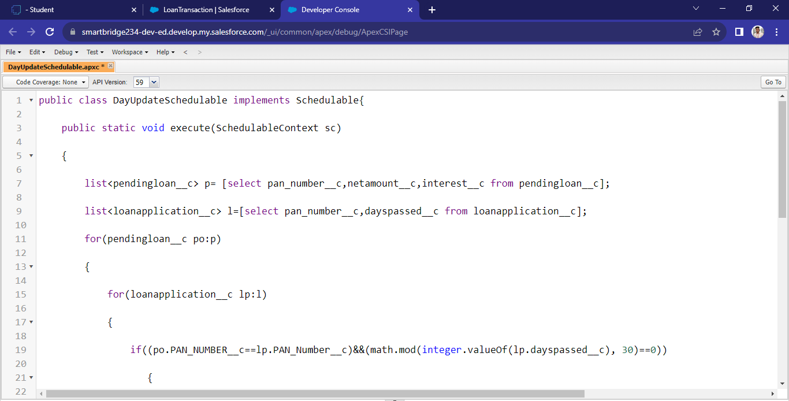
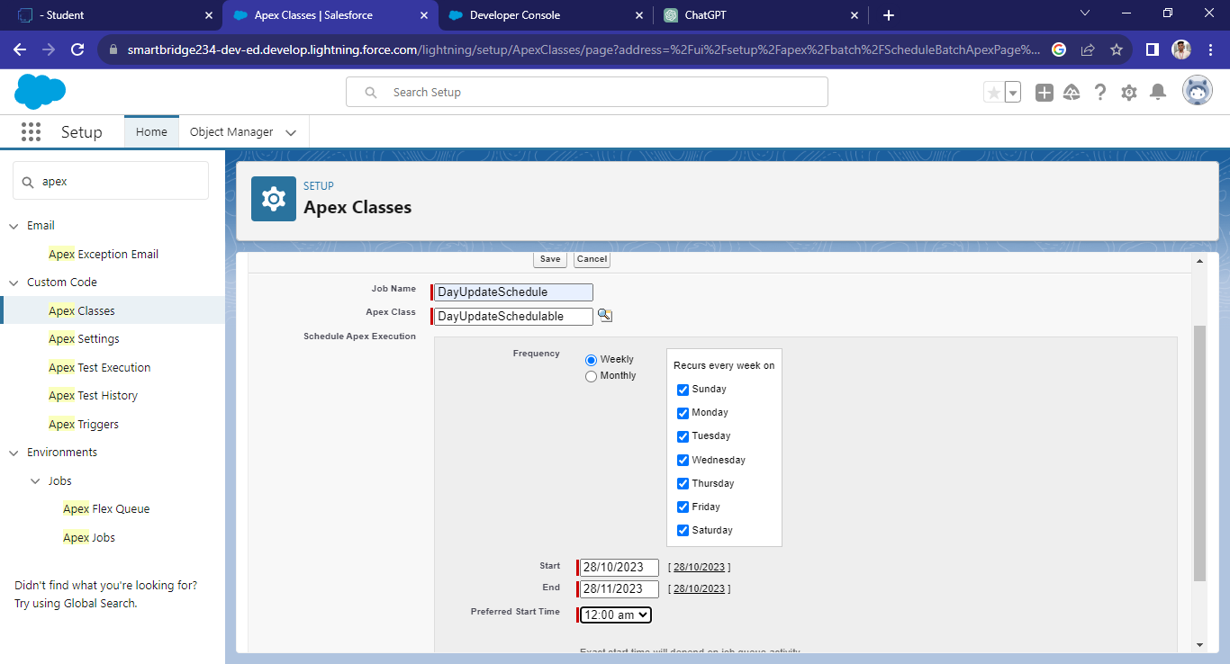
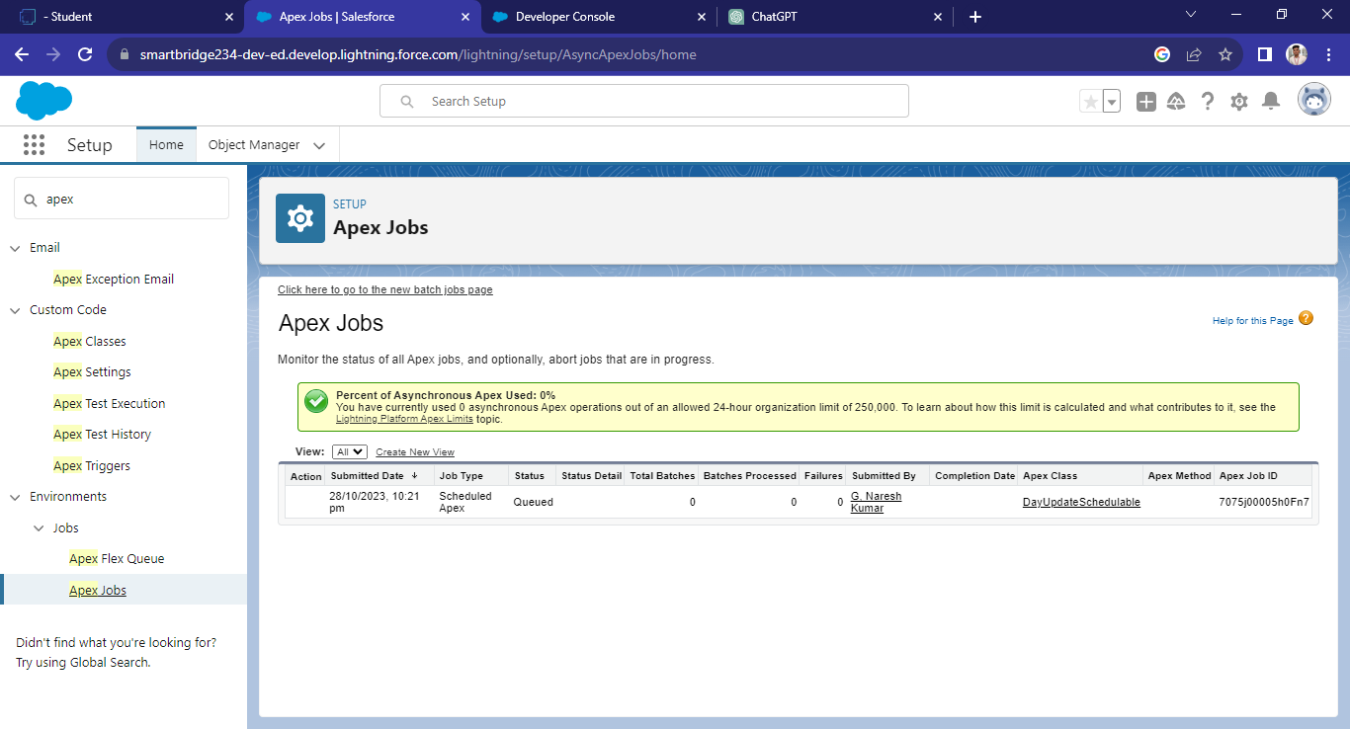
APEX SCHEDULERS:

Slide 15
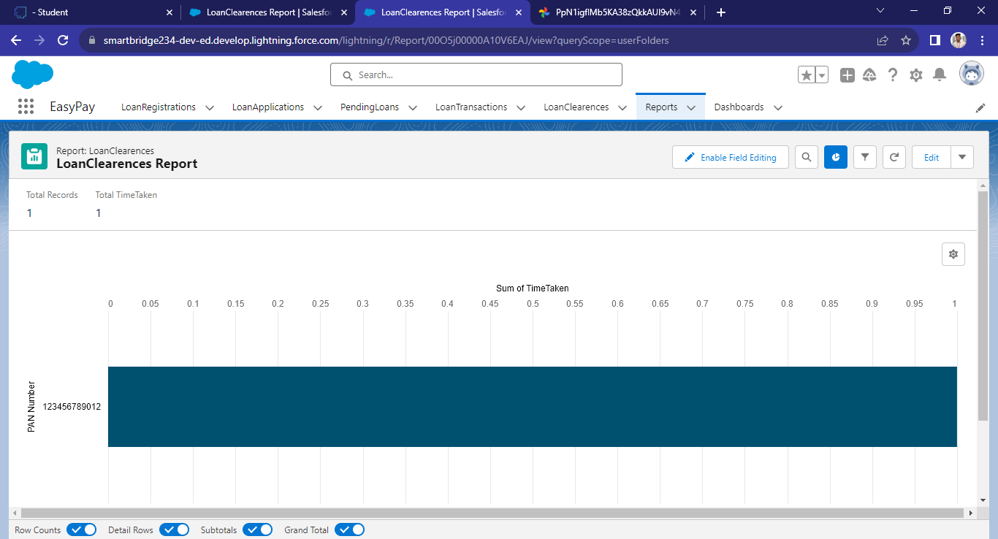
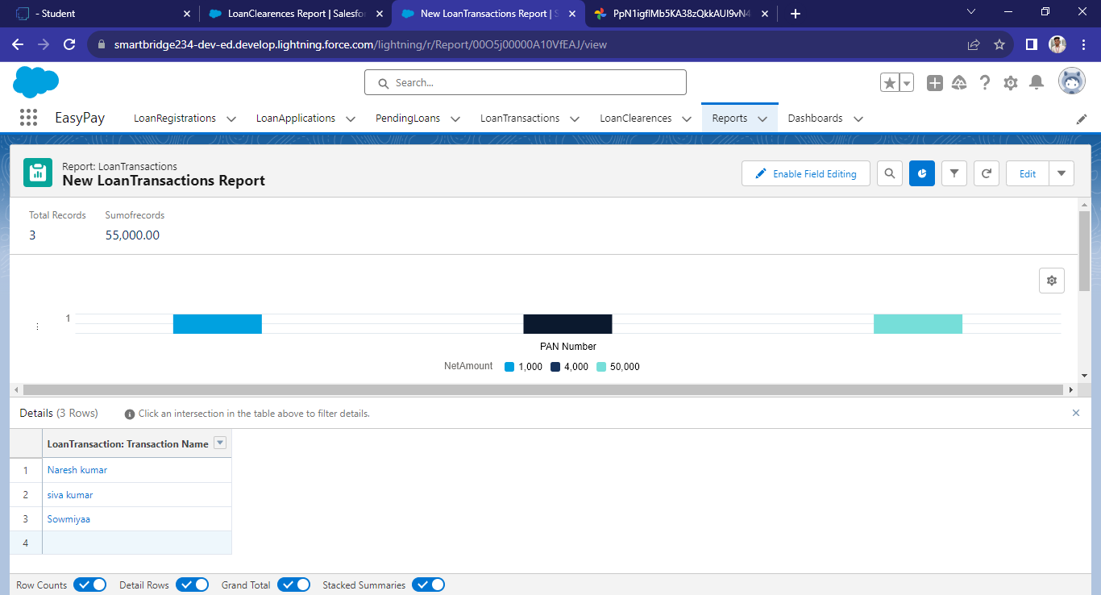
REPORTS:

Slide 16
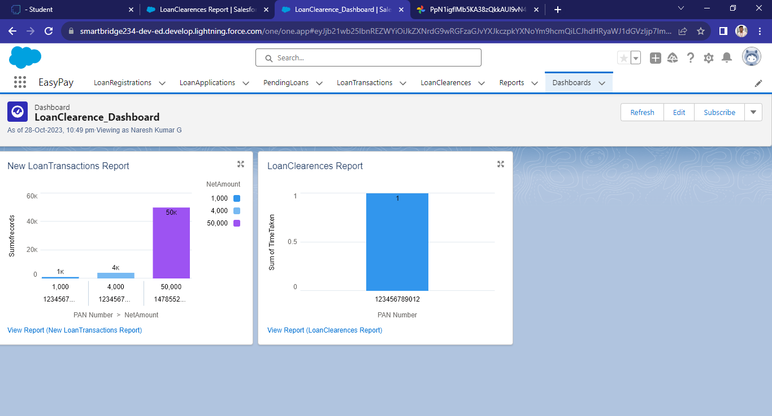
DASHBOARDS:

Slide 17
THANK YOU!

