Slide 1


Slide 2
In the name of god
Subject : Artificial intelligence in the network
Student: narges ebrahimi
November,2023
1/9

Slide 3
IOT
Smart home ….
Smart city….
Smart health….
Smart vehicles….
2/9

Slide 4
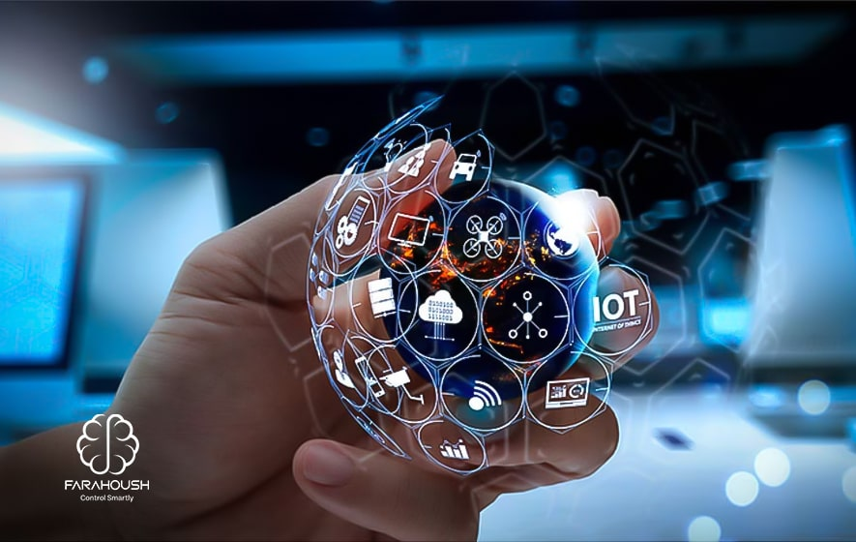
Smart home ….

Slide 5
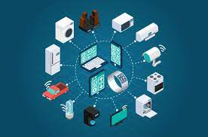
Smart city

Slide 6
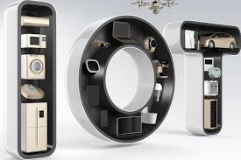
Smart health

Slide 7
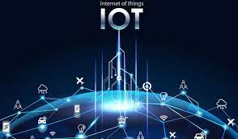
Smart vehicles

Slide 8
source
poe
Google
Internet of Things: Principles and Paradigms
Building the Internet of Things: Implement New Business Models, Disrupt Competitors, Transform Your Industry
Designing Connected Products: UX for the Consumer Internet of Things
IoT Solutions in Microsoft’s Azure IoT Suite: Data Acquisition and Analysis in the Real World

Slide 10
Q & A

