Slide 1

Machine Learning

Slide 2

What is Machine Learning?
Machine learning is a way for computers to learn from examples and experiences, rather than being directly programmed with specific instructions for each task. Just like how humans learn from practice, a computer can use data to make predictions or decisions.
Machine learning helps computers get better at tasks by learning from data, making them more accurate over time without human intervention.

Slide 3


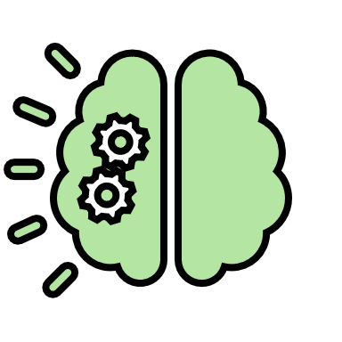

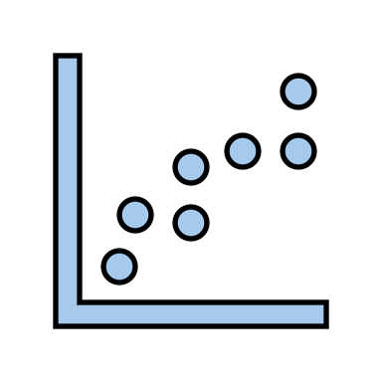




















REGRESSION
Predict Age
Clustering
Anamoly Detection
Dimensionality Reduction
Supervised Learning
Unsupervised Learning
Predict Gender
TYPES OF MACHINE LEARNING
Association Rule Based Learning
CLASSIFICATION
Speech Recognition
Self Driving Cars
Semi-supervised Learning
Reinforcement Learning
Image and video Classification
Recommendation System

Slide 4

















Fraud Detection
Inventory Management
Personalized Recommendations
Risk Management
Retail
Finance
Crop Yield Prediction
Medical Imaging
APPLICATION OF MACHINE LEARNING
Healthcare
Agriculture
Pest Detection
Diagnosis
Manufa-
cturing
Predictive Maintenance
Quality Control

Slide 5



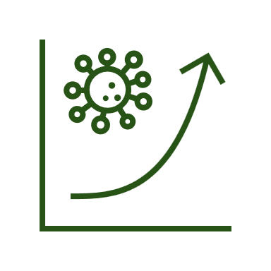





MACHINE LEARNING DEVELOPMENT LIFECYCLE
Frame the problem
Data Gathering
Data Preprocessing
Exploratory Data Analysis (EDA)
Feature Engineering
Model Training, Evaluation, and Selection
Model Deployment
Testing
Optimize

Slide 6

CHALLENGES IN MACHINE LEARNING
Data Collection
Insufficient Data
Unlabeled Data
Poor Quality Data (Outliers, Missing Values, etc.)
Irrelevant Features
Overfitting
Underfitting
Software Integration
Deployment
Cost Management

Slide 7
How to Frame a Machine Learning Problem 📈🌟
1. Business Problem to ML Problem 🧠➡️🤖
2. Type of Problem 🔍📈
3. Current Solution 🧩✅
4. Getting Data 💾📊
5. Metrics to Measure 📏📊
6. Online vs Batch Learning 🔄⏳
7. Check Assumptions 🧐✅
use case: 📞 A Telecom Company’s Journey to Reducing Customer Churn📉🚀

Slide 8
1. Business Problem to ML Problem 🧠➡️📊
Standard Prediction 📊: Start by translating the big-picture question (“Why are customers leaving?”) into a prediction task: “Predict churn for each customer.”
Ranking/Scoring 🏆: Instead of just saying “yes” or “no” for churn, you could rank customers by their likelihood of leaving. This way, the business can prioritize efforts!
Classification, Regression, or Hybrid ⚖️: Think about what kind of output you need. If it’s just “will they leave?,” go with classification. But if it’s “how likely are they to leave?,” regression might be better.
Decision-Making Use Cases 🧠: Also consider business actions! Are we trying to prevent churn, detect fraud, or recommend products? This helps shape the problem into the right type—like classification, forecasting, or recommendation.

Slide 9
2. Type of Problem 🔍
Binary Classification 🟢🔴: The model answers with one of two options (e.g., churn or no churn). Simple and quick to set up.
Multi-Class Classification 🏆: When there are more than two groups. For example, low, medium, or high churn risk.
Regression for Probabilities 📈: If the churn risk varies, we can predict a churn probability (like 80% chance a customer will leave). This lets us offer tailored retention efforts.
Time-Series Forecasting 📅: When you need to predict patterns over time (e.g., seasonal churn trends), forecasting may be better than classification.
Anomaly Detection 🚨: For finding unusual behavior, like fraud. The model identifies outliers rather than clear categories.

Slide 10
3. Current Solution 🧩
Manual or Rule-Based Systems 🤖: Many companies start with rule-based systems (e.g., flagging customers who miss payments). Knowing current solutions helps identify where ML can add value.
Other ML Models 📈: If there’s an ML model already in use, maybe it needs improving instead of creating a new one. This could mean making it more accurate or understandable.
No Solution ❌: If there’s no current solution, innovate with ML but keep checking that it aligns with the company’s goals.
Hybrid Solutions 🔄: Sometimes the solution is a mix—like using ML predictions combined with business rules (e.g., flagging at-risk customers based on both ML predictions and payment history).

Slide 11
4. Getting Data 📂
Internal Data 📊: Start with the company’s own data (e.g., customer history, usage). Reliable and accessible.
External Data 🌎: You might bring in outside data to get more context. For instance, economic data can explain how financial stress affects customer decisions.
Synthetic Data 💻: When real data is lacking, synthetic data can simulate scenarios for testing models.
Data Quality and Cleaning 🧹: Real-world data is often messy! Cleaning up missing values, duplicates, and outliers can improve model results.
Data Enrichment 🔍: Sometimes you can add extra value to data by calculating new features, like average monthly spend. Enriched data = better insights.

Slide 12
5. Metrics to Measure Success 🎯
Accuracy ✅: Good for simple tasks but not ideal if data is unbalanced (like only a few customers actually churn).
Precision and Recall 🎛️: For churn, high recall means you catch most at-risk customers, which is helpful if the goal is to keep as many as possible.
F1-Score ⚖️: This metric balances precision and recall, useful when both are equally important.
ROC-AUC 📈: Measures how well the model distinguishes between classes, useful for imbalanced datasets.
Cost-Based Metrics 💰: Sometimes a custom metric (like revenue impact) shows model success more meaningfully. For example, balancing discounts vs. churned revenue can help fine-tune retention offers.
Lift/Decile Analysis 📊: Ranking metrics like lift help prioritize customers with the highest risk of leaving.

Slide 13
6. Online VS Batch Learning 🔄
Batch Learning 🗓️: When things are stable, you can train the model periodically (e.g., monthly or quarterly).
Online Learning 🌐: If behavior changes often (like with new competitors), online learning can keep models up-to-date by continuously learning from new data.
Semi-Batch (Hybrid) 💾: A mix where models get mini-updates based on small changes without full retraining, saving time while staying adaptable.
Transfer Learning 🧠: With little data, starting with a pre-trained model and fine-tuning it can be a quick solution, especially if industry patterns apply.

Slide 14
7. Check Assumptions🧐
Assumption Testing 🔬: Make sure your assumptions fit the real world. For example, you might think frequent customer complaints mean unhappiness, but it could show loyalty.
Bias Check ⚖️: Watch out for biases in your data. If your model favors payment history, it might wrongly mark economically vulnerable customers as high churn risk.
Correlations and Feature Engineering 🔗: Test if your key features (like call volume) truly predict outcomes. Make changes based on what the data tells you.
Data Distribution Changes 🔄: Customer behavior can change over time, so check if assumptions stay accurate.
Feedback Loops 🔁: A feedback loop helps the model adjust if assumptions are off. For instance, if retention offers aren’t working, the model might need to prioritize different features.

