Slide 1
Discrete Structure II
CST_2202

Slide 2
Advanced Counting Techniques
Application of Recurrence Relations
Solving Linear Homogeneous Recurrence Relations
Solving Linear Nonhomogeneous Recurrence Relations
Divide and Conquer Algorithms and Recurrence Relations
Generating Functions
Inclusion- Exclusion
Applications of Inclusion-Exclusion

Slide 3
Application of Recurrence Relations
Introduction
Modeling with recurrence relations

Slide 4
Learning Outcomes
To find a recurrence relation to model a problem;
To solve recurrence relations iteratively;

Slide 5
Introduction
A recurrence relation together with initial conditions can be used to solve some counting problems which cannot be solved using counting techniques.

Slide 6
Modeling with Recurrence Relations
A young pair of rabbits (one of each sex) is placed on an island. A pair of rabbits does not breed until they are 2 months old. After they are 2 months old, each pair of rabbits produces another pair each month, as shown in fig 1.Find a recurrence relation for the number of pairs of rabbits on the island after n months , assuming that no rabbits ever die.

Slide 7
Reproducing Pairs | Young Pairs | Month | Repro ducing Pairs | Young Pairs | Total Pairs
 | ** | 1 | 0 | 1 | 1
 | ** | 2 | 0 | 1 | 1
** | ** | 3 | 1 | 1 | 2
** | ** ** | 4 | 1 | 2 | 3
** ** | ** ** ** | 5 | 2 | 3 | 5
** ** ** | ** ** ** ** ** | 6 | 3 | 5 | 8

Slide 8
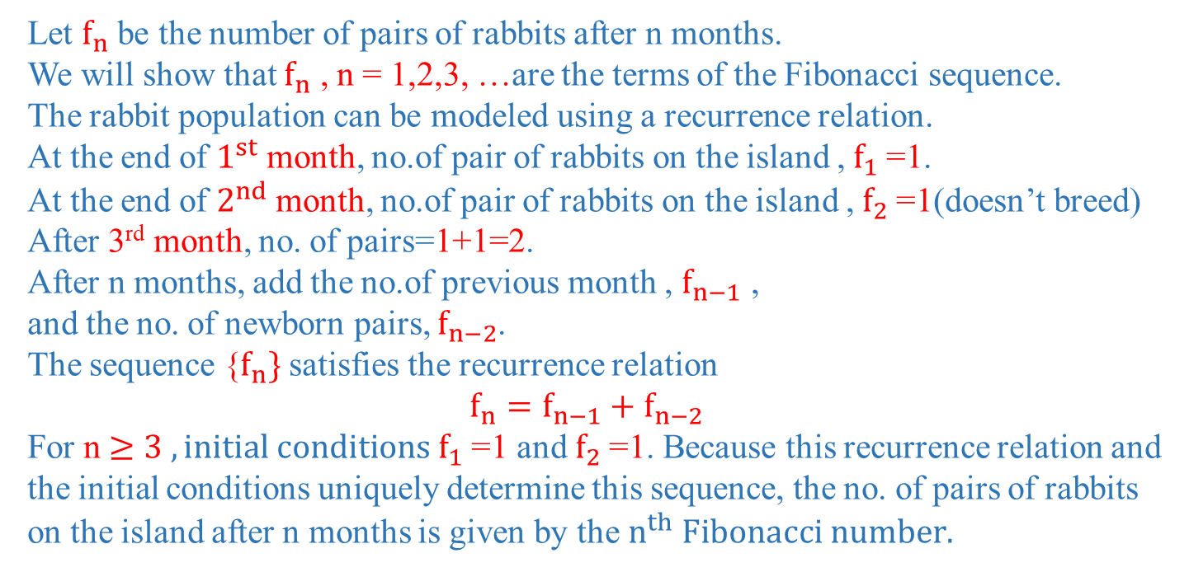
Let $f_{n}$ be the number of pairs of rabbits after n months.
We will show that $f_{n}$ , n = 1,2,3, …are the terms of the Fibonacci sequence.
The rabbit population can be modeled using a recurrence relation.
At the end of $1^{st}$month, no.of pair of rabbits on the island , $f_{1}$=1.
At the end of $2^{nd}$month, no.of pair of rabbits on the island , $f_{2}$=1(doesn’t breed)
After 3rd month, no. of pairs=1+1=2.
After n months, add the no.of previous month , $f_{n−1}$ ,
and the no. of newborn pairs, $f_{n−2}$.
The sequence {$f_{n}\}$satisfies the recurrence relation
$$f_{n}=f_{n−1}+f_{n−2}$$
For n $≥3 , initial conditions f_{1}$=1 and $f_{2}$=1. Because this recurrence relation and the initial conditions uniquely determine this sequence, the no. of pairs of rabbits on the island after n months is given by the $n^{th} Fibonacci number.$

Slide 9
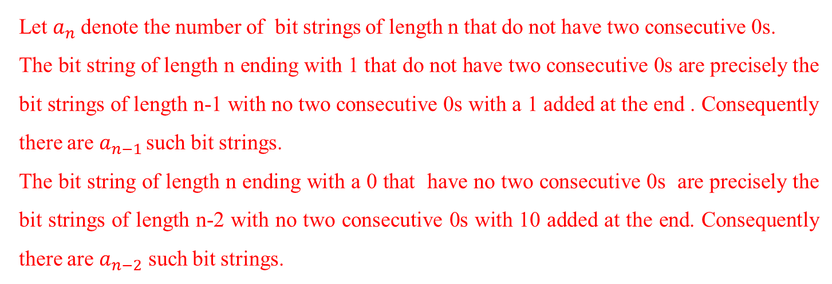
Find a recurrence relation and give initial condition for the number of bit strings of length n that do not have two consecutive 0s. How many such bit strings are there of length five?
Let $a_{n}$denote the number of bit strings of length n that do not have two consecutive 0s.
The bit string of length n ending with 1 that do not have two consecutive 0s are precisely the bit strings of length n-1 with no two consecutive 0s with a 1 added at the end . Consequently there are $a_{n−1 }$such bit strings.
The bit string of length n ending with a 0 that have no two consecutive 0s are precisely the bit strings of length n-2 with no two consecutive 0s with 10 added at the end. Consequently there are $a_{n−2}$ such bit strings.

Slide 10
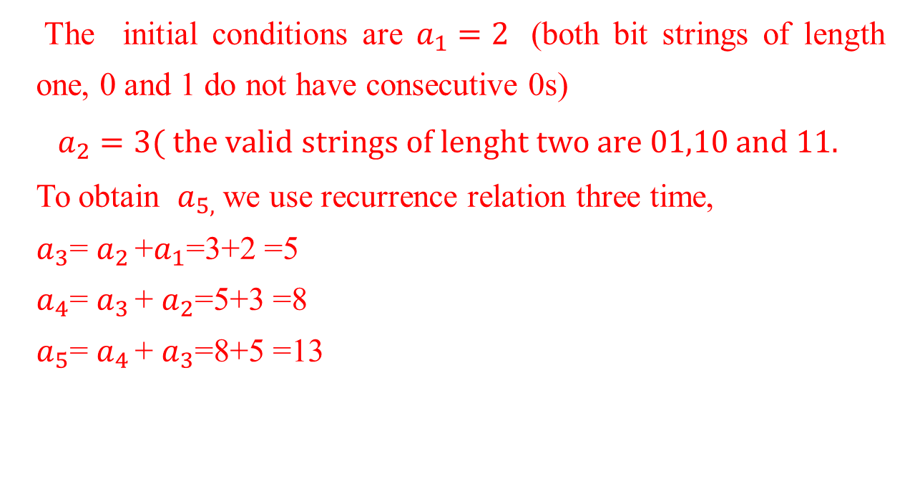
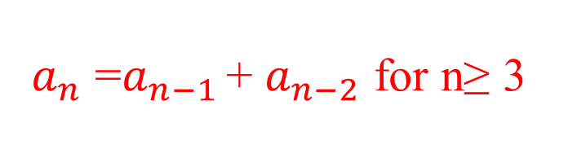
$a_{n}$ =$a_{n−1 }$+ $a_{n−2}$ for n≥ 3
The initial conditions are $a_{1}=2$ (both bit strings of length one, 0 and 1 do not have consecutive 0s)
$$a_{2}=3( the valid strings of lenght two are 01,10 and 11.$$
To obtain $a_{5,}$ we use recurrence relation three time,
$a_{3}$= $a_{2 }$+$a_{1}$=3+2 =5
$a_{4}$= $a_{3 }$+ $a_{2}$=5+3 =8
$a_{5}$= $a_{4 }$+ $a_{3}$=8+5 =13

Slide 11



$$a_{1}=2, \{0, 1\}$$
$$a_{2}=3, \{01, 10, 11\}\}$$
$$a_{3}=3, \{011, 101, 111, 010, 110\}\}$$

Slide 12
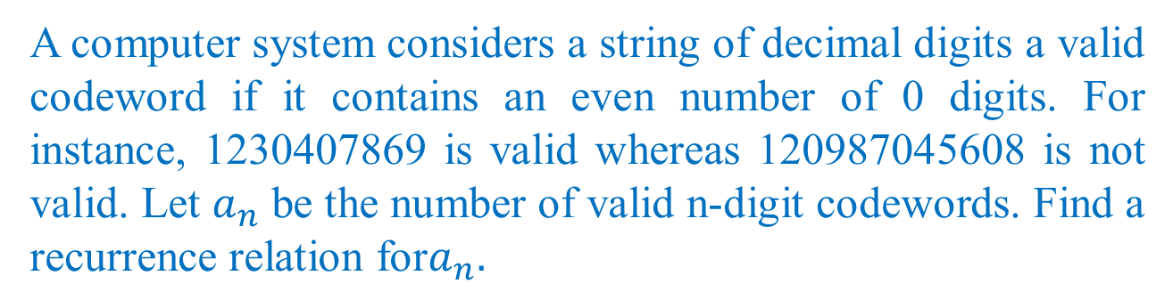
A computer system considers a string of decimal digits a valid codeword if it contains an even number of 0 digits. For instance, 1230407869 is valid whereas 120987045608 is not valid. Let $a_{n}$ be the number of valid n-digit codewords. Find a recurrence relation for$a_{n}.$

Slide 13
0 | 1 | 2 | 3 | 4 | 5 | 6 | 7 | 8 | 9
a₁=9
 | 0 | 1 | 2 | 3 | 4 | 5 | 6 | 7 | 8 | 9
0 | 00 | 01 | 02 | 03 | 04 | 05 | 06 | 07 | 08 | 09
1 | 10 | 11 | 12 | 13 | 14 | 15 | 16 | 17 | 18 | 19
2 | 20 | 21 | 22 | 23 | 24 | 25 | 26 | 27 | 28 | 29
3 | 30 | 31 | 32 | 33 | 34 | 35 | 36 | 37 | 38 | 39
4 | 40 | 41 | 42 | 43 | 44 | 45 | 46 | 47 | 48 | 49
5 | 50 | 51 | 52 | 53 | 54 | 55 | 56 | 57 | 58 | 59
6 | 60 | 61 | 62 | 63 | 64 | 65 | 66 | 67 | 68 | 69
7 | 70 | 71 | 72 | 73 | 74 | 75 | 76 | 77 | 78 | 79
8 | 80 | 81 | 82 | 83 | 84 | 85 | 86 | 87 | 88 | 89
9 | 90 | 91 | 92 | 93 | 94 | 95 | 96 | 97 | 98 | 99
a₂=9*9+1=82

Slide 14
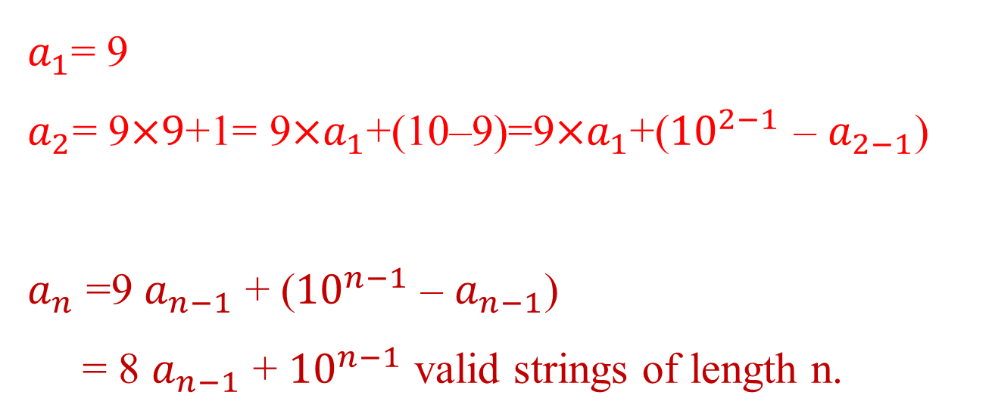
$a_{1}$= 9
$a_{2}$= 9×9+1= 9×$a_{1}$+(10–9)=9×$a_{1}$+(${10}^{2−1}$ – $a_{2−1}$)
$a_{n}$ =9 $a_{n−1}$ + (${10}^{n−1}$ – $a_{n−1}$)
= 8 $a_{n−1}$ + ${10}^{n−1}$ valid strings of length n.

Slide 15
Summary
How to solve the counting problems using recurrence relation
Firstly define the nth term of the sequence.
Start from the first step and conduct until the nth step.
Consider the initial conditions
Write the recurrence relation together with the initial conditions

Slide 16
Practice Exercise
How many different ways of adding up 1's and 2's to 14?

