Slide 1


BITCOIN PRICE
May, 2017
v.1 Narissa Shrestha
© 2017 Thomson Reuters. All rights reserved.

Slide 2
1. DATA EXPLORATION & TIME SERIES MODEL
© 2017 Thomson Reuters. All rights reserved.

Slide 3

Last week vs This week price

Slide 4
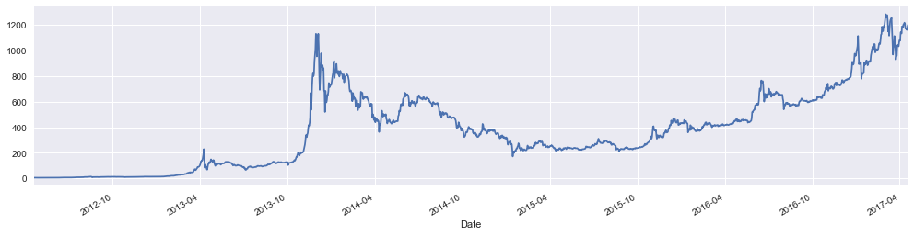
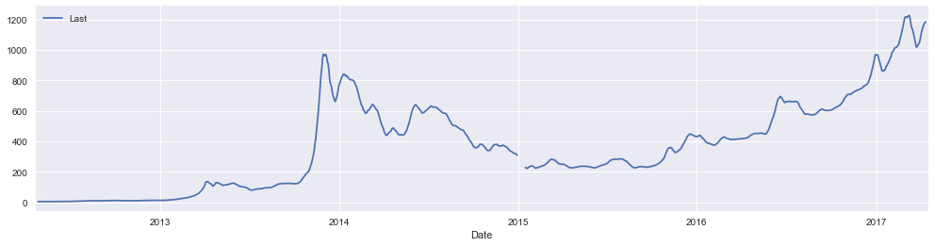
Data Set – Bitcoin Price (2012 – 2017)
Plot()
Smoothen, Resample ‘D’, rolling mean, window = 14

Slide 5
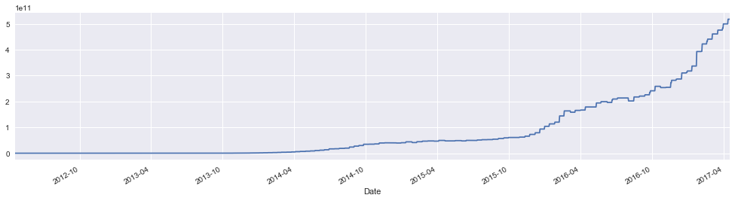
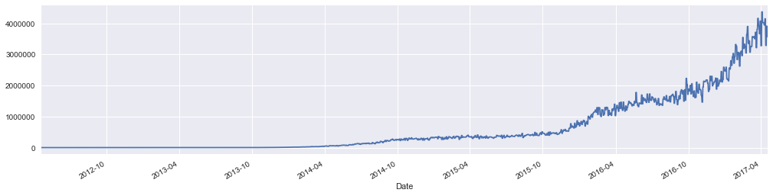
Data Set – Difficulty and Hash Rate
Difficulty Level
Hash Rate

Slide 6
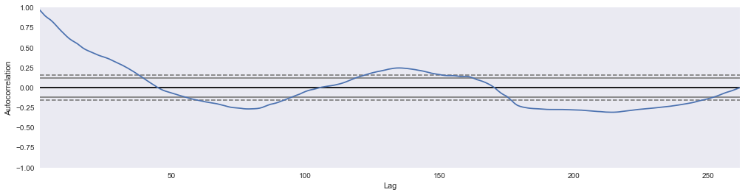
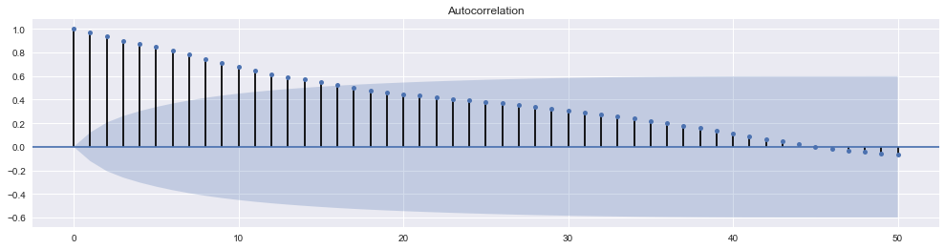
Bitcoin price - Autocorrelation
Autocorrelation, resample ‘D’, lag = 1, is 0.99736776309179975
Autocorrelation, resample ‘D’, lag = 365, is -0.026137235760321745
Autocorrelation, resample ‘W’ lag = 1, is 0.988093713769
Autocorrelation, resample ‘W’ lag = 4, is 0.932231852951
Autocorrelation, resample ‘W’ lag = 4, is -0.0163816400346

Slide 7
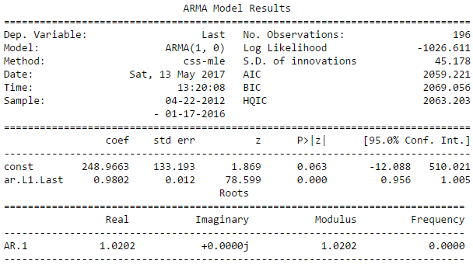
Model - ARMA
model = sm.tsa.ARIMA(train, (1, 0, 0)).fit()

Slide 8
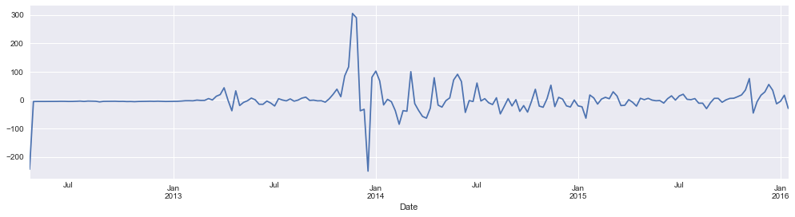
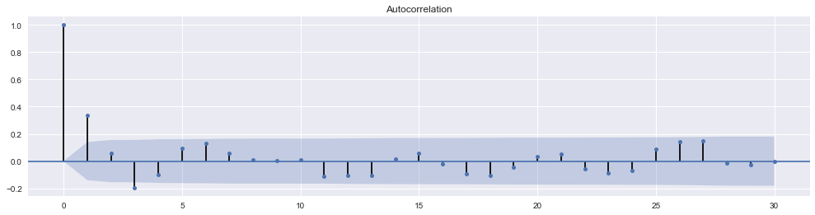
Model – ARMA – Plot residual
model.resid.plot()
plot_acf(model.resid, lags=30)

Slide 9
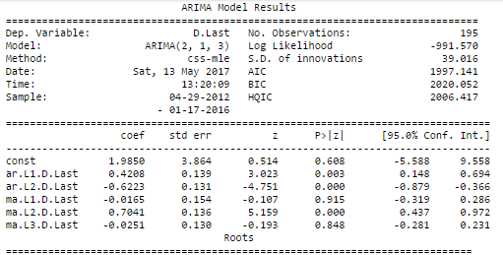

Model - ARIMA
model = sm.tsa.ARIMA(train, (2, 1, 3)).fit()

Slide 10
2. LSTM RECURRENT NEURAL NETWORK
Long Short-Term Memory Network
© 2017 Thomson Reuters. All rights reserved.

Slide 11
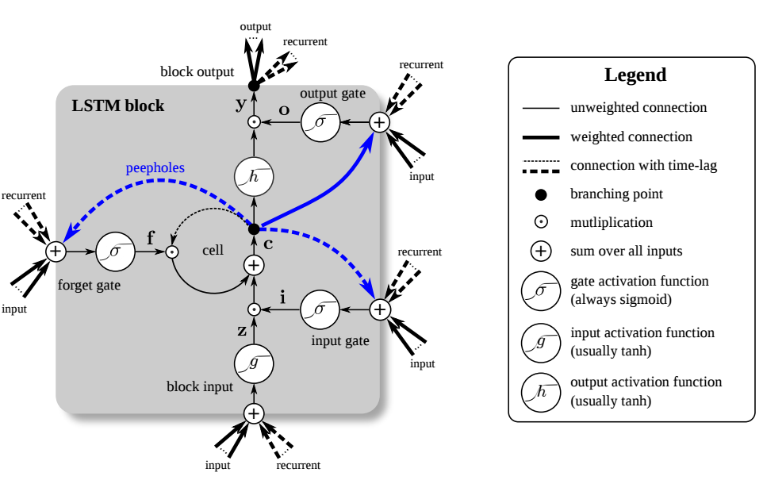
LSTM OVERVIEW
LSTMs contain information outside the normal flow of the recurrent network in a gated cell.
Forget Gate: conditionally decides what information to throw away from the block.
Input Gate: conditionally decides which values from the input to update the memory state.
Output Gate: conditionally decides what to output based on input and the memory of the block.

Slide 12




LSTM Network – Key Process
Model required
from keras.models import Sequential
from keras.layers import Dense
from keras.layers import LSTM
Define function to create new data set, price at t column and t+1 (next month) to be predicted
‘look_back’ is number of previous time steps to use as input variables to predict the next period - default to 1
Create data set where X is the price at a given time (t) and Y is the price at (t+1)
Normalize the dataset, rescale the data to the range of 0-to-1
Split the ordered dataset into train and test datasets
Create and fit LSTM model
- network has a visible layer with 1 input, hidden layer with 4 LSTM
blocks/neurons
- output layer makes a single value prediction
- default sigmoid activation function used for LSTM block
Make predictions
Invert predictions and calculate MSE
Shift train prediction for plotting

Slide 13
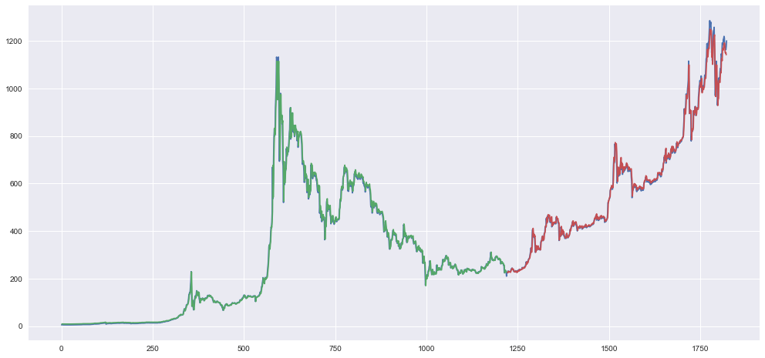
LSTM Network For Regression – Results
TRAIN SCORE: 21.87 RMSE
TEST SCORE: 22.20 RMSE
Data: 2012 – 2017 price, Epochs = 10, Batch size = 1,
➔ t and t+1 to be predicted

Slide 14
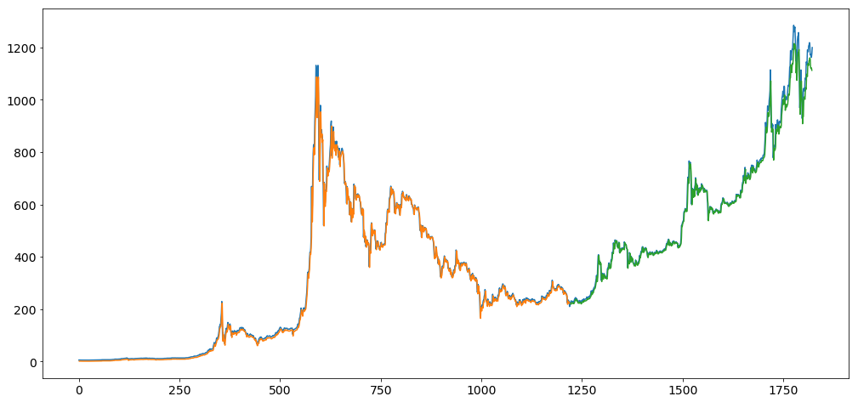
LSTM Network For Regression – Results
TRAIN SCORE: 22.28 RMSE
TEST SCORE: 27.48 RMSE
Data: 2012 – 2017 price, Epochs = 300, Batch size = 10
➔ t and t+1 to be predicted

Slide 15

LSTM Network For Regression – Window Method
TRAIN SCORE: 22.65 RMSE
TEST SCORE: 29.86 RMSE
Data: 2012 – 2017 price, Epochs = 100, Batch size = 1
Input t, t-1, t-2 to predict the output variable t+1
Look back = 3

Slide 16
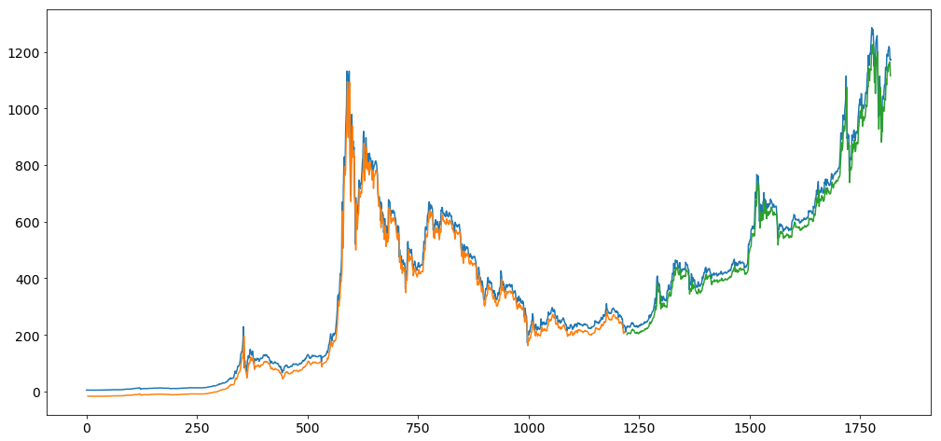
LSTM Network For Regression – Time Steps
TRAIN SCORE: 32.36 RMSE
TEST SCORE: 38.13 RMSE
Data: 2012 – 2017 price, Epochs = 100, Batch size = 1
Input t, t-1, t-2 to predict the output variable t+1
Using the same data representation as in the previous window-based example, except when we reshape the data, we set the columns to be the time steps dimension and change the features dimension back to 1
Reshape input to be [samples, time steps, features]

Slide 17
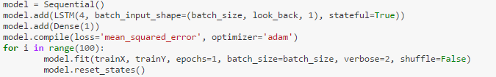
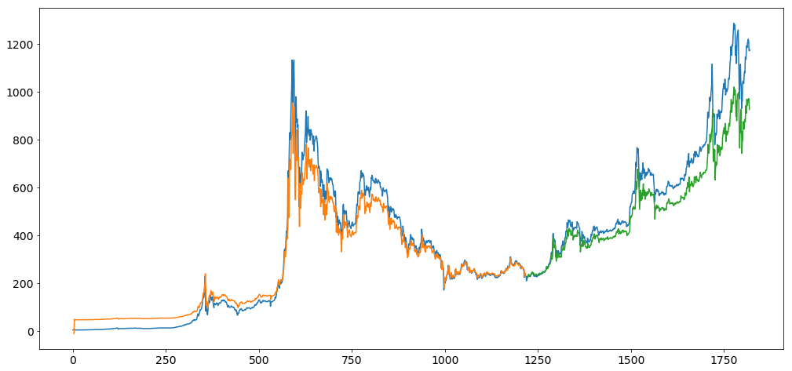
LSTM with Memory Between Batch
TRAIN SCORE: 52.91 RMSE
TEST SCORE: 103.40 RMSE
Data: 2012 – 2017 price
➔ Normally, state within the network is reset after each training batch when fitting the model. We can gain finer
control when internal state of LSTM network is cleared in Keras by making the layer “stateful”

Slide 18
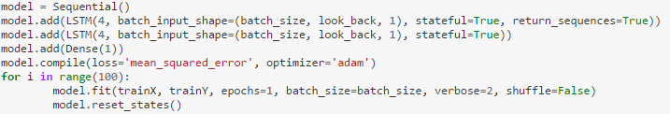
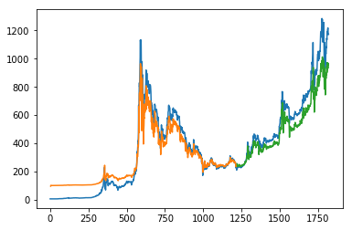
Stacked LSTM with Memory Between Batches
TRAIN SCORE: 72.53 RMSE
TEST SCORE: 104.54 RMSE
Data: 2012 – 2017 price,
➔ LSTM networks can be stacked in Keras in the same way that other layer types can be stacked

