Slide 1
Mother Teresa founded the Missionaries of Charity, a religious congregation that was initially dedicated to serving "the poorest of the poor" in the slums of Calcutta. Over the decades, the congregation grew to operate in over 133 countries, as of 2012,^{[9]} with more than 4,500 nuns managing homes for those dying from HIV/AIDS, leprosy, and tuberculosis, as well as running soup kitchens, dispensaries, mobile clinics, orphanages, and schools. Members of the order take vows of chastity, poverty, and obedience and also profess a fourth vow: to give "wholehearted free service to the poorest of the poor."^{[10]}
Biography
Early life and family
Mother Teresa's given name was Anjezë Gonxhe (or Gonxha)^{[11]} Bojaxhiu (Anjezë is a cognate of Agnes; Gonxhe means "flower bud" in Albanian).^{[12]} She was born on 26 August 1910 into a Kosovar Albanian family^{[13][14][15]} in Skopje, Ottoman Empire (now the capital of North Macedonia).^{[16][17]} She was baptised in Skopje the day after her birth.^{[11]} She later considered 27 August, the day she was baptised, her "true birthday".^{[16]}

Slide 2
She was the youngest child of Nikollë and Dranafile Bojaxhiu (Bernai).^{[18]} Her father, who was involved in Albanian-community politics in Ottoman Macedonia, was probably poisoned, an act attributed to Serbian agents, after he had visited Belgrade for a political meeting^{[19]} in 1919 when she was eight years old.^{[16][c]} He was born in Prizren (today in Kosovo), however, his family was from Mirdita (present-day Albania).^{[20][21]} Her mother may have been from a village near Gjakova,^{[22]} believed by her offspring to be Bishtazhin.^{[23]}
According to a biography by Joan Graff Clucas, Anjezë was in her early years when she became fascinated by stories of the lives of missionaries and their service in Bengal; by age 12, she was convinced that she should commit herself to religious life.^{[24]} Her resolve strengthened on 15 August 1928 as she prayed at the shrine of the Black Madonna of Vitina-Letnice, where she often went on pilgrimages.^{[25]}

Slide 3
Anjezë left home in 1928 at age 18 to join the Sisters of Loreto at Loreto Abbey in Rathfarnham, Ireland, to learn English with the intent of becoming a missionary; English was the language of instruction of the Sisters of Loreto in India.^{[26]} She saw neither her mother nor her sister again.^{[27]} Her family lived in Skopje until 1934, when they moved to Tirana.^{[28]} During communist leader Enver Hoxha's rule, she was considered a dangerous agent of the Vatican. Despite multiple requests and despite the fact that many countries made requests on her behalf, she was denied a chance to see her family and was not granted the opportunity to see her mother and sister.^{[29]} Both of them died during Hoxha's rule, and Anjezë herself was only able to visit Albania five years after the communist regime collapsed.^{[29]} Dom Lush Gjergji in his book "Our Mother Teresa" describes one of her trips to the embassy where she was crying as she was leaving the building, saying:^{[30]}
Dear God, I can understand and accept that I should suffer, but it is so hard to understand and accept why my mother has to suffer. In her old age she has no other wish than to see us one last time.

Slide 4
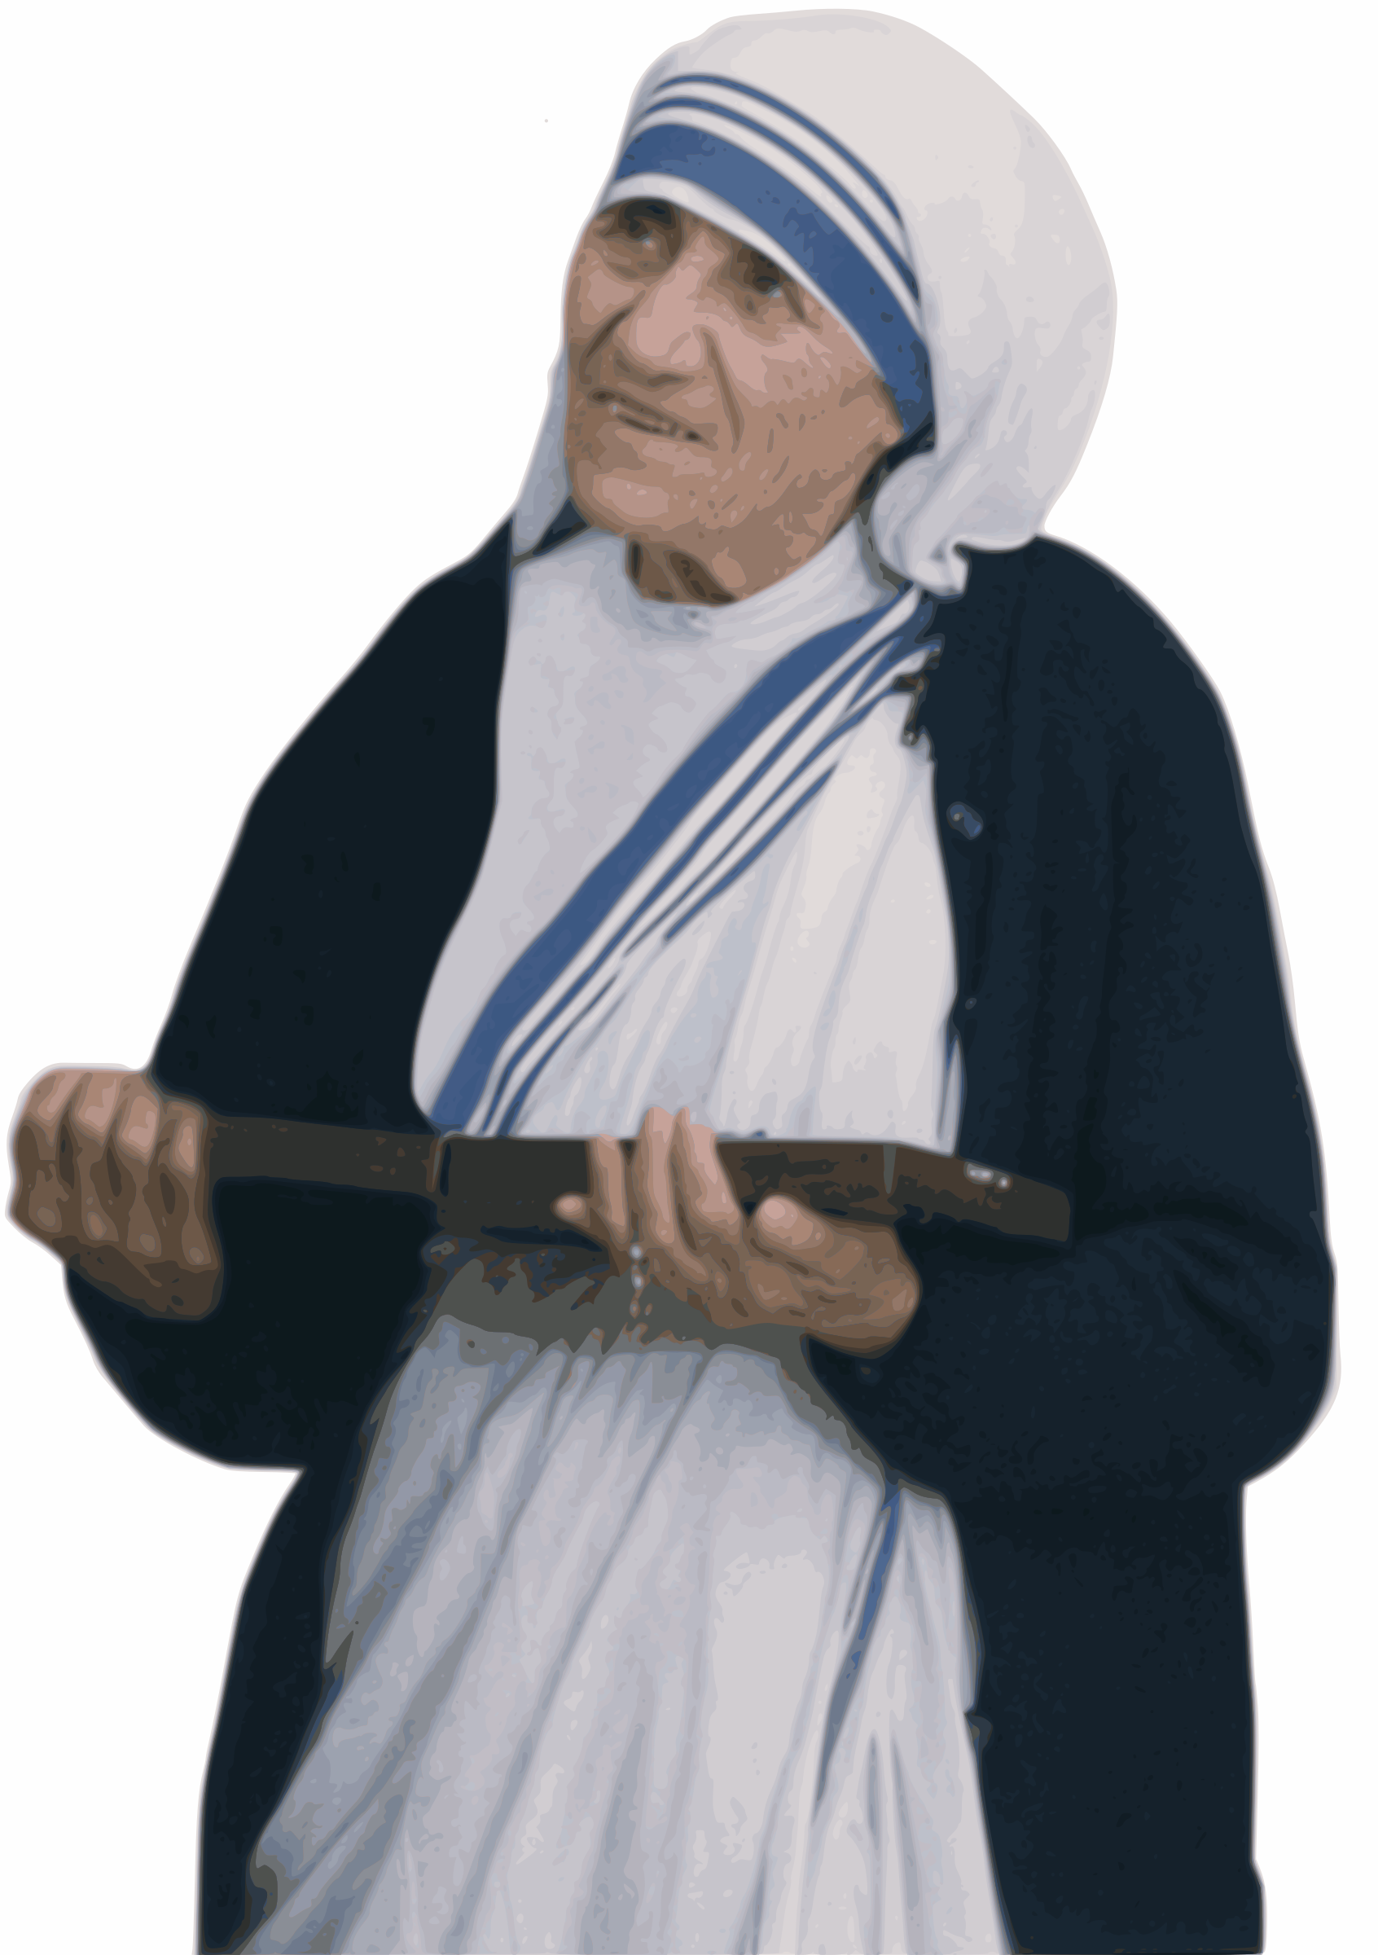
Mother Teresa (1910-1997): The Nobel Peace Prize was awarded to Mother in 1979.

Slide 5
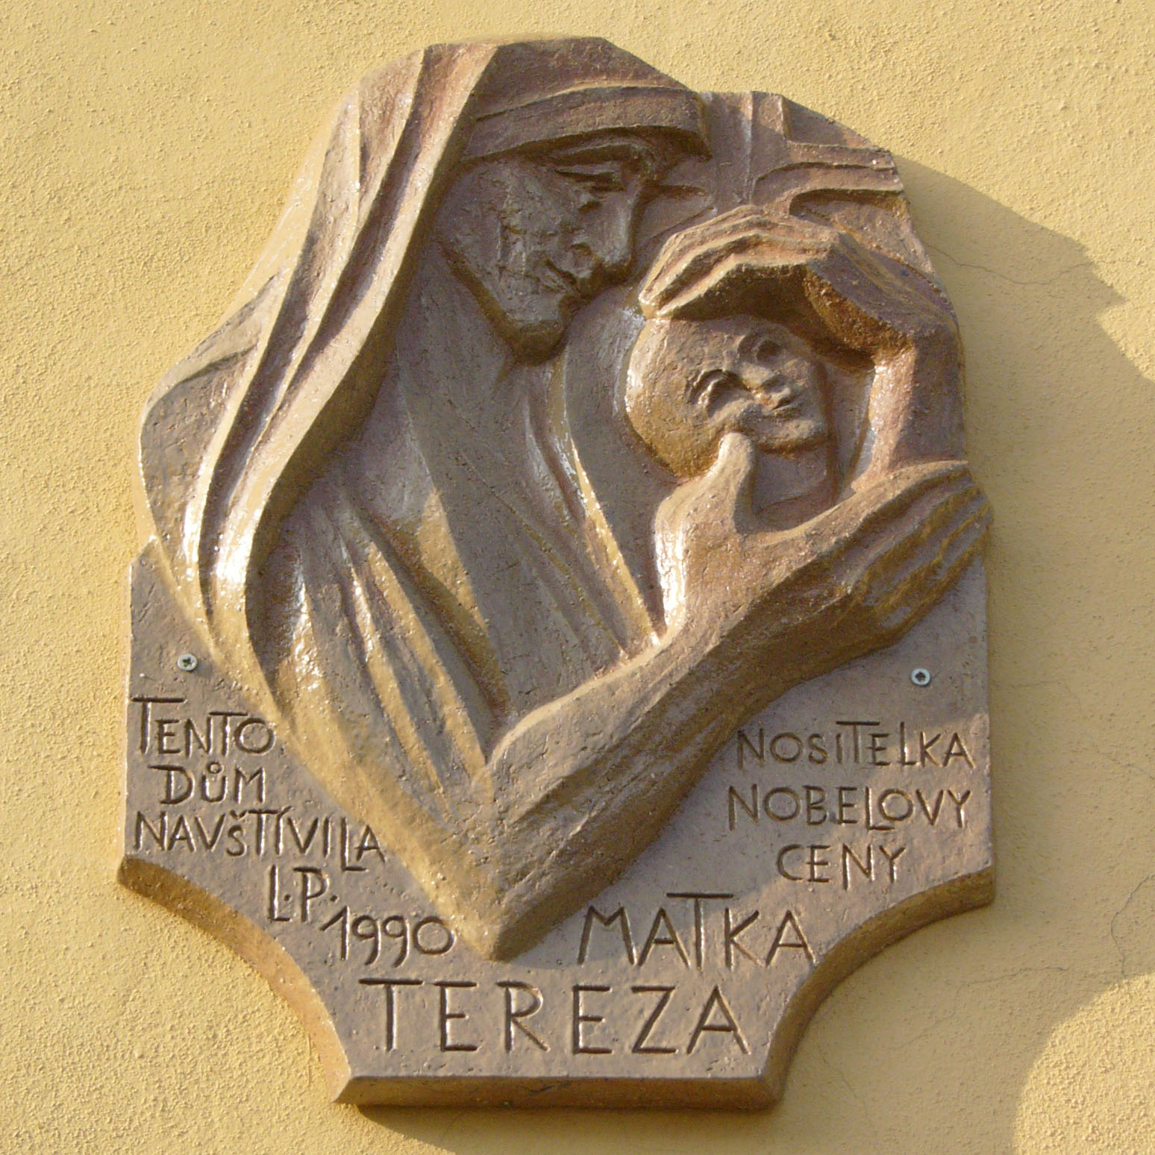
Mother Teresa
Mary Teresa Bojaxhiu MC (born Anjezë Gonxhe Bojaxhiu, Albanian: [aˈɲɛzə ˈɡɔndʒɛ bɔjaˈdʒi.u]; 26 August 1910 – 5 September 1997), better known as Mother Teresa or Saint Mother Teresa,^{[a]} was an Albanian-Indian Catholic nun, founder of the Missionaries of Charity and is a Catholic saint.^{[6][7][8]} Born in Skopje, then part of the Ottoman Empire,^{[b]} she was raised in a devoutly Catholic family. At the age of 18, she moved to Ireland to join the Sisters of Loreto and later to India, where she lived most of her life and carried out her missionary work. On 4 September 2016, she was canonised by the Catholic Church as Saint Teresa of Calcutta. The anniversary of her death, 5 September, is now observed as her feast day.
Mother Teresa received several honours, including the 1962 Ramon Magsaysay Peace Prize and the 1979 Nobel Peace Prize. Her life and work have inspired books, documentaries, and films. Her authorized biography, written by Navin Chawla, was published in 1992, and on 6 September 2017, she was named a co-patron of the Roman Catholic Archdiocese of Calcutta alongside St Francis Xavier. However, she was also a controversial figure, drawing criticism for her staunch opposition to abortion, divorce and contraception, as well as the poor conditions and lack of medical care or pain relief in her houses for the dying.

