Slide 1
EMPL0YEE DATA ANALYSIS USING EXCEL
NAME: NARMADHA V
REGISTER NO: 312217946
NM NO: C119A11054B0E53892C4FE9145C577E1
DEPARTMENT: B.COM ( ACCOUNTING AND FINANCE)
COLLEGE: ST.ANNE’S ARTS AND SCIENCE COLLEGE,CHENNAI.

Slide 2
PROJECT TITLE
Employee performance analysis using excel

Slide 3

AGENDA
Problem statement
Project overview
End users
Our Solution and Proposition
Dataset Description
Modelling approach
Result and Discussion
Conclusion

Slide 4
PERFORMANCE STATEMENT
This project aims to analyse employee performance based on satisfaction levels using Excel. The goal is to identify patterns and correlations within the data to help improve employee satisfaction and performance across different demographics and business units.

Slide 5
PROJECT OVERVIEW
The "Employee Performance Analysis Using Excel" project focuses on evaluating employee performance by analysing key factors such as satisfaction levels, gender, and business unit. The project involves collecting and organizing employee data in Excel, followed by detailed analysis using statistical functions and data visualization tools. By identifying trends and correlations, the analysis will provide insights into how different factors impact performance across various demographics and departments. The findings will support data-driven decision-making to enhance employee satisfaction and optimize performance within the organization.

Slide 6

OUR SOLUTION AND IT’S PROPOSITION
CONDITIONAL FORMATTING
Highlighting cells that are blanks or have no value
FILTER
Focusing on blank cells and removing them
FORMULA
For identifying the age category from late 20s to early60s
PIVOT TABLE
Summarizing data and analysing relationship and generating report
SLICER
Filtering data for enhancing user experience and highlight clear view of specific data
GRAPH
For data visualization

Slide 7
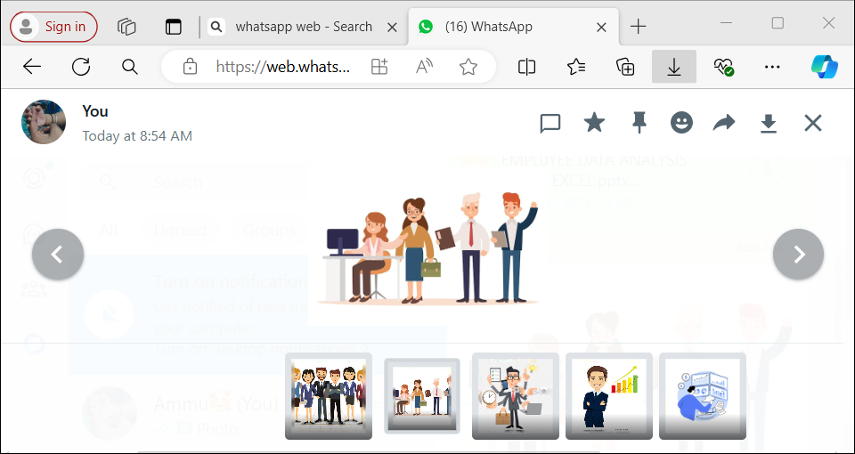
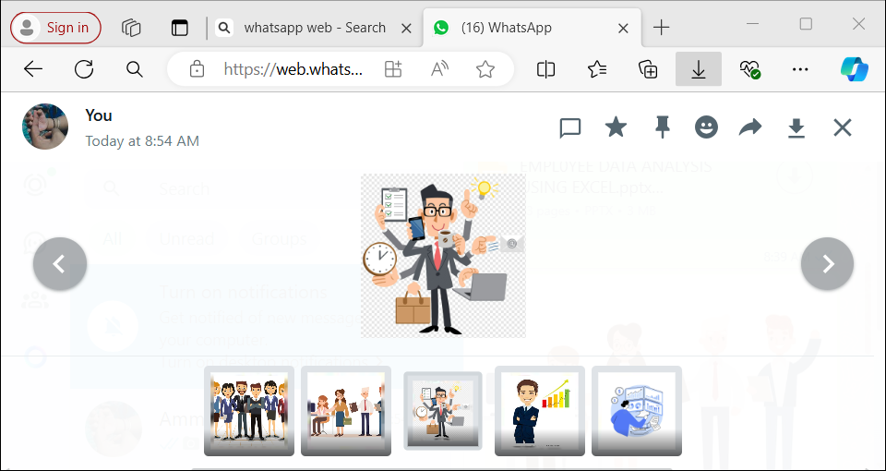
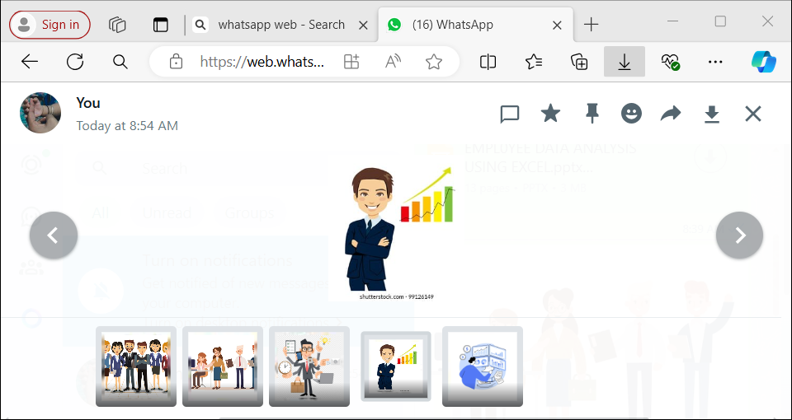


WHO ARE THE END USERS?
HR MANAGER
DEPARTMENT MANAGER
EXECUTIVES
DATA ANALYST
EMPLOYEES

Slide 8

THE "WOW" IN OUR SOLUTION
FORMULA : Performance level =IFS(Z8>=5,"VERY HIGH",Z8>=4,"HIGH", Z8>=3,"MED", TRUE, "LOW")
INSIGHTS: Used to evaluate the scores as levels from low to very high

Slide 9
DATASET DESCRIPTION
Dataset Name: Employee Performance Analysis Data
Description: Contains performance metrics for employees, including satisfaction scores, performance ratings, and demographic details.
Source: Kaggle.com
Variables/Columns:
Name: First name
Gender: Male and Female
Employee Type: contract, Full time, Part time
Performance Rating: Very high, High, Medium, Low
Satisfaction Score: 1-5
Data Types: Numeric and Text
Units of Measurement:
Satisfaction score: Scale of 1-5
Performance rating: Very high, High, Medium, Low
Size: 26 records, 5 fields

Slide 10
MODELLING AND APPROACH
DATA COLLECTION
Data source : edunet Foundation Dashboard
Basis: Employee dataset
DATA PREPARATION
Feature selection: Selected based on Performance
Features: First Name, Department, Gender code, performance level, Employee type
DATA CLEANING
Conditional Formatting: Missing values was identified
DATA AGGREGATION
Excel function: IFS function used for categorizing employees on the basis of their performance level
Performance level categories
5 - Very high
4 – High
3 - Medium
2 &1 – Low
DATA ANALYSIS
Pivot table: Pivot table was generated to summarize data and cross tabulation ( performance level by department; Filtered by Gender)
Slicer: To filter/ slice the data to scrutinize and sort particular information (Employee type )
VISUALIZATION OF DATA
Chart: Recommended charts (Column chart) was used
Chart Element: Chart title was added
Trendline: Linear and exponential line was used

Slide 11
RESULTS

Slide 12
RESULTS

Slide 13
CONCLUSION
This project focuses on employee performance analysis conducted using Excel, it is evident that key performance indicators such as productivity, efficiency play a crucial role in overall performance. The analysis highlights top-performing employees and areas needing improvement. Recommendations include targeted training and better resource allocation. This approach can help enhance employee performance and achieve organizational goals more effectively.

