Slide 1
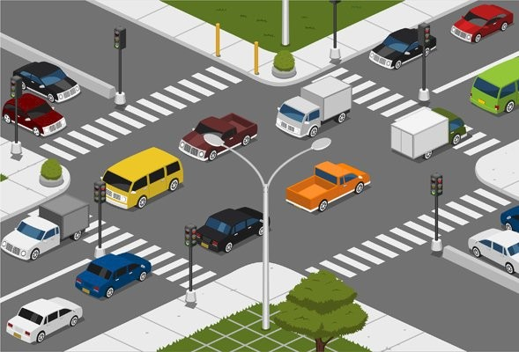
Neuro Fleet X –AI Powered Fleet Management System
TEAM-B NARMADHA L
Pitch

Slide 2
Project: Neuro Fleet X – AI Powered Urban Fleet & Traffic Intelligence
Our project aims to manage and control both autonomous vehicles and normal human-driven vehicles in future smart cities.
The system helps the city to:
Reduce traffic congestion
Predict and avoid high-risk areas
Guide vehicles through optimized routes
Monitor all vehicles in real time
Improve safety and traffic flow

Slide 3
Project: Neuro Fleet X – AI Powered Urban Fleet & Traffic Intelligence
We provide one unified platform with three roles:
Admin (System Owner)
Manager (Traffic Controller)
Driver (Vehicle User)
AI supports all roles by analyzing traffic, vehicle density, speed patterns, and risk zones.

Slide 4
Neuro Fleet X – AI Powered Urban Fleet & Traffic Intelligence
Admin – System
Owner
2. Manager – Traffic
Controller
3. Driver – Vehicle User
(Human + Autonomous Unit)
Monitors traffic flow in different areas
Updates traffic density (for humans driving in crowded areas)
Verifies AI predictions
Checks vehicle statuses (both human + autonomous)
Manages risk zones and congestion alerts
Enters Source → Destination
Receives optimized AI route
Views traffic alerts and risk zone warnings
Updates GPS location
Checks vehicle health and performance
Controls the entire platform
Adds managers and vehicles (human or autonomous)
Views all city vehicle movement (live map)
Monitors congestion, risk zones, and alerts
Uses AI reports to make decisions

Slide 5
Project: Neuro Fleet X – AI Powered Urban Fleet & Traffic Intelligence
To cover all modules, we divided our team:
Admin Module: Narmadha L & Ganesh
Manager Module: Nitin & Gayatri
Driver Module: Dinesh

Slide 6
Project: Neuro Fleet X – AI Powered Urban Fleet & Traffic Intelligence
ADMIN ROLE:
Login → Secure JWT login
Dashboard → Shows all vehicles + traffic + risk zones
Vehicle Management → Add/Edit/Delete vehicles
User Management → Add Managers and Drivers
AI Monitoring → Congestion prediction, risk zones, route insights

Slide 7
Project: Neuro Fleet X – AI Powered Urban Fleet & Traffic Intelligence
1. Admin Login (Authentication)
Feature:
Secure login using JWT authentication
What it includes:
Email + password login
Token-based access
Protecting Admin pages from unauthorized users
2. Admin Dashboard
Feature:
A real-time dashboard to monitor city traffic and vehicles.
What the dashboard will show:
Total vehicles (human-driven + autonomous)
Active vehicles
Idle vehicles
Stuck/busy vehicles
Live congestion levels
Risk zone heatmap (Critical, High, Medium, Low)

Slide 8
Project: Neuro Fleet X – AI Powered Urban Fleet & Traffic Intelligence
3. Vehicle Management
Feature:
Admin can manage all vehicles in the system.
What Admin can do:
Add new vehicles
Edit vehicle details (fuel level, status, type, etc.)
Delete vehicles (if no longer active)
4. User Management
Feature:
Admin controls who can use the system.
What Admin can do:
Add Manager accounts
Add Driver accounts
Update user information
Control user access (roles/permissions)

Slide 9
Project: Neuro Fleet X – AI Powered Urban Fleet & Traffic Intelligence
5. AI Monitoring
Feature:
Admin can view AI-generated insights to understand city conditions.
What AI will show:
Congestion Prediction → Where traffic will increase soon
Risk Zone Detection → Areas that are unsafe / high density
Route Analysis → AI-selected best routes

Slide 10
Project: Neuro Fleet X – AI Powered Urban Fleet & Traffic Intelligence
I am going to work on, 1.DASHBOARD
Total vehicles (human-driven + autonomous)
Active vehicles
Idle vehicles
Stuck/busy vehicles
Live congestion levels
Risk zone heatmap (Critical, High, Medium, Low)
2.VECHICLE MANAGEMENT
Add new vehicles
Edit vehicle details (fuel level, status, type, etc.)
Delete vehicles (if no longer active)

Slide 11
Project: Neuro Fleet X – AI Powered Urban Fleet & Traffic Intelligence
System Workflow (Updated for Human + Autonomous)
Driver (human or autonomous) enters Start → Destination
AI analyzes:
Traffic density
Speed of vehicles
Road conditions
Risk zones
AI recommends the optimized safest route
Manager monitors the traffic and updates real-time data
Admin oversees the entire system through live dashboard
System keeps updating predictions continuously

Slide 12
THANK YOU…..

