Slide 1
NeuroFleetX
AI-Powered Urban Fleet & Traffic Intelligence System
Role: Developed Driver Module
Presenting by: Dinesh Kumar
1/18

Slide 2

Abstract: NeuroFleetX
NeuroFleetX: intelligent fleet and traffic management for urban efficiency.
Comprehensive Management
Manages drivers, vehicles, and trips.
Secure & Scalable
Robust backend architecture.
Real-time Insights
Provides operational data and role-based access.
Future-Proof
Designed for reliability, security, and AI integration.
2/18

Slide 3




Introduction: Bridging the Gap in Urban Fleet Operations
Current Challenges
Traditional Systems
NeuroFleetX Solution
Poor monitoring
Lack automation
Centralized digital platform
Manual tracking
Limited real-time intelligence
Effective fleet management
Security risks
Modern web technologies
3/18

Slide 4

The Problem: Manual Fleet Management
Inefficiency
Manual processes are error-prone and slow.
No Centralization
Lack of unified driver and vehicle monitoring.
Security Flaws
Weak authentication mechanisms lead to risks.
Limited Scalability
Traditional systems cannot grow with demand.

Slide 5





Project Objectives
Secure & Scalable
Design a robust fleet management system.
Role-Based Access
Implement authentication and authorization.
Efficient Management
Manage drivers, vehicles, and trips effectively.
Reliable APIs
Provide stable REST APIs for frontend integration.

Slide 6

Scope of the Project
Current Focus
Future Expansion
Backend development with Spring Boot
AI integration for predictive analytics
Driver module design and implementation
Advanced data analysis and reporting
Integration with vehicle and trip management
Optimization algorithms for routing
REST API support for frontend

Slide 7

System Architecture: Three-Tier Model
Presentation Layer
React frontend for user interaction.
Business Layer
Spring Boot REST APIs handle logic.
Data Layer
MySQL database for persistent storage.
This architecture ensures scalability, security, and maintainability.

Slide 8

Technology Stack
Backend
Java
Spring Boot
Spring Security
JWT
Frontend
React
Axios
Database
MySQL
Tools
Postman
Eclipse

Slide 9
MODULES OVERVIEW
Core System Architecture
1
2
Authentication
Admin Module
Secure user access
System-wide control
3
4
Manager Module
Driver Module
Operational oversight
Manage driver operations
5
6
Vehicle Management
Trip Management
Fleet asset control
Route & delivery tracking
9/18

Slide 10




MY CONTRIBUTION
Full Stack Development: Driver Module
Backend Logic
Spring Boot implementation
REST APIs
Driver operations
React Frontend
Driver features & UI
Seamless Integration
Secure API connections

Slide 11

DRIVER MODULE
Comprehensive Driver Management
Each driver linked to user account
Vehicles assigned by Admin
Drivers associated with multiple trips
Secure, role-based access
Seamless frontend-backend communication

Slide 12

DRIVER MODULE
Key Functionalities Implemented
Registration & Profile
Full frontend & backend support
Vehicle Assignment
Driver-vehicle mapping
Display Vehicle Details
UI integration
Trip Management
Creation, association, tracking
Secure API Access
JWT token utilization
12/18

Slide 13
SECURITY
Robust Security Measures
JWT-based Authentication
Role-based Authorization
BCrypt Password Encryption
Admin, Manager, Driver roles
Frontend & backend communication
Enhanced data protection
Spring Security Filters
Token Validation
Protecting backend APIs
Enforced on every secured request
13/18

Slide 14
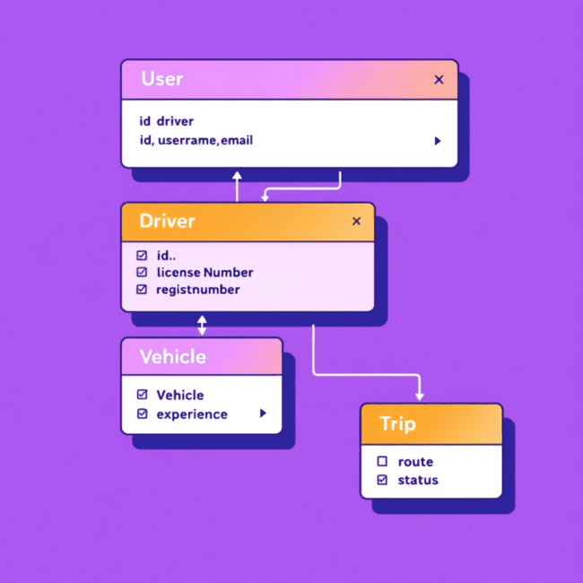
DATA STRUCTURE
Normalized Database Design
User: Core user accounts
Driver: Driver-specific information
Vehicle: Fleet assets
Trip: Route and delivery data
Relationships optimized for data integrity and minimal redundancy.

Slide 15





QUALITY ASSURANCE
Testing & Validated Results
API Testing
Login & Role Validation
Verified with Postman
Successful implementation
Data Operations
Frontend Integration
Stored & retrieved effectively
Supported by REST APIs
15/18

Slide 16





ROADMAP
Future Enhancements
Mobile Support
Native application
Predictive Maintenance
Vehicle health analytics
Driver Analytics
Behavior & performance
Real-time GPS
Live tracking capabilities
AI Route Optimization
Efficient pathfinding
16/18

Slide 17



SUMMARY
NeuroFleetX: A Secure & Scalable Solution
Modern Fleet Management
Secure & Scalable
Advanced system capabilities
Robust architecture
Critical Driver Module
Real-world Skills
Central to operations
Backend development expertise
17/18

Slide 18
Thank You
18/18

