Slide 1
covid 19 spatial data analysis
narmadha.s narmadha devi.v Pavithra.N

Slide 2
ABSTRACT
In this paper, we present a spatial data science system for analysing big covid 19 epidemiological data, with focus on the spatial data analytics among different geographical location. The system helps user to get a better understanding of information about the confirmed cases of covid 19, evaluation results shows the benefit of our system in spatial data analytics of big covid 19 data.

Slide 3
PROBLEM STATEMENt Data Visualization analysis based on
Specific geographic region
Episode week
Gender
Age group
Set of symptoms [dry cough ,high fever, sore throat, difficulty in breathing, infected with covid-19]
Hospitalization status
Age group distribution over region, gender, hospitalization status.
Clinical outcome distribution [death and recovered]
Absolute and relative cumulative covid 19 cases in a region of population

Slide 4
DATASET AND FEATURE SELECTION
Dataset Overview
The dataset was collected and integrated from a provincial and territorial public health authorities by the Public Health Agency of Canada [PHAC].
The dataset contains information such as Case Identifier Number (COV_ID), Region (COV_REG), Episode week (COV_EW), Episode year (COV_EY), Gender (COV_GDR), Age group (COV_AGR), Hospital status (COV_HSP), and Death (COV_DTH) for individual cases.
Feature Selection Rationale:
Region (COV_REG): Essential for understanding geographical variations in COVID-19 cases and outcomes.
Episode week and Episode year (COV_EW, COV_EY): Important for temporal analysis, tracking the progression of cases over time.
Gender (COV_GDR): Vital for gender-based analysis to identify potential disparities.
Age group (COV_AGR): Significant for understanding the impact of age on COVID-19 outcomes.
Hospital status and Death (COV_HSP, COV_DTH): Crucial outcome variables for predictive modeling or survival analysis.

Slide 5
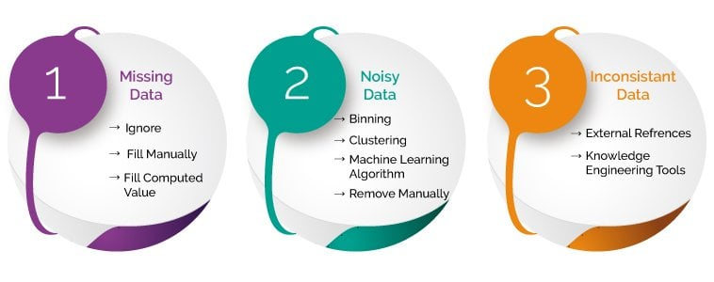
DATA PREPROCESSING AND CLEANING
reads three datasets, checks for missing values, removes duplicates, handles outliers, and transforms the data to prepare it for analysis, including features selection and cleaning steps.

Slide 6
DATA MODELLING
Spatial Analysis:
If geospatial data is available, spatial analysis techniques may be used to study the geographic spread of COVID-19 cases. Spatial regression models or spatial autocorrelation analysis could be applied.
Descriptive Analytics:
Descriptive statistics and visualizations are essential for summarizing and presenting key characteristics of the dataset. This might involve creating bar charts, line plots, heatmaps, or choropleth maps to convey information.
Predictive Modeling:
This involves building models to predict outcomes such as hospitalization or mortality based on various features in the dataset. Common algorithms include logistic regression.

Slide 7
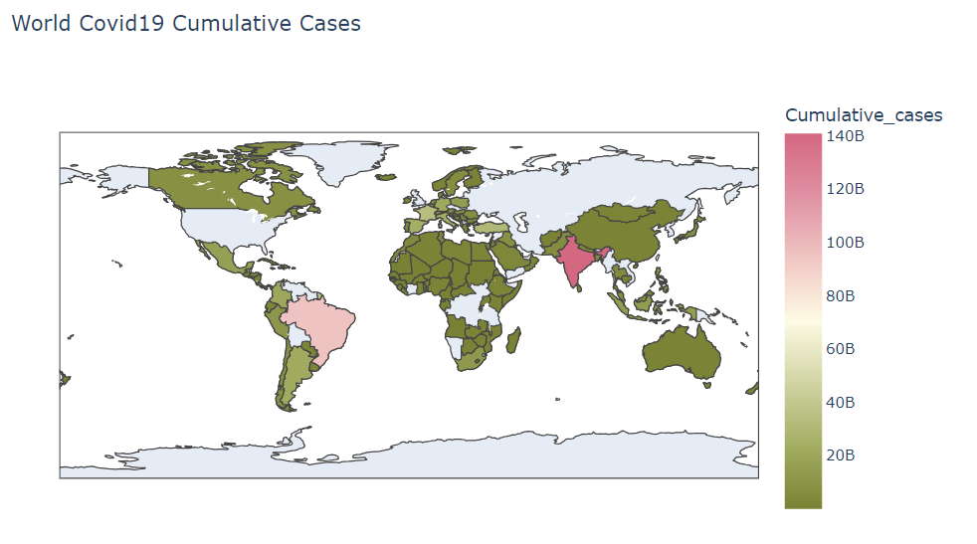
DATA VISUALIZATION AND RESULT

Slide 8
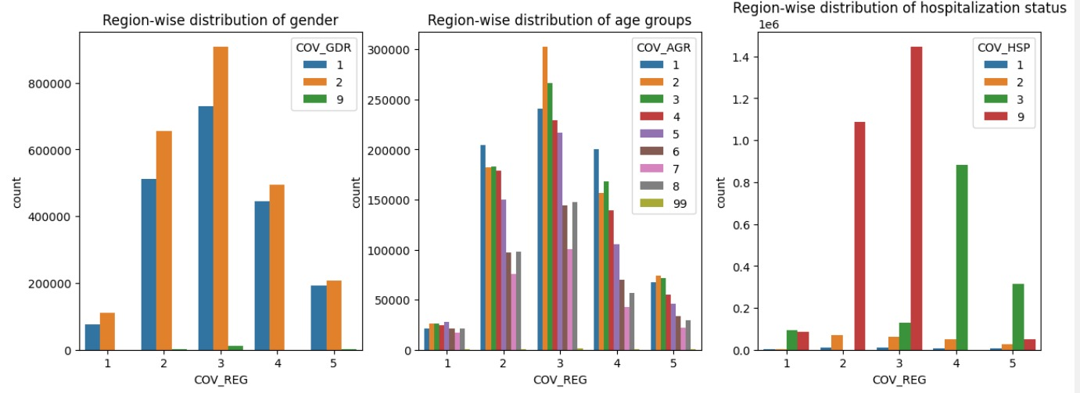
Specific geographic region

Slide 9
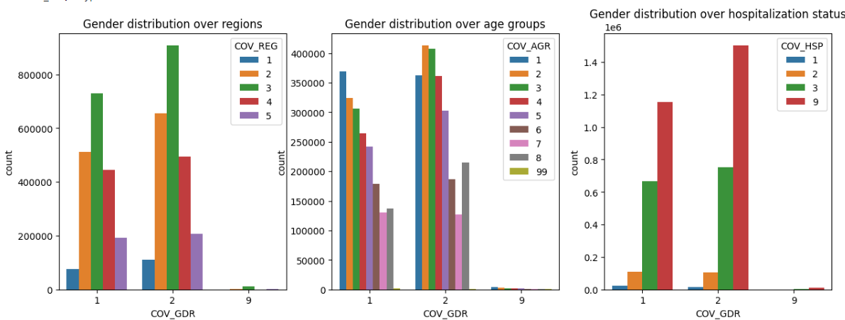
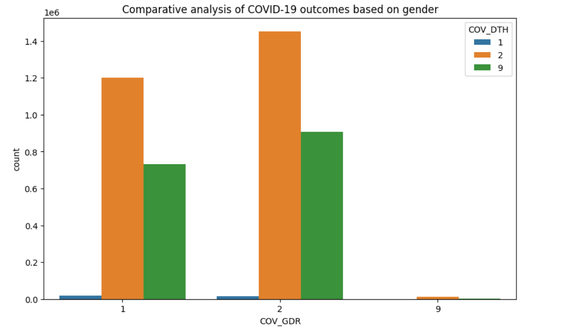
Analysis based on gender distribution
.

Slide 10
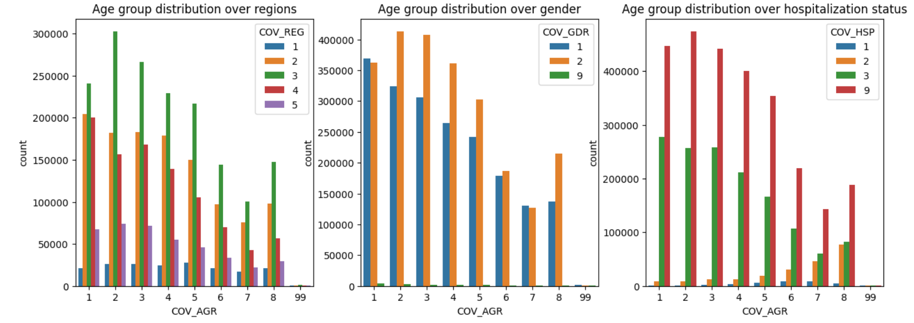
ANALYSIS BASED ON AGE GROUP

Slide 11
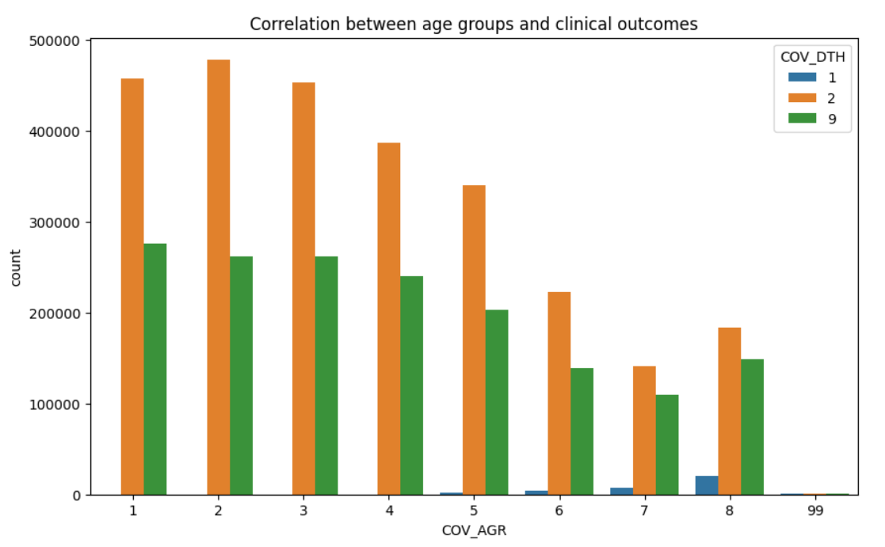
ANALYSIS BASED ON AGE GROUP

Slide 12
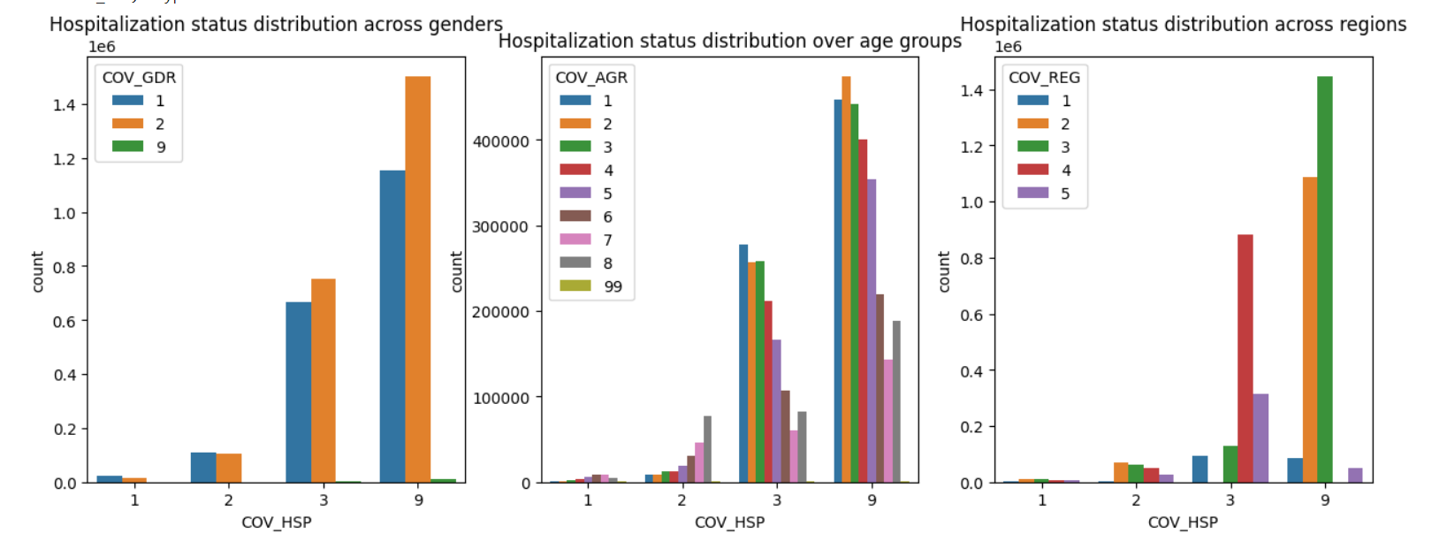
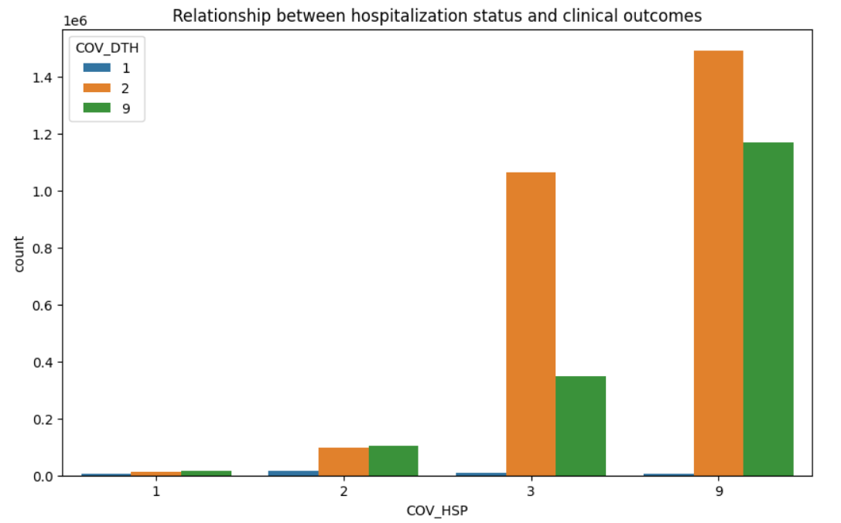
HOSPITALIZATION STATUS ANALYSIS

Slide 13
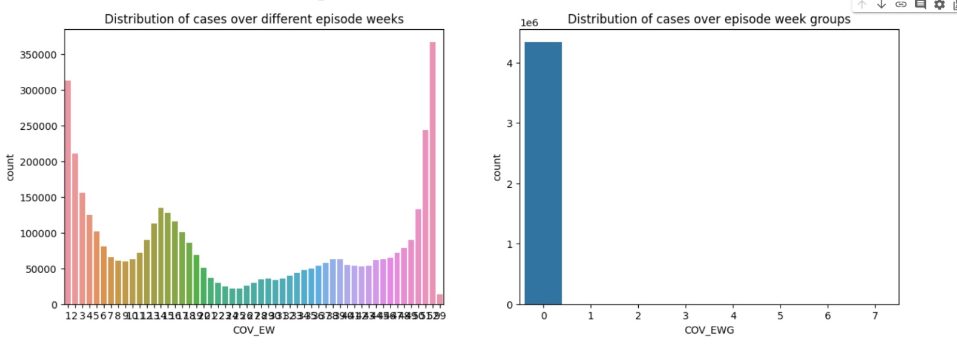
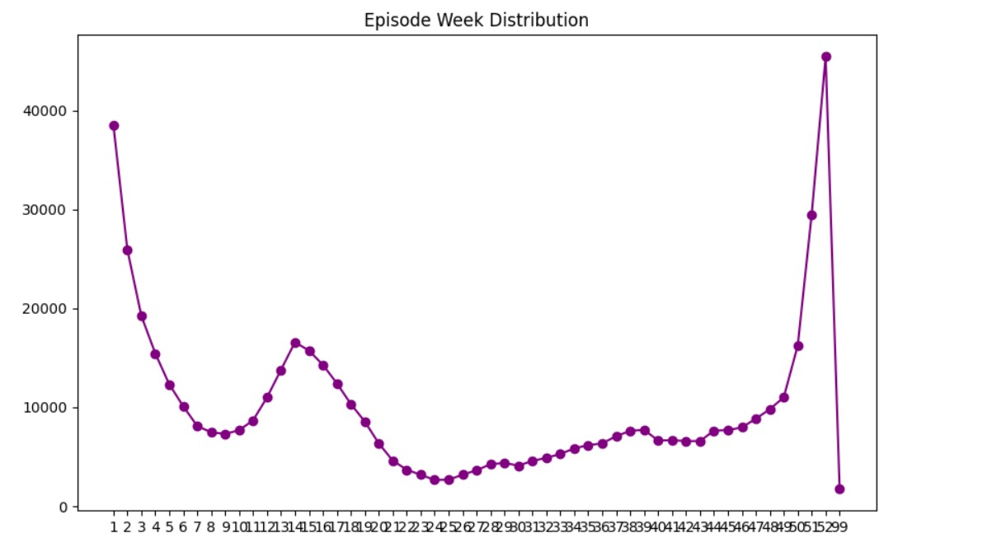
Analytics based on Episode week

Slide 14
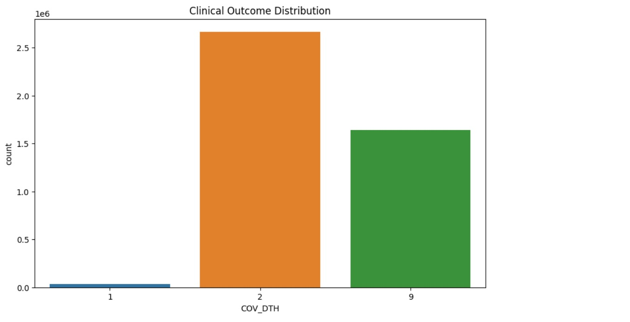
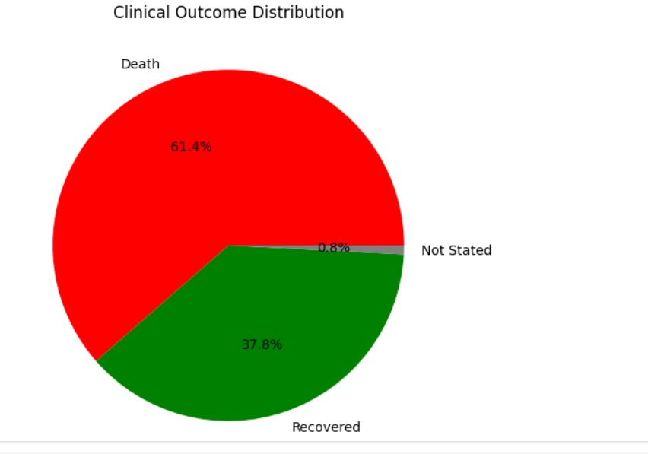
Clinical outcome distribution [death and recovered]

Slide 15
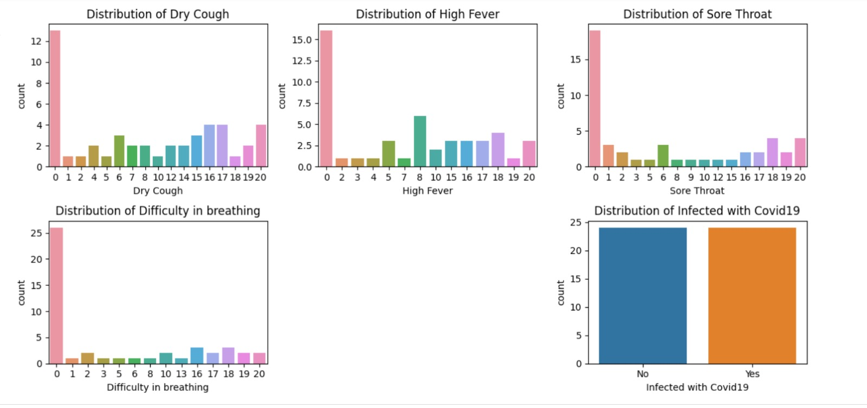
Set of symptoms [dry cough ,high fever, sore throat, difficulty in breathing, infected with covid-19]

Slide 16
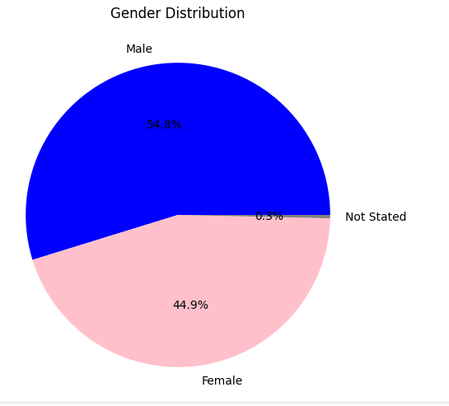
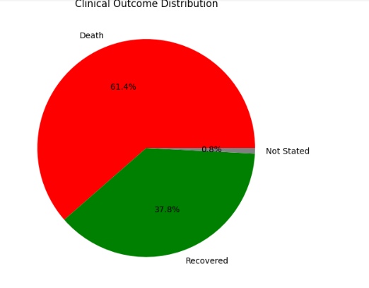
Analysis based on gender distribution and clinical outcome distribution

Slide 17
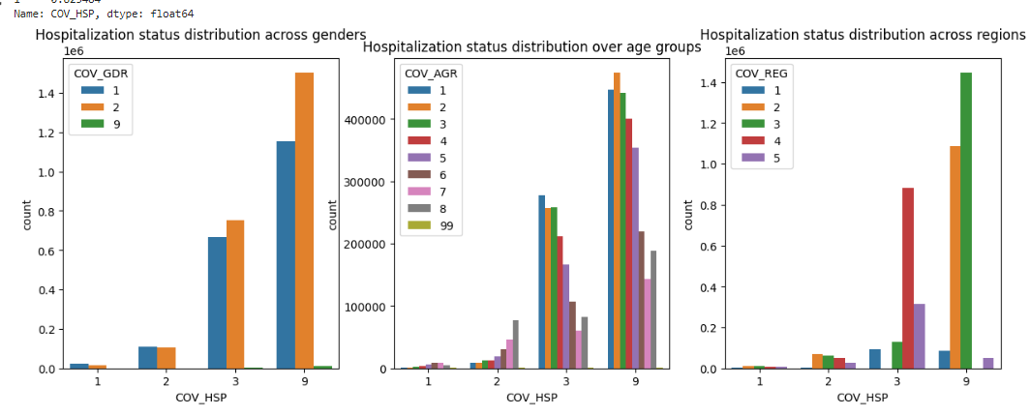
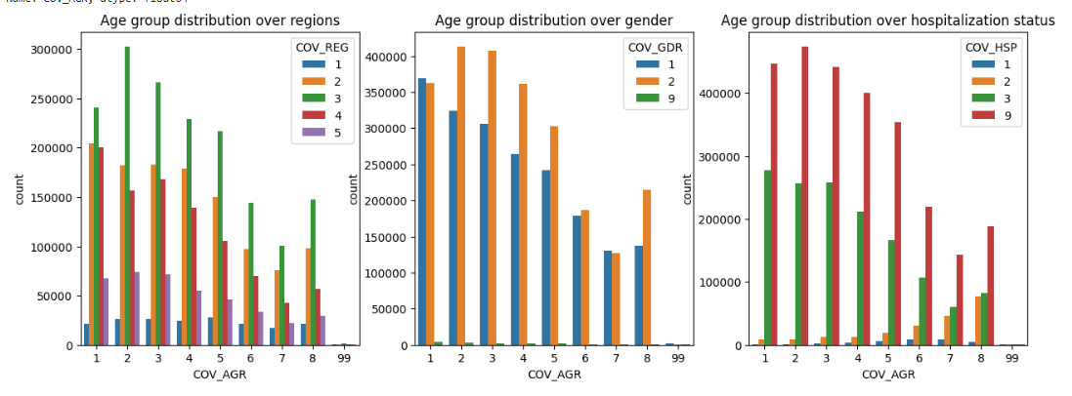

Slide 18
PROJECT EXECUTION
https://colab.research.google.com/drive/1xSIY5uj84YRkaMQJKupKHZo13WHDt7Jc#scrollTo=_UtUOiRc2Y9P&line=1&uniqifier=1
https://colab.research.google.com/drive/1yGSGrROdPzLx07FH1GW8b2Zk9-Pn9Rck#scrollTo=fzZZJlzLhB2O&line=1&uniqifier=1

Slide 19
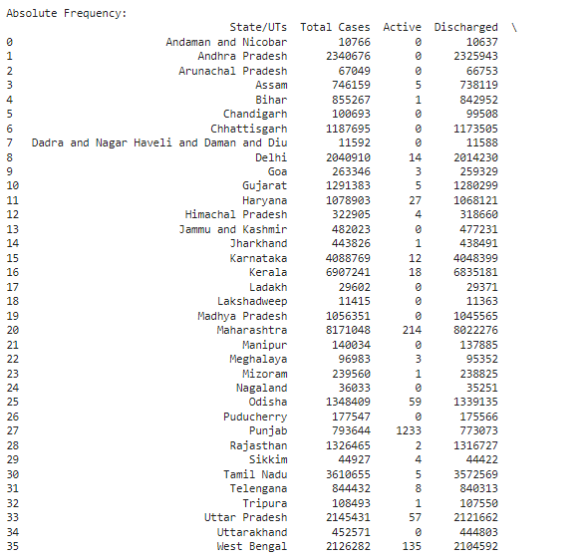
ABSOLUTE FREQUENCY

Slide 20
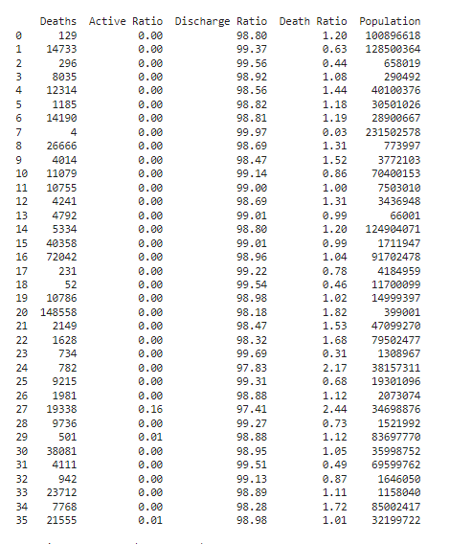

Slide 21
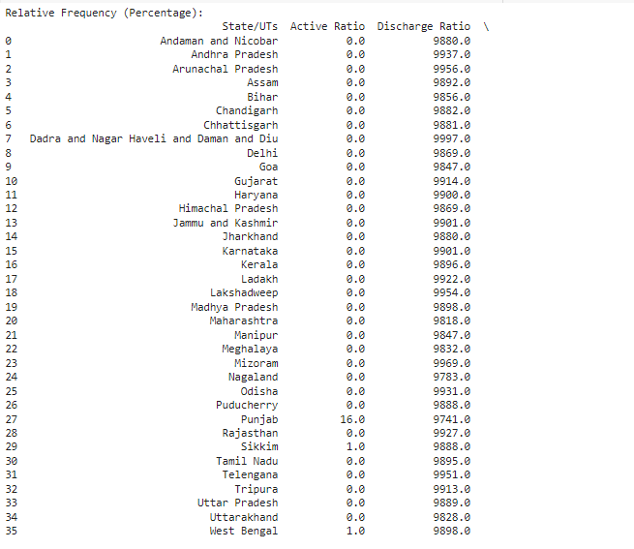
RELATIVE FREQUENCY

Slide 22
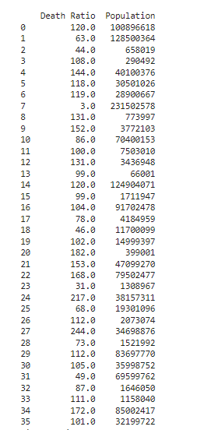

Slide 23
CONCLUSION
In this project, we conducted a comprehensive spatial data analysis of COVID-19 cases, leveraging information from the provided dataset. The dataset included essential variables such as case identifier numbers, geographical regions, episode weeks, gender, age groups, hospitalization status, and clinical outcomes.
Key Findings:
Geographical Distribution:
Our spatial analysis revealed the geographic distribution of COVID-19 cases across different regions, allowing us to identify areas with higher prevalence.
Temporal Trends:
Analysis of episode weeks highlighted temporal trends, aiding in understanding the progression of COVID-19 over time.
Demographic Patterns:
Examination based on gender and age groups provided insights into how different demographics were affected, contributing to a better understanding of vulnerability.
Hospitalization and Clinical Outcomes:
Exploration of hospitalization status and clinical outcomes (recovered and death) facilitated an assessment of the severity and impact of cases.
Symptomatic Analysis:
Spatial visualization of COVID-19 cases with specific symptoms like dry cough, high fever, sore throat, and difficulty in breathing provided additional layers of information.

Slide 24
Implications:
The analysis can inform public health strategies, resource allocation, and targeted interventions based on geographic and demographic patterns.
Insights into temporal trends are crucial for predicting healthcare demands and planning for future outbreaks.
Understanding the spatial distribution of symptoms can aid in identifying potential hotspots and areas requiring focused public health campaigns.
Limitations and Further Research:
Future research could delve into more granular spatial analyses, considering factors like population density, socio-economic status, and healthcare infrastructure.

Slide 25
THANK YOU

