Slide 1
Day 7
RDBMS Fundamentals, Oracle Forms, Intro to Oracle, DB Design, Functional Programming

Slide 2
What is RDBMS?
System or program
basis - MySQL, Microsoft SQL Server, Oracle, and Microsoft Access.
RDBMS uses SQL queries to access the data in the database
A relational database defines database relationships in the form of tables. The tables are related to each other - based on data common to each.

Slide 3
What is a Database Table?
A table is a collection of related data entries, and it consists of columns and rows.
A column holds specific information about every record in the table.
A record (or row) is each individual entry that exists in a table.

Slide 4
Sample
CustomerID | CustomerName | ContactName | Address | City | PostalCode | Country
1 | Alfreds Futterkiste | Maria Anders | Obere Str. 57 | Berlin | 12209 | Germany
2 | Ana Trujillo Emparedados y helados | Ana Trujillo | Avda. de la Constitución 2222 | México D.F. | 05021 | Mexico
3 | Antonio Moreno Taquería | Antonio Moreno | Mataderos 2312 | México D.F. | 05023 | Mexico
4 | Around the Horn | Thomas Hardy | 120 Hanover Sq. | London | WA1 1DP | UK
5 | Berglunds snabbköp | Christina Berglund | Berguvsvägen 8 | Luleå | S-958 22 | Sweden
Notes:
Qustn – how many records?

Slide 5
Table
Customers Table
CustomerID | CustomerName | ContactName | Address | City | PostalCode | Country
1 | Alfreds Futterkiste | Maria Anders | Obere Str. 57 | Berlin | 12209 | Germany
2 | Ana Trujillo Emparedados y helados | Ana Trujillo | Avda. de la Constitución 2222 | México D.F. | 05021 | Mexico
3 | Antonio Moreno Taquería | Antonio Moreno | Mataderos 2312 | México D.F. | 05023 | Mexico
4 | Around the Horn | Thomas Hardy | 120 Hanover Sq. | London | WA1 1DP | UK
5 | Berglunds snabbköp | Christina Berglund | Berguvsvägen 8 | Luleå | S-958 22 | Sweden

Slide 6
Table
OrderID | CustomerID | EmployeeID | OrderDate | ShipperID
10278 | 5 | 8 | 1996-08-12 | 2
10280 | 5 | 2 | 1996-08-14 | 1
10308 | 2 | 7 | 1996-09-18 | 3
10355 | 4 | 6 | 1996-11-15 | 1
10365 | 3 | 3 | 1996-11-27 | 2
10383 | 4 | 8 | 1996-12-16 | 3
10384 | 5 | 3 | 1996-12-16 | 3
Orders Table

Slide 7
Shippers
Shippers Table
ShipperID | ShipperName | Phone
1 | Speedy Express | (503) 555-9831
2 | United Package | (503) 555-3199
3 | Federal Shipping | (503) 555-9931

Slide 8
What is SQL?
SQL is the standard language for dealing with Relational Databases.
SQL is used to insert, search, update, and delete database records.

Slide 9
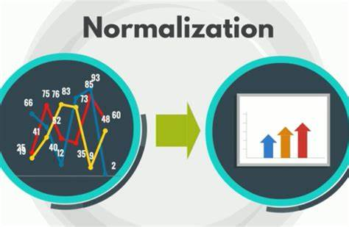
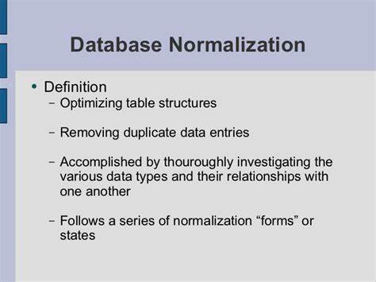
What is Normalization?

Slide 10
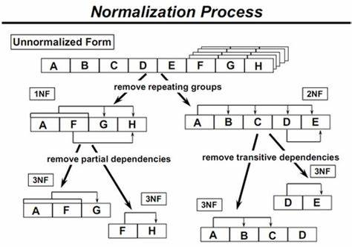
Normalization

Slide 11
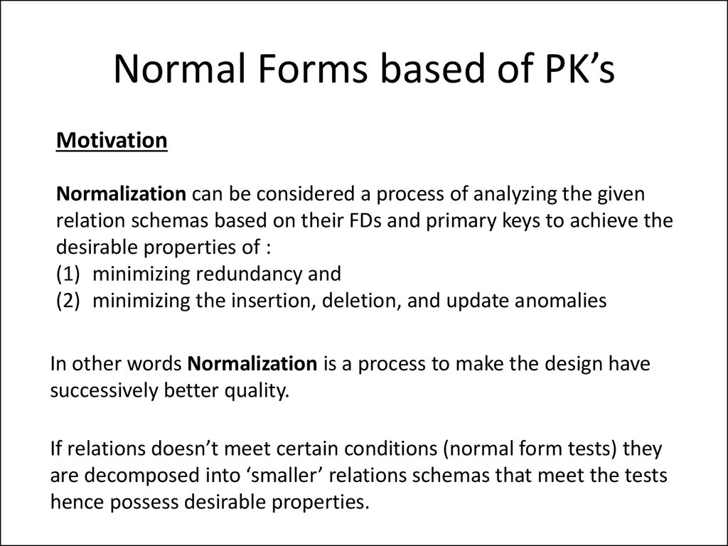
Normalization - PKs

Slide 12
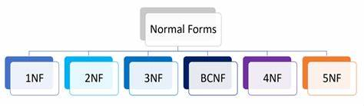
Forms
BCNF (Boyce-Codd Normal Form)
Notes:
BCNF (Boyce-Codd Normal Form)

Slide 13
Primary Key
A primary is a single column value used to identify a database record uniquely.
It has following attributes
A primary key cannot be NULL
A primary key value must be unique
The primary key values should rarely be changed
The primary key must be given a value when a new record is inserted.

Slide 14
What is Composite Key?
A composite key is a primary key composed of multiple columns used to identify a record uniquely
In our database, we have two people with the same name Robert Phil, but they live in different places.
Composite key in Database
Hence, we require both Full Name and Address to identify a record uniquely. That is a composite key.
Let’s move into second normal form 2NF

Slide 15
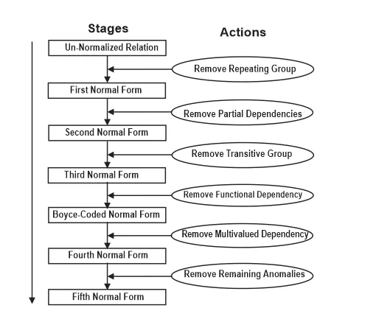
Nn

Slide 16
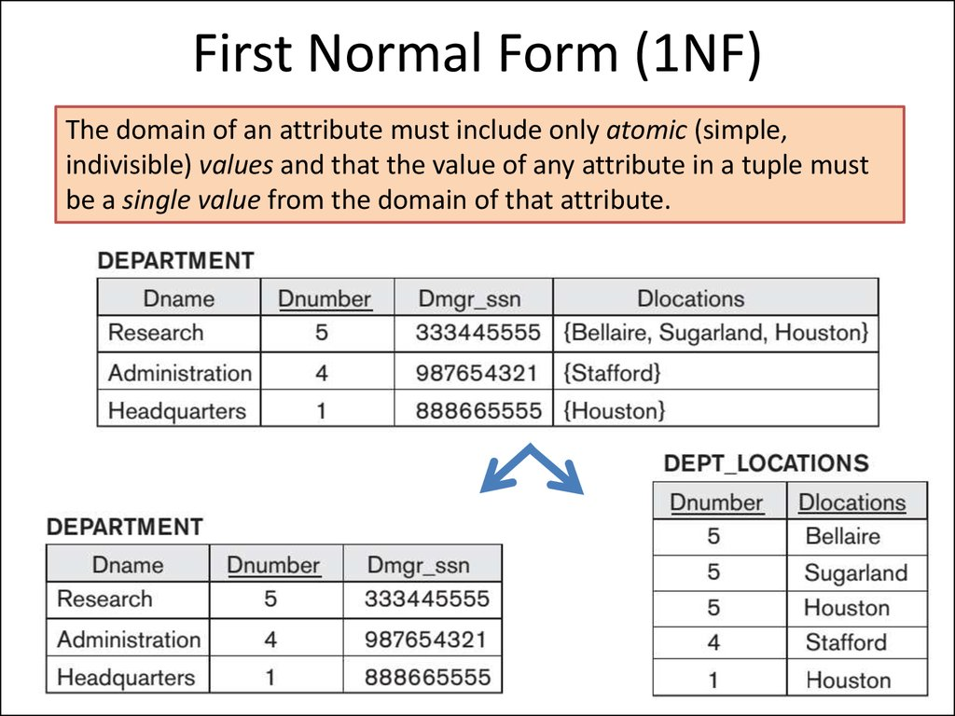
1NF

Slide 17
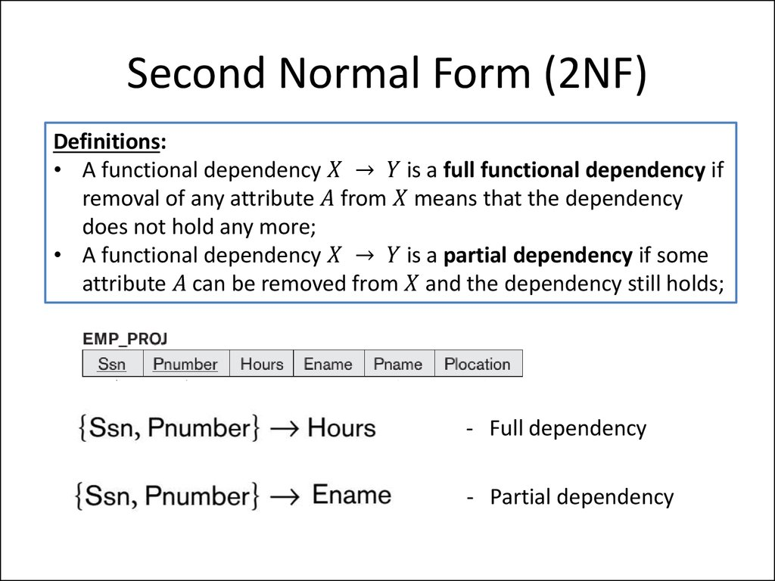
2NF

Slide 18
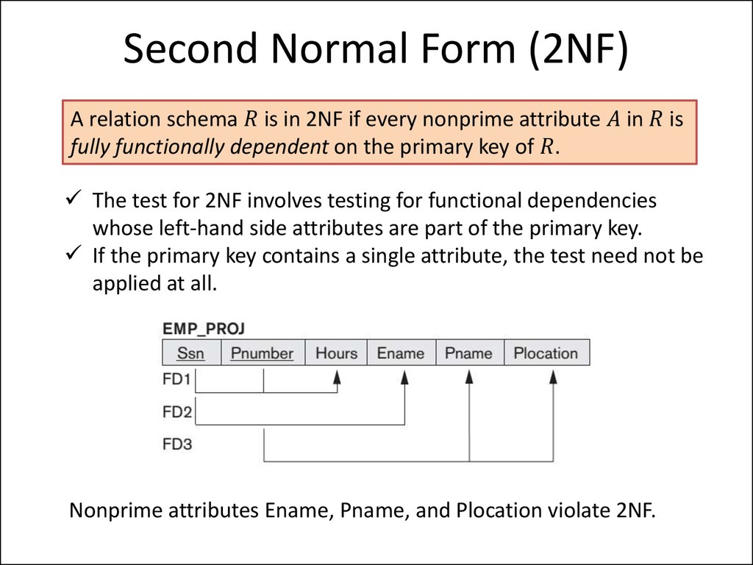
2NF

Slide 19
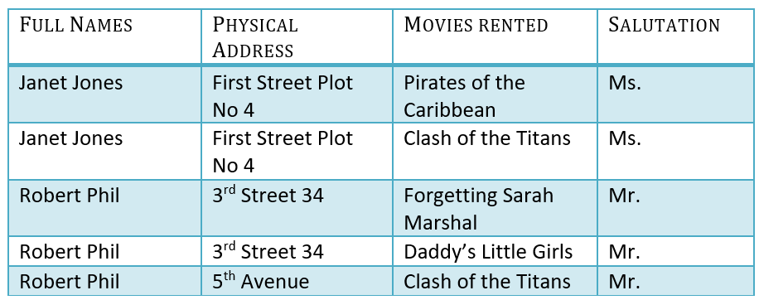
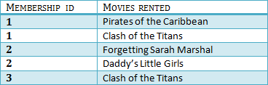

2NF (Foreign Key)

Slide 20
Foreign Key
Foreign Key references the primary key of another Table! It helps connect your Tables
A foreign key can have a different name from its primary key
It ensures rows in one table have corresponding rows in another
Unlike the Primary key, they do not have to be unique. Most often they aren’t
Foreign keys can be null even though primary keys can not

Slide 21
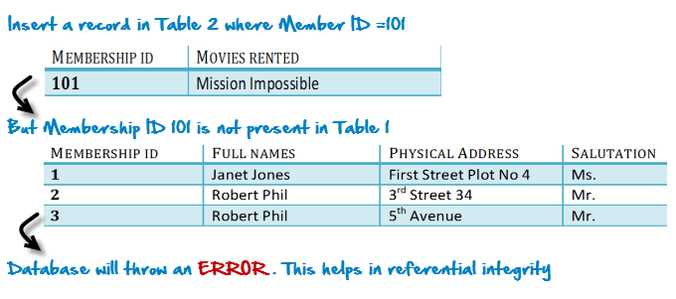
2NF
Why Foreign Key?
(Referential Integrity)

Slide 22
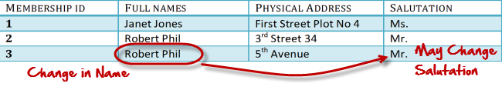
3NF – Transitive Dependency
A transitive functional dependency is when changing a non-key column, might cause any of the other non-key columns to change

Slide 23
Rule 1- Be in 2NF
Rule 2- Has no transitive functional dependencies

Slide 24



3NF

Slide 25
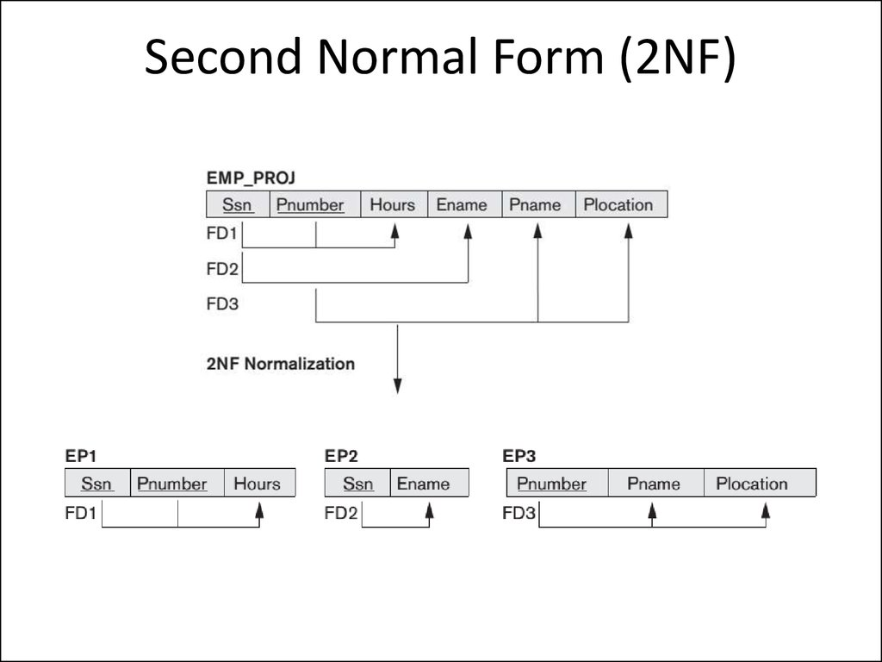

Slide 26
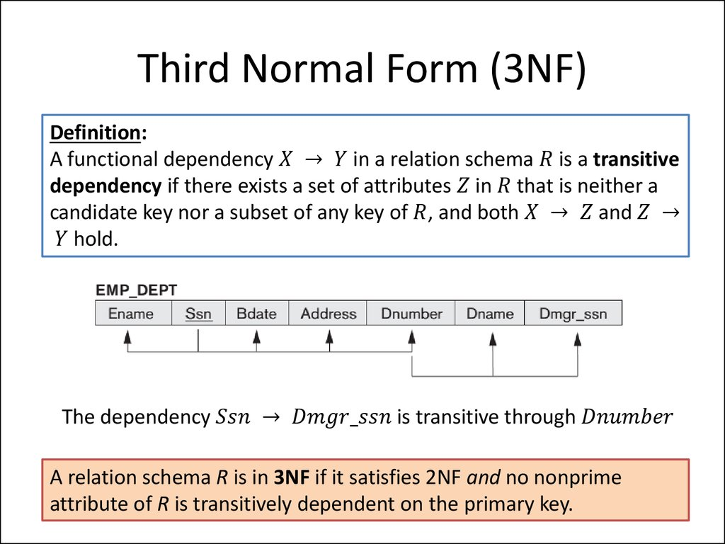

Slide 27
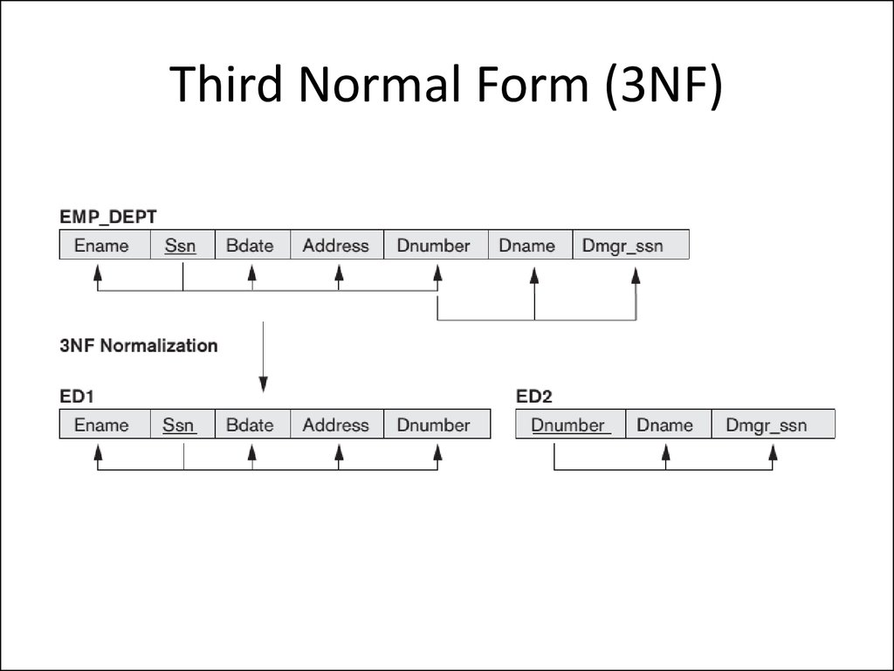
3NF

Slide 28
Levels >3NF
Needed for complex systems
3NF – Higher level of Normalization
BCNF (Boyce-Codd Normal Form)
Even when a database is in 3rd Normal Form, still there would be anomalies resulted if it has more than one Candidate Key.
Sometimes is BCNF is also referred as 3.5 Normal Form.
4NF (Fourth Normal Form) Rules
If no database table instance contains two or more, independent and multivalued data describing the relevant entity, then it is in 4th Normal Form.
5NF (Fifth Normal Form) Rules
A table is in 5th Normal Form only if it is in 4NF and it cannot be decomposed into any number of smaller tables without loss of data.
6NF (Sixth Normal Form) Proposed
6th Normal Form is not standardized, yet however, it is being discussed by database experts for some time. Hopefully, we would have a clear & standardized definition for 6th Normal Form in the near future…

Slide 29
ORacle

Slide 30
MySQL DB

Slide 31
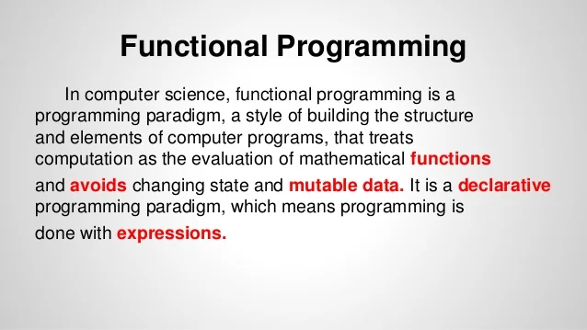
Functional Programming in Java

Slide 32
Functions in Java 8
Function
Function Reference
Lambda Predefined Java Functions
Lambda

Slide 33
