Slide 1
Day 1
SDLC

Slide 2
SDLC
Waterfall
Incremental

Slide 3
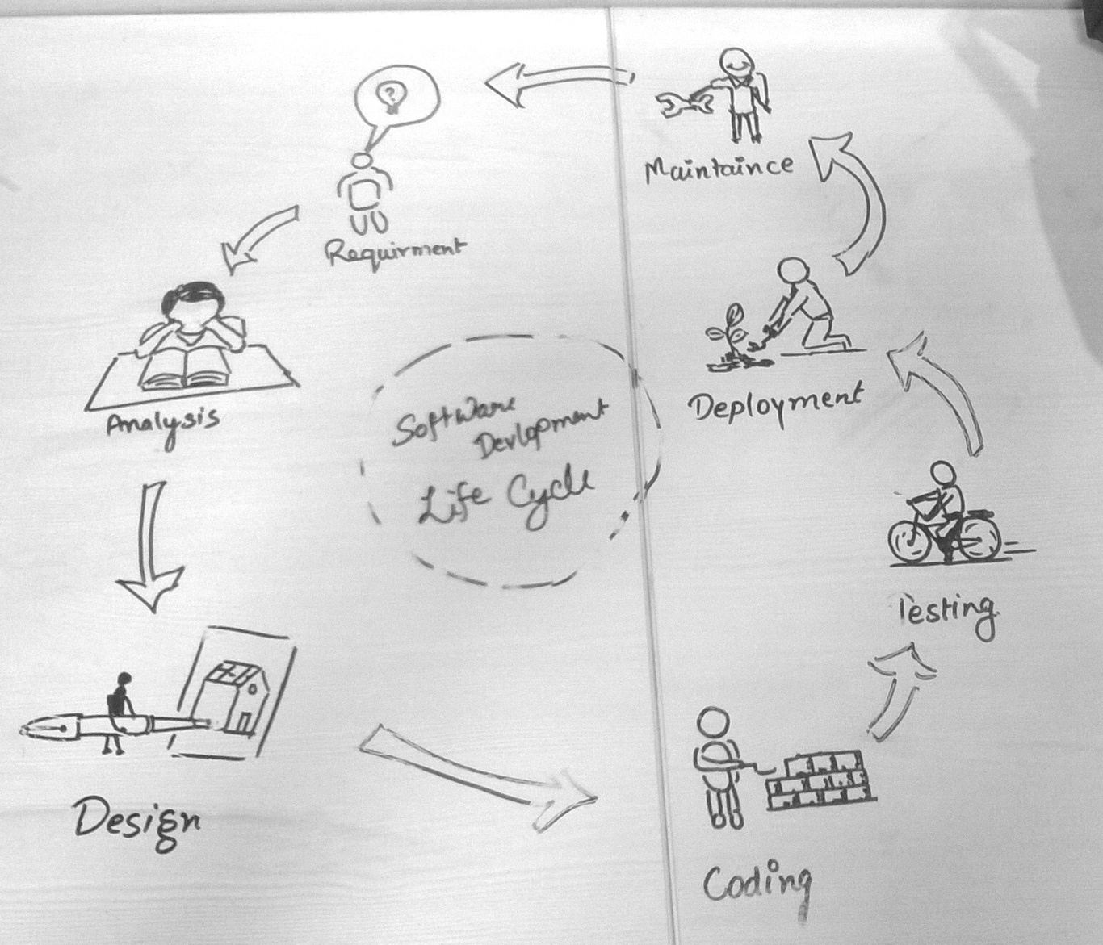
SDLC

Slide 4

Agile
Scrum?
Scrum team
User story

Slide 5
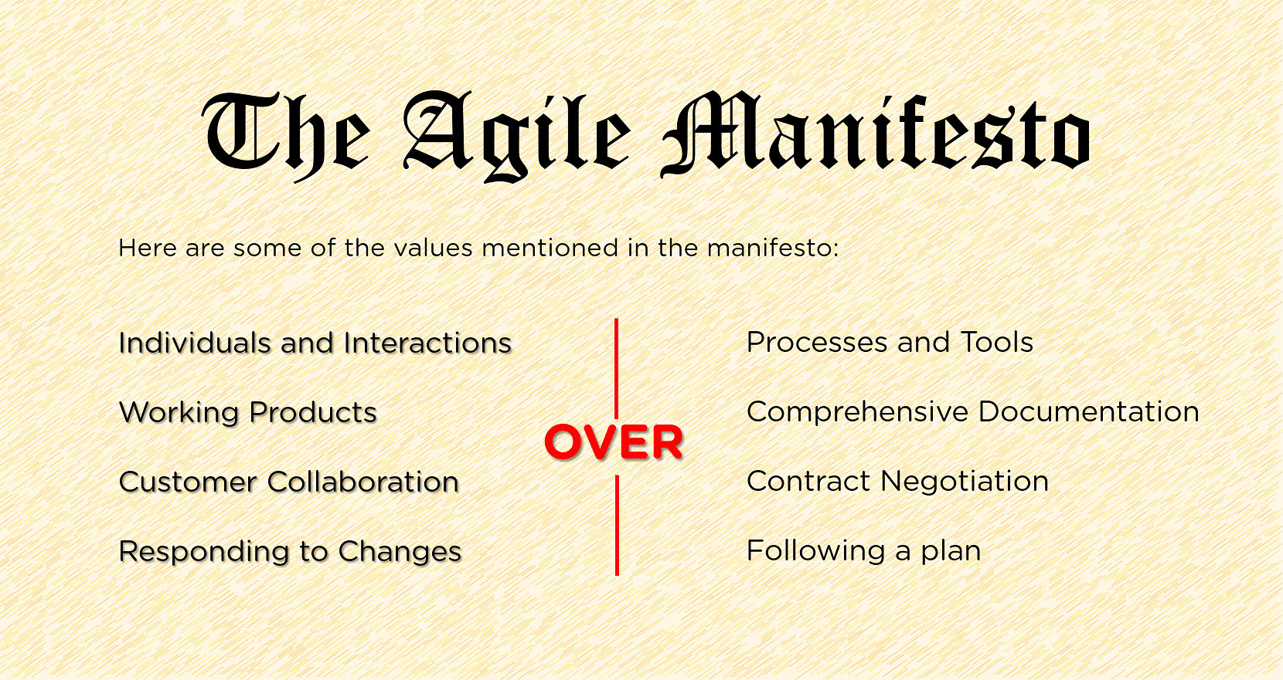
Agile

Slide 6
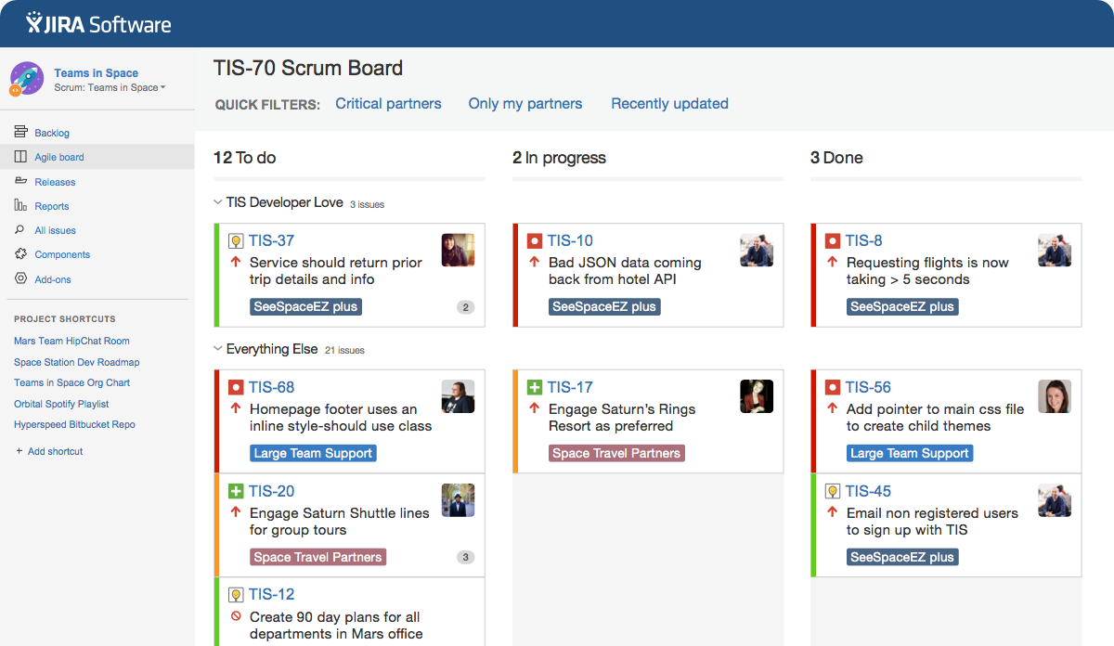
JIRA
Notes:
Sprint 2-4 weeks, sprint, backlog, product owner

Slide 7
Models and Modelling
Model-based software design and development
Analyze prior to implementation
Requirements models, static models, and dynamic models of the software system
Modelling language
Notes:
Different perspective, graphic language-UML

Slide 8
Structural Modeling
Classes diagrams
Objects diagrams
Deployment diagrams
Package diagrams
Composite structure diagram
Component diagram

Slide 9
Behavioral Modeling
Activity diagrams
Interaction diagrams
Use case diagrams

Slide 10
Architectural Modeling
Package diagram

Slide 11
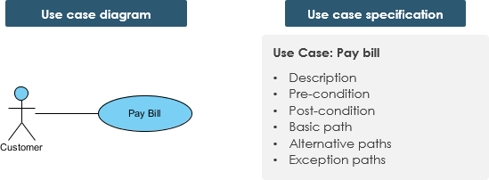
Use Case
Notes:
task , list of users, normal language , HLD .. LLD of use case is Sequence diagram

Slide 12
Exercise
Launching new phone – Ecommerce
Create Use case specification document – HLD
User stories:
As a [person], I [want to], [so that] I get this – Agile product backlog
As Admin, I want to monitor others work, so I can feel more in control.
As a manager, I want to be able to understand my colleagues progress, so I can better report our sucesss and failures.
Notes:
https://www.atlassian.com/agile/project-management/user-stories

Slide 13
Lets start Action
Thank you

