Slide 1
DATA ANALYTICS PROJECT
Telecom Customer Churn Analysis
Predicting customer attrition using statistical analysis and machine learning
Narmatha Muralidharan | Student ID: 83722937
GitHub: github.com/Narmatha-Muralidharan/DA-120B_Telecom_Customer_Churn_Analysis

Slide 2
PROJECT OVERVIEW
Problem Statement & Dataset
!
The Problem
Telecom companies lose significant revenue due to customer churn (~26.5% churn rate).
Acquiring a new customer costs 5–7x more than retaining an existing one.
Dataset — IBM Telco Customer Churn (Kaggle)
7,043
21
Yes/No
Customer records
Feature columns
Target: Churn
✓
Objective
Feature categories
Identify the key drivers of customer churn.
Build and compare predictive machine learning models.
Provide actionable business recommendations.
Demographics
Services
Account Info
Telecom Customer Churn Analysis
2

Slide 3
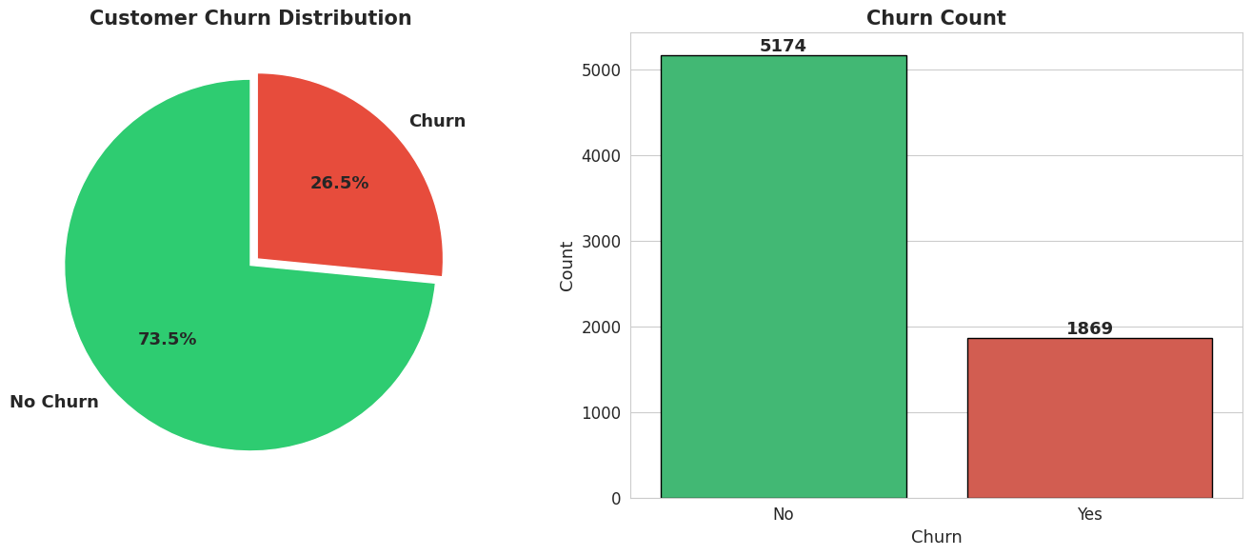
EXPLORATORY DATA ANALYSIS
Churn Distribution
73.5%
Retained — 5,174 customers
26.5%
More than 1 in 4 customers have left the service — a significant churn rate requiring immediate attention and intervention.
Churned — 1,869 customers
Telecom Customer Churn Analysis
3

Slide 4
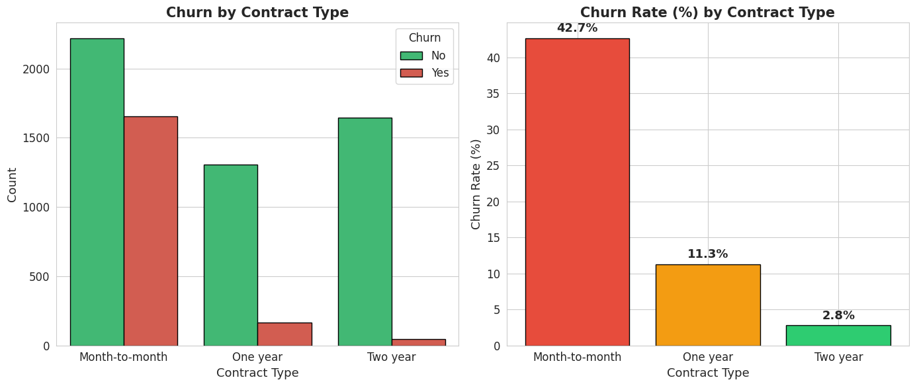
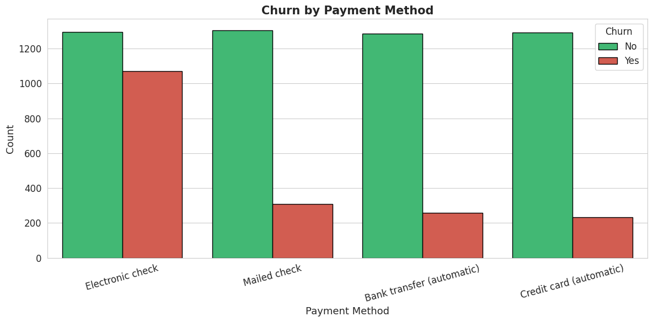
EXPLORATORY DATA ANALYSIS
Contract Type & Payment Method
42.7%
2.8%
45.3%
Month-to-month churn (highest)
Two-year contract churn (lowest)
Electronic check churn (highest)
Telecom Customer Churn Analysis
4

Slide 5
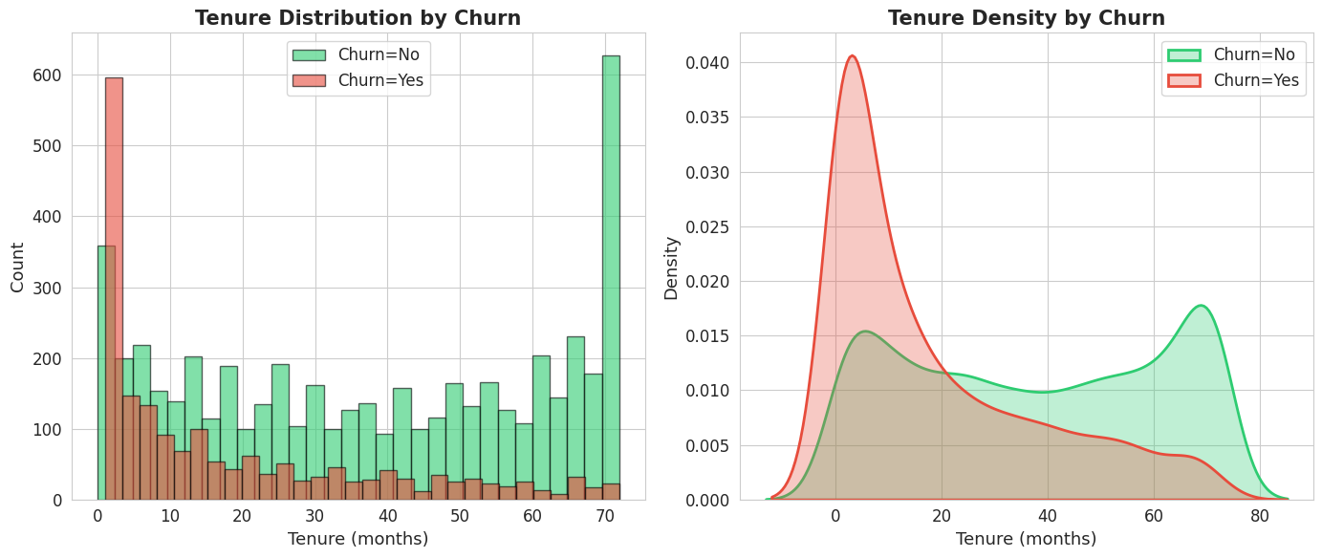
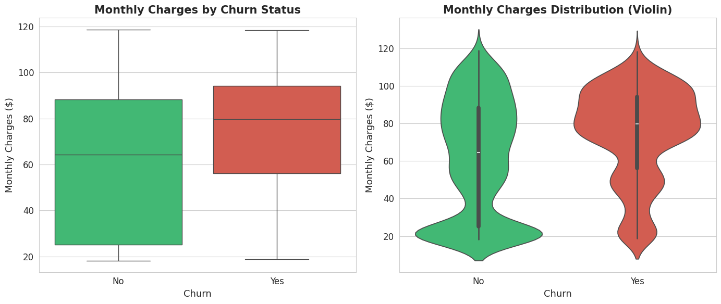
EXPLORATORY DATA ANALYSIS
Tenure & Monthly Charges
Avg. Tenure — Churned: 18.0 mo vs Retained: 37.6 mo
Avg. Monthly Charges — Churned: $74.44 vs Retained: $61.27
Telecom Customer Churn Analysis
5

Slide 6
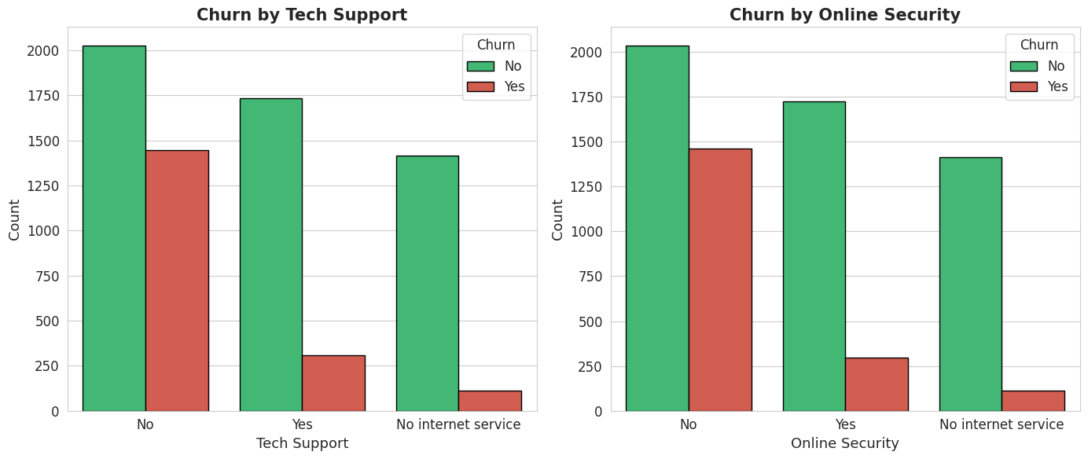
EXPLORATORY DATA ANALYSIS
Services & Correlation Analysis
41.6%
15.2%
Churn without tech support
Churn with tech support
Top correlations with churn: Contract (−0.397), Tenure (−0.352), Online Security (−0.289)
Telecom Customer Churn Analysis
6

Slide 7
STATISTICAL ANALYSIS
Statistical Hypothesis Testing
1
Chi-Square Test
2
T-Test
3
Chi-Square Test
Churn vs. Contract Type
Monthly Charges
Churn vs. Internet Service
H₀: Churn is independent of contract type
H₀: Charges are equal for both groups
H₀: Churn is independent of internet type
Chi-Square = 1184.60
p-value < 0.000001
T-statistic = 16.54
p-value < 0.000001
Chi-Square = 732.31
p-value < 0.000001
All 3 tests statistically significant (p < 0.05). Contract type, monthly charges, and internet service all significantly impact customer churn decisions.
Telecom Customer Churn Analysis
7

Slide 8
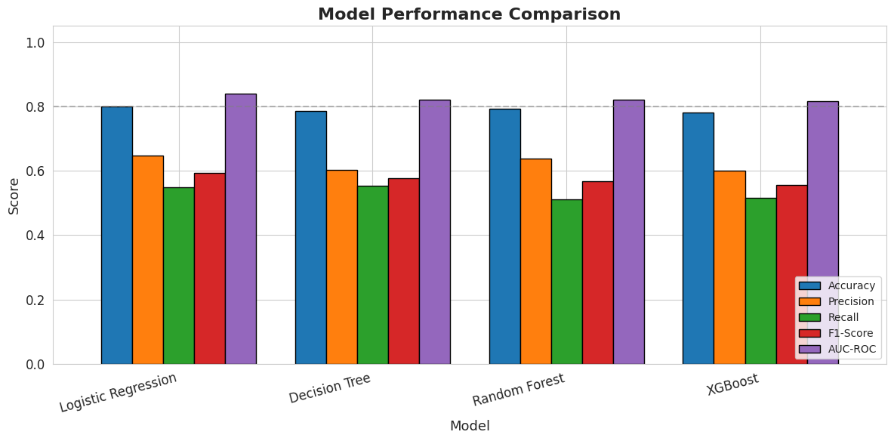
MACHINE LEARNING
Model Comparison
BEST MODEL
Logistic Regression
Accuracy
80.06%
Precision
64.67%
Recall
54.81%
F1-Score
59.33%
AUC-ROC
84.03%
OTHER MODELS
Random Forest
79.35%
Four classification models were trained and evaluated on accuracy, precision, recall, F1-score, and AUC-ROC.
Decision Tree
78.50%
XGBoost
78.07%
Telecom Customer Churn Analysis
8

Slide 9
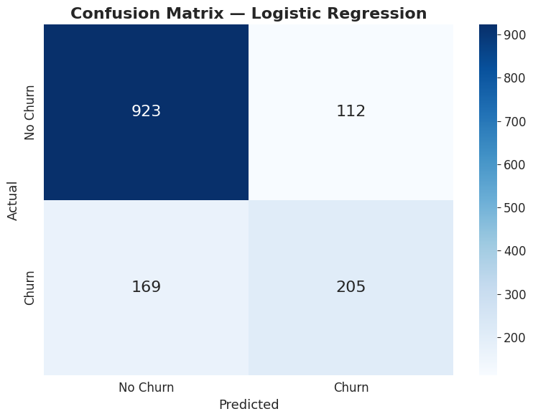
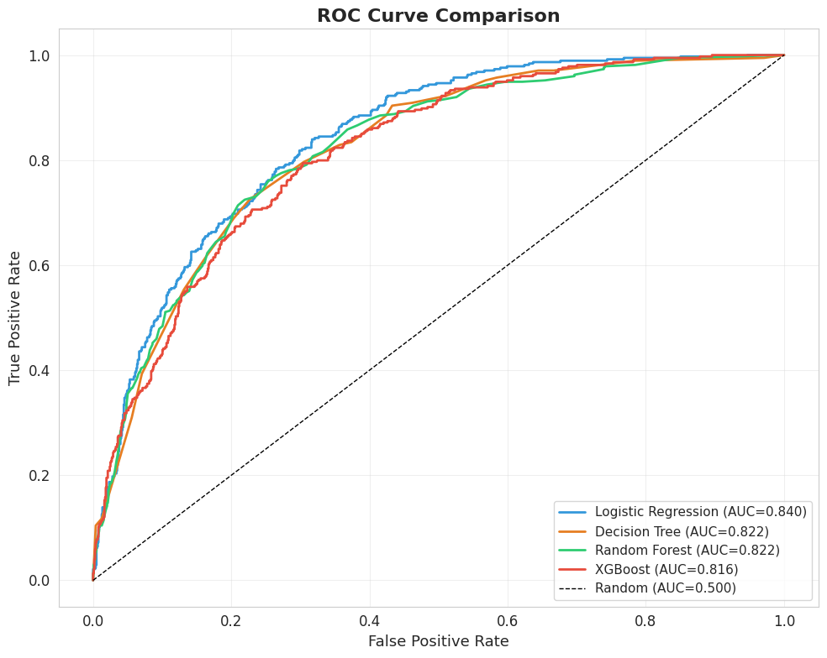
MACHINE LEARNING
Best Model — Confusion Matrix & ROC Curve
Correctly predicted 89% of retained customers and 55% of churned customers.
AUC-ROC: 0.84 — good discrimination ability between churners and non-churners.
Telecom Customer Churn Analysis
9

Slide 10
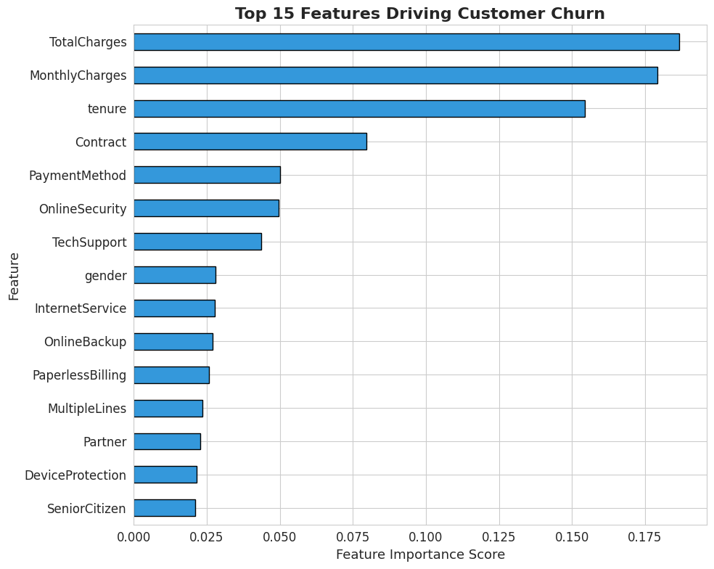
MACHINE LEARNING
Top Churn Drivers — Feature Importance
1
Total Charges (0.187)
Overall spending pattern
2
Monthly Charges (0.179)
Higher bills correlate with more churn
3
Tenure (0.154)
New customers are at highest risk
4
Contract Type (0.080)
Month-to-month is the danger zone
5
Payment Method (0.050)
Electronic check is a red flag
Telecom Customer Churn Analysis
10

Slide 11
CONCLUSION
Key Insights & Business Recommendations
KEY INSIGHTS
RECOMMENDATIONS
26.5% overall churn rate (1,869 customers)
1
Offer discounts for long-term contracts to convert month-to-month subscribers
Month-to-month churn (42.7%) vs. two-year churn (2.8%)
2
Focus retention efforts in the first 12 months with onboarding & engagement programs
New customers (0–12 months) are the highest-risk group
3
Bundle tech support and online security as default services
Without tech support: 41.6% churn | with support: 15.2%
4
Review pricing for high-paying customers to improve perceived value
Electronic check users churn at 45.3% vs. 15.2% for credit card
5
Encourage auto-pay enrollment to reduce electronic check usage
Telecom Customer Churn Analysis
11

Slide 12
Thank You!
Narmatha Muralidharan | Student ID: 83722937
GitHub: github.com/Narmatha-Muralidharan/DA-120B_Telecom_Customer_Churn_Analysis

