Slide 1

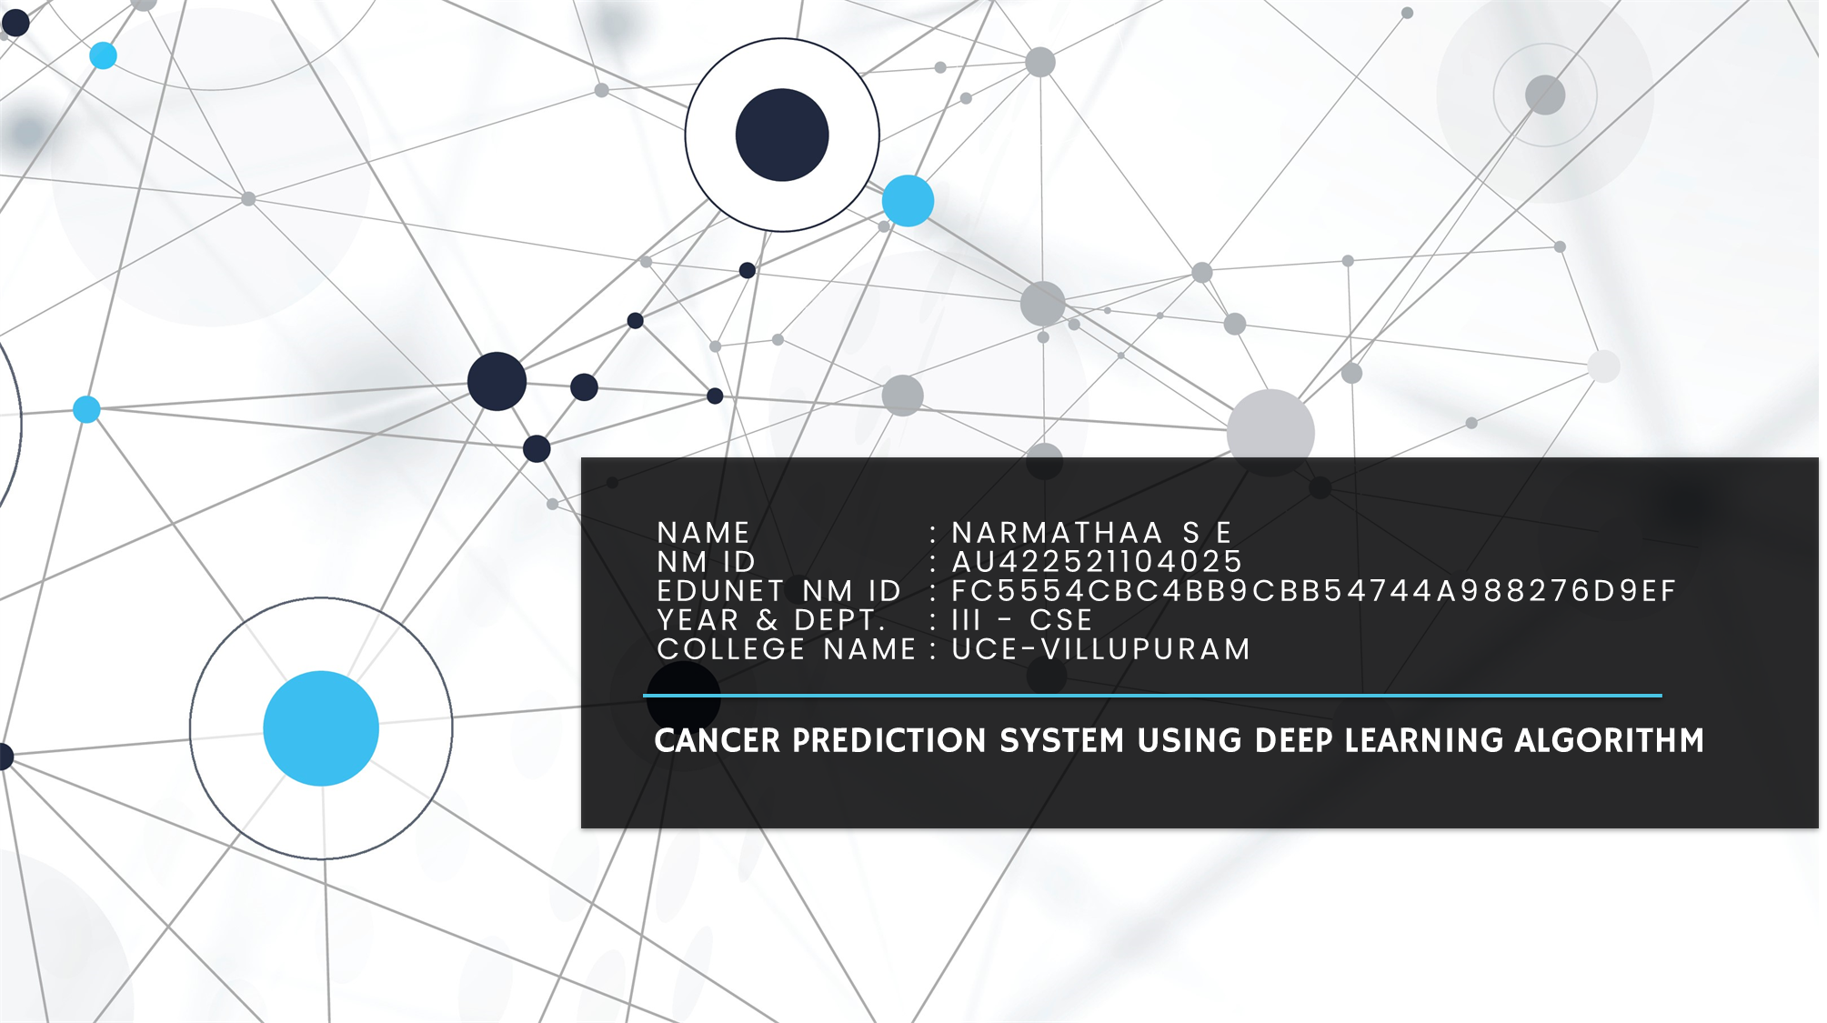

Slide 2
PROJECT TITLE
CANCER PREDICTION SYSTEM USING DEEP LEARNING
Cancer is a leading cause of mortality worldwide, underscoring the importance of early detection for successful treatment. This project focuses on utilizing deep learning techniques to predict the presence of cancer in medical images, aiming to improve diagnostic accuracy and facilitate timely intervention.

Slide 3
AGENDA
Early Detection: Develop a deep learning model for early detection of cancer in medical images.
Automation: Create an automated system to analyze medical images, reducing manual workload and speeding up diagnosis.
Accuracy Improvement: Utilize advanced deep learning techniques to enhance prediction accuracy and reliability.
Scalability: Design the model to handle large volumes of medical image data efficiently, accommodating diverse healthcare settings.
Deployment: Ensure seamless integration of the model into healthcare systems for real-world diagnosis.
Validation: Rigorously validate the model's performance using appropriate metrics and real-world datasets.
Impact: Evaluate the potential impact of the model on patient care and outcomes, contributing to cancer diagnosis and treatment advancements.

Slide 4
PROBLEM STATEMENT
Problem Description: Cancer is one of the leading causes of death worldwide, with early detection being crucial for successful treatment. This project aims to predict the presence of cancer based on medical images (such as X-rays or MRI scans) using deep learning techniques.
Algorithm and Techniques: Convolutional Neural Networks (CNNs) are commonly used for image classification tasks, making them suitable for this project. Techniques such as data augmentation, transfer learning, and ensemble methods can enhance model performance.
Reason for Choosing the Problem: Early detection of cancer significantly improves patient outcomes. By leveraging deep learning techniques, we can automate the process of analyzing medical images, potentially assisting healthcare professionals in timely diagnosis and treatment planning.

Slide 5
PROJECT OVERVIEW
This project aims to develop a deep learning model for early cancer detection using medical images. By leveraging convolutional neural networks (CNNs) and advanced techniques like transfer learning, the model seeks to accurately predict the presence of cancer, aiding in timely intervention and treatment planning. The project emphasizes automation to reduce manual workload for healthcare professionals, improving diagnostic efficiency and patient outcomes. Through rigorous training, validation, and deployment, the project strives to make a significant impact on cancer care, highlighting the potential of deep learning in revolutionizing medical diagnosis.

Slide 6
WHO ARE THE END USERS?
Radiologists and Oncologists: Healthcare professionals responsible for interpreting medical images and diagnosing cancer. They can use the developed deep learning model as a supplementary tool to aid in their decision-making process, potentially improving diagnostic accuracy and efficiency.
Clinicians and Healthcare Providers: Medical professionals involved in patient care who may need to assess cancer risk or monitor treatment progress. They can benefit from the model's predictions to inform their treatment plans and interventions.
Healthcare Institutions: Hospitals, clinics, and medical centers can integrate the developed model into their diagnostic workflows to streamline the cancer detection process. This integration can lead to improved patient care, reduced healthcare costs, and enhanced institutional reputation.
Patients: Individuals undergoing medical imaging for cancer screening or diagnosis are indirect end users. The timely and accurate predictions provided by the deep learning model can offer patients peace of mind and ensure they receive appropriate medical care in a timely manner.

Slide 7
YOUR SOLUTION AND ITS VALUE PROPOSITION
Our solution involves training a deep learning model on a dataset of medical images labeled with cancer status. The trained model can then predict whether a new medical image indicates the presence of cancer or not. The value proposition lies in providing a fast and accurate screening tool that aids healthcare professionals in identifying potential cases of cancer earlier, thus improving patient care and outcomes.

Slide 8
THE WOW IN MY SOLUTION
One unique feature of this project is its integration of deep learning technology for cancer prediction in medical imaging. By leveraging convolutional neural networks (CNNs) and transfer learning, the model can analyze complex patterns and features within medical images to accurately predict the presence of cancer.
This project stands out due to its:
Advanced Technology: The use of deep learning techniques represents a cutting-edge approach to cancer diagnosis, offering superior performance compared to traditional methods.
Automation: The model automates the analysis of medical images, reducing the reliance on manual interpretation by healthcare professionals. This automation streamlines the diagnostic process, leading to faster results and improved efficiency.
Scalability: The model is designed to handle large volumes of medical image data efficiently, making it suitable for deployment in diverse healthcare settings, from small clinics to large hospitals.
Interdisciplinary Collaboration: The project involves collaboration between data scientists, healthcare professionals, and technologists, combining expertise from multiple domains to address a critical healthcare challenge.
Potential Impact: The project's focus on early cancer detection has the potential to significantly impact patient outcomes and public health by facilitating timely intervention and treatment.
.

Slide 9
MODELLING
In this project, the following frameworks and libraries are utilized:
TensorFlow: TensorFlow is an open-source machine learning framework developed by Google. It provides a comprehensive ecosystem of tools, libraries, and resources for building and deploying machine learning models, including deep learning models.
Keras: Keras is an open-source neural network library written in Python. It serves as a high-level API for building and training deep learning models, offering a user-friendly interface and seamless integration with TensorFlow.
NumPy: NumPy is a fundamental package for scientific computing in Python. It provides support for large, multi-dimensional arrays and matrices, along with a collection of mathematical functions to operate on these arrays.
Pandas: Pandas is a powerful data manipulation and analysis library in Python. It offers data structures and functions for efficiently handling structured data, such as tabular data and time series.
Matplotlib: Matplotlib is a plotting library for creating static, interactive, and animated visualizations in Python. It provides a wide range of functions for generating plots, charts, and graphs to visualize data and model performance.
Seaborn: Seaborn is a statistical data visualization library built on top of Matplotlib. It provides a high-level interface for creating informative and visually appealing statistical graphics, including heatmaps, distribution plots, and regression plots.
.

Slide 10
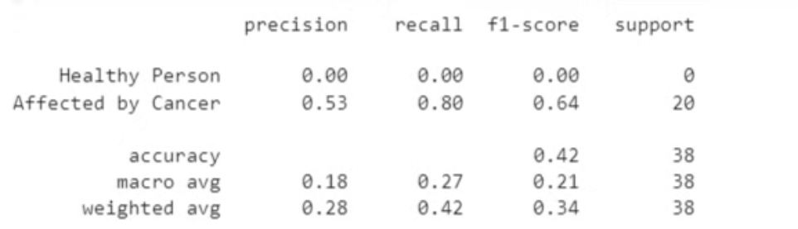
RESULTS
Performance Metrics:
Accuracy, precision, recall, and F1-score

Slide 11
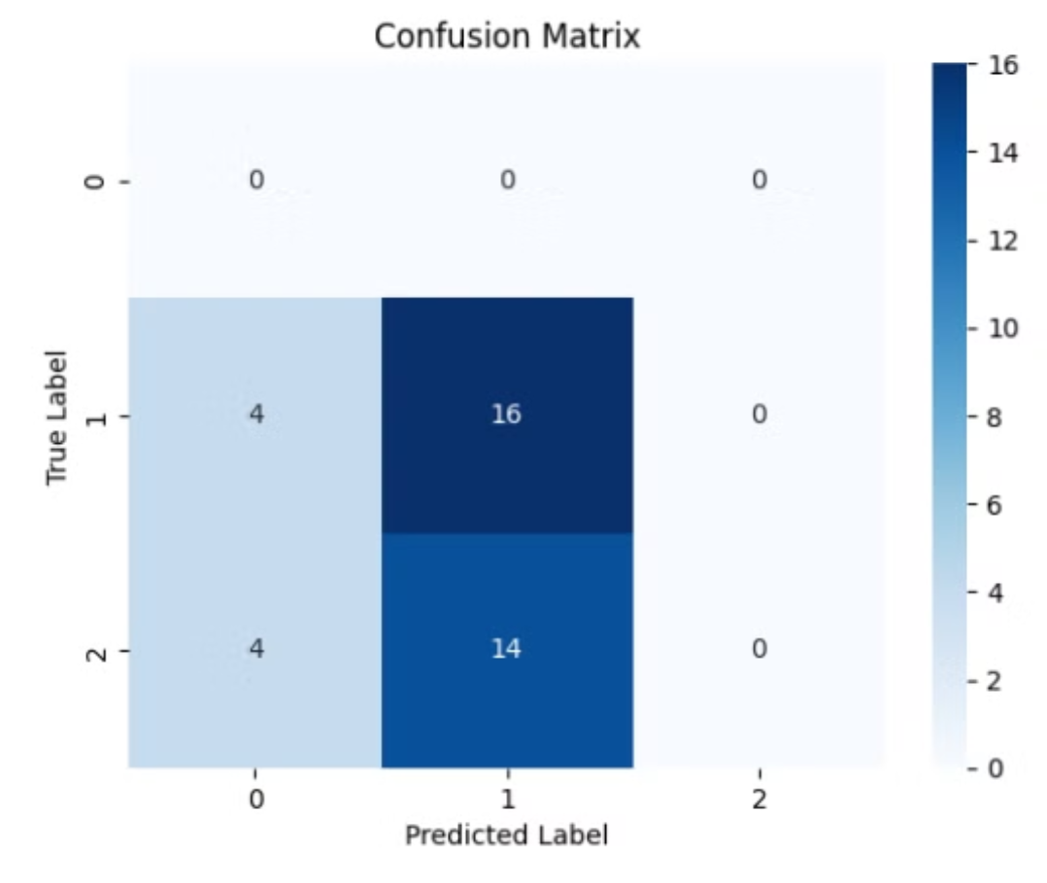
RESULTS
Performance Metrics:
Confusion matrix for detailed evaluation

Slide 12
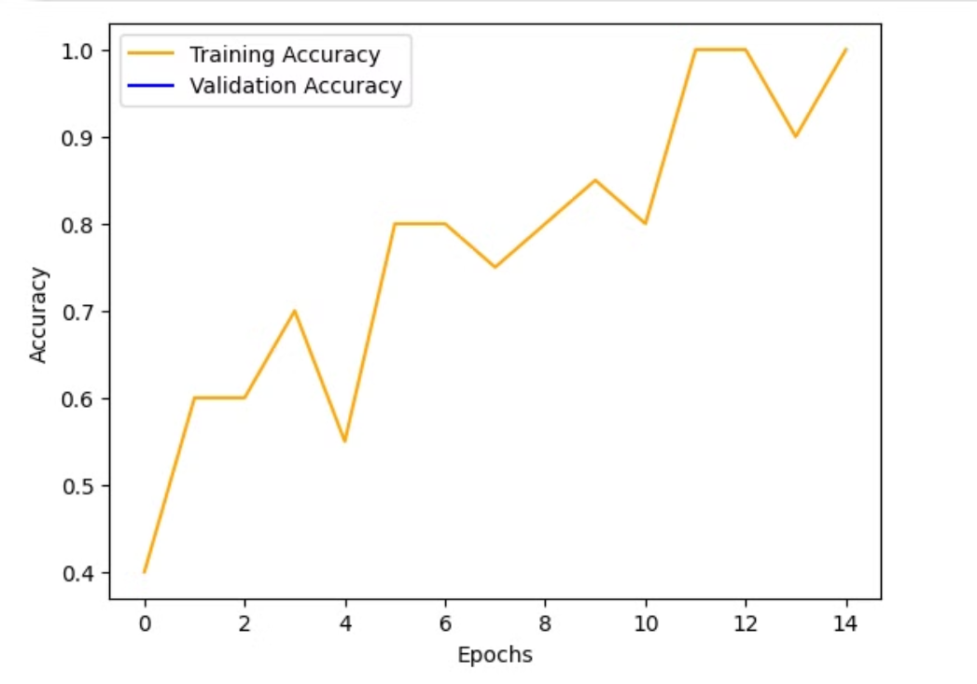
RESULTS
Visualization:
Graphs illustrating training/validation accuracy

Slide 13
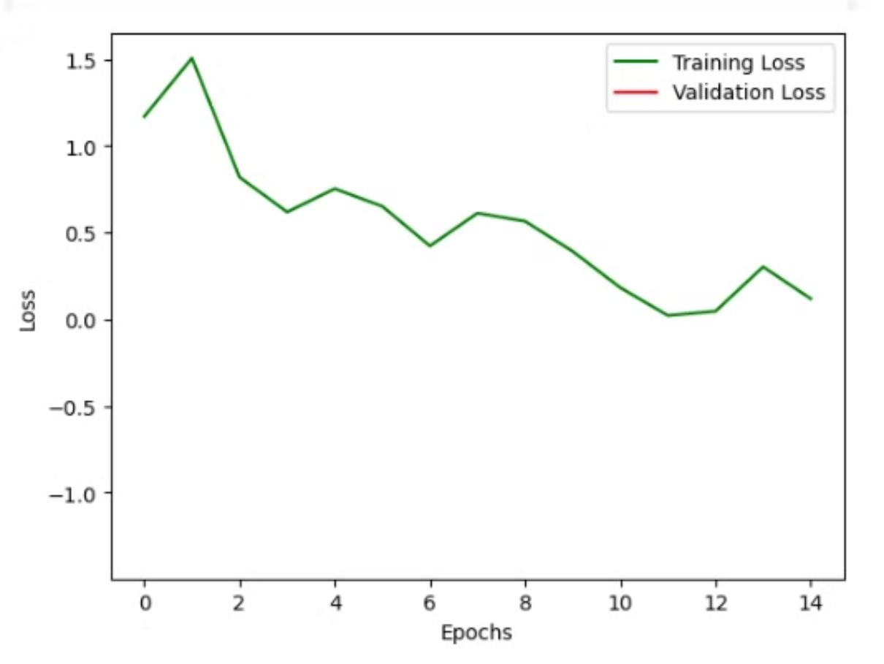
RESULTS
Visualization:
Graphs illustrating training/validation loss

Slide 14
GITHUB LINK:
https://github.com/Narmathaa84/Gen-AI.git
THANK YOU

