Slide 1
Employee Data Analysis using Excel
STUDENT NAME: NARMADHA B
REGISTER NO: 312209430
DEPARTMENT: B.COM (ACCOUNTING AND FINANCE)
COLLEGE: ANNA ADARSH COLLEGE FOR WOMEN

Slide 2

PROJECT TITLE
Employee Performance Analysis using Excel

Slide 3



AGENDA
AGENDA
Problem Statement
Project Overview
End Users
Our Solution and Proposition
Dataset Description
Modelling Approach
Results and Discussion
Conclusion
3/21/2024 Annual Review

Slide 4

PROBLEM STATEMENT
Employee performance analysis is useful to Identify Strength and Weakness,Set goals and expectations. It will enhances Accountability and informs Development and growth opportunities,supports fair compensation and promotion decisions,boosts employee engagement and motivation
And also improves overall organizational performance.!

Slide 5

PROJECT OVERVIEW
Analysing the performance of employee by considering various factors like gender, performance level, ratings, achievents.
The employee database contains various attributes such as employee ID, Name, Department, Job title, Starting date , Employee type (full-time / part-time) , Employee status (voluntarily terminated , active , etc).

Slide 6

WHO ARE THE END USERS?
End users of employee data analysis
Primary end users
Secondary end users
Tertiary end users
Employees (receive feedback and development plans)
Managers/Supervisors (evaluate performance and make decisions)
HR Department (monitor trends, identify training needs, and develop strategies) Organizational Leadership (evaluate performance management systeem and make strategic decisions.)
Succession Planning Teams (identify and develop future leaders) Compensation and Benefits Teams(determine rewards and recognition)
Training and Development Teams (design and deliver training program)

Slide 7

OUR SOLUTION AND ITS VALUE PROPOSITION
Conditional formatting- used for missing values or blanks
Filter- To remove the blanks
Formula-To find the performance level
Pivot table- To summarise the data
Graph- Data visualization

Slide 8
Dataset Description
Employee data- from kaggle
It has 26 features
I’ve taken 10 features
Employee ID- in number
Name-Texrt
Employee type- Text
Performance level – Text
Gender- Male or female
Employee rating – in number.

Slide 9

THE "WOW" IN OUR SOLUTION
PERFORMANCE LEVEL =
=IFS(Z8>=5,"VERYHIGH",Z8>=4,"HIGH",Z8>=3,"MED",4TRUE,"LOW")
3/21/2024 Annual Review
9

Slide 10
MODELLING
1.Data Collection
Employee data is downloaded from kaggle
Analysed the data
2.Feature collection
Gathered the wanted data points
And noticed it
3.Data cleaning
Cleaned the data
And highlighted it for better understanding
4 Performance level
Performance level is calculated from the current employee ratings
It was calculated using formula
5.Conditional formatting
Used for missing values or blanks
10

Slide 11
6.Filter
To remove the blanks
7.Pivot table
To summarise the data
By using pivot table we can precise the data for better understanding
8.Graph
Graph is used for data visualization
And also show the performance of the employee.
Continued…..

Slide 12
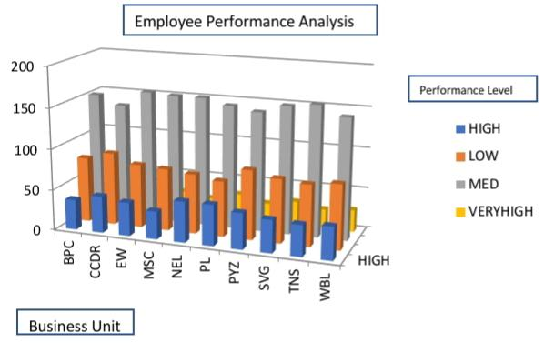
RESULTS
12

Slide 13
conclusion
“Employee data analysis provides valuable insights into workforce performance, productivity, and development needs. By leveraging data-driven decision making, organizations can: - Enhance employee engagement and retention - Identify skill gaps and training opportunities - Inform strategic talent management decisions - Optimize performance management processes - Improve overall business outcomes Effective employee data analysis enables organizations to unlock the full potential of their workforce, drive business success, and maintain a competitive edge in the market.”

