Slide 1

ImpactFlow-AI Powered Adaptive Software Change Impact & Risk Prediction Platform
SOA Project Review-2
 | Under the Guidance of Dr. Neelima G Professor, Department of Computer Science and Engineering, KLH CSE Bowrampet Campus
Team Members Susmitha(2420030045) N. Amrutha Lekha (2420030477)

Slide 2
What We'll Cover Today
Agenda – SOA Project Review-2
01
Review-1 Recap: Problem & Approach
Slide 3
02
Project Design – ImpactFlow
Slide 4
03
SOA Architecture – Component Design
Slide 5
04
Layered Architecture of ImpactFlow
Slide 6
05
Services / Modules in ImpactFlow
Slide 7
06
Microservices Security
Slide 8
07
Key Advantages of ImpactFlow
Slide 9
08
Detailed Technical Design – ImpactFlow
Slide 10
09
Implementation Status
Slide 11

Slide 3
Review-1 Recap: Problem & Approach
Problem: In microservice systems, a small change can affect multiple interconnected services, making service dependencies and overall impact difficult to track.
ImpactFlow analyses a proposed change, its dependency relationships, and affected services to identify potential impact and predict change risk.
Platform uses Spring Boot microservices, REST APIs, Eureka Service Discovery, Spring Cloud Gateway, Kafka event-driven communication, and JWT-based security.
Review-1 established the core SOA and microservices architecture, including service communication, contracts, discovery, security, and database-per-service design.
Review-2 focuses on deeper SOA concepts: communication patterns, orchestration vs choreography, SOA vs microservices, security, service discovery, API Gateway, and testing.

Slide 4
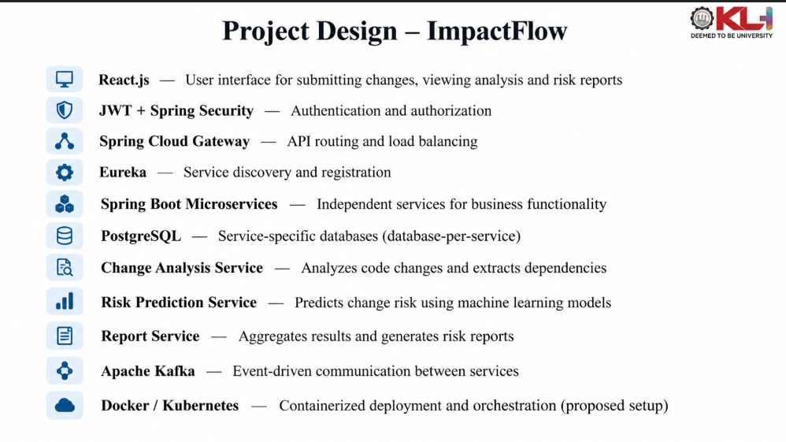

Slide 5
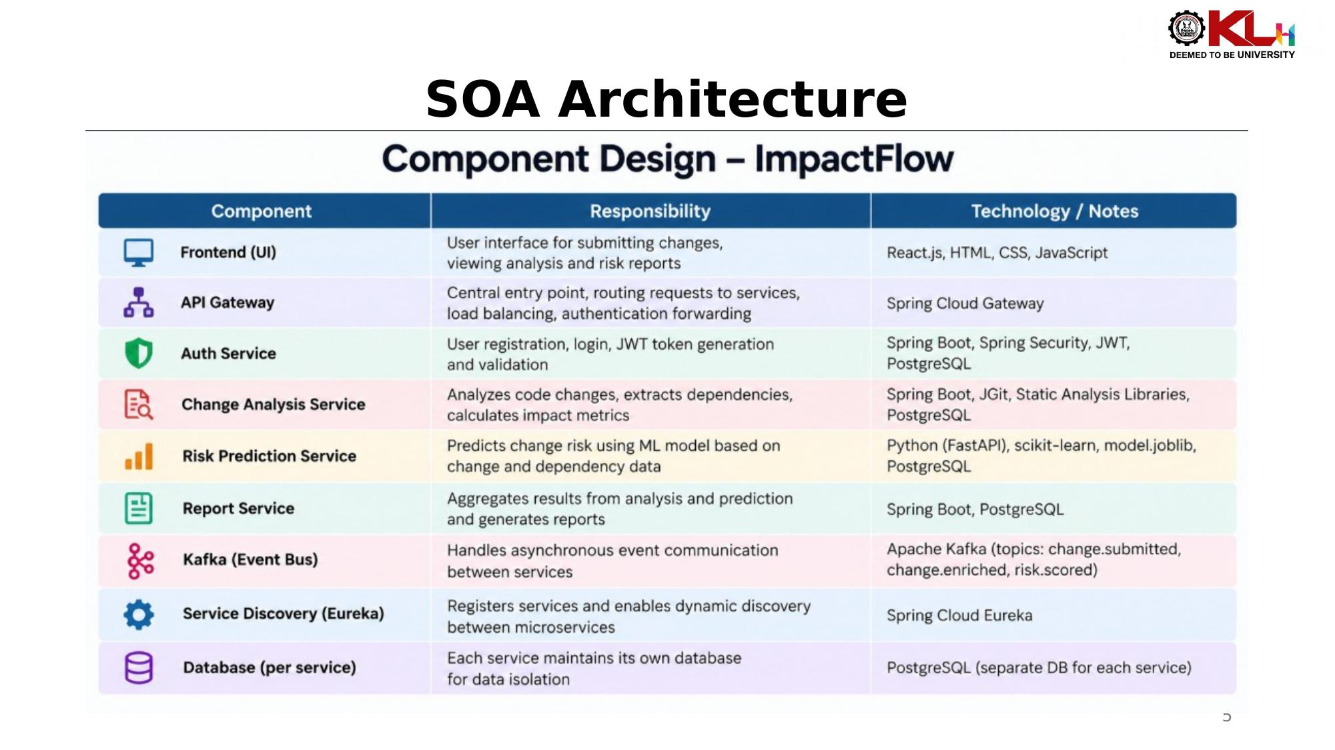

Slide 6
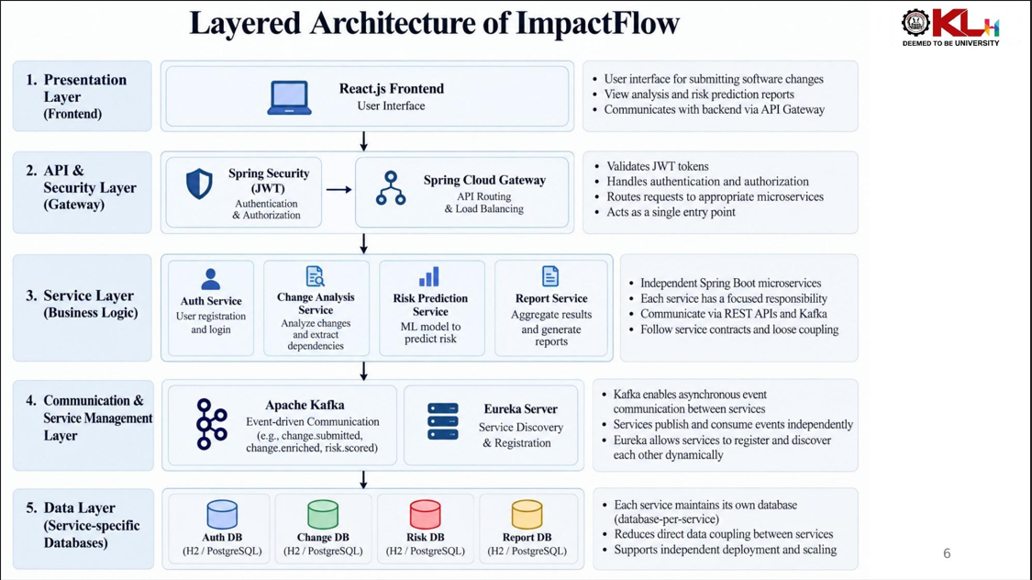

Slide 7
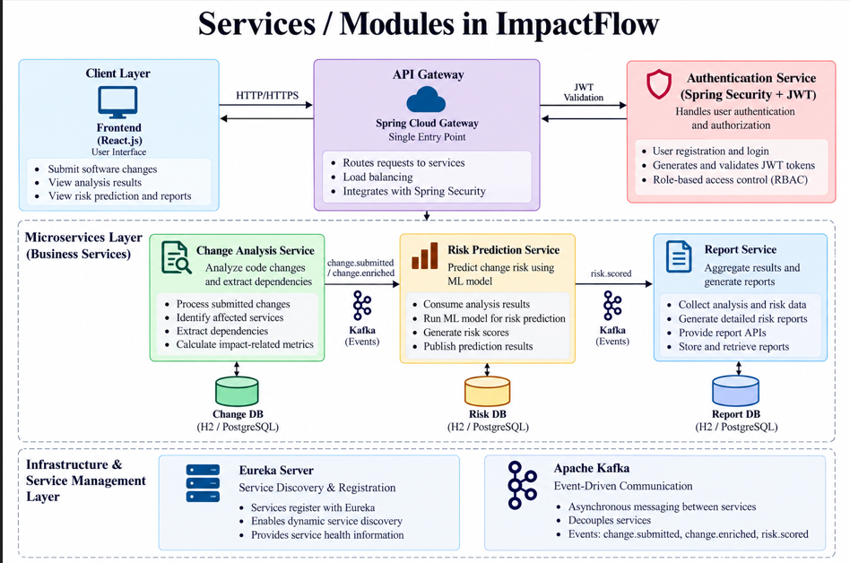

Slide 8
Microservices Security
Authentication: ImpactFlow uses Spring Security with JWT to authenticate users and secure service access.
Authorization: JWT-based access control ensures that authenticated requests can access protected microservice APIs.
CORS: Cross-Origin Resource Sharing is configured to control which frontend origins can communicate with backend APIs.
TLS/SSL: TLS can secure communication between clients, gateways, and services, protecting data in transit.
Security Testing: Authentication and authorization should be validated through security-focused unit and integration tests.
Security Best Practices: Secrets such as JWT keys and database credentials should be managed securely rather than stored directly in application code or configuration.

Slide 9
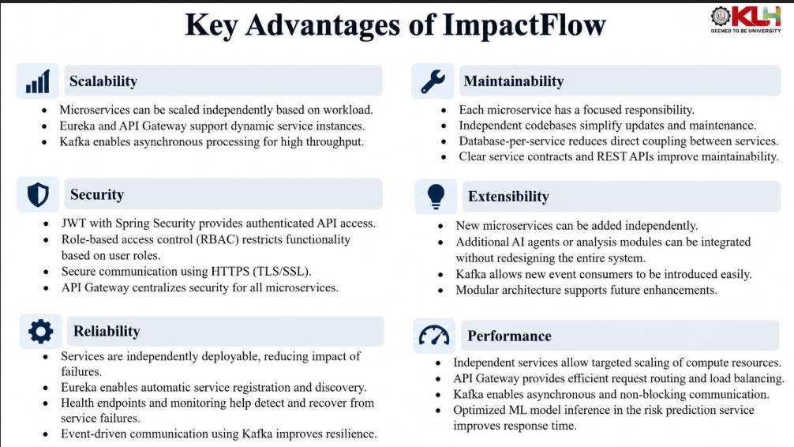

Slide 10
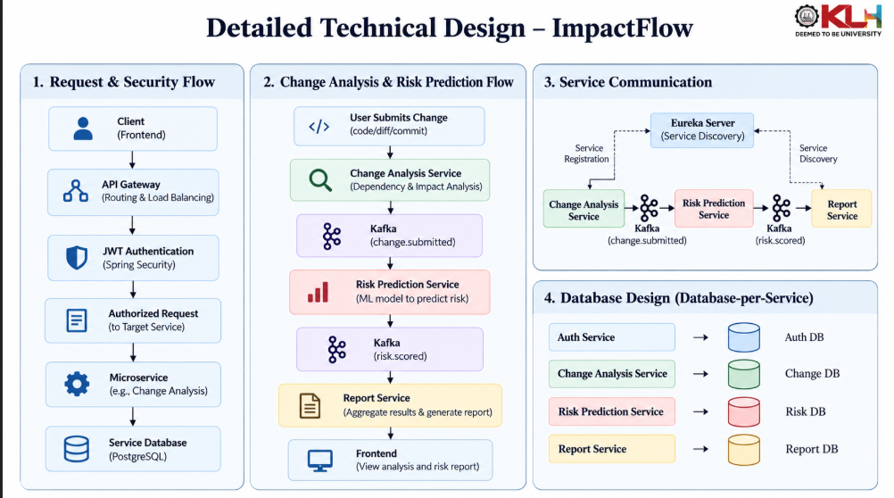

Slide 11
Implementation Status
Core microservices, REST APIs, Eureka service discovery, Spring Cloud Gateway, JWT security, and database-per-service design are implemented.
Kafka event-driven communication is implemented between Change Analysis, Risk Prediction, and Report services.
SOA communication patterns, service contracts, API routing, and dependency-based service interaction are demonstrated through the project architecture.
Work Item | Status
Service discovery with Eureka | Done
REST APIs & service contracts | Done
Spring Cloud Gateway routing | Done
JWT + Spring Security | In Progress
Kafka event-driven communication | In Progress
Database-per-service with JPA | In Progress
Unit/Integration testing | In Progress
Contract testing | In Progress

Slide 12
THANK YOU

