Slide 1
MONSOON
Should a Rajasthan bajra exporter enter the GCC millet market — and which country first?
Yash Narotam · September 2026

Slide 2
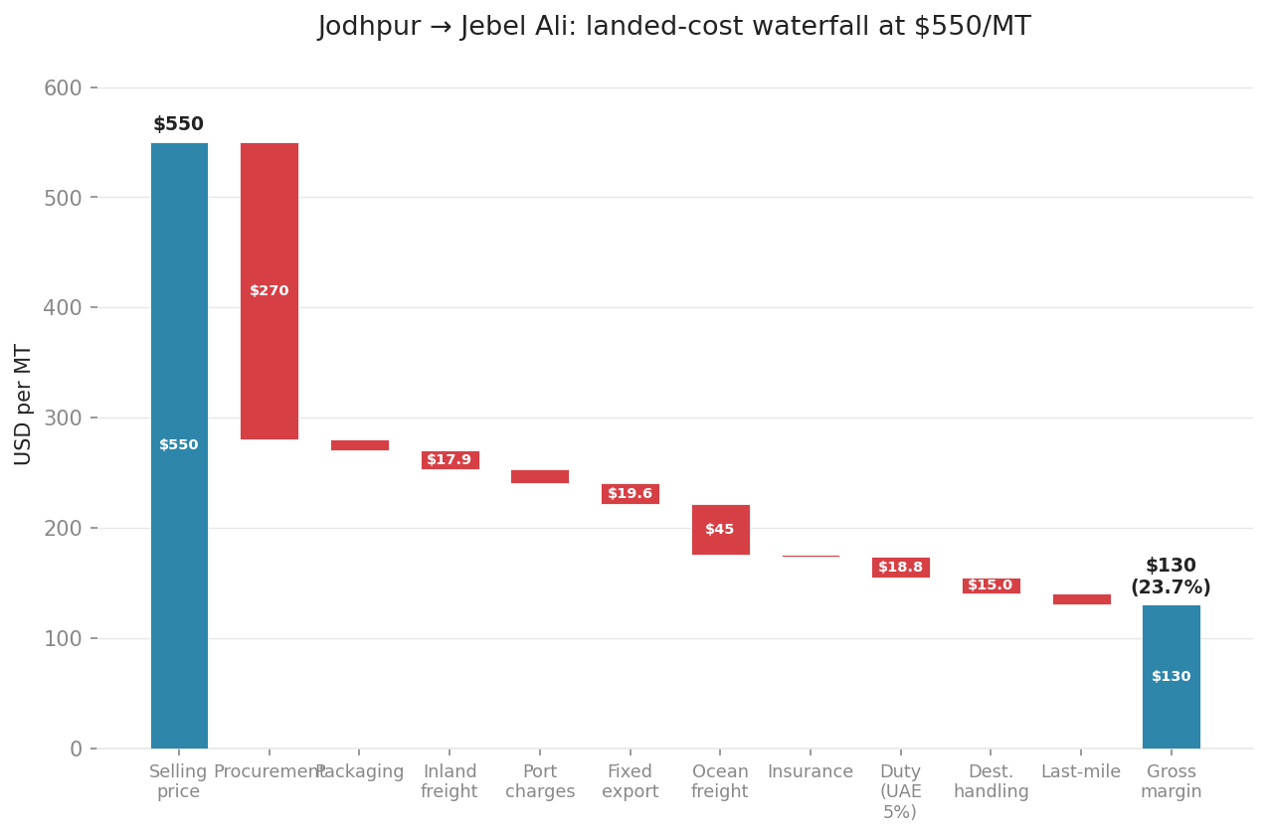
Enter UAE first with cleaned whole grain at $550/MT: a 23.7% gross margin on an $8.0M adjusted market growing at 4.8% annually
• Landed cost from Jodhpur to Jebel Ali is $419.81/MT across ten components; procurement is 64% of total
• UAE absorbed $8.01M of millet domestically in 2023 after netting Jebel Ali re-exports
• 2 TEUs/month at $550/MT generates $24,200 gross revenue; the $130/MT margin is positive from the first container
Source: Comtrade HS 100821+100829 (2023); APEDA Product Code 0606 FY2023-24; Jodhpur–Jebel Ali cost model
Notes:
This is the answer — every slide that follows is evidence for one of these three numbers.

Slide 3
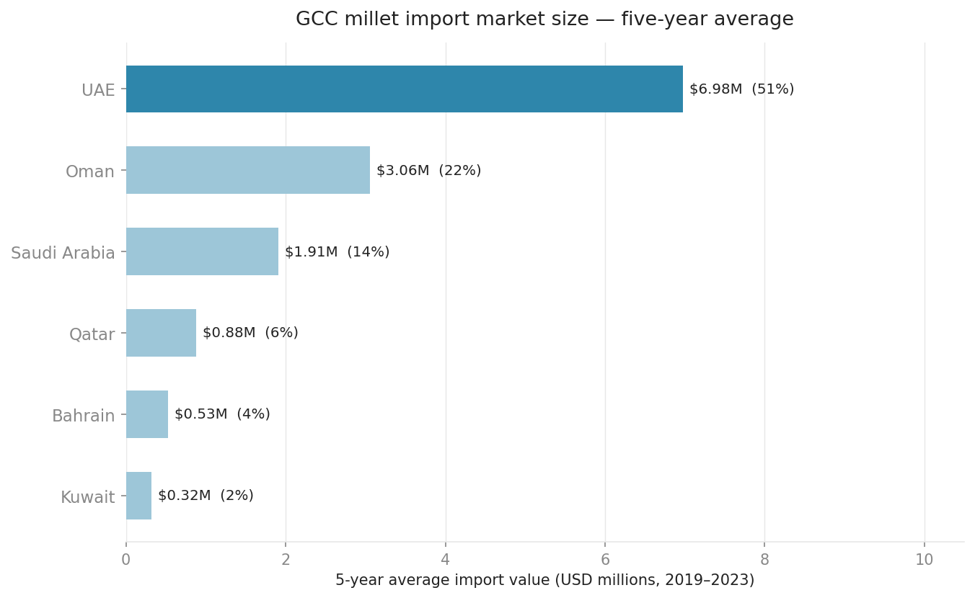
GCC millet imports total $13.7M annually; UAE captures 51%, making it the only single-market entry worth the freight
• Oman is the second-largest market at $3.06M avg but is dominated by re-export and transit flows via Salalah
• Saudi Arabia, Qatar, Bahrain, and Kuwait combined average $3.64M — half of UAE alone
• UAE's 51% share has been stable across all five years in the Comtrade dataset
Source: UN Comtrade HS 100821+100829, annual_summary VIEW (2019–2023 average)
Notes:
Oman's $3.06M looks tempting but nearly all flows through Salalah for re-export; the domestic buyer is much smaller.

Slide 4
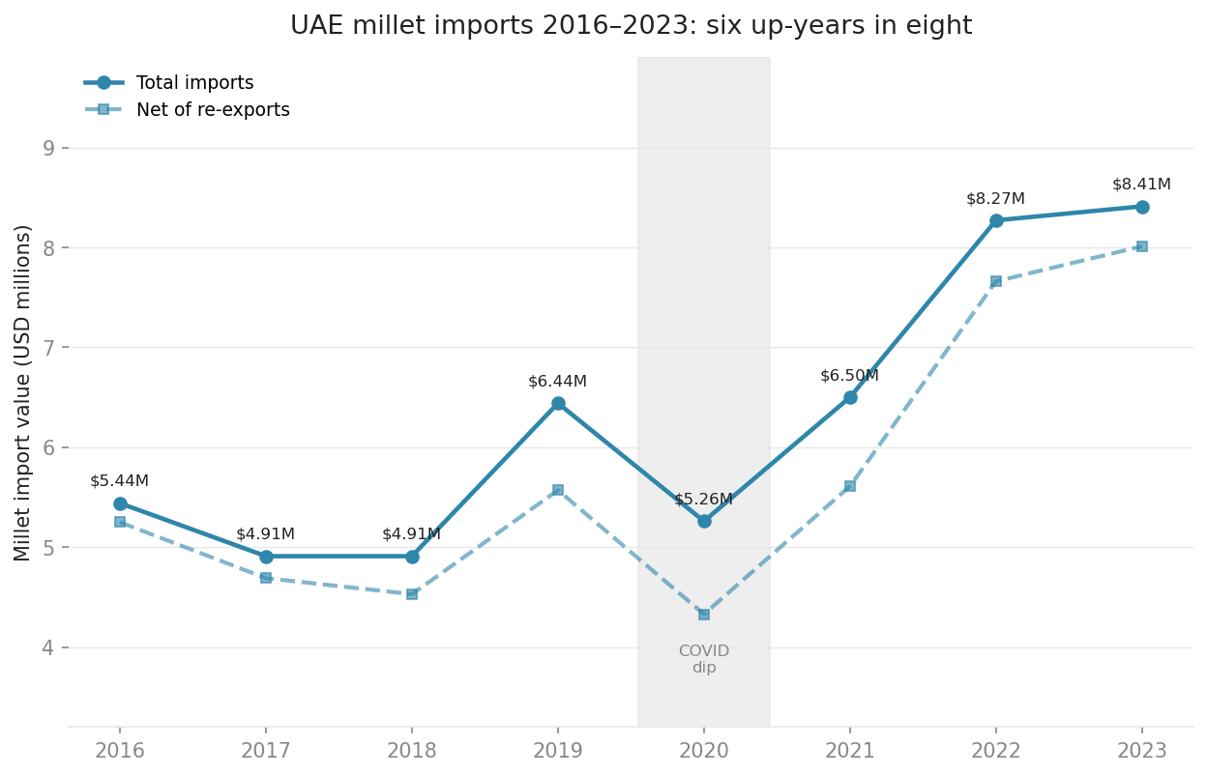
UAE millet imports grew in six of eight years from 2016 to 2023; the 2020 dip was COVID, not structural
• UAE total millet imports reached $8.41M in 2023, up 55% from $5.44M in 2016
• The adjusted series (net of re-exports) tracks within 5% of total — domestic absorption, not transit trading
• 2021, 2022, and 2023 each set a new record; post-COVID acceleration is sharper than pre-COVID
Source: UN Comtrade HS 100821+100829 (2016–2023); re-exports netted via Comtrade flow code RX
Notes:
The dashed line is what UAE actually consumes; the gap is Jebel Ali re-exports to East Africa.

Slide 5
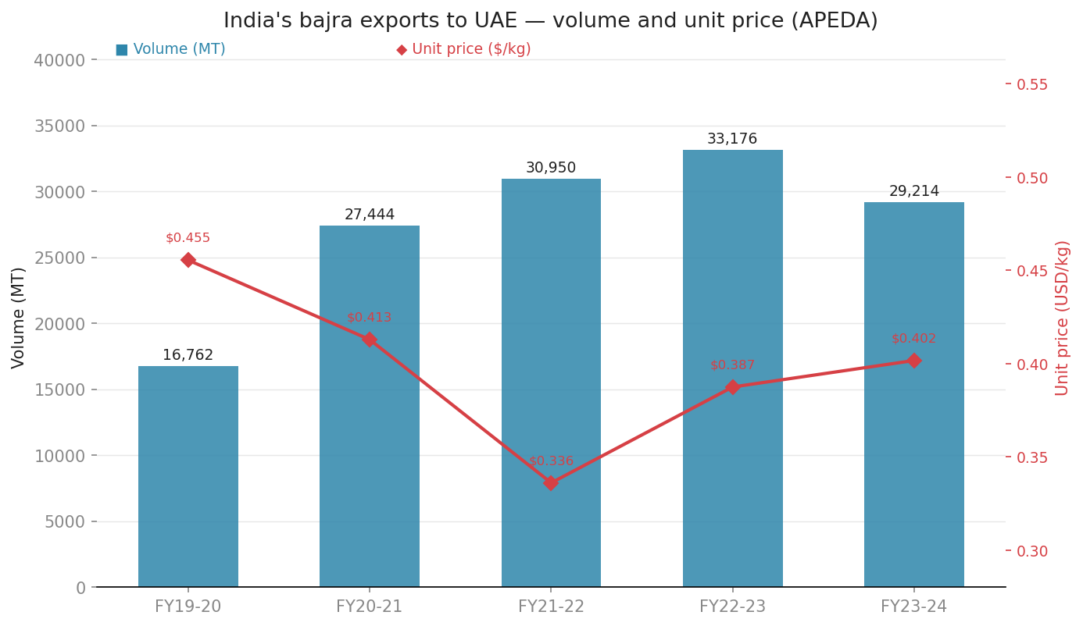
India exports 29,214 MT of bajra to UAE annually — more than to all other GCC markets combined
• India's exports to UAE peaked at 33,176 MT in FY2022-23 before normalising to 29,214 MT — still 74% above baseline
• UAE absorbs more Indian bajra than Saudi Arabia, Kuwait, Qatar, and Oman combined in every year on record
• Unit price fell to $0.336/kg in FY2021-22 as volumes surged, then recovered — commodity-grade bulk compressing price on volume
Source: APEDA AgriExchange, Product Code 0606 (Millet), FY2019-20 to FY2023-24
Notes:
Unit price drop in FY21-22 is the signal — commodity dumping suppressed price; recovery says market is ready for graded product.

Slide 6
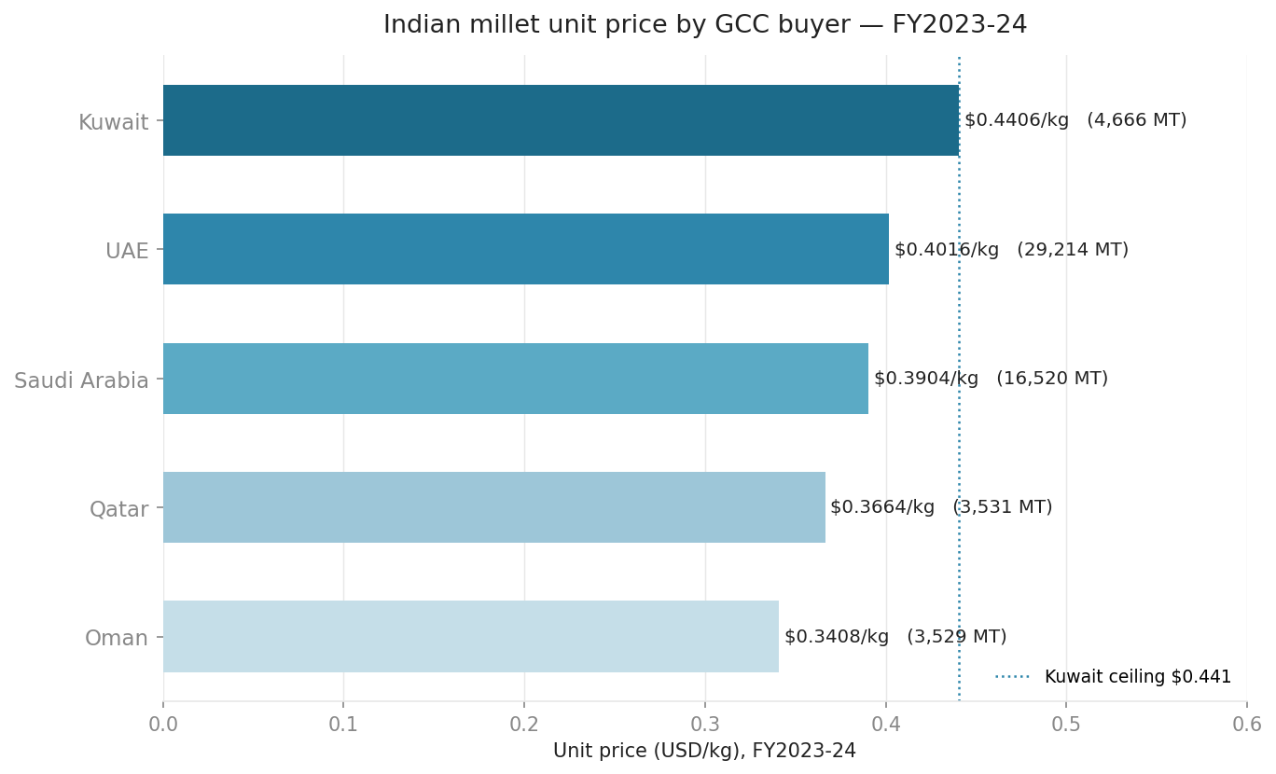
Kuwait pays $0.44/kg for Indian millet; Oman pays $0.34/kg — a 29% spread driven by grain quality, not geography
• Kuwait receives the highest unit prices despite taking one-sixth of UAE's volume — volume does not explain the premium
• Oman's $0.34/kg floor reflects bulk commodity exports likely for re-processing or animal feed
• UAE at $0.40/kg sits mid-range; targeting the Kuwait price band ($0.42–$0.44) through grading is a defined price lever
Source: APEDA AgriExchange, Product Code 0606 (Millet), FY2023-24
Notes:
Reference line at $0.441 is the Kuwait ceiling — the price our product should target in UAE retail.

Slide 7
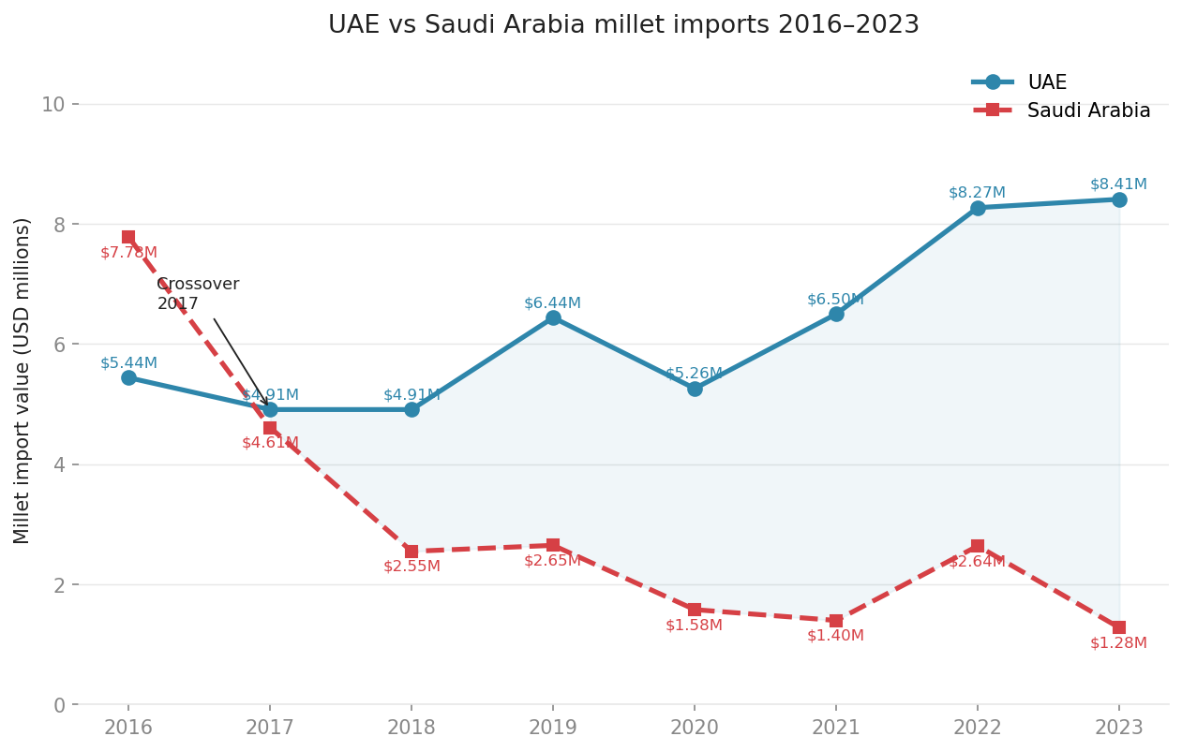
Saudi Arabia shrank 84% from 2016 to 2023; the demand it shed did not leave the GCC — it migrated to UAE
• Saudi Arabia was the GCC's largest millet market in 2016 at $7.78M; it crossed below UAE in 2017 and never recovered
• The 2022 partial rebound ($2.64M) reversed entirely in 2023; two recovery-reversal cycles indicate structural substitution
• UAE's 2023 value ($8.41M) now exceeds Saudi Arabia's 2016 peak — the volume migrated, it did not evaporate
Source: UN Comtrade HS 100821+100829 (2016–2023)
Notes:
Saudi's decline is structural: local grain policy and domestic sorghum subsidies, not reversible on a 2-year horizon.

Slide 8
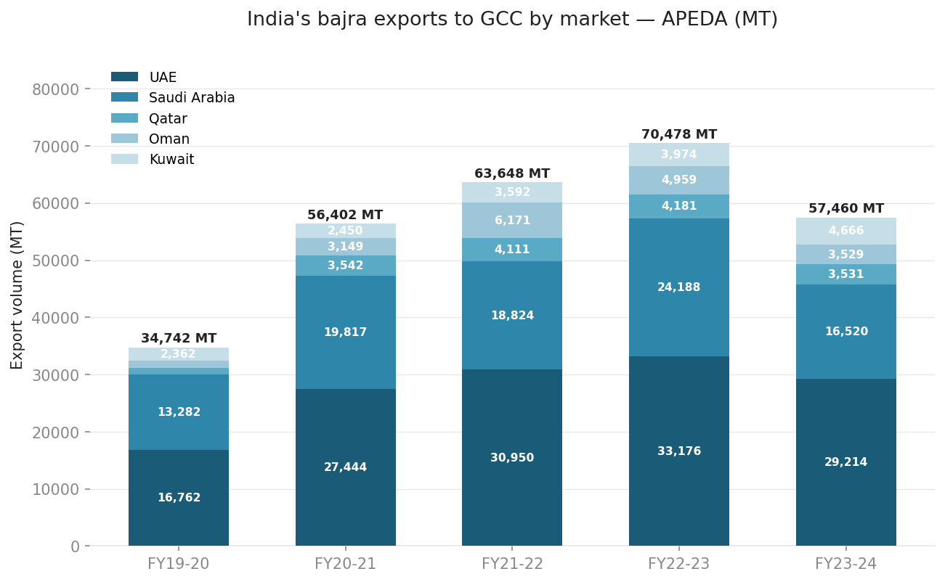
India's GCC bajra exports grew 65% by volume over five fiscal years; UAE absorbed nearly half the total every year
• India's total GCC bajra exports grew from 34,742 MT in FY2019-20 to a peak of 70,478 MT in FY2022-23 — 103% in three years
• UAE absorbed 48%–51% of India's total GCC volume in each of the five years — destination concentration is stable
• FY2023-24 normalisation to 57,460 MT is a 19% pullback from peak but 65% above the FY2019-20 baseline
Source: APEDA AgriExchange, Product Code 0606 (Millet), FY2019-20 to FY2023-24
Notes:
Darker UAE segment is constant as a share of the stack every year — that consistency is the argument for supply-chain focus.

Slide 9
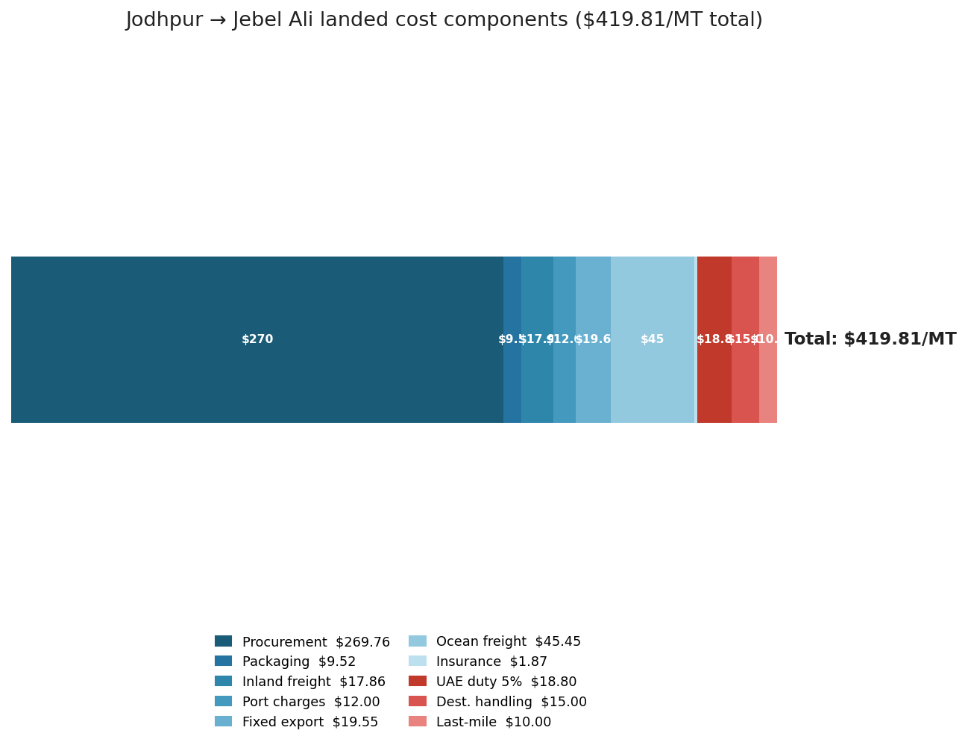
The Jodhpur-to-Jebel Ali landed cost is $419.81/MT; procurement at $269.76 is the only component Rajasthan controls
• Procurement ($269.76/MT) is 64% of total landed cost and the only component reducible by sourcing strategy
• Ocean freight ($45.45) and UAE duty ($18.80) together add $64.25 — fully external, pass-through costs
• Non-procurement subtotal is $150.05/MT — the fixed overhead any Rajasthan-origin exporter must absorb
Source: Jodhpur–Jebel Ali cost model; Jebel Ali port tariff (UAE HS 1008 MFN 5%); JNPT rates FY2023-24
Notes:
The only cost lever is the darkest blue segment — everything to its right is fixed by geography and regulation.

Slide 10
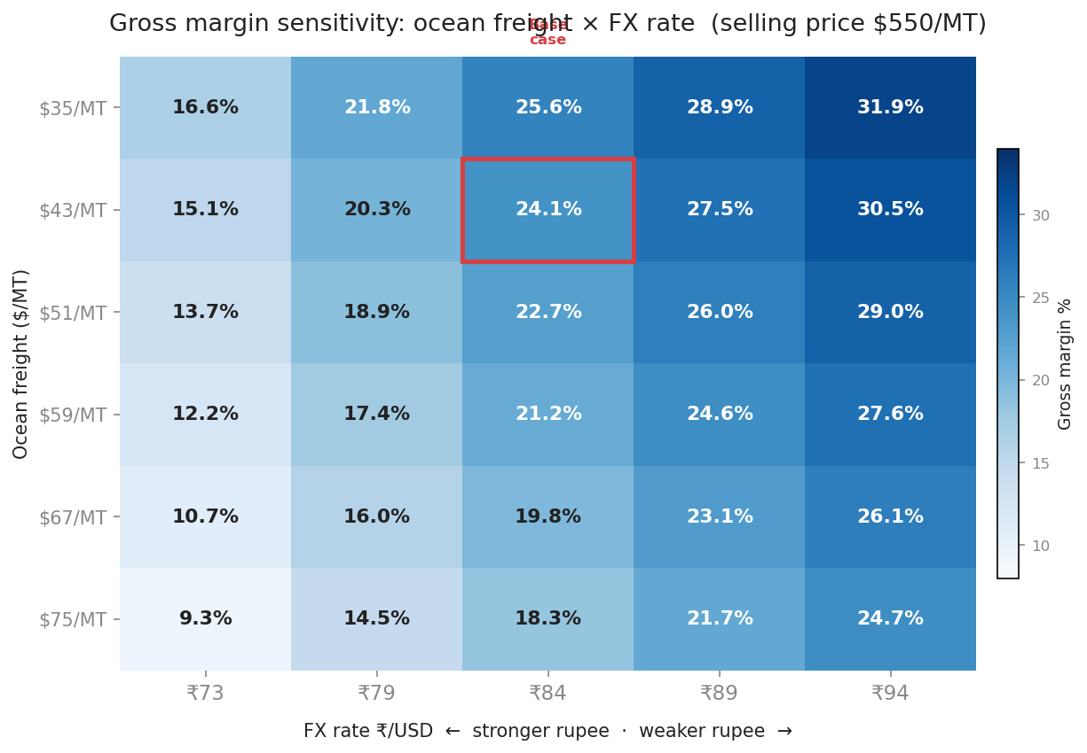
Gross margin ranges from 9.6% to 31.9% across 30 freight and FX scenarios; no combination wipes out profit
• At the worst scenario (₹73/USD, $75/MT freight), gross margin is 9.1% — still cash-positive
• FX drives more margin variance than freight: a ₹10 move shifts margin ~4.5 pp; a $16 freight move shifts ~2.9 pp
• 17 of 30 scenarios produce a margin above 20%; all 30 remain above zero
Source: Jodhpur–Jebel Ali cost model; sensitivity computed parametrically, 30 freight × FX combinations
Notes:
Base case (red box) sits in the upper half of the distribution — deliberately conservative freight and FX assumptions.

Slide 11
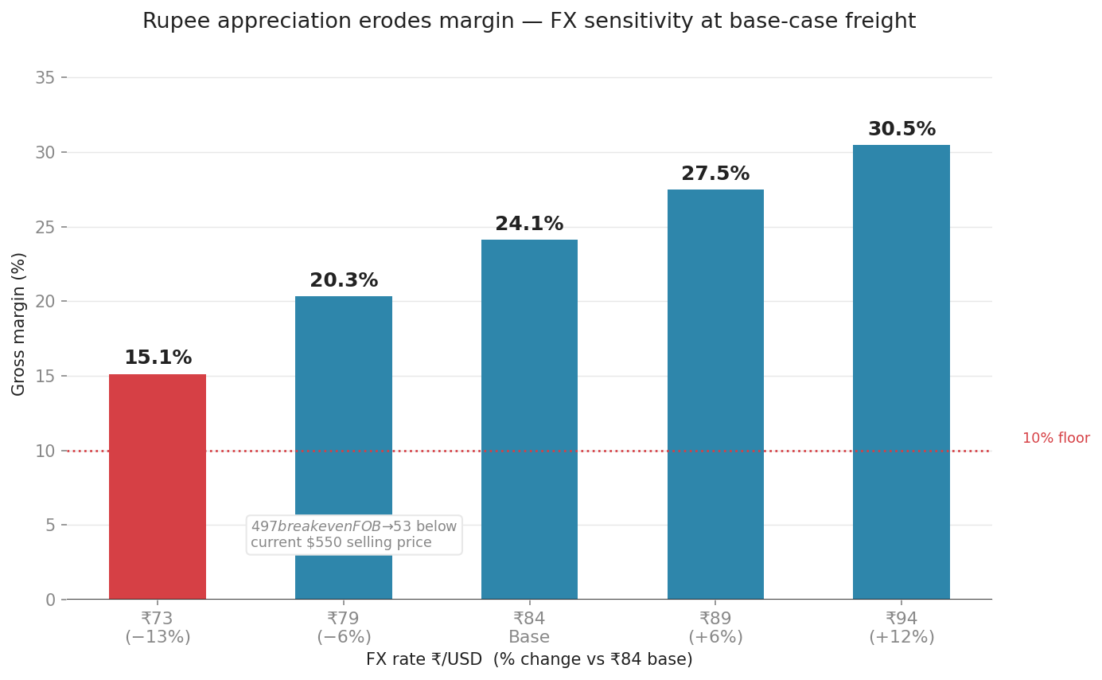
The $497/MT breakeven FOB leaves a $53 buffer at ₹84; rupee appreciation is the one risk that closes this gap
• Every ₹1 of rupee appreciation cuts gross margin by ~0.9 pp; a move from ₹84 to ₹73 costs 9 pp
• Rupee must strengthen beyond ₹60 to reach zero margin at base freight — a 28% appreciation from current levels
• $497 breakeven FOB means a buyer offering less than $497 landed CIF is a no-go; $53 is the negotiating buffer
Source: Jodhpur–Jebel Ali cost model; RBI USD/INR historical range 2020–2024
Notes:
Hedge recommendation: six-month forward INR contract on procurement cost; ocean freight is USD-settled.

Slide 12
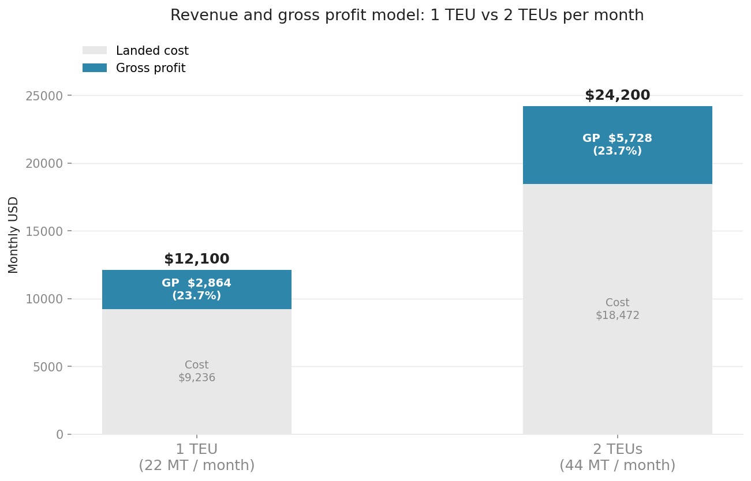
Two TEUs per month generates $24,200 in monthly revenue; the model is cash-positive from the first shipment
• At 2 TEUs/month gross profit is $5,728 — covers a part-time export manager's compensation at Indian market rates
• Cost structure is entirely variable at this volume; no fixed overhead beyond APEDA registration required in month one
• Scaling from 1 TEU to 2 TEUs doubles gross profit with no change in unit economics — linear until a 3PL is needed
Source: Jodhpur–Jebel Ali cost model; 22 MT per 20ft FCL (standard bajra bagging density)
Notes:
Left bar is the trial shipment; right bar is steady state — if trial clears customs and buyer pays, you're in business.

Slide 13
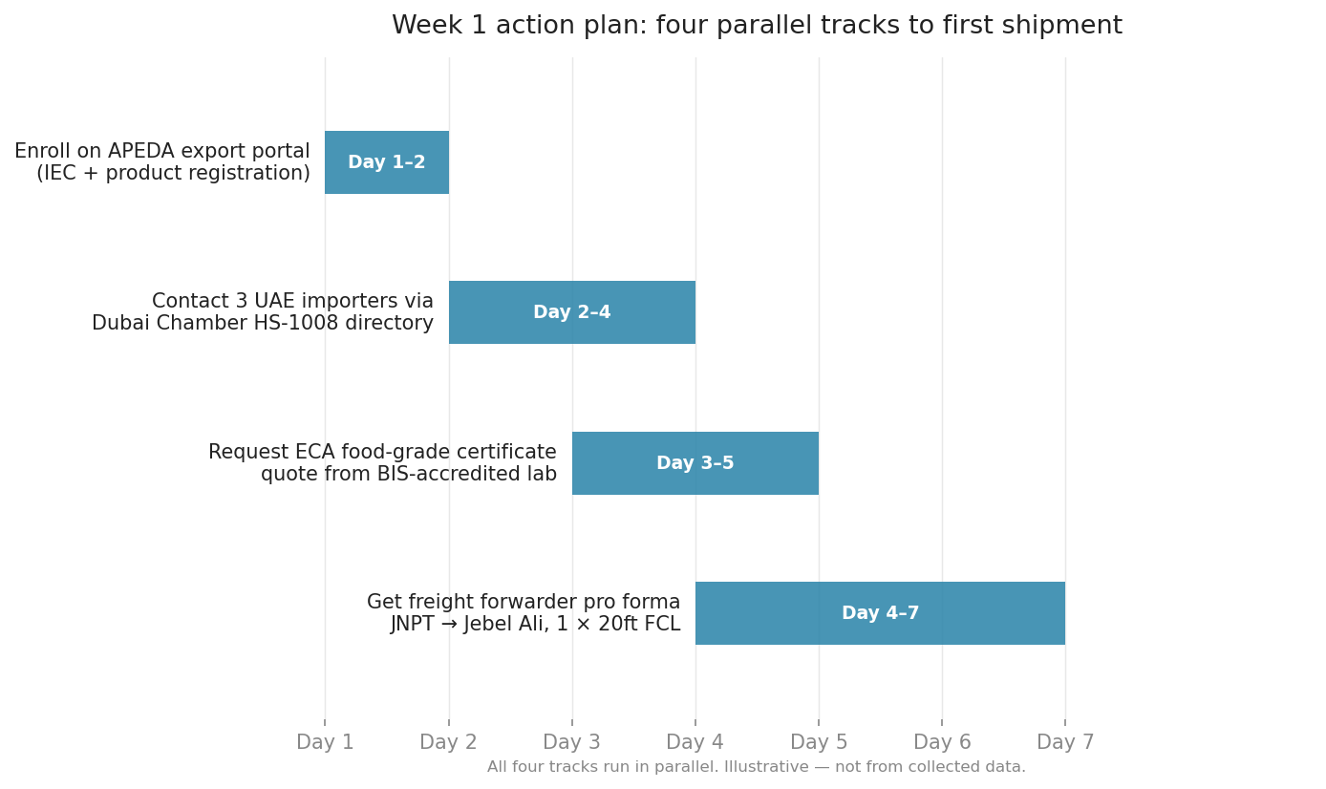
Register with APEDA, identify one UAE buyer, and book a trial TEU: three actions executable in week one
Deliverable by day 7: APEDA IEC registration submitted · one buyer NDA requested · freight forwarder quote in hand.
Source: APEDA export portal; Dubai Chamber importer search; UAE ESMA food import requirements
Notes:
If only one track completes in week one, make it the APEDA IEC — without it, nothing else can move.

