Slide 1
Behavioral Analysis of Malware Using Dynamic Sandboxing
Brent Creehan, Tyller ferderer

Slide 2
Introduction
Sandboxing helped us look at behaviors
View behaviors in isolation
3 different sandboxes were used. (Any.Run, Hybrid Analysis, VirsusTotal)
Analyzed 3 samples
Ransomware, Trojans, Virus
Automation techniques helped us sift through results more efficiently

Slide 3

Programming tools used
Python
Python was used for scripting
JSON
JSON is used for report parsing

Slide 4
Automation
File Submission Automation
Python scripts automate submission of malware samples
Submitted to 3 sandboxes we used
Feature Extraction and Parsing
Scripts get and parse JSON reports from the platforms
Extract API calls, file modifications, and network activity
Behavioral Indicators
Key indicators selected for behavioral analysis
API call frequency, registry edits, and network behavior

Slide 5
Sandboxing
Any.Run
Interactive/Real-Time monitoring of malware behavior
Secure Windows Environment
(BETA) AI Summary
Hybrid Analysis
Cloud-based sandbox
Both static and dynamic analysis statistics provided
Particularly useful for API calls and network behavior
VirusTotal
Multi-engine scanning
Limited behavior data

Slide 6


Sandbox Results

Slide 7
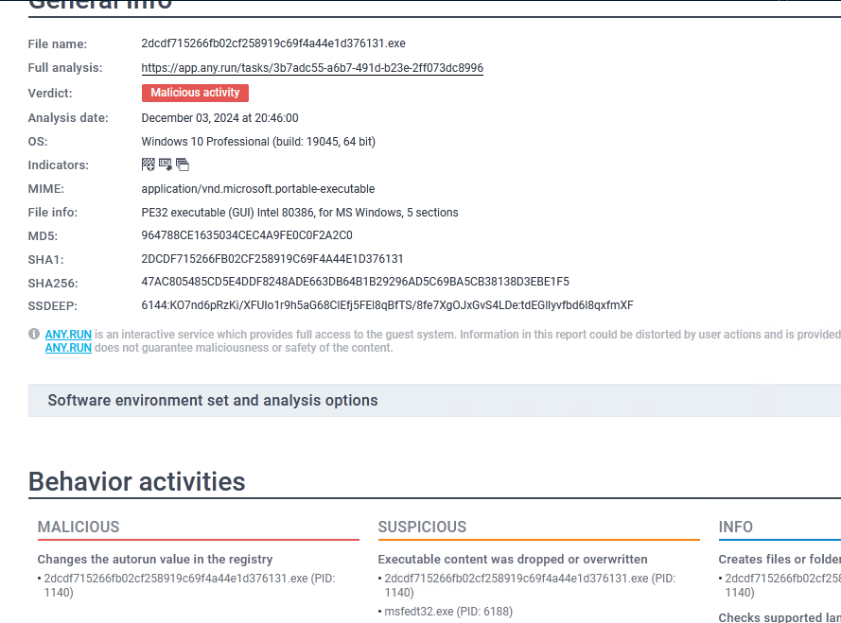
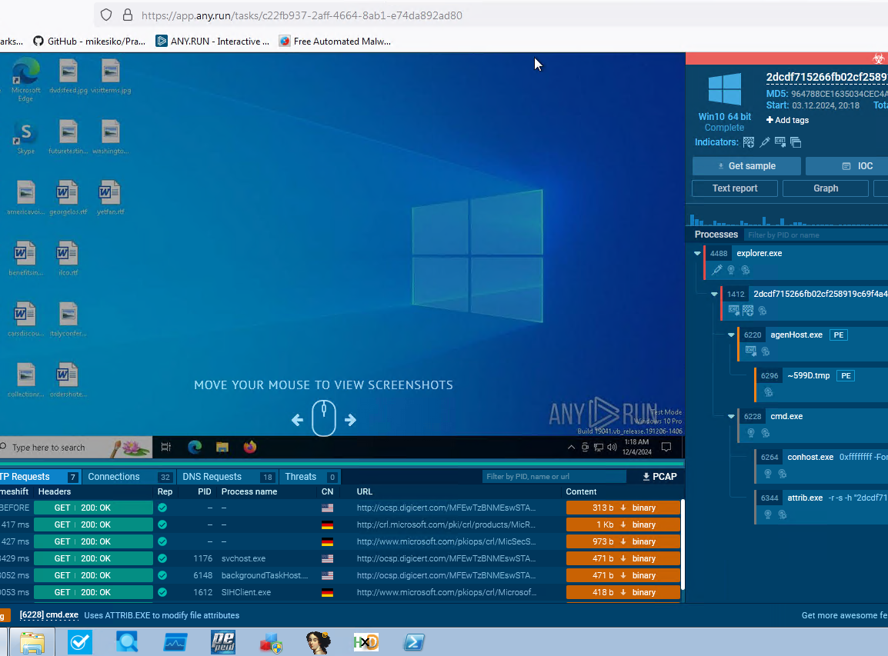
Any.run - Ransom
Live view of application execution through system emulation
Timeline of process events
Monitoring of CPU and RAM usage
Logging of network activity (HTTP, DNS, Connections, and threats)
Usage of AI to create easily readable summary
Ability to see graph and text reports for extra analysis

Slide 8
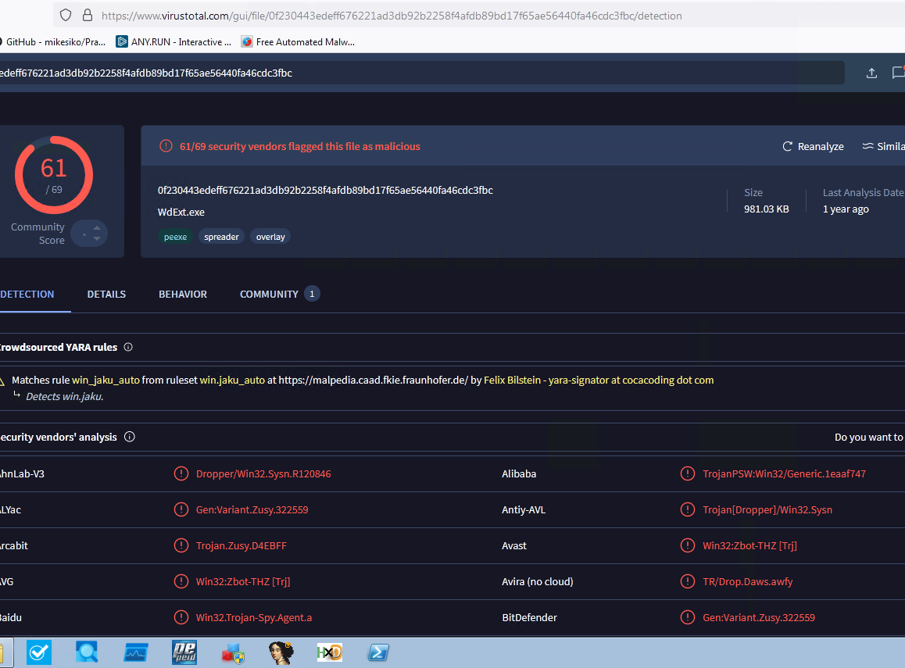
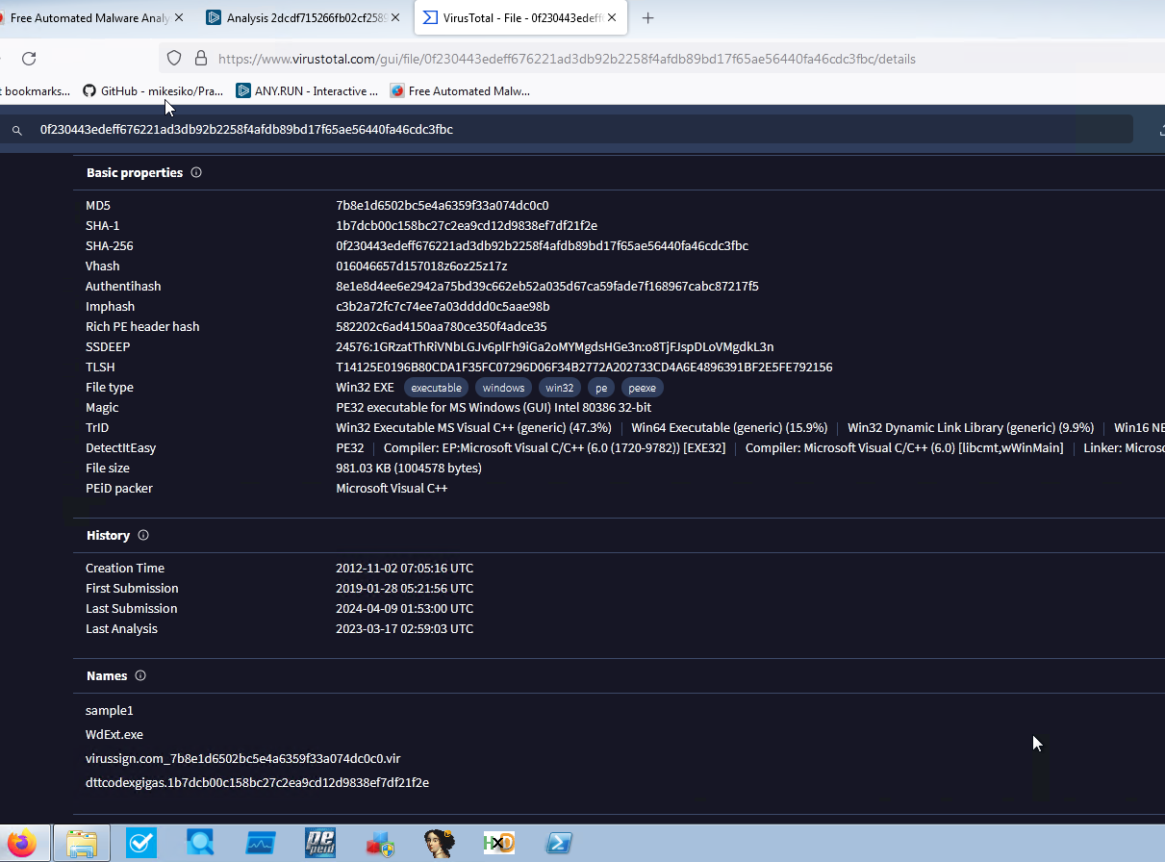
Virus Total - Trojan
Static Analysis Sandbox
Allows for detection from multiple security vendors
Basic and standard identification and program classification
Very barebones and low-level analysis
Allowed us to see PEID packer and track file history going back to the date of creation

Slide 9
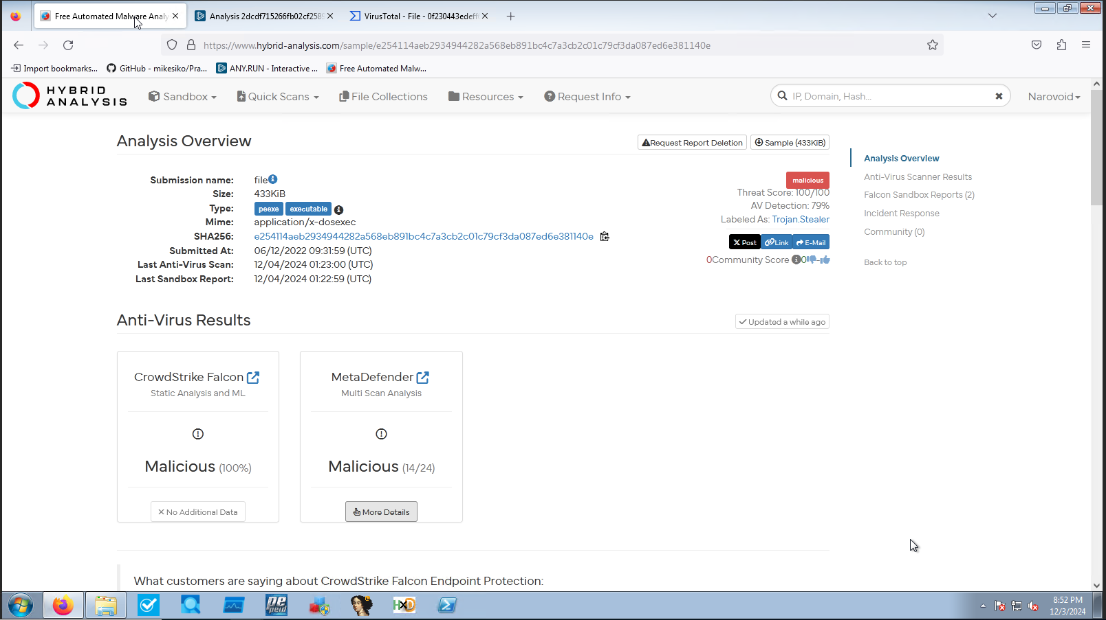
Hybrid analysis - virus
Basic Static Sandboxing
Threat level based on 100 scale
Antivirus scores based on CrowdStrike and MetaDefender applications (McAfee, Bitdefender)
Easy to read Labeling

Slide 10
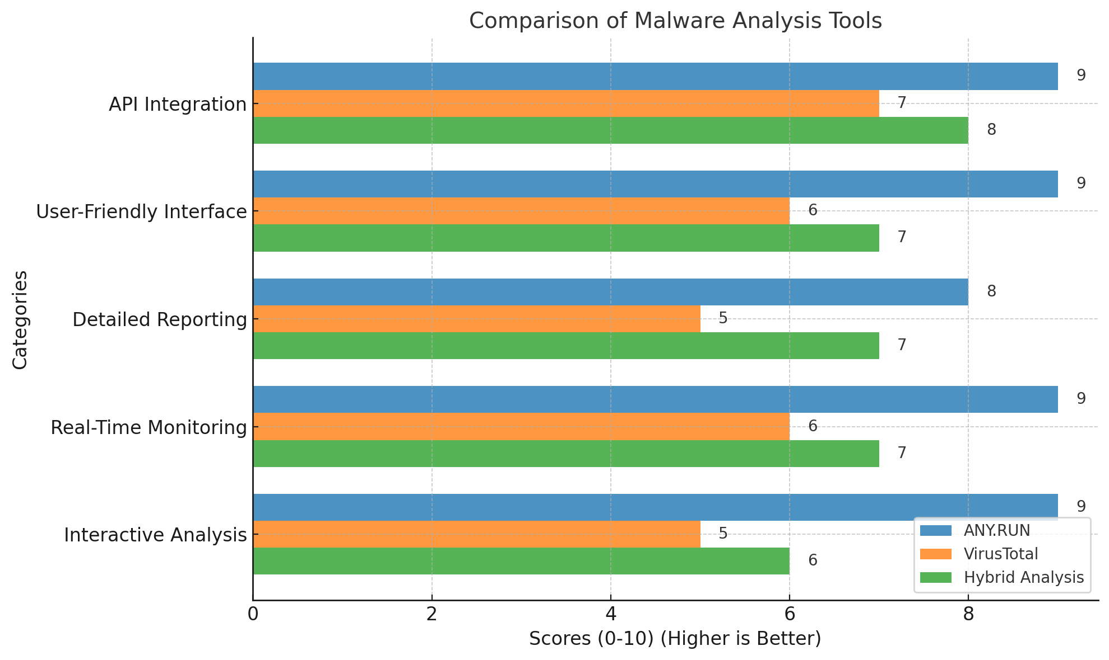
Sandbox Scores

Slide 11


Conclusion
Any.Run Sweeps the competition across the board based on the categories presented
Is a free web-based application allowing for live system monitoring and simulated systems
Provides the most detail in reporting
Utilizes new growing AI technology to allow the user to have a clearer understanding of their samples they provide

