Slide 1

Narrow Nav
Navigate Faster , Navigate Now

Slide 2
Welcome to Our Vision
Where ideas meet execution

Slide 3
Team Members
Gasser Zayed
Eyad Mohamed
Lamar Ahmed
Nour Ramy
Lojain Ahmed

Slide 4
Arrangement of presentation content
Interactive Question
The Problem
The Solution
Key features
Interview findings
Empathy map
APP overview
Marketing Plan
Ending

Slide 5
What do you think we have used from these technologies?
A ) Map Component Only
B ) Location Sensors Only
C ) A & B
D ) API Only
E ) All of them

Slide 6
Problem Statement
GPS fails indoors, causing difficulty navigating places like malls or airports. A reliable indoor navigation system is needed.

Slide 7
Our Solution
A prototype app ( Narrow Nav ) that provides real-time local navigation

Slide 8
Key Features
APP Works In Poor Internet
APP Works In Complex Places
Simple Design and Easy Directions ( UI / UX )
Location Tracking In thin Meters

Slide 9
Interview findings
User Needs Questions : APP Work In Narrow Places & With Poor Internet .
UI / UX Questions : Simple user Interface & easy to use .

Slide 10
Empathy Map
Thinks
Says
I hate spending so much time just trying to find a place
Finding a specific store takes forever
Feels
Does
Frustrated and stressed when lost
Tries Google Maps but it doesn’t work indoors.

Slide 11
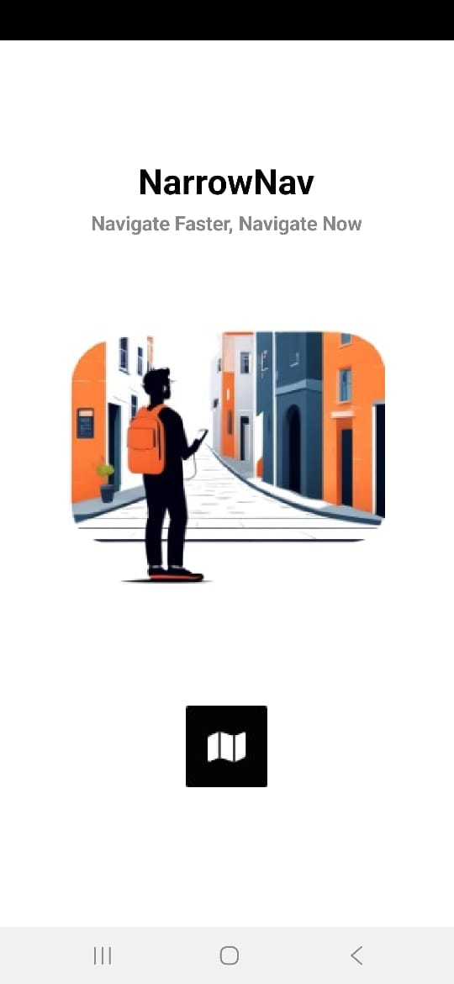
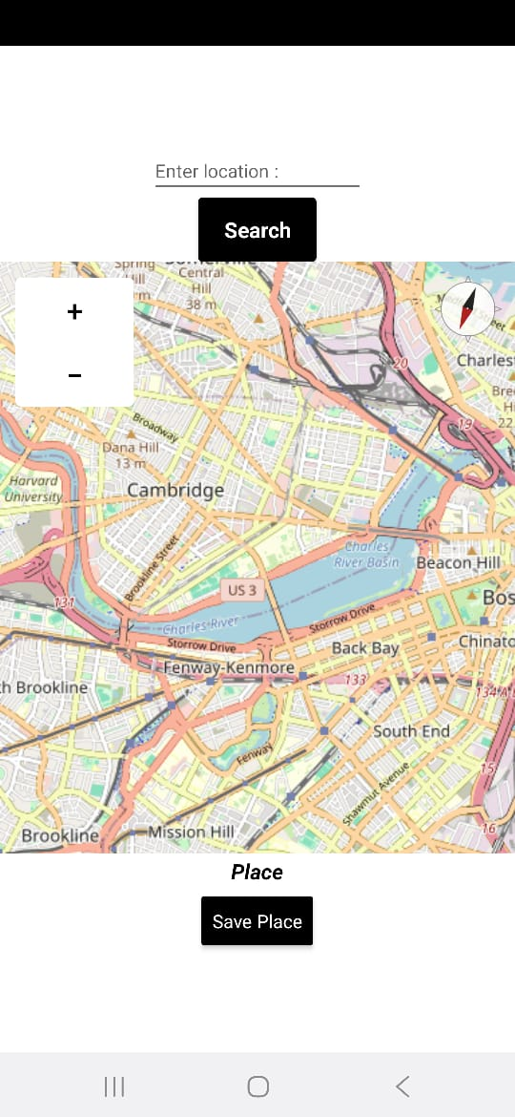
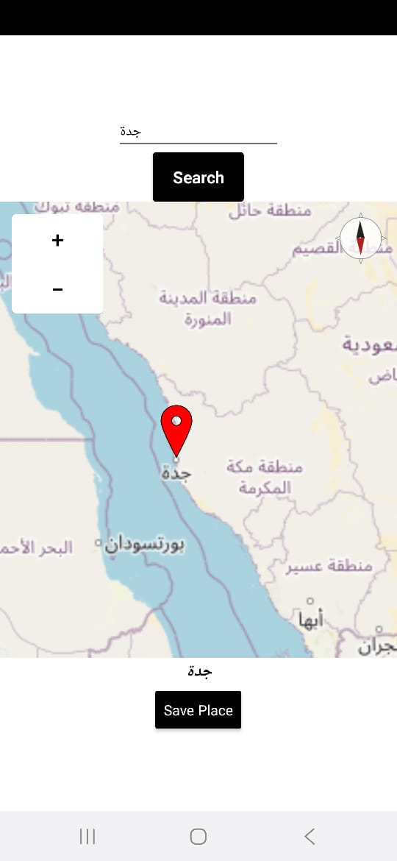
ِAPP Overview

Slide 12
Marketing Plan
Who is the target audience?
Adults and teenagers.
What are their marketing goals?
Guide the app to the highest amount of users.
Which Channels Provide The highest Reach ?
Social Media Platforms

Slide 13
The End
Any questions?
[-----------------------------------------------------------]
Thanks for your time

