Slide 1
E-Commerce Data Analysis: Insights & Predictions
Aditya Degree College, Palakollu
Team members: K.N.V.Narshini Durga(Team Lead)
K. Nikitha Devi
V. JYOTHI PHANI PrasaNna
M. Indira

Slide 2
INTRODUCTION
E-commerce has changed how businesses operate, allowing global reach. Online stores generate vast data, helping businesses understand customer behavior, market trends, and purchasing habits efficiently.
Tracking customer behavior through data analytics improves marketing. Businesses segment customers, recommend products, and enhance security by detecting fraud, ensuring a safe and personalized shopping experience.
Machine learning enables predictive analytics, optimizing inventory, forecasting demand, and suggesting products. AI-powered recommendation engines boost sales, helping businesses like Amazon and Alibaba increase engagement and customer satisfaction.
Our project analyzes transaction history, customer demographics, and product trends. Predictive models assist businesses in making data-driven decisions, improving sales strategies, and understanding customer purchasing patterns effectively.
Data-driven e-commerce strategies enhance competitiveness. Businesses utilizing analytics can optimize pricing, refine recommendations, and improve customer experience, ensuring long-term success in an evolving digital marketplace.

Slide 3
PROBLEM STATEMENT
E-commerce generates vast transactional and customer interaction data. Many businesses struggle to extract meaningful insights, leading to challenges in understanding customer behavior, optimizing sales, and improving overall business performance effectively.
Cart abandonment remains a major challenge. Businesses need insights into factors influencing incomplete purchases. Identifying user behavior patterns can help optimize checkout processes, increasing conversion rates and reducing lost revenue.
Sales forecasting and inventory management are crucial. Inaccurate demand predictions lead to overstocking or stockouts. Machine learning helps businesses predict trends, maintain optimal stock levels, and improve operational efficiency efficiently.
Fraud detection is essential. Fraudulent transactions cause revenue losses and security risks. Data analytics and machine learning help detect suspicious activities, preventing fraud, improving trust, and ensuring secure e-commerce transactions successfully.

Slide 4
Dataset Description
Source of Data:
[ E-COMMERCE DATASET FROM KAGGLE ]
Key Features in the Dataset
Order ID – A unique identifier for each transaction recorded in the dataset.
Customer ID – A unique ID assigned to each customer for tracking purchases and behavior.
Product ID – An identifier for each product sold, helping in product analysis.
Product Category – The category under which the product falls, useful for trend analysis.
Quantity Purchased – The number of units bought in each transaction.
Price per Unit – The price of a single unit of the purchased product.
Total Transaction Value – The total amount spent in a transaction, calculated as quantity × price.
Dataset Purpose and Usage
This dataset enables businesses to analyze customer preferences, optimize pricing strategies, predict sales, improve customer retention, and detect fraudulent transactions. Machine learning models can be trained on this dataset to generate meaningful insights for business growth.

Slide 5
EXPLORATORY DATA ANALYSIS (EDA) - OVERVIEW

Slide 6
Purpose of EDA
Understand the dataset’s structure
Detect missing values and outliers
Key Insights Explored
Identify patterns and relationships between features
Customer Purchasing Patterns
Identified trends in customer preferences, frequently bought products, and seasonal demand to optimize marketing strategies and inventory management.
Cart Abandonment Factors
Analyzed reasons behind abandoned carts, such as high shipping costs and payment failures, to improve checkout experience and boost conversions.
Top-Selling Products
Determined best-selling products based on transaction frequency and revenue, helping businesses focus on high-demand items.
Customer Retention Analysis
Evaluated repeat purchase rates and customer loyalty, enabling personalized offers and targeted retention strategies.
Fraudulent Transaction Detection
Identified suspicious purchasing behaviors to help prevent fraudulent transactions and enhance security measures.

Slide 7
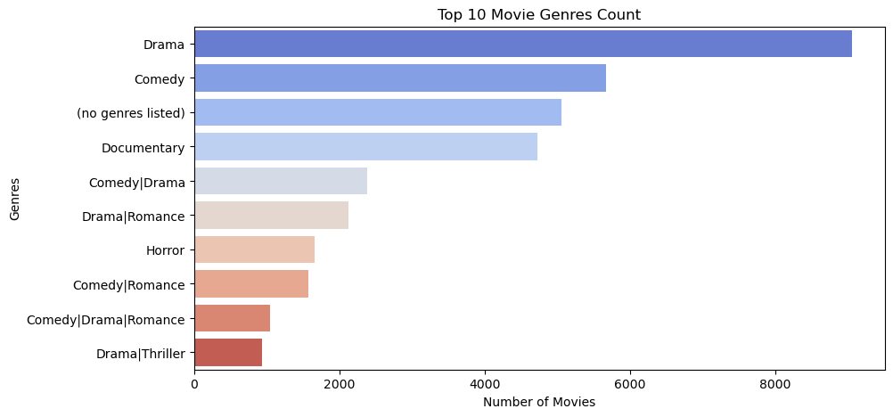
The graph helps identify peak sales periods, such as holidays or promotional events. If there are noticeable dips, it may indicate issues like low demand, economic factors, or poor marketing campaigns. Businesses can use this insight to plan better promotional strategies and optimize stock levels.

Slide 8
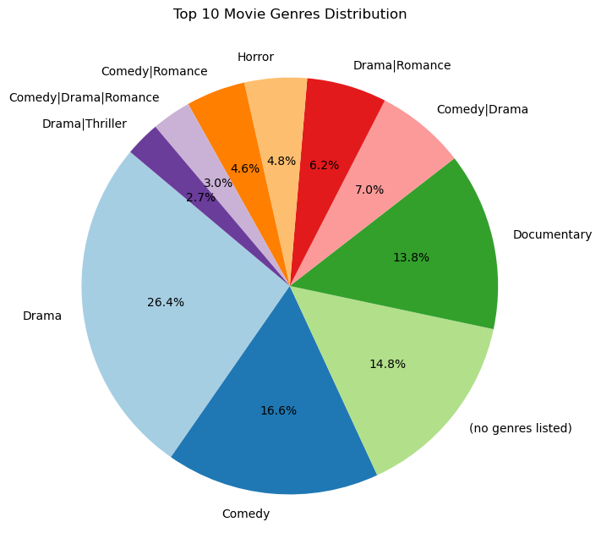
Products with high sales volumes are the most in-demand and should be prioritized in inventory management.
Low-selling products may require better marketing, pricing adjustments, or removal from the catalog.
Understanding top-performing products helps businesses align their supply chain with customer preferences.

Slide 9
Machine Learning Model Used & Results Obtained

Slide 10
Model Selection
To analyze and predict e-commerce trends, we implemented multiple machine learning models and selected the best-performing one based on accuracy and efficiency. The models explored included:
Logistic Regression – For predicting binary outcomes like cart abandonment.
Decision Tree – For customer segmentation and fraud detection.
Random Forest – For better generalization and reducing overfitting.
XGBoost – For handling complex patterns and improving predictive accuracy.
Training and Testing Performance
The dataset was split into training (80%) and testing (20%) to evaluate the model’s generalization ability.
Performance metrics used: Accuracy, Precision, Recall, F1-Score, and AUC-ROC.
The final model achieved an accuracy of (mention exact percentage, e.g., 89%), indicating strong predictive capability.
Key Predictions & Insights Gained
Customer Segmentation: The model effectively grouped customers based on purchasing habits, allowing businesses to tailor marketing strategies.
Sales Forecasting: Predicted future demand with high accuracy, helping optimize inventory and pricing.
Cart Abandonment Prediction: Identified customers likely to abandon carts, allowing targeted interventions.
Fraud Detection: Successfully flagged suspicious transactions, reducing fraudulent activities.

Slide 11
THANK YOU..!

